Slide 1
Carvana Mask using CNN
https://www.forbes.com/sites/mattperez/2020/02/27/china-removed-epidemic-themed-game-plague-inc-from-the-china-app-store

Slide 2
To be able to classify patients with Pneumonia through a Chest X-Ray:
using a CNN architecture
Problem Statement

Slide 3
EDA on BIMCV-COVID-19 Dataset

Slide 4
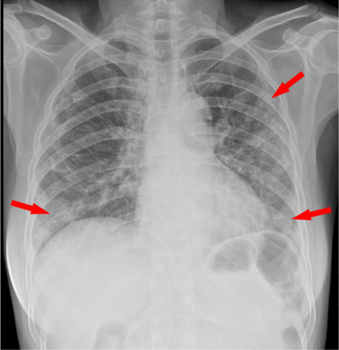
Source: https://github.com/BIMCV-CSUSP/BIMCV-COVID-19
Resizing to 524 x 524
Rotation of Images
Dropping of blurry or otherwise invalid images
Pre-processing

Slide 5
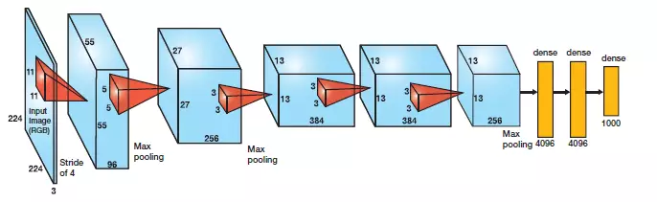
https://cv-tricks.com/cnn/understand-resnet-alexnet-vgg-inception/
AlexNet’s novel features:
ReLu(Rectified Linear Unit)- counters vanishing gradient problem
Dropout Layers introduced- counters overfitting
CNN Architectures

Slide 6
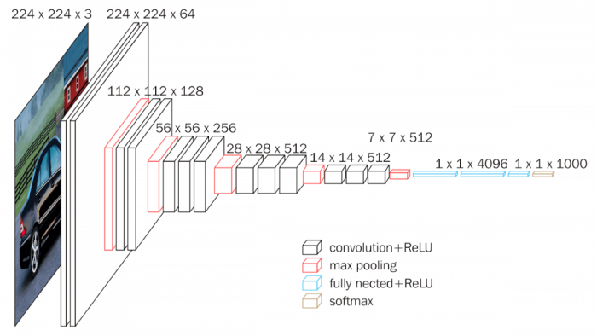
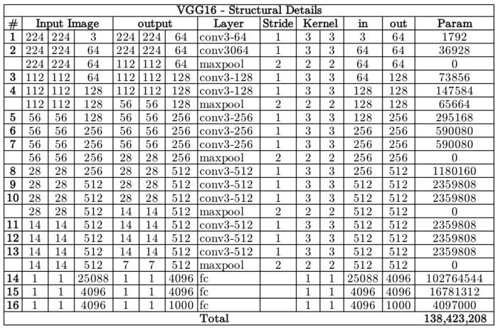
https://www.pyimagesearch.com/2017/03/20/imagenet-vggnet-resnet-inception-xception-keras/
Replacing large kernel-sized filters with multiple 3X3 kernel-sized filters one after another.
ImageNet: pre-training
CNN –VGG16

Slide 7
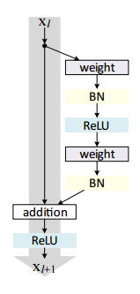
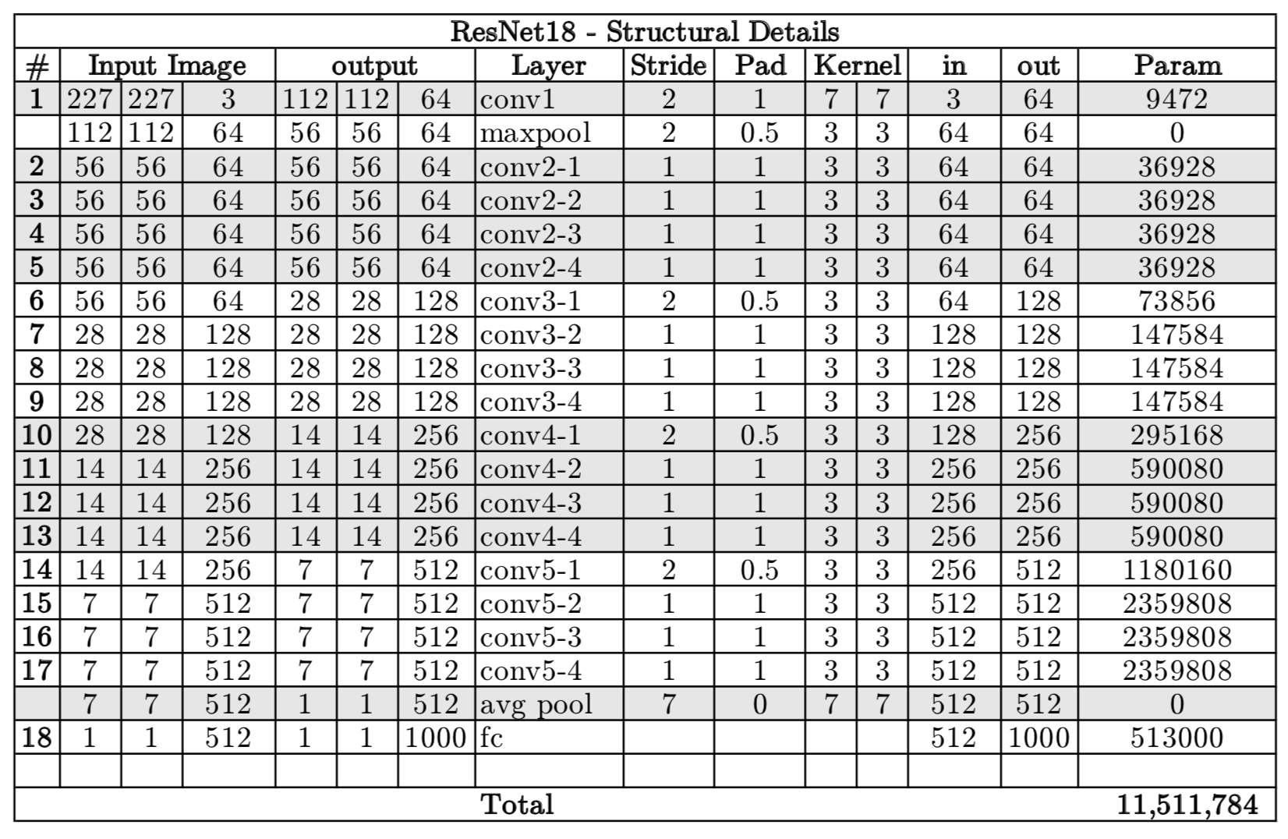
https://www.pyimagesearch.com/2017/03/20/imagenet-vggnet-resnet-inception-xception-keras/
Identity Connections: shortcuts
Retains many of the 3x3 layers
ImageNet: pre-training
CNN – ResidualNet50

Slide 8
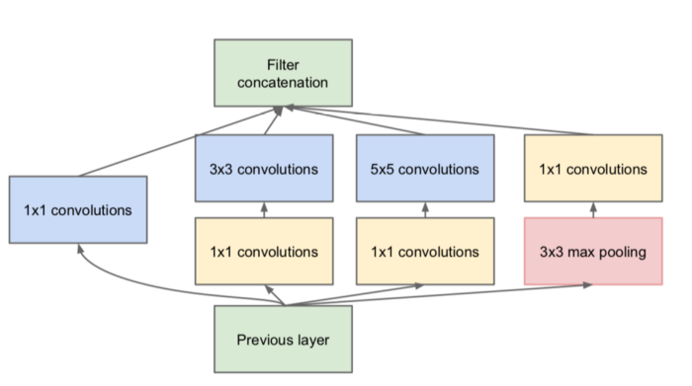
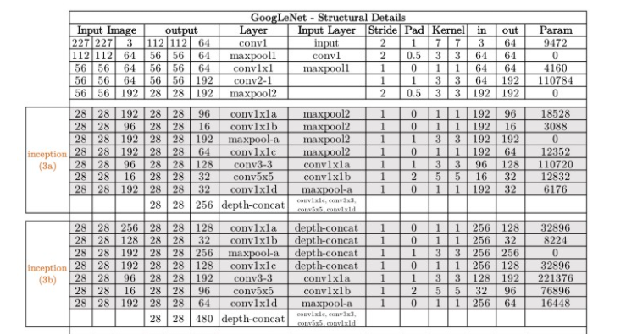
Source:https://towardsdatascience.com/the-w3h-of-alexnet-vggnet-resnet-and-inception-7baaaecccc96
Simultaneous 3x3, 5x5, and 1x1 neural nets
Retains many of the 3x3 layers
ImageNet: pre-training
CNN – InceptionNet

Slide 9
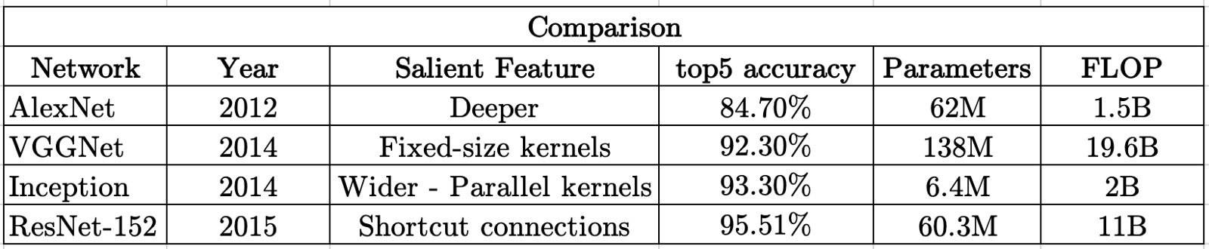
Source:https://towardsdatascience.com/the-w3h-of-alexnet-vggnet-resnet-and-inception-7baaaecccc96
Model Comparison

Slide 10
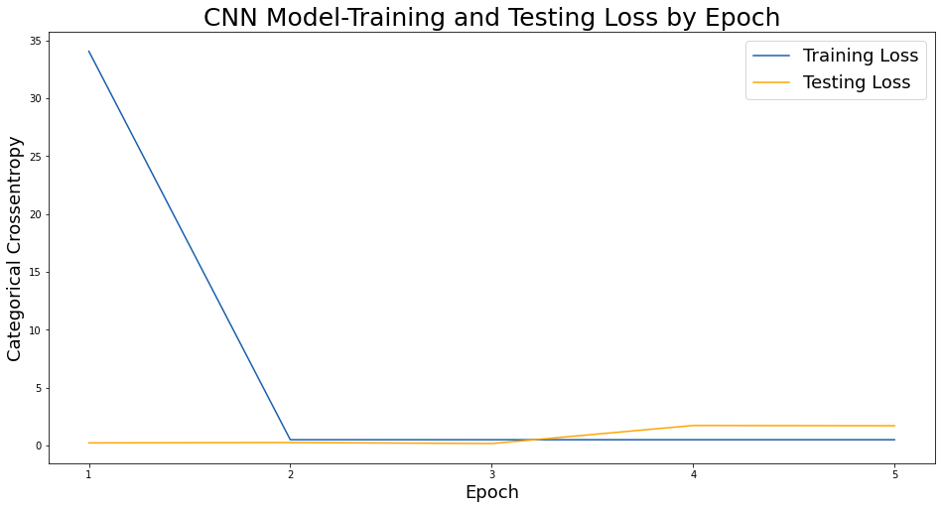
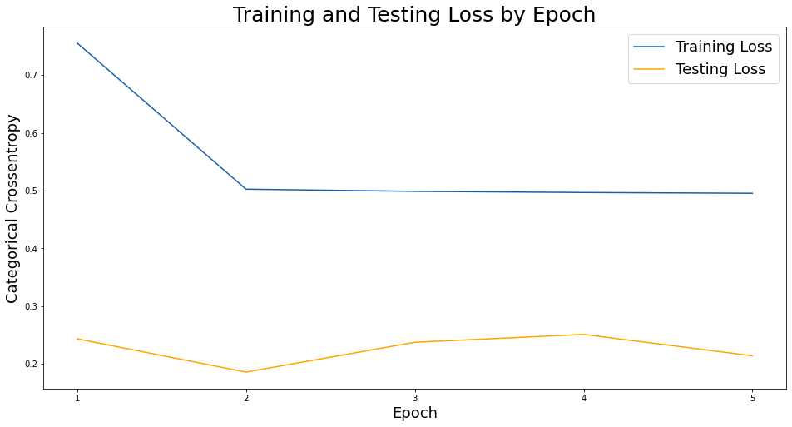
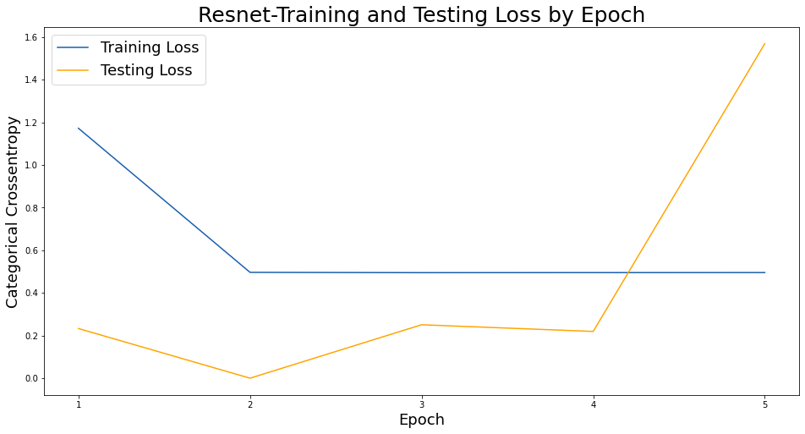
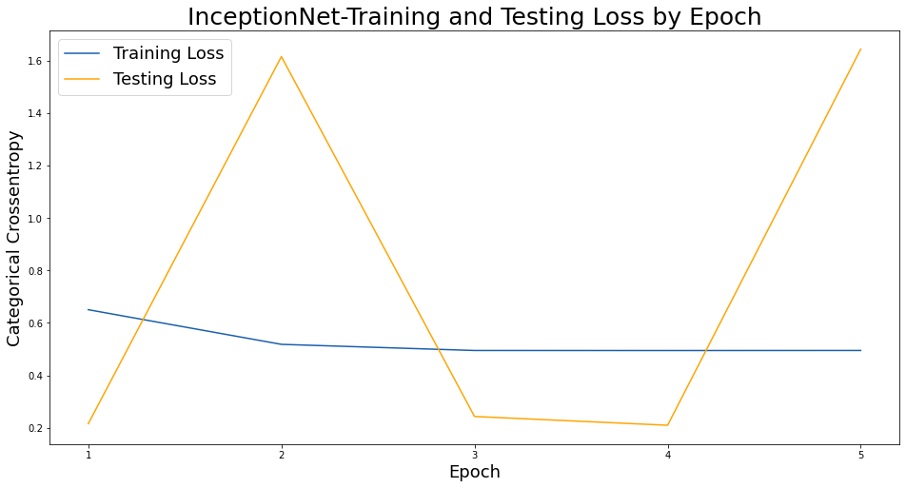
Model Comparison – COVID

Slide 11
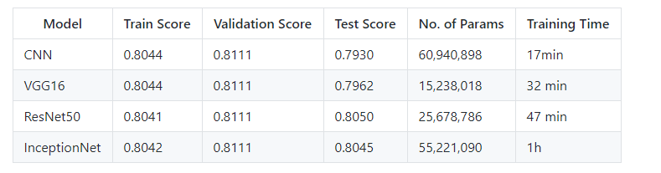
Model Comparison – COVID

Slide 12
Question Time

Slide 13
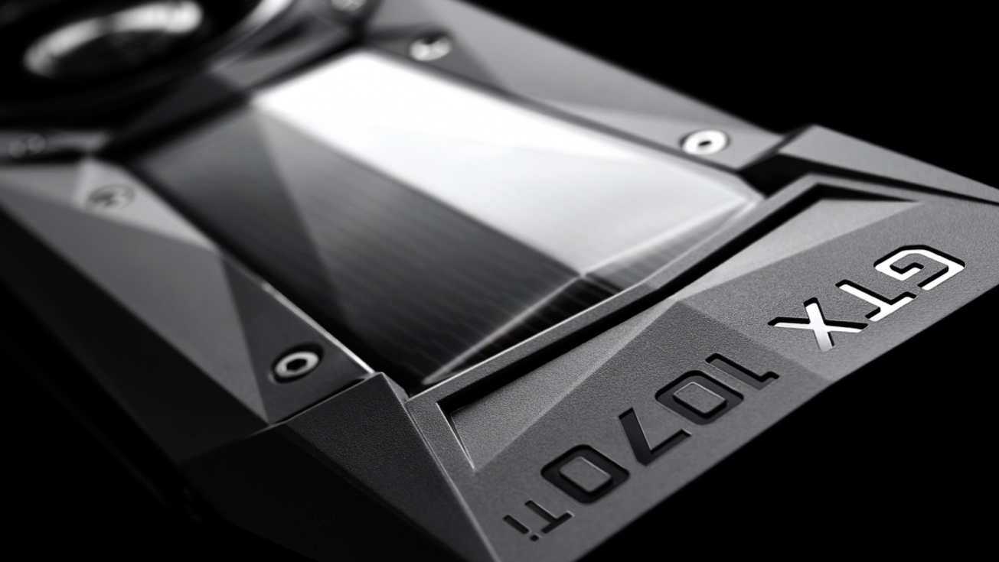
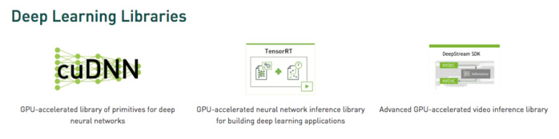

Source: https://www.nvidia.com/en-sg/geforce/products/10series/geforce-gtx-1070-ti/
Other than TensorFlow, many other DL frameworks rely on CUDA for their GPU support:
Caffe2
CNTK
Databricks
H2O.ai
Keras
MXNet
PyTorch
Theano
Torch
Chip: GP104
CUDA Cores: 2432
RAM: 8 GB GDDR5
CUDA

Slide 14
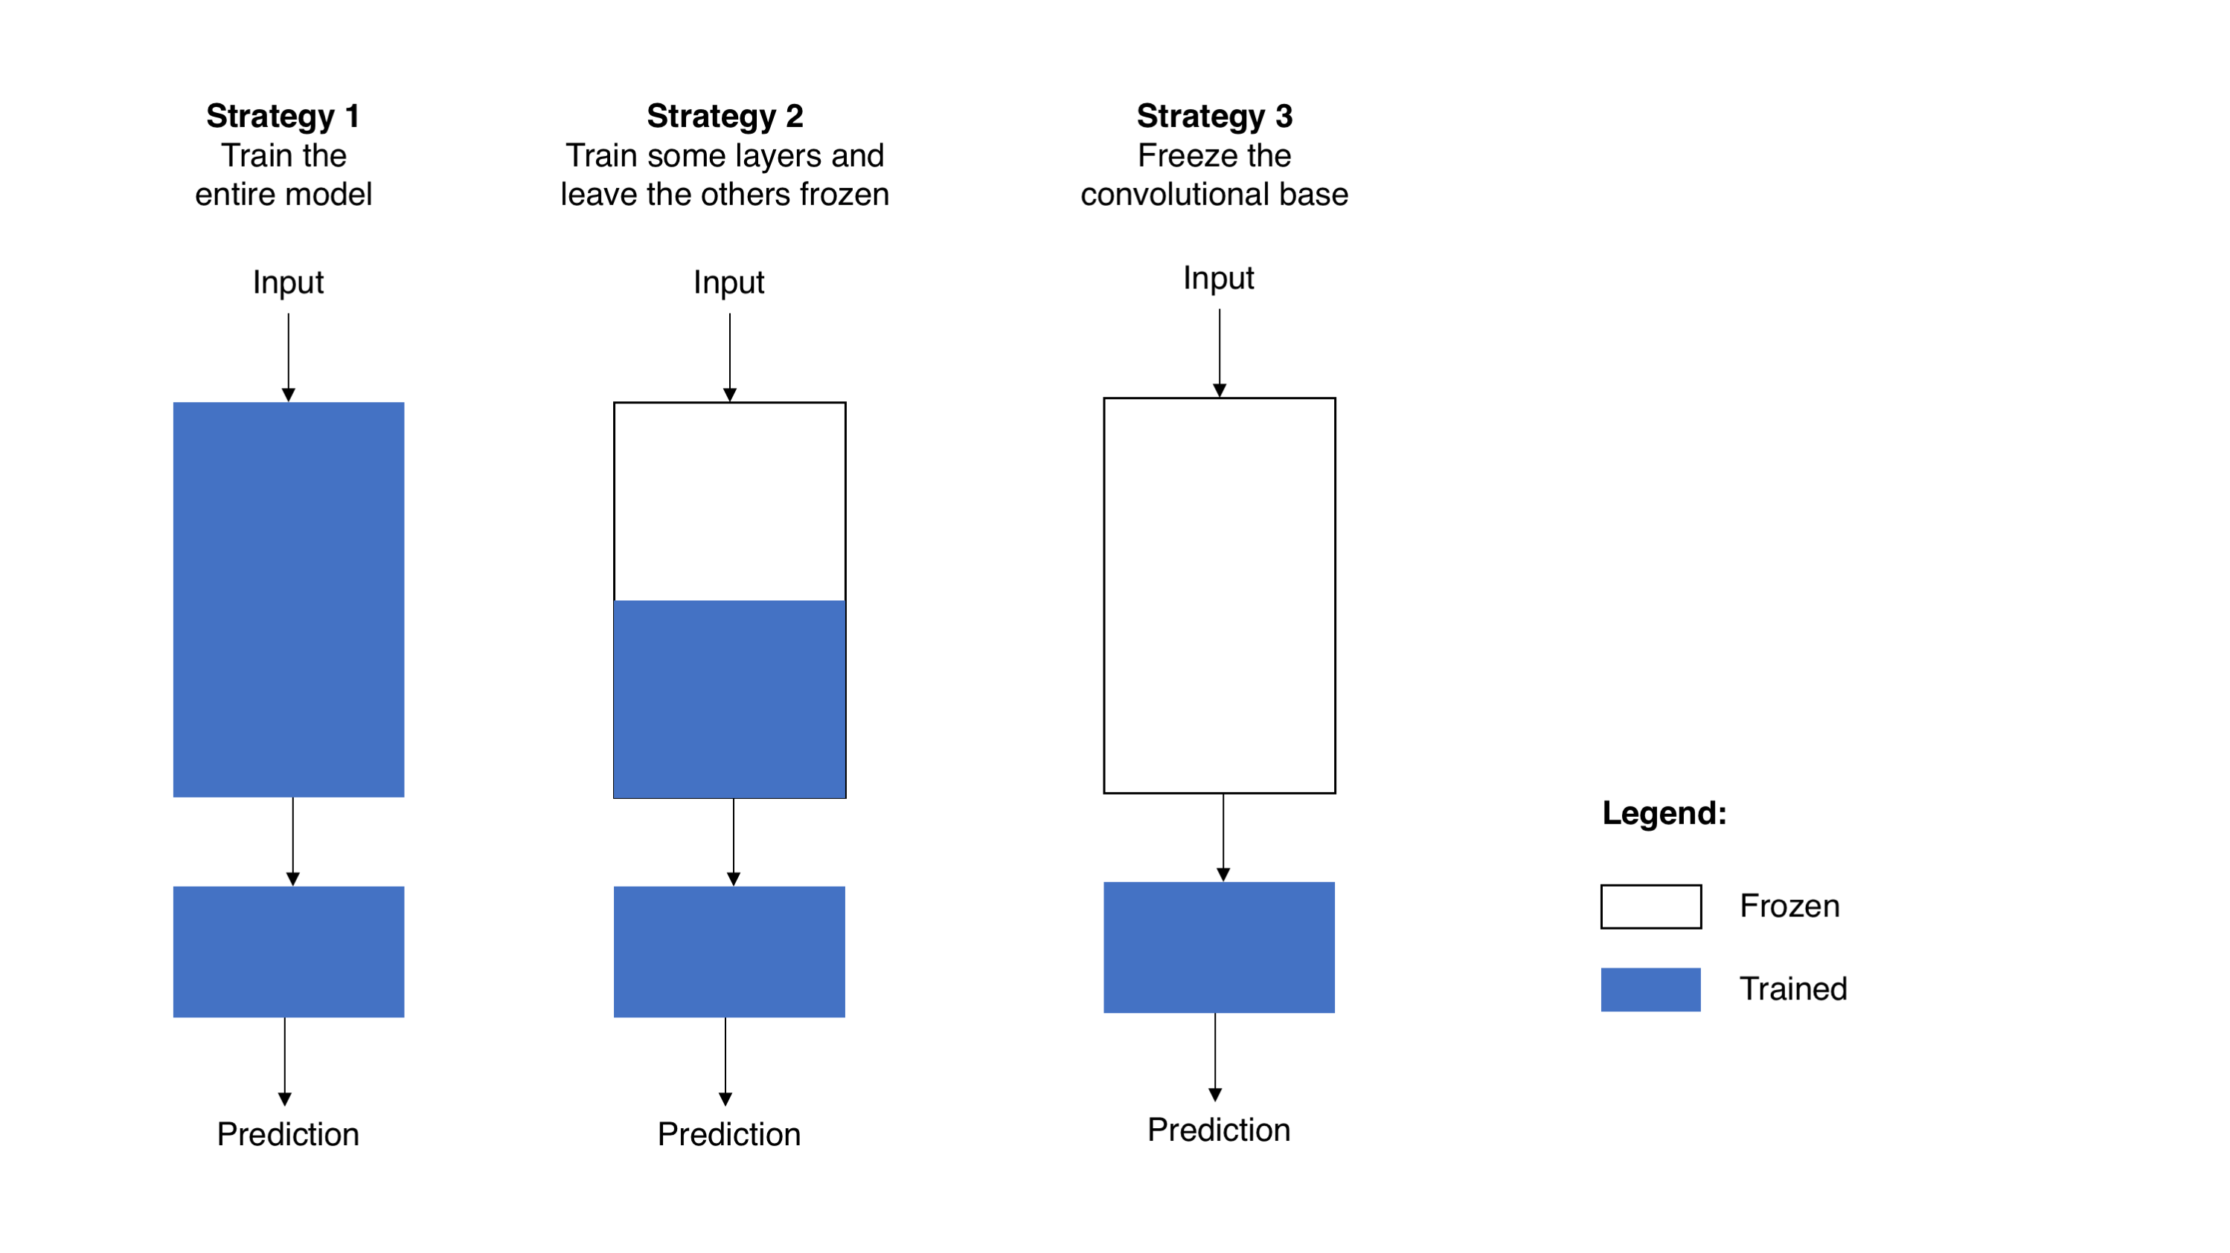
Source: https://towardsdatascience.com/transfer-learning-from-pre-trained-models-f2393f124751
Select a pre-trained model
Classify your problem according to the Size-Similarity Matrix
Fine-tune your model
Transfer Learning

