Slide 1
Graphql and Relay
gitHub:bochen2014@yahoo.com
Notes:
feel free to stop me if you have any questions

Slide 2
Graphql
what is graphql?
why graphql
Notes:
the easist wayt to understand something is by looking at at an example. so let's do it

Slide 3
Graphql
{
viewer {
user(id:1, [name:undefined]) {
id
completedCount
...F0
}
}
}
fragment F0 on User {
totalCount
}
{
"data": {
"viewer": {
"user": {
"id": "User:me",
"completedCount": 1,
"totalCount": 8
}
}
}
}
Notes:
Something worth noting : field, fragment, fragment spread, and filters
This is just a query example. GraphQL also supports mutations (update, create, delete) and subscription (which I’ll cover later)

Slide 4
Graphql
select userId,
completedCount,
totalcount
from user
where id=1
userid | completeCount | totalCount
1 | 1 | 8
Notes:
there is nothing special about it. just a query language

Slide 5
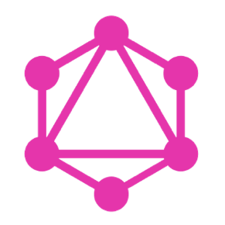
Graphql
Notes:
and the language is called 'graphql‘ because it contains nodes and edges
Nodes and edges can have different meanings in different places, for eaxmple

Slide 6
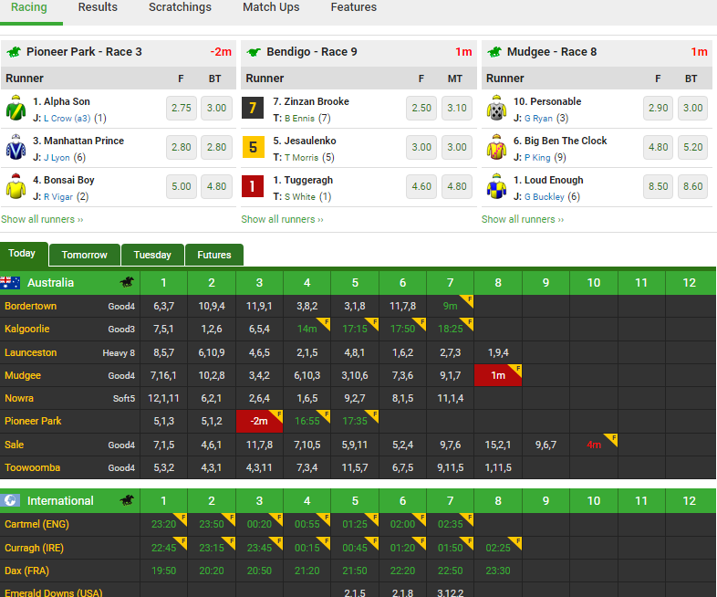
Graphql
Notes:
This the landing page of unibet production. meetings (the palce where horse races take place) event (horse race ) , and competitors

Slide 7
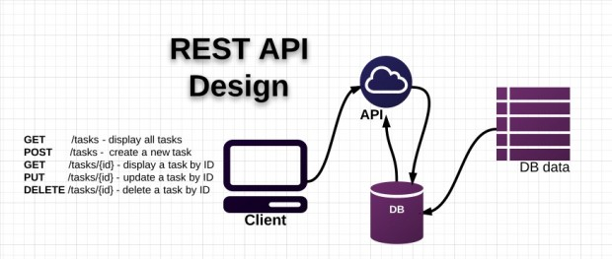
Graphql
Notes:
So now we know that Graphql is just a query language and there is nothing special about. why are there so many talks about it?
It turns out to be Because we don't have a query language between web client and web server.
Web services (Soap ) → RESTful apis
But restful apis are just protocols, conventions, it’s nota language. It can express very limited information

Slide 8
Graphql
It is language designed for communcation between Web Client and Web Server
web clients: browser and mobile apps
web Server: node.js python .net ..
2. It can do queries, mutations and subscriptions
3. It is easy, flexible, and strong typed
JSON without Key
strong typed (demo)
dynamic
less round trips
Notes:
Now look at Graphql
you write a JSON with key only and it returns you a full JSON object
it's strong typed (demo)
it's a language, so it's much more dynamic and flexible than REST APIs
it makes http more efficient as it can combine queries together (e.g. to render you home page, you probably need to send more than one requests. like, fetch logged in user info, fetch stories, fetch story's comments..etc)

Slide 9
Graphql
/{userId}/overview
/{userId}/details
/find?name='user_name'&status='active'
/{userId}/friends
nested queries must be handled at client var friendId = friends[0].id; $.get(`/${friendId}/details`, data=>{ ....... })
Notes:
To help better understand the beauty of Graphql. Let’s look at a real-world example
Note about the nested queries that can only be handled at client side

Slide 10

Graphql
db.getUserOverviewById
db.getUserDetailsById
db.findUsers(name, status)
db.getUserFriendsById
/{userId}/overview
/{userId}/details
/find?name='user_name'&status='active'
/{userId}/friends
Notes:
when implementing an RESTs api server, **one way** is to map each of your operations to a database stored procedure
but you don't want to write a SP just for inserting a new record. or a SP that only returns you a certain type of records. you want to build those queries on the fly, because it's too dynamic
BTW, I did once worked for a company that mapped every API into a stored procedure

Slide 11
Graphql
Database Operations V.S Server Operations
Notes:
So, if we don’t want to create SP for each database operation => maybe we shouldn’t create a Restful API for each server operaton;
Why can’t we let client tell us what they want? Using a language?
Over-fetching and under-fetching is not a issue; because client get exactly what they asked
We don’t have to create a getUserOverview and GetUserDetails that return different set of data to better suit client’s need

Slide 12
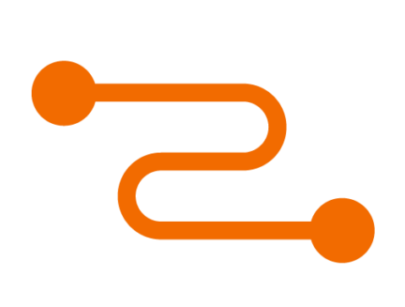
Relay
Notes:
Now we can talk about relay. the first question is, what is realy? -> move to next slide

Slide 13
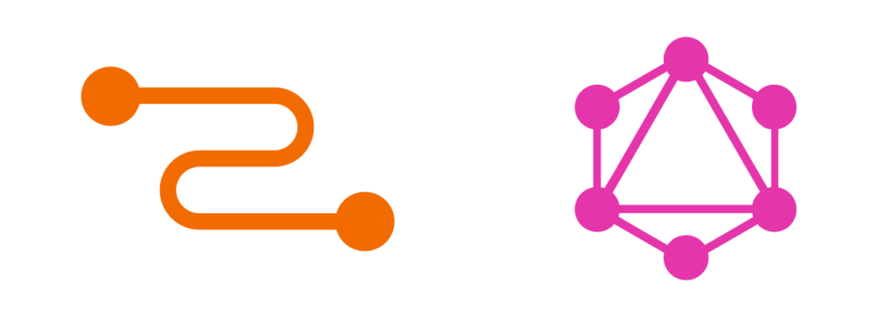
Relay
Notes:
relay is client side javascript framework which
1. undertands graphQL
2. can sends graphQL queries to server on behalf of you,
handle payload for you, and it notifies you when payload arrives
Before I dive into code examples and show you how to use it, I want to first make an analogy , and show you what it really is;

Slide 14
Graphql
ORM (object-relational Mapping) Tools
Entity framework / Hibernate
sqlAlchemy
What do they do?
database objects < --- > in-memory data structures
Store (cache)
Notes:
I took ORMs as an comparison. Because I think they are of similar nature.
I think they share many commonalities. so let's compare them
This is very handy because
you don’t have to write explicit queries, but rather, you manipulate those in-memory data structures and the ORM tools will sync the data into database; or the otherway around;
It maintains its own store, so that you don’t have to hit database again once you have fetched it;

Slide 15
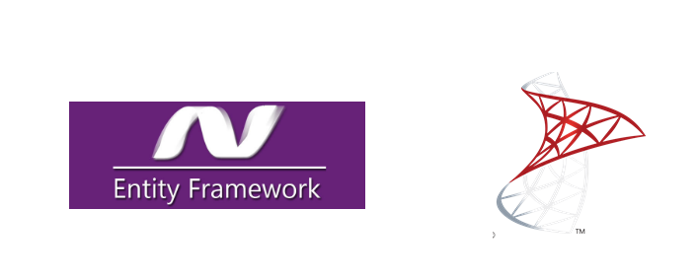
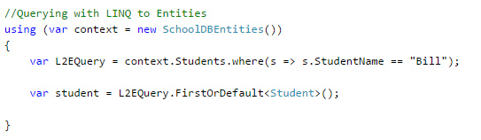
Relay
Notes:
This is an example of a EF.
As you can see, we are querying the student whose name is ‘Bill’. Throughout the code, we are not writing any queries, but, EF will generate a query for us; and send us the result of course;
if we execute the **where** part again, EF will use the data from memory instead of hitting database;

Slide 16
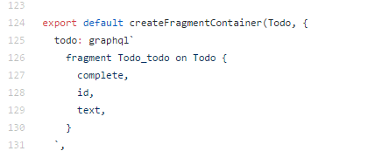
Relay
Notes:
This is a code snippet of Relay. It basically says: “ relay, please select the 'complete, id, and text ' field for the 'Todo' item I'm looking at “
and in run-time, relay will do the following
It walks through the entire react-component hierarchy and build a big Graphql-Query;
it send the query to grpahql-server,
It save response into its store
Once data is ready, it notified each component with the data that they registered interest for
So you can see that it does same nature of things as EF, but obviously it takes a further step. Differences: EF is imperative; Relay is declarative
Actually Declarative data-fetching is something that Relay Team is very proud of
BTW, relay achieve these by acting as a hight-order-components. Similar as React-Redux (but it has its own store )

Slide 17
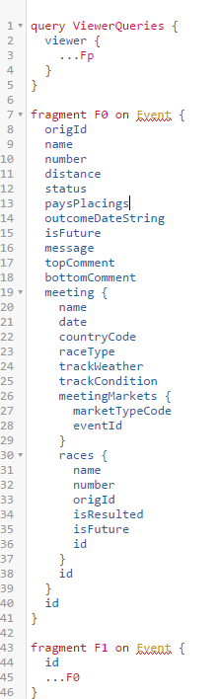
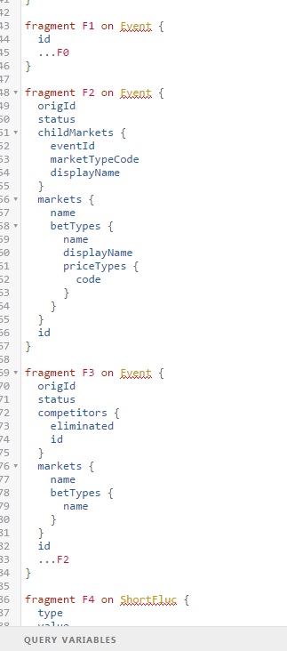
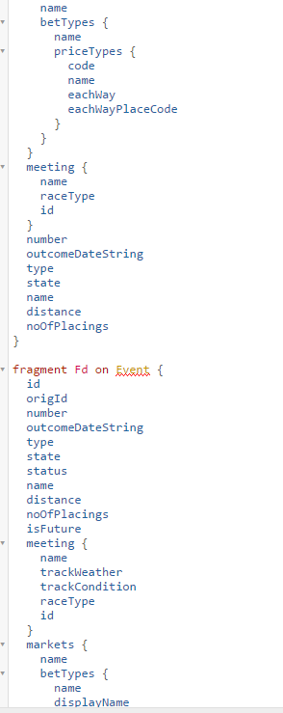
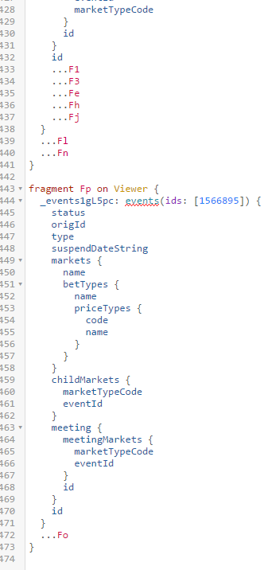
Relay
Notes:
Example: this the final query that relay build for us when loading the first page of unibet racing client. as you can see,
it's a big query
The query is a result of the combination of all react-component that have declared themselves require graphql-data
it makes http request more efficient

Slide 18

Relay
Notes:
Moreover, Relay is not only about let you make declarative data dependencies and handle all the data-fetching for you.
It has its design beauty.
One big beauty about Relay is that it supports composition. Just like react components. -- Building blocks --
Read this:
“
Relay's approach to data-fetching is heavily inspired by our experience with React. In particular, React breaks complex interfaces into reusable components, allowing developers to reason about discrete units of an application in isolation, and reducing the coupling between disparate parts of an application
”

Slide 19
Relay
Code Demo
1. colocation
2. declarative
Notes:
So now I’m going to show you a piece of relay code
Todo.js ( line 89 , this.props.todo.text )
------------------------------
after code demo
1. garphql queries live in the same place as you react component
2. you declare what data you want, and relay will fetch it for you. How relay fetches the data is invisible to users
Blog. Relay 2 , over-haul. The essence of relay, something they want to keep.

Slide 20
Relay
https://speakerdeck.com/wincent/relay-deep-dive
query runner
literals -> AST-> composition -> diff nodes -> print -> network
network -> traverse (query AST, payload) -> save & notify
own store
flattened result
notification
garbage collection
Notes:
inside Relay

Slide 21
Relay
classic relay
relay classic
relay compat
relay modern
Notes:
classic relay -- diff node, build query on the fly (unpredictable ),
pros: wont' fetch data that it already has
cons: tied to react and makes Apollo popular
relay classic
relay compatible
relay modern -- static query. generate AST at compile time; global level optimization
pros: code is clearer and easier to understand; reduce runtime build AST cost -- benefit under-powered mobile devices split into relay-compiler, react-relay , and relay-runtime
cons: will sometimes fetch data that it always has

Slide 22
Graphql and Relay
Q&A
Notes:
Before entering QA, subscription demo

