Slide 1
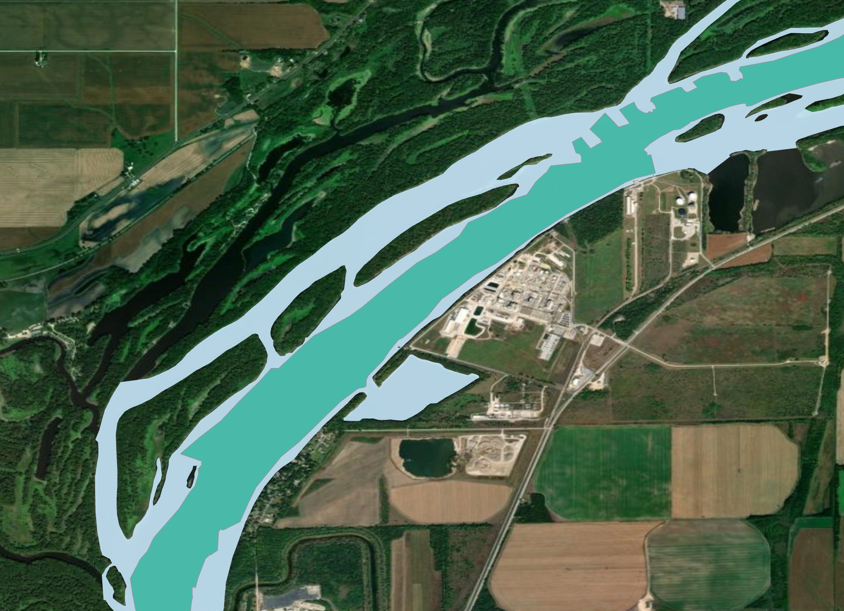
DRAFT Update
Barrie Chileen Martinez

Slide 2
Agenda
Overview of project
CSAT Data Wrangling
CSAT Product
LSTM
CNN
Project Timeline

Slide 3
Where we left off…
Started experimenting with CSAT
Massive QA effort

Slide 4
CSAT – Corps Shoaling Analysis Tool
Leverages surveys in eHydro to calculate shoaling rates and volume changes
Surveys associated with dredge events are omitted from CSAT shoaling rate calcs
Uses a hindcasting algorithm that incorporates new survey data over time
Estimates dredging events based on volume decreases outside of an adjustable threshold
Currently set to 2% variation

Slide 5
Strategic Engagements
Met with Michael Hartman to discuss CSAT output
Determined bank to bank Channel Framework had impact on extraneous CSAT rates
Working with test level script to clip Hydrosurvey data to exclude wingdams and off channel areas
Path forward: Develop channel boundary constrained to navigable section and continue QA of surveys

Slide 6
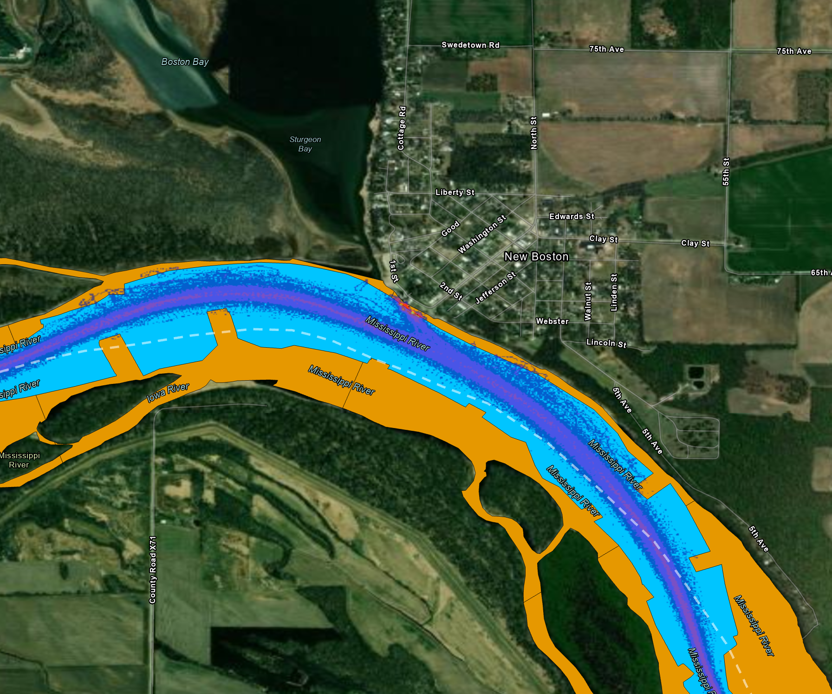
Developing a workable channel framework
Started with IENC Depth Layer
Manual editing based on AIS vessel tracks
Where are vessels physically in the channel
Targets modeling to navigable area
Clipped out any wingdams or river training structures from IENC and internal datasets

Slide 7
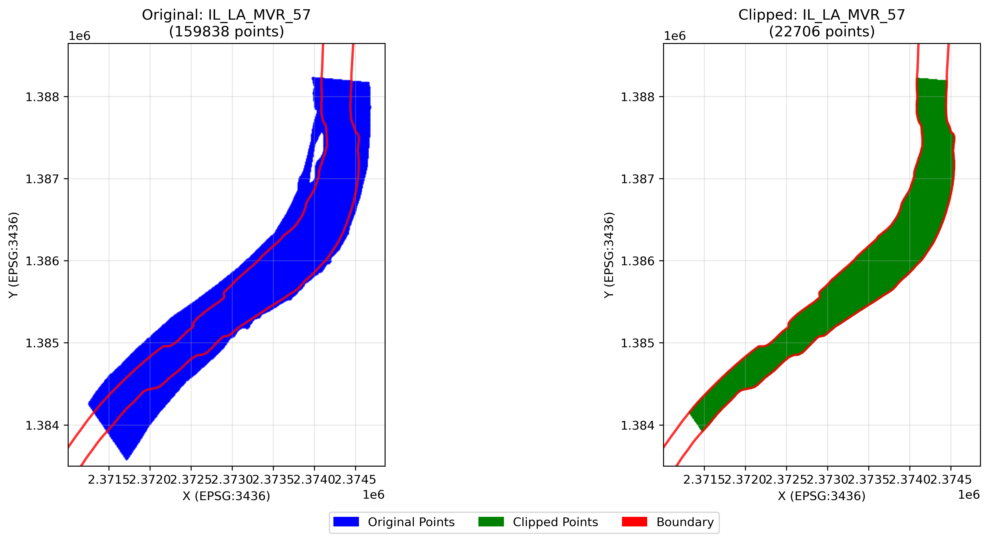
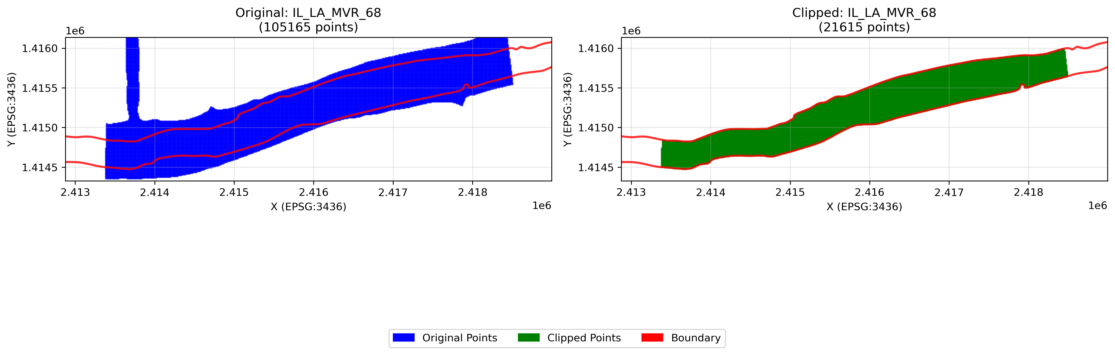
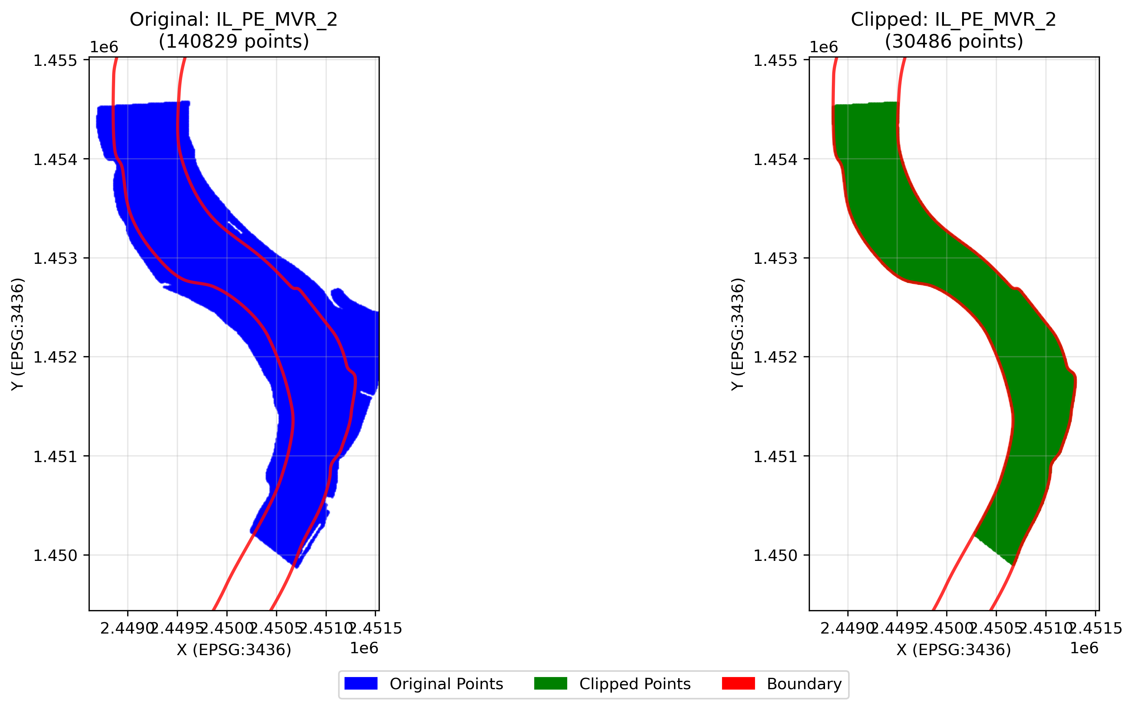
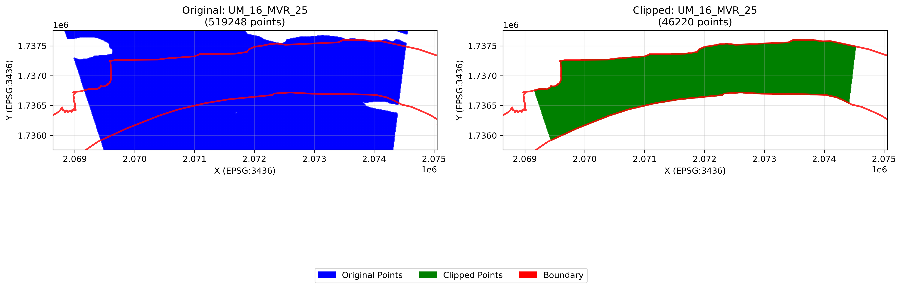
518 Reaches Clipped

Slide 8
Examples of CSAT Output
IL_LA_MVR_68 Mackinaw River
IL_PE_MVR_2 Wesley Bend
UM_16_MVR_25 Hershey Chute
IL_LA_MVR_57 Copperas Creek

Slide 9
Long Short-Term Memory Model (LSTM)
Can set “lookback” windows to determine how far model looks back in time to generate output
Can adjust forecasting range: next day, 14 days, 120 days….
Model is able to retain both short and long-term context
It remembers things and uses it to forecast
One of the best deep learning approaches for modeling tasks where context matters

Slide 10

Overview of LSTM Gating Mechanisms
Gate mechanisms control how much context is carried forward through the model
Forget Gate – Tells the model to forget context from memory cell
Input Gate – Controls how much context is passed into the memory cell
Output Gate – Controls how much context is in output in the prediction
Think of each gate as Gandalf on the Moira Bridge when standing against the Balrog - YOU SHALL NOT PASS

Slide 11
Convolutional Neural Network
Type of deep learning that works well with image data
Ideal for spatial pattern recognition
Feature segmentation
Edge detection
Input
Convolution
Pooling
Fully Connected Layer
Output
Feature Extraction
Classification

Slide 12
Another way to think about it…
Orange = Shoal
Pink = Scour

Slide 13
Putting it all together
CSAT shoaling rasters by reach
River gage arrays associated with reaches
Downstream modeling approach
Gages within and upstream of shoaling raster will be used
Gages provide the when/temporal context
CSAT provides the where/spatial outcome
Allows us to identify, at a pool or subreach level, where dredging will occur

Slide 14
Project Timeline
Three Key Phases:
Phase 1 – Data wrangling and exploration
Phase 2 – Model Development and Analysis
Phase 3 – Assessment and Synthesis
Key Engagement – Stakeholder Engagement
Phase and Activities | September | October | November | December
Phase 1 Data Preparation – Gather data, conduct data quality assessment
Phase 1 Exploratory Data Analysis – Feature selection through PCA and xGBoost of cleaned CSAT Data
Phase 2 LSTM Development – Build model and format data for LSTM Modeling
Phase 2 CNN Development – Build model and format data for CNN Modeling
Mid-Project Stakeholder Presentation
Phase 2 Model Training and Validation - Train and Validate LSTM and CNN Models
Phase 3 Assess model performance - Compare LSTM and CNN model
Phase 3 Complete Capstone - Develop final deliverables and create visualizations
9/2-10/20
9/16-10/20
10/10-11/3
10/10-11/3
10/17
11/1-11/25
11/15-11/25
11/25-12/12

Slide 15
Questions?

