Slide 1
Tuesday 2/20
COMS 3163

Slide 2
ToDo List
Check All Button
DeleteCompleted Button

Slide 3
Testing
Types of testing
Unit Testing
Integration Testing
e2e Testing
API Testing
Accessibility Testing
Fuzz Testing
Penetration Testing
Boundary testing
Smoke Testing
Performance Testing
Stress Testing
A/B Testing

Slide 4
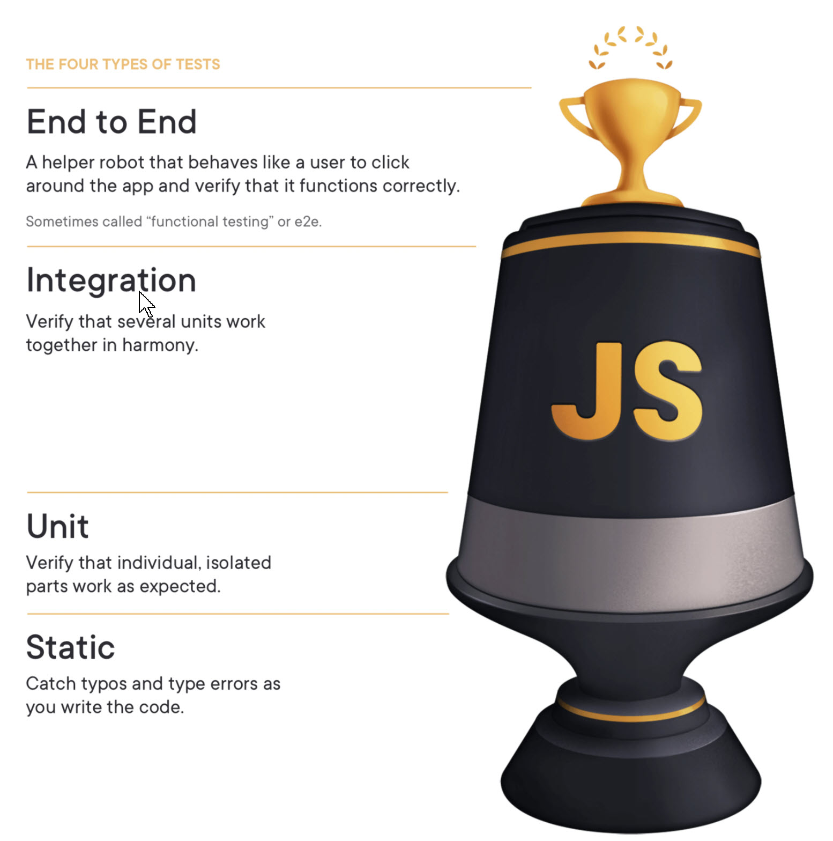
The Testing Trophy and Testing Classifications
Kent C. Dodds
https://kentcdodds.com/blog/the-testing-trophy-and-testing-classifications

Slide 5
Software Principle
Make it work, make it right, make it fast -- Kent Beck

Slide 6
Test Driven Development
Approach where tests are written before actual code
Red, Green, Refactor
Write a Test
Make sure it fails (Red)
Write code Make it pass (Green)
Simplest code to make the test pass
Refactor
Make it right

Slide 7
Three Laws of TDD - Robert C. Martin "Uncle Bob"
You are not allowed to write any production code until you have written a unit test that fails due to its absence
You are not allowed to write more of a unit test than is sufficient to fail. Failing to compile is failing.
You are not allowed to write more production code than is sufficient to cause the currently failing test to pass.

Slide 8
TDD Best Practices
Only one thing under test.
Use spies or mocks where necessary to avoid database and external dependencies not under test.
Don't write a long script of login, add data, edit, delete and logout. Write each as separate tests.
Tests should be written as documentation.
The test should have the details to setup the test.
The setup should not hide in data.
Tests should be concise and simple.
Don't test the implementation. Test the behavior.

Slide 9
TDD Best Practices (cont)
Follow AAA Pattern
Arrange (setup the test)
Act (perform action)
Assert the correct behavior has occurred
Each test in isolation.
Don't have the result of one test required for a second test
Tests should be executable in any order, a subset of tests or just a single test executed.
Test driven development is a discipline

Slide 10
TDD Benefits
Documentation
Confidence
Focus on feature
Momentum
Know when you are done
Safe refactoring
Improved design
Early feedback
Avoid Time Consuming Debugging Sessions
Avoid artificial complexity/over-engineering
less code === fewer bugs
Not coupled to implementation
QA Finds Fewer Bugs

Slide 11
Myth
Writing tests slows development
It increases developer performance
Without tests a developer needs to login, enter data, click around to get to area to test.
This must be done several times making sure
This doesn't run all possible tests

Slide 12
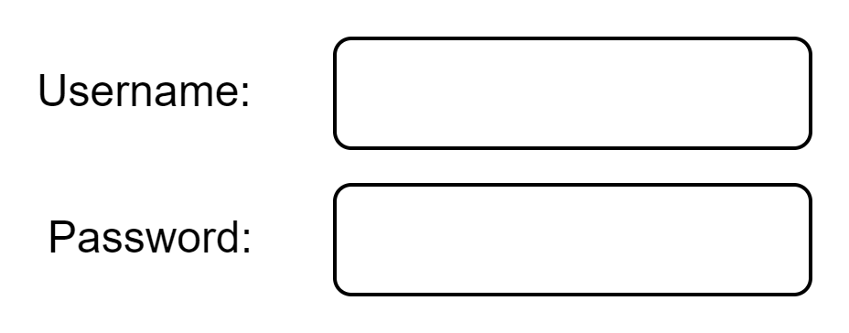
Possible Tests to Write

Slide 13
Possible Tests to Write
Username | Password
Empty | Empty
Empty | Incorrect
Empty | Wrong Case
Empty | Correct
Incorrect | Incorrect
Incorrect | Empty
Incorrect | Correct
Wrong Case | Empty
Wrong Case | Incorrect
Wrong Case | Wrong Case
Wrong Case | Correct
Correct | Empty
Correct | Incorrect
Correct | Wrong Case
Correct | Correct

Slide 14
Testing Libraries
JestJS https://jestjs.io/
JavaScript testing framework.
Cypress https://www.cypress.io/
A browser testing framework for component and e2e testing.
Playwright https://playwright.dev/
A browser testing framework for e2e testing.
Selenium https://www.selenium.dev/
Seleniuma automates the browser using a Selenium Web Driver. Tests can be written in a number of languages. Test are run outside the browser, even remotely, sending commands and receiving data via the web driver.

Slide 15
Mobile Testing
Devices
OS
Version
Screen Sizes
Portrait / Landscape

Slide 16
Bowling Game Kata
Robert C. Martin (Uncle Bob)
http://butunclebob.com/ArticleS.UncleBob.TheBowlingGameKata
A game consists of 10 frames. Each frame has 2 rolls to knock down 10 pins. Score is total of pins knocked down.
A spare is 10 pins knocked down in a single frame in 2 rolls, gives a bonus of the first roll of the next frame.
A strike is knocking down 10 pins in the first roll of the frame. A bonus of the 2 rolls of the next frame.
A player rolls a strike in the 10th frame, two extra bonus rolls to complete the frame. 10th frame, with a strike or spare, is the only frame to have 3 rolls.

