Slide 1
February 13
COMS 3163

Slide 2
Quiz Site Project JavaScript
Build a quiz tool front-end written in JavaScript or TypeScript
Use the JavaScript or TypeScript Instructions to start the project
Similar Front-End will be written in Angular and React in the future.
A backend server will be written in the future and all 3 front-ends will be edited to connect to that server.
A paper will be written comparing JS, Angular, and React
JavaScript app should implement 2 Types Of Questions
True/False
Multiple Choice / 1 or more answers
Fill-in the blank
Other (discuss and get approval first)
Libraries
Data Validation Library Zod (TypeScript), Joi (JavaScript) or other
Discuss any other dependencies you wish to add to your projects and have approval before using them.

Slide 3
Angular
Full framework
Opinionated
New Major release every ~6 months
Weekly patch/minor updates

Slide 4
Angular
Components
Services
Directives
Pipes
Testing
Data Binding
Life Cycle Hooks
Routing
Route Guards

Slide 5
Components
A directive associated with a HTML template.
Renders template in place of element directive.
ng generate component <name> || ng g c <name>
Files
<name>.component.ts - Component Class
<name>.component.html - Component Template
<name>.component.css - Component CSS
<name>.component.spec.ts - Unit Test for component

Slide 6
Services
reusable logic/code to be used in multiple components or
Is a Class decorated with @Injectable
Singleton
Uses
Interact with backend service
Business Logic
Share Data between Components

Slide 7
Directives
Component
Directive with Template
Attribute Directives
Change the appearance or behavior of an element, component or another directove
NgClass, NgStyle, NgModel
Structural Directives
Change the DOM layout by adding and removing DOM elements.
NgIf, NgFor, NgSwitch

Slide 8
Pipes
Transform data for rendering
DatePipe, UpperCasePipe, LowerCasePipe, CurrencyPipe, DecimalPipe, PercentPipe

Slide 9
Testing
Testing part of the framework
Unit testing
e2e testing

Slide 10
Data Binding
Data binding keeps the page in-sync with data automatically rendering changes

Slide 11
Component Lifecycle
Lifecycle callbacks during points in component render cycle
ngOnChanges called when an input or output binding value changes
ngOnInit (called after the first ngOnChanges) // common
ngDoCheck handles developer's custom change detection
ngAfterContentInit called after component content initialized
ngAfterContentChecked called after every check of component content
ngAfterViewInit called after every check of a components view(s)
ngOnDestory called just before the directive is destroyed // common

Slide 12
Routing
Single page app (SPA)
Handles page rendering based on URL routes

Slide 13
Route Guards
A method to execute before a route change occurs to cancel the change or redirect it.
CanActivateFn
Common checking auth for secure routes
CanMatchFn
CanActivateChildFn
CanDeactivateFn
Common if changing and data needs to be saved before leaving

Slide 14
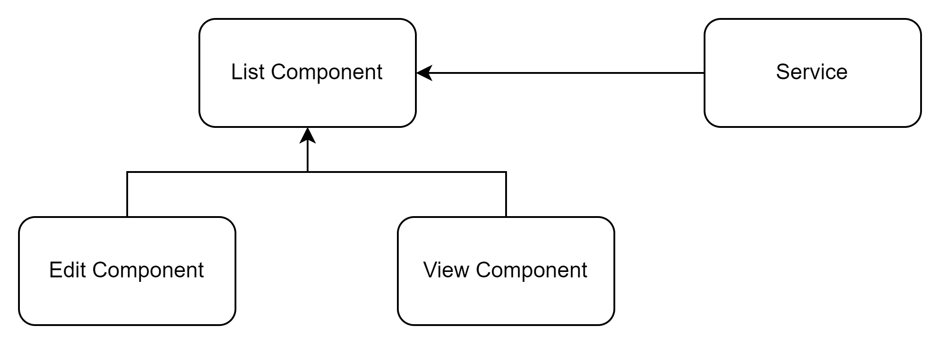
Component Pattern

Slide 15
RESTful API
Representational State Transfer (REST)
Stateless
Methods
GET
POST
PUT
DELETE
Error Codes
2xx success
3xx URL redirection.
4xx client error responses
5xx server error responses

