Slide 1
Title Title Title Title
Brady M. Chisholm
May 1 2025
Advisor: Dr. Jean-Paul Noel and his Neuroscience Lab

Slide 2
Background
Part of the brain must be to guide our actions
How do goals or reward opportunities from the environment get turned into decisions?
Unclear how guidance emerges from neural systems

Slide 3
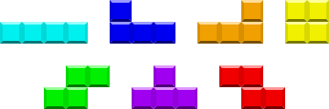
Aims
Used original seven `Tetrominoes` from Tetris
Tetris offers a unique framework for research
Tableaus – Tetris games frozen in time
Akin to chess puzzles

Slide 4
Tableau Example Set
Most key in the 4-AFC Section of the experiment

Slide 5
Method and Design
Built in MATLAB 2024b with PsychToolbox

Slide 6
Section 1: Piece Presentation

Slide 7
Section 2: Pieces in Context

Slide 8
Section 3: 4-AFC

Slide 9
Section 5: Playing Tetris

Slide 10
Data and Planned Analyses

Slide 11
Preliminary Data

Slide 12
Implications and Next Steps

Slide 13

Thank You! Questions?

Slide 14


