Slide 1
HPE Technical Test 08/06/23
Presented By Bryan Choo

Slide 2
Table Of Contents
Deliverables
Functional / Non Functional Requirements
Assumptions Made
User Stories
View/ Application/ Database Layers
Future Improvements

Slide 3
Deliverables
If you choose option B
Save the design in a power point slide
Focus on application implementation. Demonstrate, and explain your solution implementation
Result should be hosted in Git repository, either hosted on public GitHub or local git repository. This is mandatory for both option A and B
Propose future enhancement(s) on the current solution
Explain the implemented algorithm if there is any

Slide 4
Functional Requirements
Based on micro services architecture, design and implement an ecommerce-based solution, any ecommerce-based store/application
The solution is capable to handle at least ONE of below:
2500 HTTP request per second
2500 records transaction per second

Slide 5
Non-Functional Requirements
Solution must be cost effective
Site should load fast ( 0 -2 seconds )
Site should be mobile responsive

Slide 6
Assumptions Made
There is a warehouse with an operations team with sufficient capacity and capability to handle orders in a timely manner ( within 1 week )
Current stock is properly accounted for in the database
Count is correct and product SKUs are matching
Code is well written without errors
Database queries are well optimized
No unnecessary joins
Frequented queries are using a materialized view

Slide 7
User Stories
As a User I would like to be able to browse all the products available in the store
As a User I would like to be able to add my preferred item to cart
As a User I would like to be able to add/ deduct/ remove items from my cart
As a User I would like to be able to enter my payment details to checkout my cart
As a User I would like to be able to receive an email confirmation that my order has been placed

Slide 8
Architecture Diagram

Slide 9
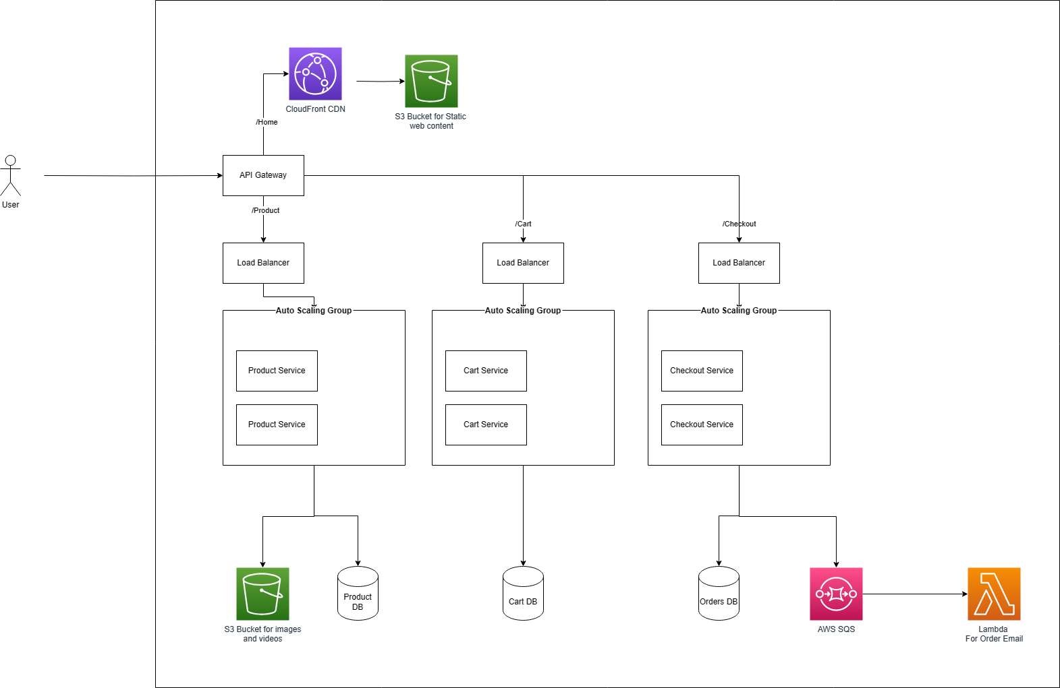

Slide 10
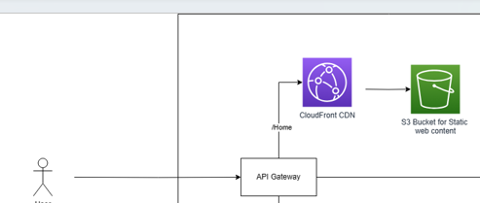
View Layer
Will be using a CDN to serve static content
Reduce Page load
Reduce server load

Slide 11
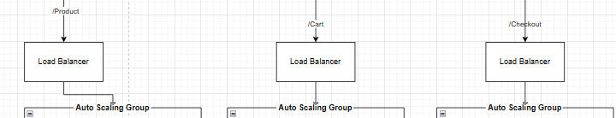
Application Layer
Will be separating the main functions of the website into modules
Each of these modules will be using microservices and will be part of an Auto Scaling group with a Load Balancer before it.
Allows scalability ( Able to spin up more instances to handle more traffic )
Cost Efficiency ( Able to spin down instances during low traffic )

Slide 12
Application Layer ( cont. )
Scaling Metrics
Dynamic Scaling
Using CPU Usage as a metric
We can use the simple scaling strategy
when at 80% capacity -> add 20% more machines
When at 30% capacity -> terminate 20% machines
Scheduled Scaling
If we are expecting a large amount of traffic to come all at once during a certain time. We can spin up more instances during this period . i.e 5pm – 7pm ( if there is a sale )

Slide 13
Application Layer ( Product )
This service should serve the relevant product page to the user, based on what they have clicked
i.e All Items Category , single product
This microservice will query the database and fetch the relevant information

Slide 14
Application Layer ( Cart )
The cart service should be able to show the user the current items in his cart and allow him to add/ deduct/ remove items from the cart

Slide 15
Application Layer ( Checkout )
Checkout service should handle payment processing and accepting or rejecting the request
Will be sending the order details to a 3rd party payment processor like Stripe to handle
If success , checkout service will show a success page and then deduct from stock
If failure, to return to checkout page with error message

Slide 16
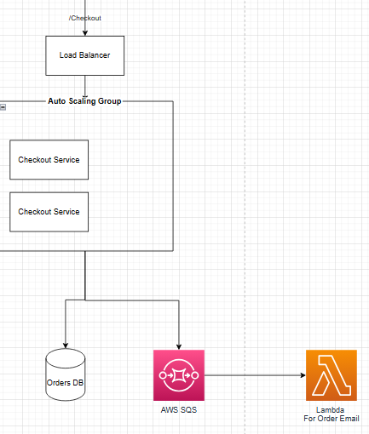
Email Service
Upon checkout there would 2 emails that needs to be sent out
Order Confirmation to the user
Order details to operations team (to pick and pack)
Choosing to use serverless functions
Since this is a simple program
Do not need an instance to be on standby to receive requests
Does not need to be very quick ( user expectation for emails can be few mins )

Slide 17
Database Layer
Not a key focus but would like to speak to how it can be achieved
Vertical Scaling ( Improving hardware )
Read Replicas ( + reads )
Sharding ( + reads , +writes )

Slide 18
Future Improvements
Architecture Improvements
Cost Optimizations ( Using right instance type )
Security ( DDOS Attacks )
New Modules
User Login and Authentication
Discount/ Coupon Code Module
Backend 3PL integrations
Sales Dashboard

