Slide 1
CSS

Slide 2
What is CSS
CSS stands for Cascading Style Sheets. It is a way to divide the content from the layout on web pages.
With CSS you will be able to:
Add new looks to your old HTML
Completely restyle a web site with only a few changes to your CSS code
Use the "style" you create on any web page you wish!

Slide 3
CSS Selector
CSS selectors are the heart and soul of CSS. They define which HTML elements you are going to be manipulating with CSS code.
Syntax:
SELECTOR { PROPERTY: VALUE }
Example:
h4 { color: red; }

Slide 4
Cascading Style Sheets come in three flavors:
1. internal
2. external
3. inline.

Slide 5
Internal CSS
When using internal CSS, you must add a new tag, <style>, inside the <head> tag.
Example:
<html>
<head>
<style type="text/css">
</style>
</head>
<body>
<p>Your page's content!</p>
</body>
</html>

Slide 6
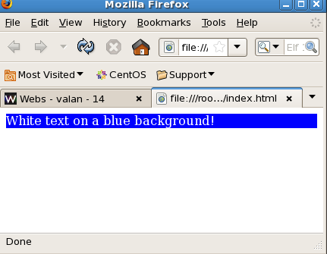
Example
<html>
<head>
<style type="text/css">
p {color: white; background-color: blue;}
</style>
</head> <body>
<p>White text on a blue background!</p>
</body>
</html>

Slide 7
External CSS
When using CSS it is preferable to keep the CSS separate from your HTML. Placing CSS in a separate file allows the web designer to completely differentiate between content (HTML) and design (CSS).
External CSS is a file that contains only CSS code and is saved with a ".css" file extension. This CSS file is then referenced in your HTML using the <link> instead of <style>

Slide 8
Example
demo.css
body{ background-color: gray;}
p { color: blue; }
h3{ color: white; }

Slide 9
HTML Code:
<html><head>
<link rel="stylesheet" type="text/css" href="test.css" />
</head>
<body>
<h3> A White Header </h3>
<p> This paragraph has a blue font.
The background color of this page is gray because
we changed it with CSS! </p>
</body></html>

Slide 10
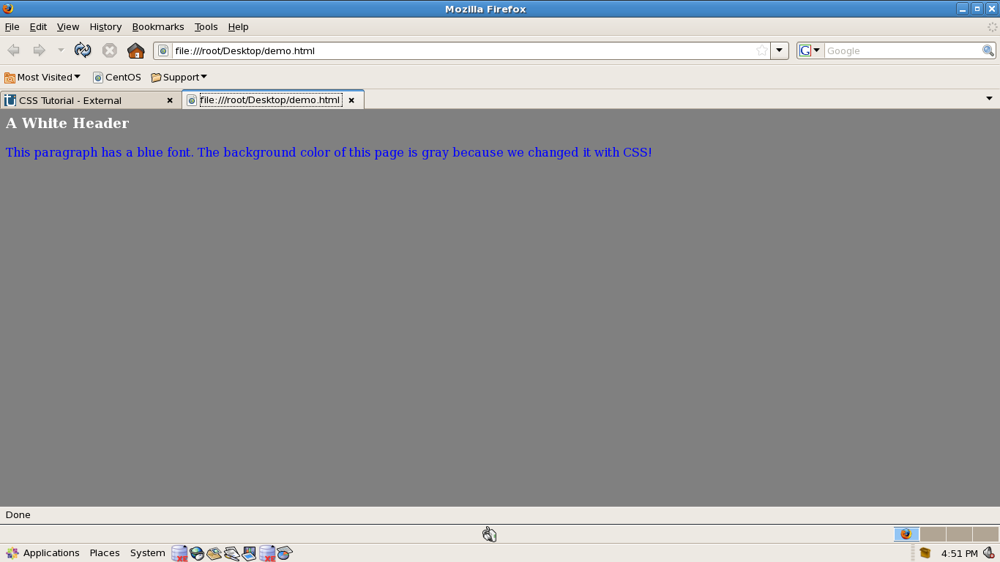
Output

Slide 11
CSS Inline
Thus far, we have only shown you how to use CSS the way it was meant to be used -- separated from the HTML. However, it is possible to place CSS right in the thick of your HTML code, and this method of CSS usage is referred to as inline css.

Slide 12
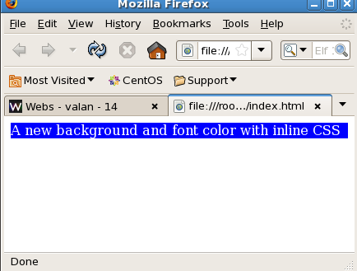
Example
<html>
<head>
</head>
<body>
<p style="background: blue; color: white;">
A new background and font color with inline CSS
</p>
</body>
</html>

Slide 13
CSS Background

Slide 14
CSS Background Color
CSS Code:
h4 { background-color: white; }
p { background-color: #1078E1; }
ul { background-color: rgb( 149, 206, 145); }

Slide 15
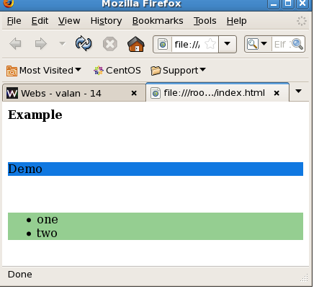
Example
<html><head>
<style type="text/css">
h4 { background-color: white; }
p { background-color: #1078E1; }
ul { background-color: rgb( 149, 206, 145); }
</style>
</head><body>
<h4>Example</h4><br>
<p> Demo</p><br>
<ul><li>one</li>
<li>two</li></ul>
</body></html>

Slide 16
CSS Background Image
CSS Code:
p { background-image: url(smallPic.jpg); }
h4{ background-image: url(smallPic.jpg); }

Slide 17
CSS Font

Slide 18
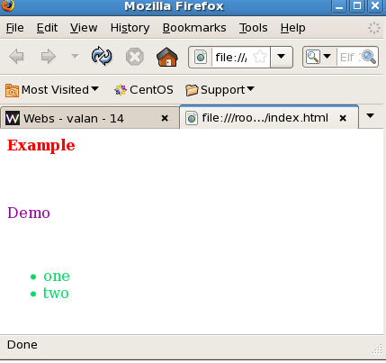
CSS Font Color
<html><head>
<style type="text/css">
h4 { color: red; }
p { color: #9000A1; }
ul { color: rgb(0, 220, 98); }
</style>
</head><body>
<h4>Example</h4><br>
<p> Demo</p><br>
<ul><li>one</li>
<li>two</li></ul>
</body></html>

Slide 19
CSS Font Family
CSS Code:
h4 { font-family: sans-serif; }
h5 { font-family: serif; }
h6 { font-family: arial; }

Slide 20
CSS Font Size
CSS Code:
p { font-size: 120%; }
ol{ font-size: 10px; }
ul{ font-size: x-large; }

Slide 21
CSS Font Style
CSS Code:
p { font-style: italic; }
h4{ font-style: bold; }

Slide 22
CSS Text

Slide 23
Text Decoration
CSS Code:
h4{ text-decoration: line-through; }
h5{ text-decoration: overline; }
h6{ text-decoration: underline; }
a { text-decoration: none; }

Slide 24
Text Align
CSS Code:
p { text-align: right; }
h5{ text-align: left; }

Slide 25
Text Transform
CSS Code:
p { text-transform: capitalize; }
h5{ text-transform: uppercase; }
h6{ text-transform: lowercase; }

Slide 26
CSS Word Spacing
CSS Code:
p { word-spacing: 10px; }

Slide 27
CSS Letter Spacing
CSS Code:
p { letter-spacing: 3px; }

Slide 28
CSS Border

Slide 29
Border Style Types
CSS Code:
p.solid {border-style: solid; }
p.double {border-style: double; }
p.groove {border-style: groove; }
p.dotted {border-style: dotted; }
p.dashed {border-style: dashed; }
p.inset {border-style: inset; }
p.outset {border-style: outset; }
p.ridge {border-style: ridge; }
p.hidden {border-style: hidden; }

Slide 30
Example
<html><head><style type="text/css">
h1{border-style: solid; }
h2{border-style: double; }
h3{border-style: groove; }
h4{border-style: dotted; }
h5{border-style: dashed; }
h6{border-style: inset; }
</style><body><h1>Border 1</h1><br>
<h2>Border 2</h2><br>
<h3>Border 3</h3><br>
<h4>Border 4</h4><br>
<h5>Border 5</h5><br>
<h6>Border 6</h6><br>
</body></html>

Slide 31
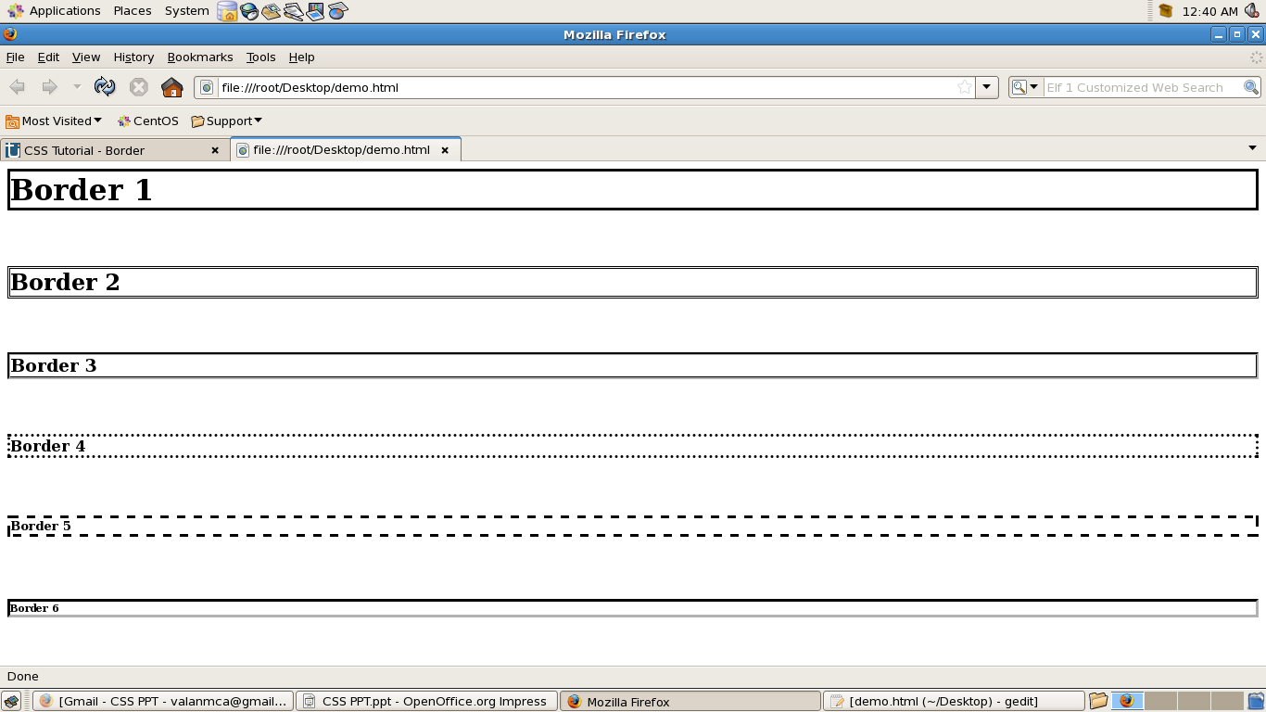
Output

Slide 32
CSS Lists

Slide 33
CSS List Style Type
CSS Code:
ol { list-style-type: upper-roman; }
ul { list-style-type: circle; }

Slide 34
CSS Lists With Images
CSS Code:
ul { list-style-image: url("listArrow.gif"); }
ol { list-style-image: url("listArrow2.gif"); }

Slide 35
CSS Mouse Cursor

Slide 36
CSS Cursor Icons
* default - Display the normal mouse cursor icon
* wait - The mouse icon to represent the computer "thinking"
* crosshair - A cross hair reticle
* text - An "I" shaped icon that is displayed when selecting text
* pointer - A hand icon that you see when you hover over an HTML link
* help - A question mark (usually)

Slide 37
CSS Cursor Code
CSS Code:
p { cursor: wait }
h4 { cursor: help }
h5 { cursor: crosshair }

