Slide 1
Java Script

Slide 2
What is JavaScript ?
By definition, JavaScript is a client-side scripting language.

Slide 3
Javascript - Syntax
<html>
<head>
<script type="text/JavaScript">
----------------------
---------------------
</script>
</head>
<body>............</body>
</html>

Slide 4
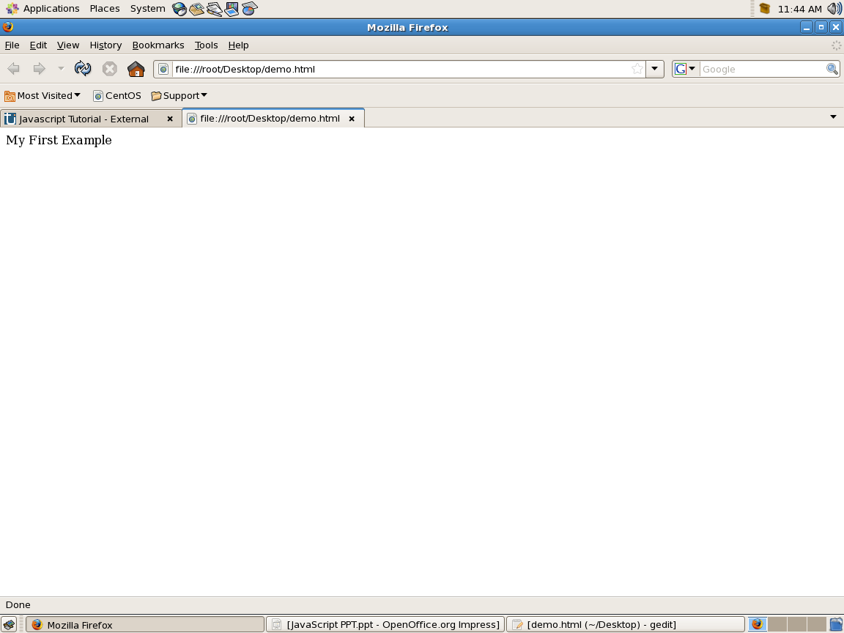
First Example
<html>
<head>
<script type="text/JavaScript">
document.write("My First Example");
</script>
</head>
<body>
</body>
</html>

Slide 5
JavaScript Variables

Slide 6
Example
<html>
<head>
<script type="text/JavaScript">
s="Hello World !";
document.write(s);
</script>
</head>
<body>
</body>
</html>

Slide 7
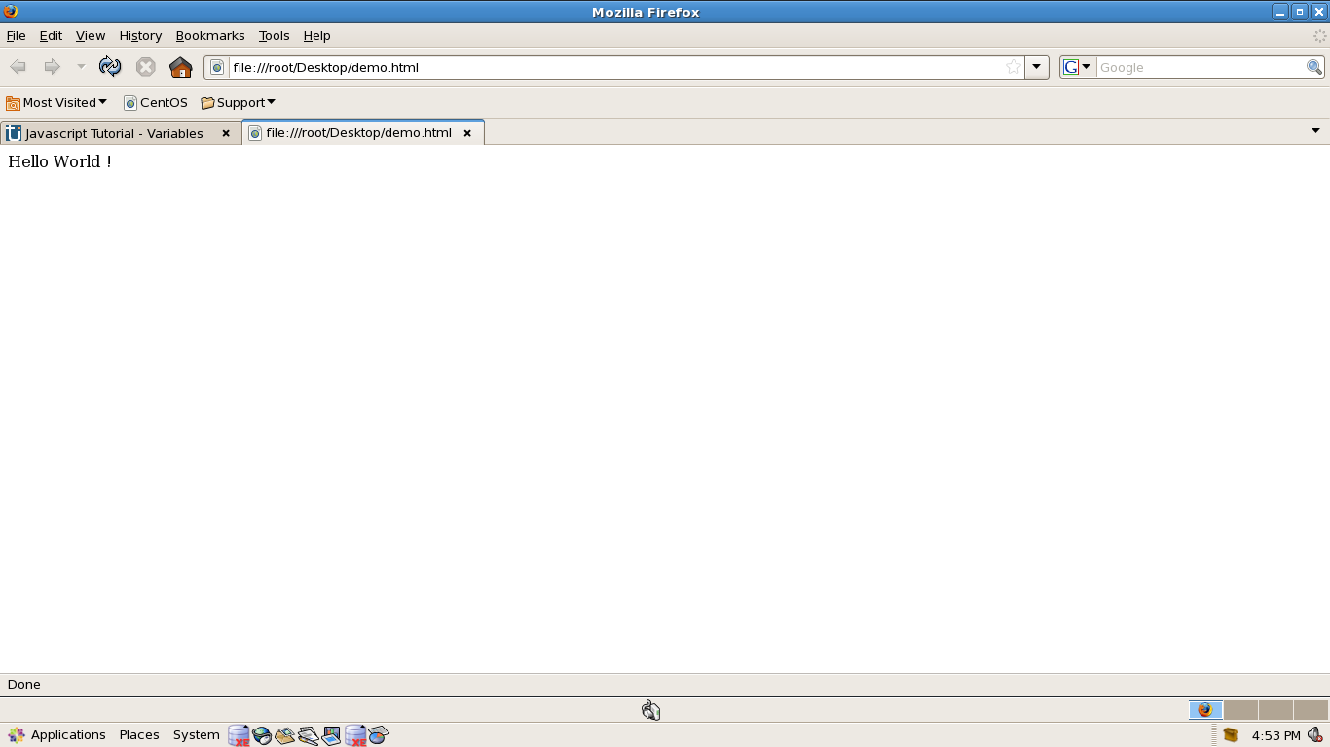
Output

Slide 8
JavaScript Functions

Slide 9
Example
<html><head>
<script type="text/JavaScript">
function show(){
document.write("Function Example");
}
</script>
</head>
<body>
<input type="submit" value="click" onClick="show()"/>
</body>
</html>

Slide 10
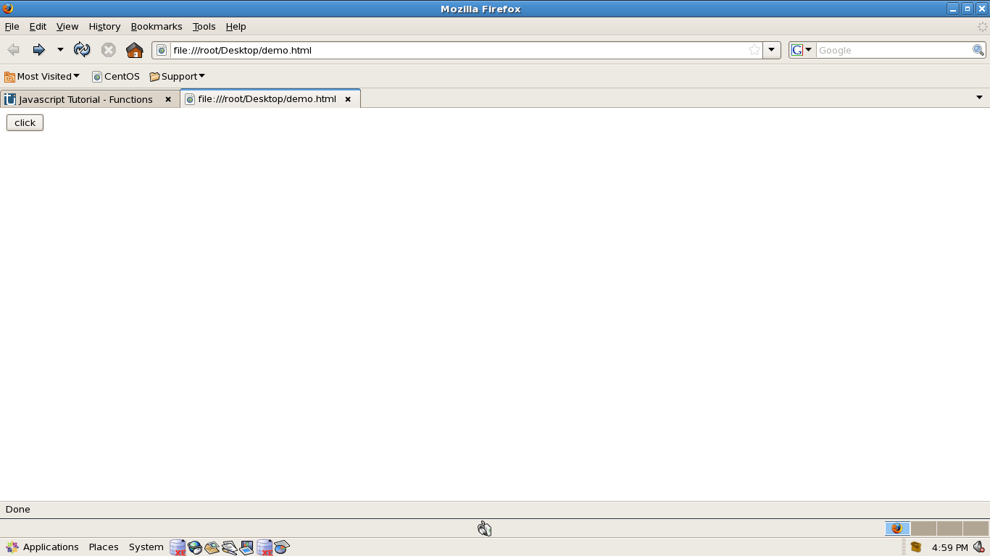
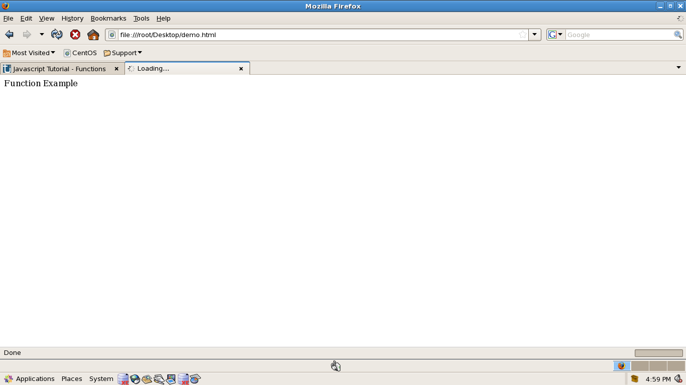
Output

Slide 11
JavaScript Operators & Control Statements

Slide 12
Example
<html><head><script type="text/JavaScript">
a=10;b=20;
function add(){
document.write(a+b); }
function comp(){
if(a>b)
document.write("A is Big");
else
document.write("B is Big"); }
</script></head><body>
<input type="submit" value="Add" onClick="add()"/>
<input type="submit" value="Compare" onClick="comp()"/>
</body></html>

Slide 13
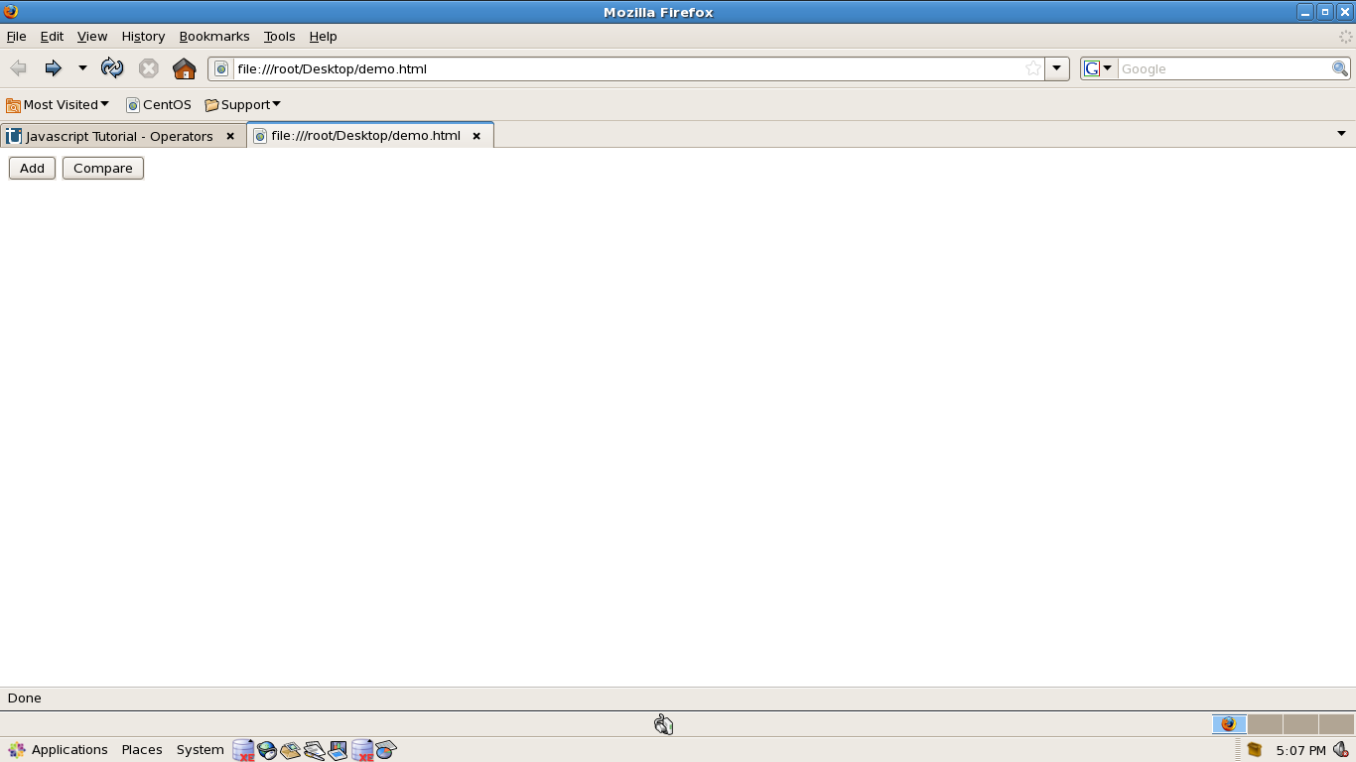
Output

Slide 14
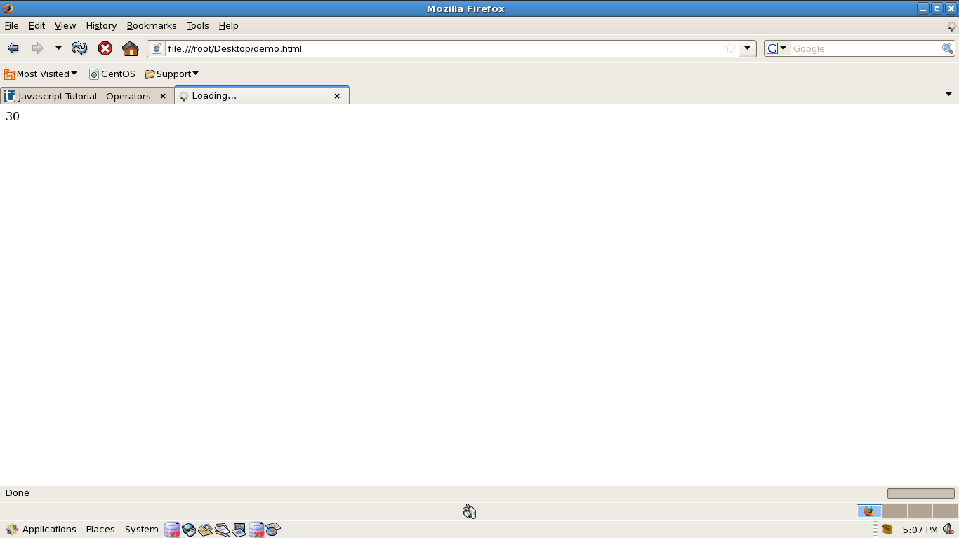

Slide 15
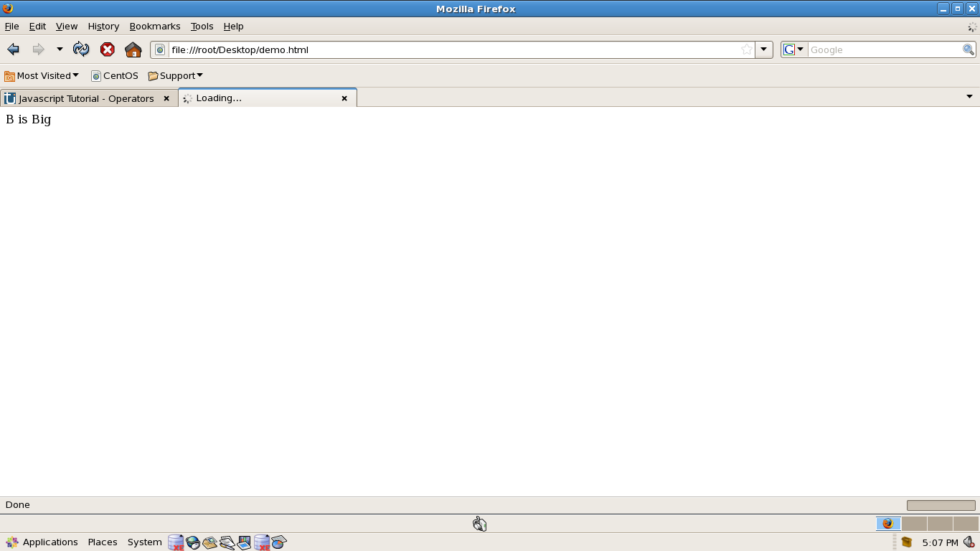

Slide 16
JavaScript Alert
<html><head>
<script type="text/JavaScript">
function call(){
alert("Alert Demo");
}
</script></head>
<body>
<input type="submit" value="Alert" onClick="call()"/>
</body></html>

Slide 17
JavaScript Confirm
<html><head>
<script type="text/JavaScript">
function call(){
confirm("confirm Demo");
}
</script></head><body>
<input type="submit" value="Confirm" onClick="call()"/>
</body>
</html>

Slide 18
JavaScript Prompt
<html><head>
<script type="text/JavaScript">
function call(){
prompt("prompt Demo");
}
</script></head>
<body>
<input type="submit" value="prompt" onClick="call()"/>
</body></html>

Slide 19
JavaScript document.getElementById
<html><head><script type="text/javascript">
function myfun(){
myTextField = document.getElementById("myText");
if(myTextField.value !="")
alert("You entered: " + myTextField.value)
else
alert("Would you please enter some text?")
}
</script><body>
<input type="text" id="myText" />
<input type="submit" value="Click" onclick="myfun()" />
</body></html>

Slide 20
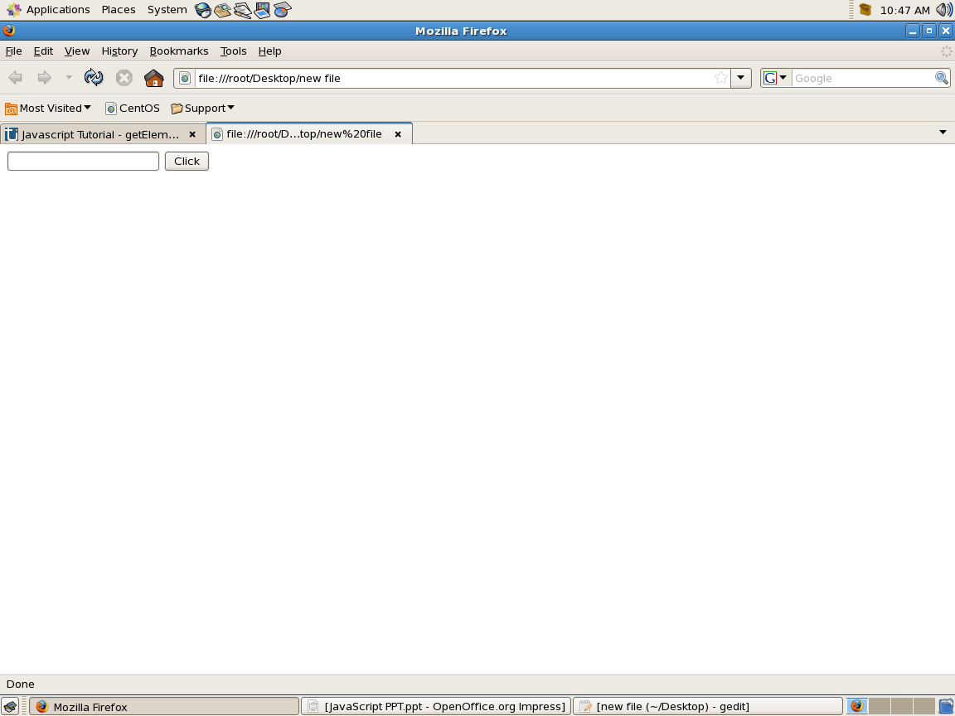
Output

Slide 21
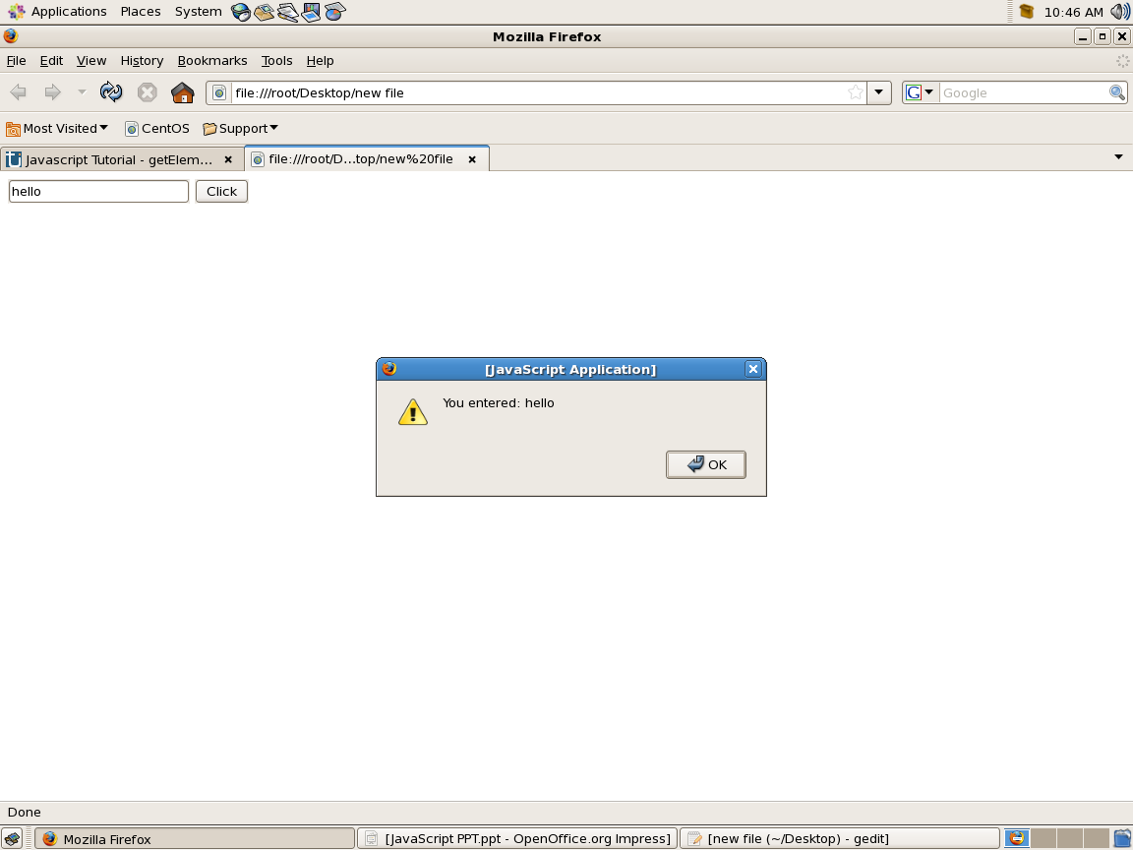

Slide 22


Slide 23
Example
<html><head><script type="text/javascript">
function myfun(){
myTextField = document.form1.t1;
if(myTextField.value !="")
alert("You entered: " + myTextField.value)
else
alert("Would you please enter some text?")
}
</script><body><form name="form1" >
<input type="text" name="t1" />
<input type="submit" value="Click" onclick="myfun()" />
</form></body></html>

Slide 24
Javascript - Events

Slide 25
onClick
<html><head><script type="text/javascript">
function myfun(){
myTextField = document.form1.t1;
if(myTextField.value !="")
alert("You entered: " + myTextField.value)
else
alert("Would you please enter some text?")
}
</script><body><form name="form1" >
<input type="text" name="t1" />
<input type="submit" value="Click" onclick="myfun()" />
</form></body></html>

Slide 26
OnClick cont..
<html><head><script type="text/javascript">
</script><body><form name="form1" >
<input type="radio" name="c1" onclick="document.bgColor='red'">Red
<input type="radio" name="c1" onclick="document.bgColor='green'">Green
<input type="radio" name="c1" onclick="document.bgColor='blue'">Blue
</form></body></html>

Slide 27
OnMouseOver & OnMouseOut
<html>
<body>
<a href="www.google.com"
onmouseover="document.bgColor='red'"
onmouseout="document.bgColor='green'">
Change the background color </a>
</body>
</html>

Slide 28
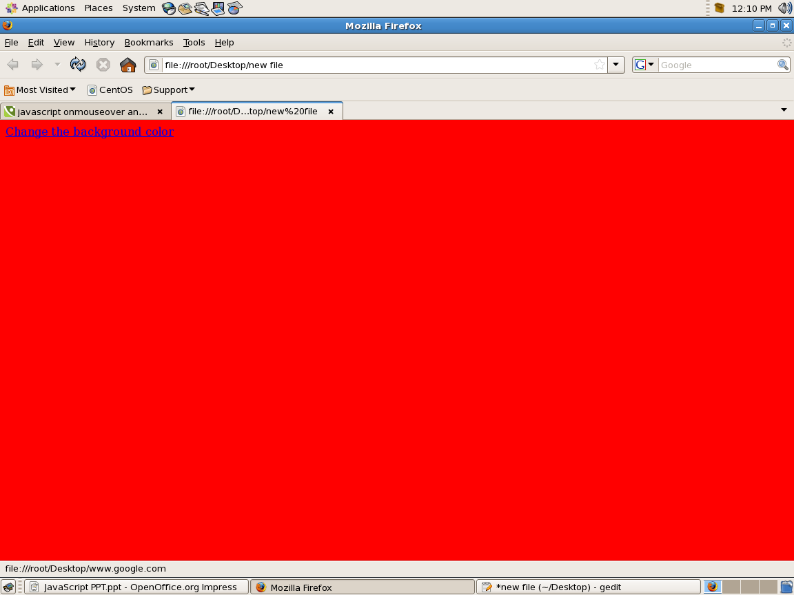
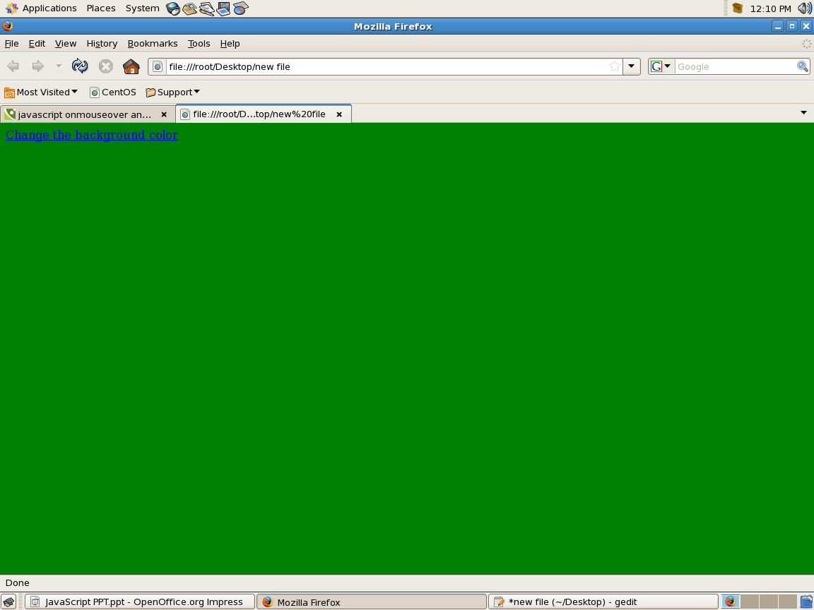
output

Slide 29
onFocus
<HTML>
<BODY>
<H3>Example of onFocus Event Handler:</H3>
<BR>
<input type="text" name="data" value="example@gmail.com" onfocus="this.value=''">
</BODY></HTML>

Slide 30
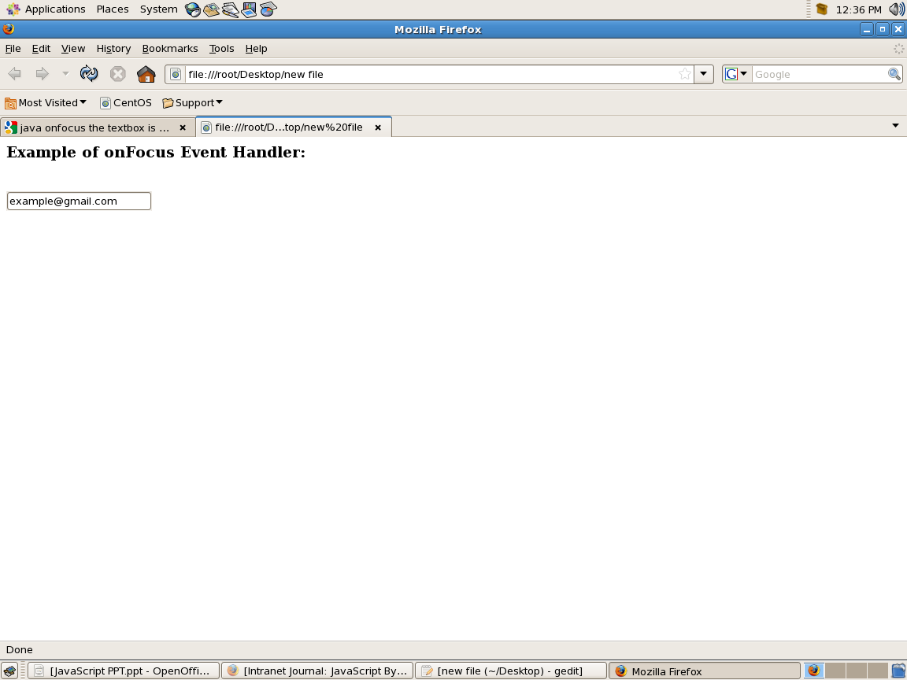
Output

Slide 31
onBlur
<HTML>
<HEAD><SCRIPT LANGUAGE="JavaScript">
function valid(){
input=document.myform.data.value;
if (input<0){
alert("Please enter a value that is greater than 0");}
}
</SCRIPT></HEAD><BODY>
<H3>Example of onBlur Event Handler:</H3>
Try entering a value less than zero:<BR>
<form name="myform">
<input type="text" name="data" onBlur="valid()">
</form></BODY></HTML>

Slide 32
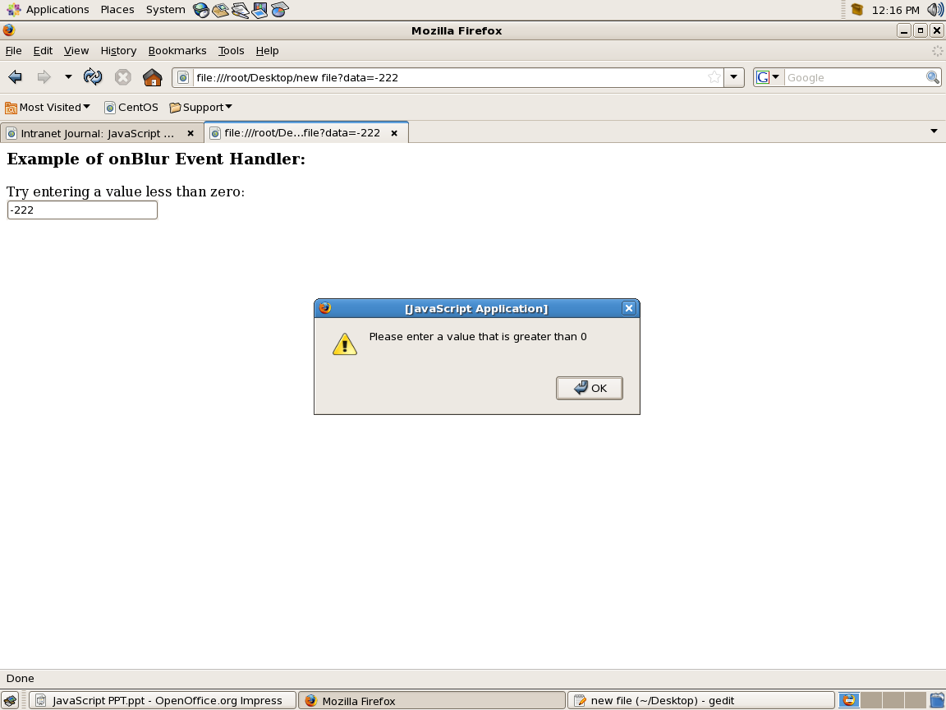
Output

Slide 33
onChange
<HTML><SCRIPT LANGUAGE="JavaScript">
function myfun(){
alert(form1.select1.value);
}
</script><BODY>
<H3>Example of onChange Event Handler:</H3><BR>
<form name="form1">
<select name="select1" onchange="myfun()">
<option>One</option>
<option>Two</option>
<option>Three</option>
</select></form></BODY></HTML>

Slide 34
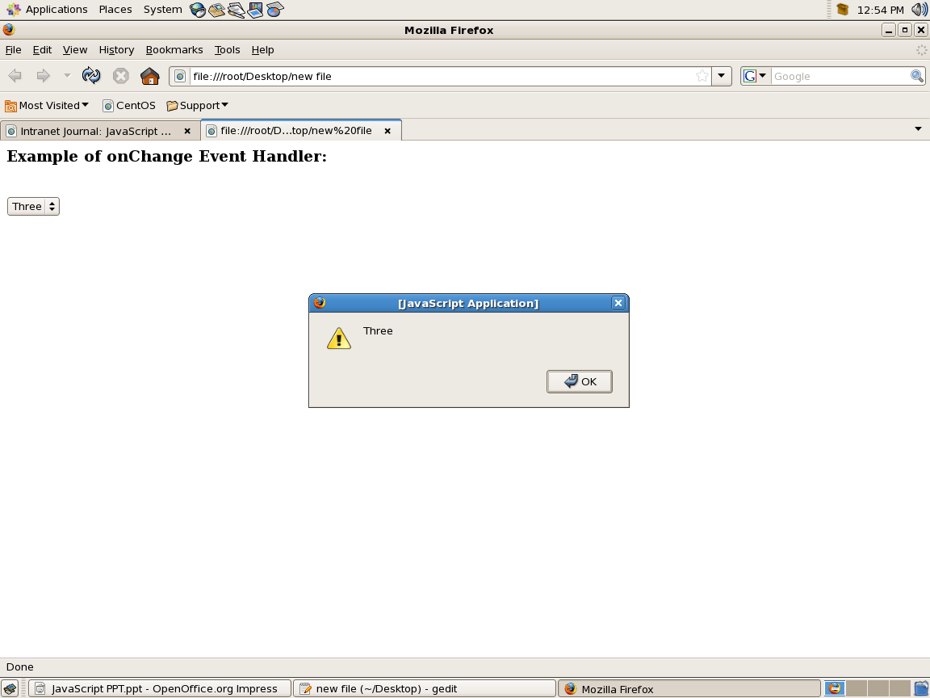
Output

Slide 35
onLoad
<html>
<SCRIPT LANGUAGE="JavaScript">
function myfun(){
alert("Welcome");
}
</script>
<body onload="myfun()">
</body>
</html>

Slide 36
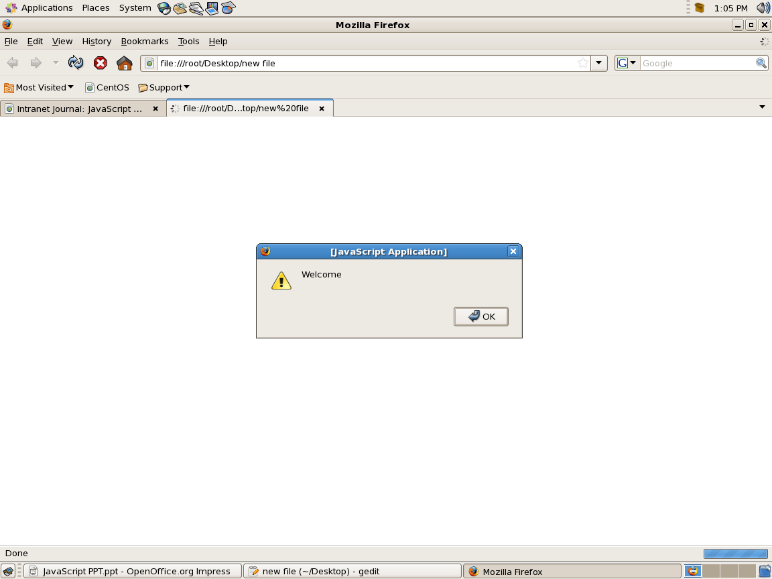
Output

Slide 37
onUnLoad
<HTML>
<HEAD><SCRIPT LANGUGE="JavaScript">
function goodbye(){
alert("Thanks for Visiting!");
}
</SCRIPT>
</HEAD><BODY onUnLoad="goodbye()">
<H3>Example of onUnload Event Handler</H3>
Look what happens when you try to leave this page...
</BODY></HTML>

Slide 38
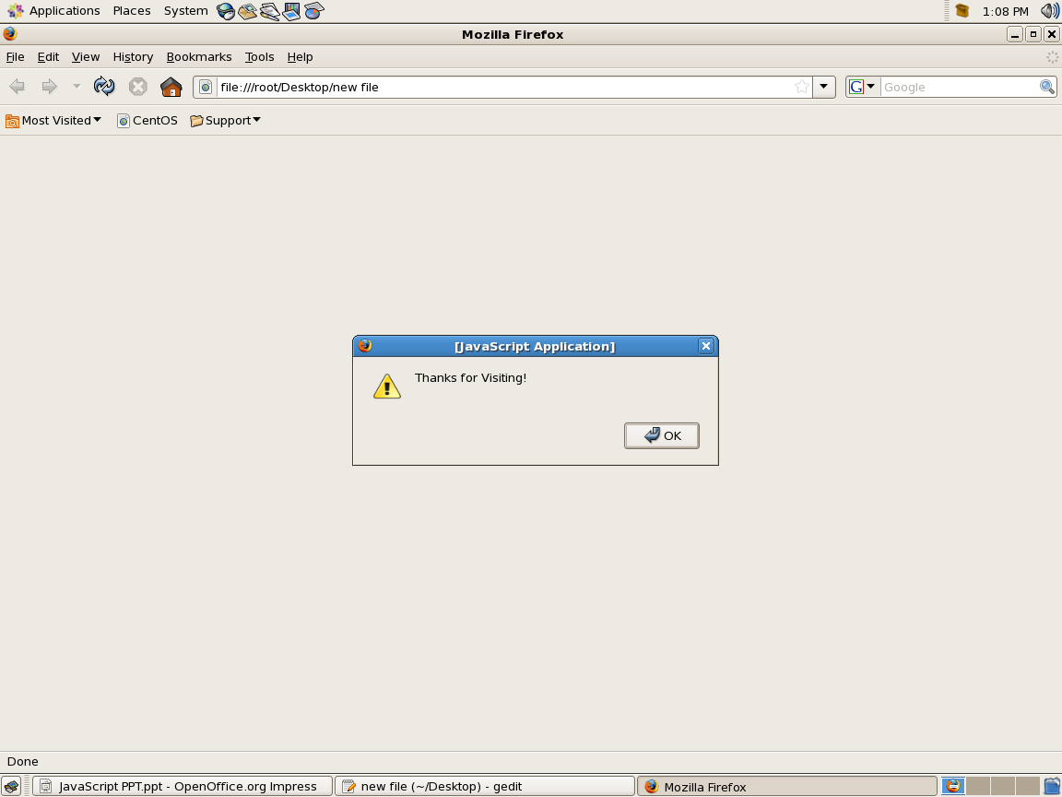
Output

Slide 39
JavaScript Form Validation

Slide 40
Form Validation - Checking for Non-Empty
<html><SCRIPT LANGUGE="JavaScript">
function notEmpty(){
if(document.form1.t1.value=="")
alert("Please Enter a Value");}
</script><body>
<form name="form1">
Required Field:<input type="text" name="t1"/>
<input type="submit" value="check" onclick="notEmpty()"/>
</form></body></html>

Slide 41
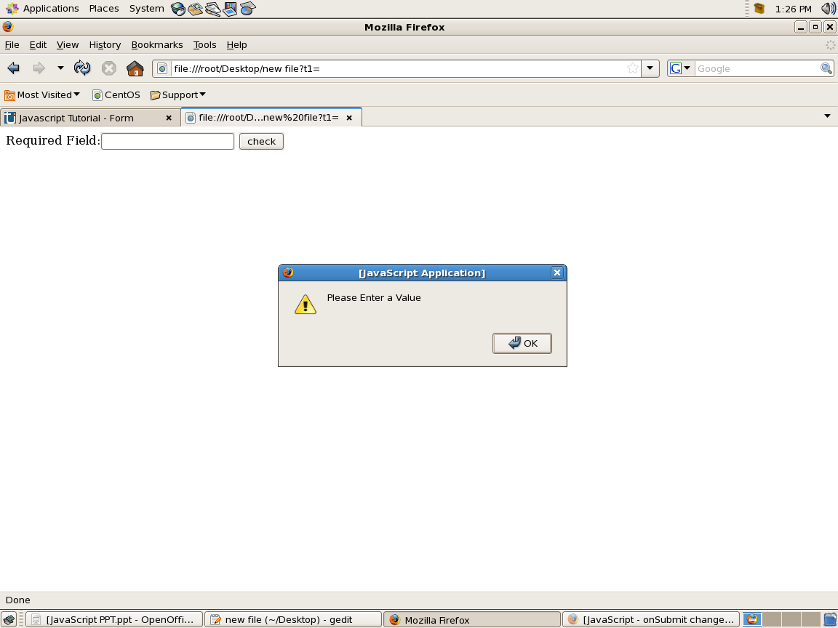
Output

Slide 42
Form Validation - Restricting the Length
<html><SCRIPT LANGUGE="JavaScript">
function myfun(){
s=document.form1.textbox1.value;
if(s.length < 5 )
alert("Enter atleast 5 characters");
}
</script><body><form name="form1">
<input type="text" name="textbox1" /><br>
<input type="submit" value="click" onClick="myfun()"/>
</form></body></html>

Slide 43
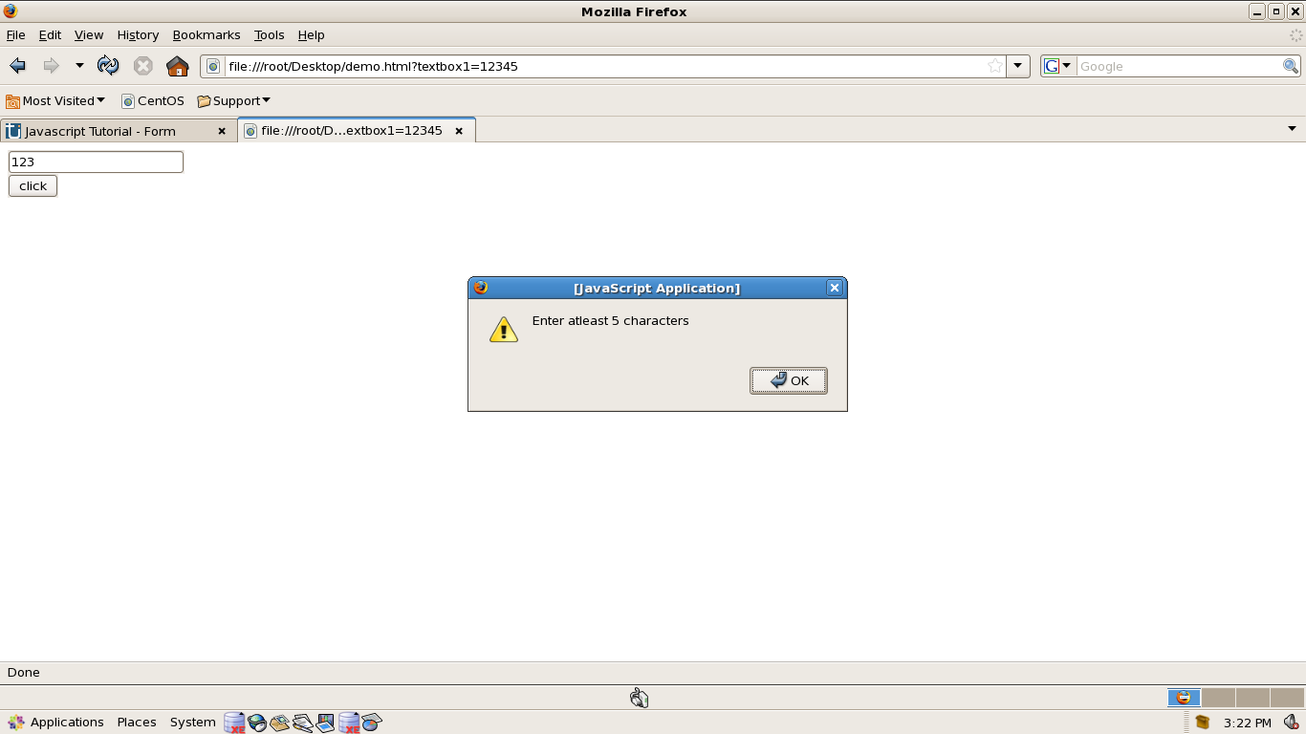
Output

Slide 44
Form Validation - Checking for All Numbers
<html><SCRIPT LANGUGE="JavaScript">
function isNumeric(){
var numericExpression = /^[0-9]+$/;
if(!document.form1.textbox1.value.match(numericExpression))
alert("Enter Numbers only");
}
</script><body>
<form name="form1">
<input type="text" name="textbox1" /><br>
<input type="submit" value="click" onClick="isNumeric()"/>
</form></body></html>

Slide 45

Output

