Slide 1
HTML

Slide 2
What the following term mean:
Web server: a system on the internet contains one or more web site
Web site: a collection of one or more web pages
Web pages: single disk file with a single file name
Home pages: first page in website

Slide 3
What is HTML ?
HTML stands for Hypertext Markup Language, and it is the most widely used language to write Web Pages.
Technically, HTML is not a programming language, but rather a markup language.

Slide 4
Creating HTML Document
Creating an HTML document is easy.
To begin coding HTML you need only two things:
simple-text editor
web browser.
Notepad is the most basic of simple-text editors and you will probably code a fair amount of HTML with it.

Slide 5
HTML Document Structure
An HTML document starts and ends with <html> and </html> tags. These tags tell the browser that the entire document is composed in HTML. Inside these two tags, the document is split into two sections:
1. The <head>...</head> elements, which contain information about the document such as title of the document, author of the document etc. Information inside this tag does not display outside.
2. The <body>...</body> elements, which contain the real content of the document that you see on your screen.

Slide 6
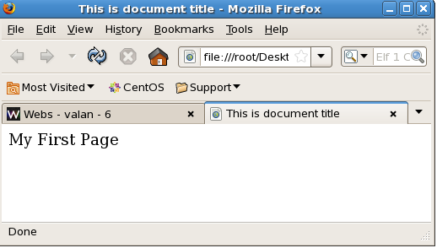
First Example
<html>
<head>
<title>This is document title</title>
</head>
<body>
My First Page
</body>
</html>

Slide 7
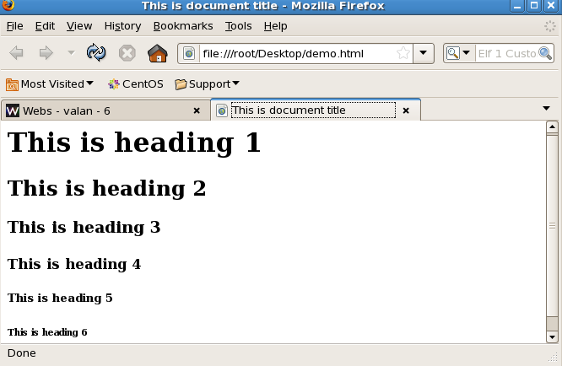
Create Headings
<html><body>
<h1>This is heading 1</h1>
<h2>This is heading 2</h2>
<h3>This is heading 3</h3>
<h4>This is heading 4</h4>
<h5>This is heading 5</h5>
<h6>This is heading 6</h6>
</body></html>

Slide 8
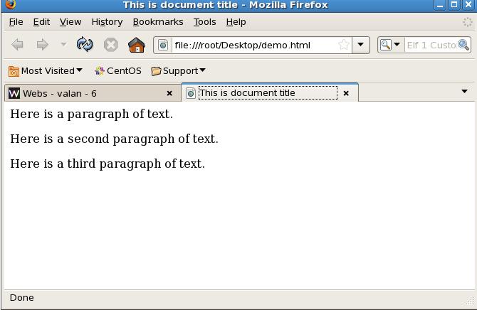
Create Paragraph
<html>
<head>
<title>This is document title</title>
</head>
<body>
<p>Here is a paragraph of text.</p>
<p>Here is a second paragraph of text.</p>
<p>Here is a third paragraph of text.</p>
</body>
</html>

Slide 9
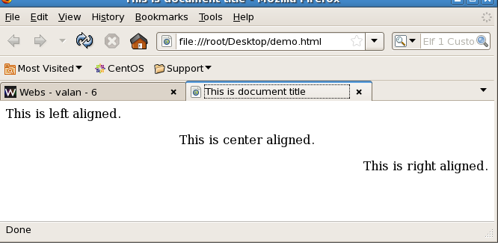
Paragraph cont...
<html>
<head>
<title>This is document title</title>
</head>
<body>
<p align="left">This is left aligned.</p>
<p align="center">This is center aligned.</p>
<p align="right">This is right aligned.</p>
</body>
</html>

Slide 10
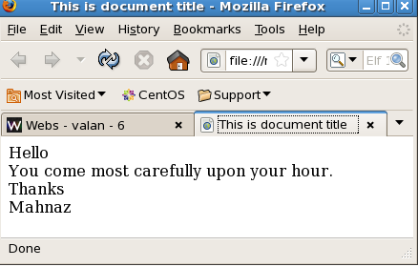
Create Line Breaks
<html>
<head>
<title>This is document title</title>
</head>
<body>
Hello<br>
You come most carefully upon your hour.<br>
Thanks<br>
Mahnaz
</body>
</html>

Slide 11
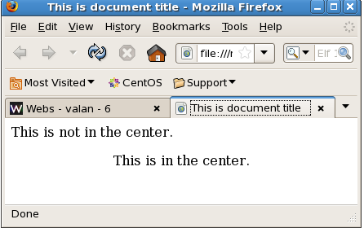
Centering Content
<html>
<head>
<title>This is document title</title>
</head>
<body>
<p>This is not in the center.</p>
<center>
<p>This is in the center.</p>
</center>
</body>
</html>

Slide 12
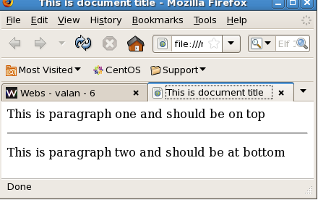
Horizontal Rules
<html>
<head>
<title>This is document title</title>
</head>
<body>
<p>This is paragraph one and should be on top</p>
<hr>
<p>This is paragraph two and should be at bottom</p>
</body>
</html>

Slide 13
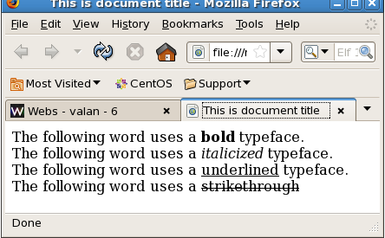
Bold, Italic, underlined and Strike Text
<html>
<head>
<title>This is document title</title>
</head><body>
The following word uses a <b>bold</b> typeface.<br>
The following word uses a <i>italicized</i> typeface.<br>
The following word uses a <u>underlined</u> typeface.<br>
The following word uses a <strike>strikethrough</strike><br>
</body>
</html>

Slide 14
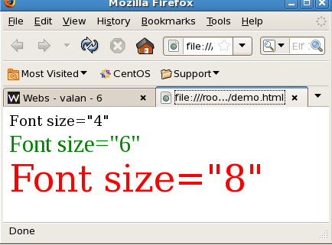
HTML Fonts
<html><body>
<font size="4" face="WildWest">Font size="4"</font><br>
<font size="6" face="Times New Roman" color="green">Font size="6"</font><br>
<font size="8" color="red">Font size="8"</font> <br></body></html>

Slide 15
Insert Image
<html><body>
<img src="location" />
</html></body>

Slide 16
HTML Background Colors & Images
1. <tagname bgcolor="color_value"...>
Ex:
<table bgcolor="yellow" width="100%" >
2.<tagname background="Image URL"...>
Ex:
<body background="/images/html.gif" >

Slide 17
Links
<a href="www.google.com/" ></a>

Slide 18
HTML Marquees
<marquee>This is basic example of marquee</marquee>
<marquee direction="right">This text will scroll from left to right</marquee>
<marquee direction="up">This text will scroll from bottom to up</marquee>

Slide 19
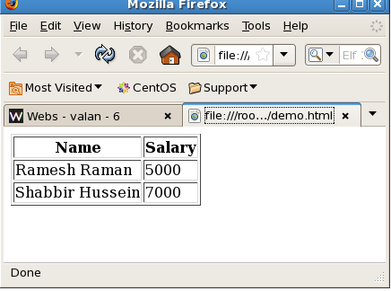
Table
<html>
<body>
<table border="1">
<tr><th>Name</th><th>Salary</th></tr>
<tr><td>Ramesh Raman</td><td>5000</td></tr>
<tr><td>Shabbir Hussein</td><td>7000</td></tr>
</table>
</body>
</html>

Slide 20
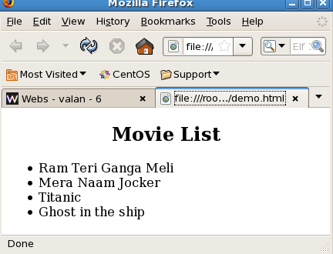
HTML Unordered Lists
<html><body>
<center><h2>Movie List</h2></center>
<ul>
<li>Ram Teri Ganga Meli</li>
<li>Mera Naam Jocker</li>
<li>Titanic</li>
<li>Ghost in the ship</li>
</ul>
</body></html>

Slide 21
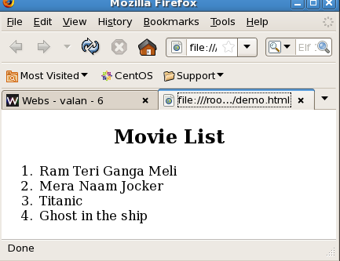
HTML Ordered Lists
<html>
<body>
<center><h2>Movie List</h2></center>
<ol>
<li>Ram Teri Ganga Meli</li>
<li>Mera Naam Jocker</li>
<li>Titanic</li>
<li>Ghost in the ship</li>
</ol>
</body>
</html>

Slide 22
HTML Forms
There are different types of form controls that you can use to collect data from a visitor to your site.
Text input controls
Buttons
Checkboxes and radio buttons
Select boxes
File select boxes
Hidden controls
Submit and reset button

Slide 23
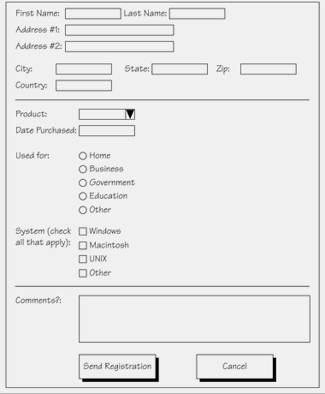
An Example of a Form

Slide 24
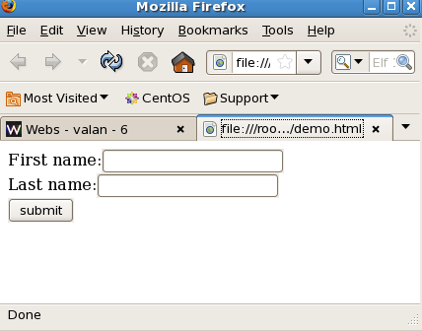
Single-line text input controls
<html><body>
<form>
First name:<input type="text" name="first_name"/>
<br>
Last name:<input type="text" name="last_name" />
<br>
<input type="submit" value="submit" />
</form>
</body>
</html>

Slide 25
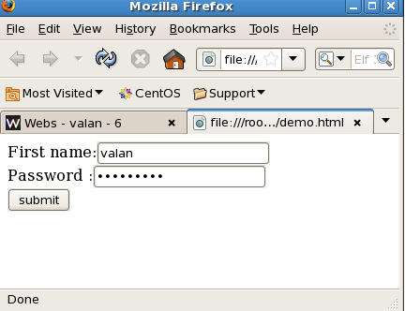
Password input controls
<html><body>
<form>
First name:<input type="text" name="first_name"/>
<br>
Password :<input type="password" name="password" />
<br>
<input type="submit" value="submit" />
</form>
</body>
</html>

Slide 26
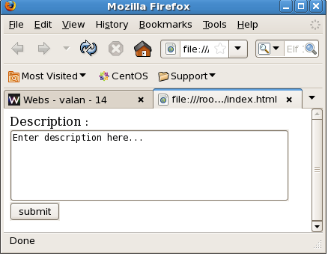
Multiple-Line Text Input Controls
<html><body>
<form>
Description : <br />
<textarea rows="5" cols="50" name="description">
Enter description here...
</textarea>
<input type="submit" value="submit" />
</form>
</body>
</html>

Slide 27
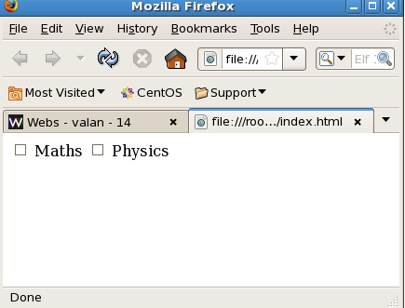
HTML Forms - Checkboxes Control
<html><body>
<form>
<input type="checkbox" name="maths" > Maths
<input type="checkbox" name="physics"> Physics
</form>
</body>
</html>

Slide 28
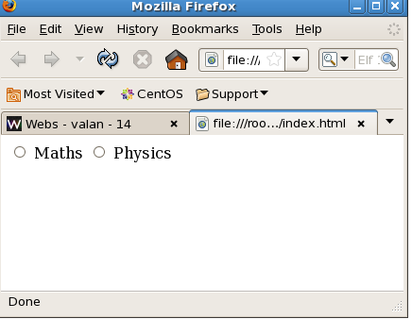
HTML Forms - Raidobox Control
<html><body>
<form>
<input type="radio" name="maths" > Maths
<input type="radio" name="physics"> Physics
</form>
</body>
</html>

Slide 29
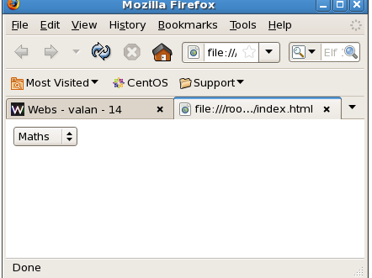
HTML Forms - Select box Control
<html><body>
<form>
<select name="dropdown">
<option value="Maths" selected>Maths</option>
<option value="Physics">Physics</option>
</select>
</form>
</body>
</html>

Slide 30
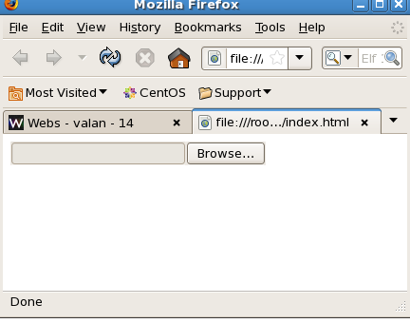
HTML Forms - File Select Boxes
<html><body>
<form>
<input type="file" name="fileupload" />
</form>
</body>
</html>

Slide 31
Frames
<html>
<frameset cols="20%,60%,30%">
<frame src="one.html"/>
<frame src="two.html"/>
<frame src="three.html"/>
</frameset>
</html>

Slide 32
Frame cont..
One.html
<html>
<body bgcolor="red">
<center>One Page</center>
</body>
</html>
two.html
<html>
<body bgcolor="green">
<center>Two Page</center>
</body>
</html>

Slide 33
Frame cont..
Three.html
<html>
<body bgcolor="blue">
<center>Three Page</center>
</body>
</html>

Slide 34
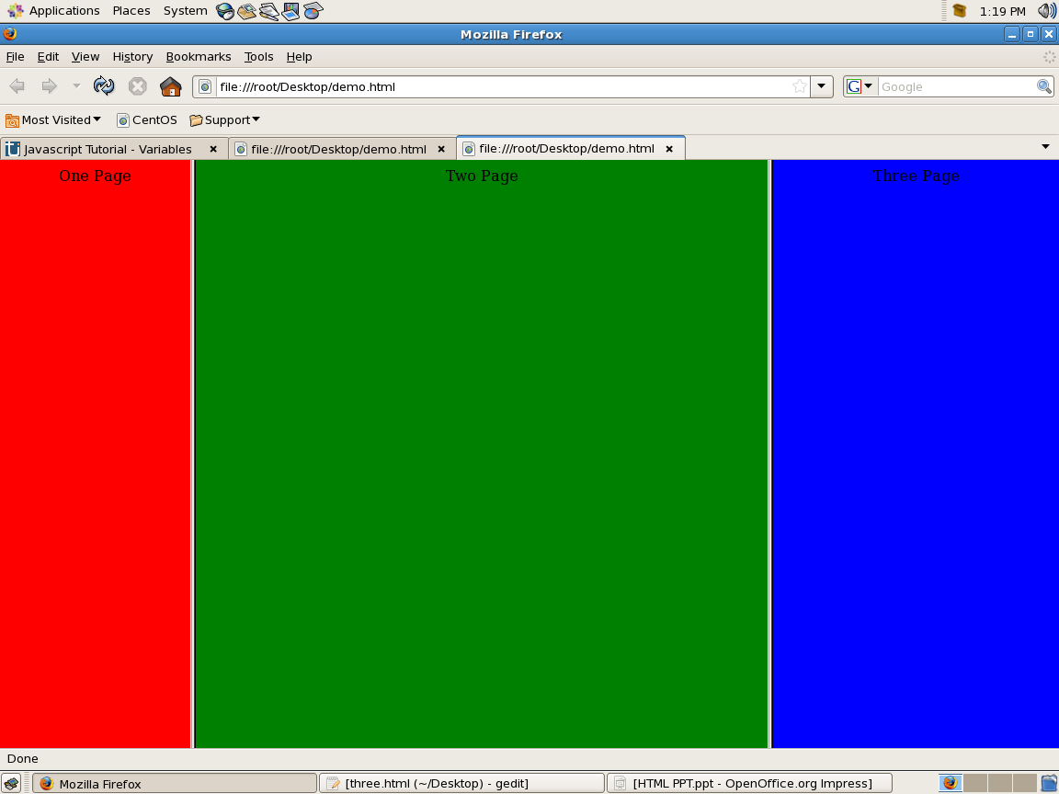
Output

