Slide 1
CORRECTIONS
L2 regularization ||w||₂² , not ||w||₂
Show second derivative is positive or negative on exams, or show convex
Latter is easier (e.g. x²)
Loss = error associated with one data point
Risk = sum of all losses
Pseudoinverse gives least-squares solution, NOT exact solutions
Magnitude of w matters for SVMs.

Slide 2
HW 3
Will be released today.
Probably harder than HW1 or HW2
Due Oct 6 (two Tuesdays from now)
HW party: Oct 1.
I wrote (some of) it. ☹

Slide 3
Downsides of using kernels
Speed & memory
Need to store all training data, each test point must be computed against each training point
SVMs only need subset of data (support vectors)
Overfit

Slide 4
3 Perspectives on Linear Regression

Slide 5
1. Minimize Loss (see lecture)
Take derivative of ||Xw – y||², set to 0
Result: X’Xw = X’y

Slide 6
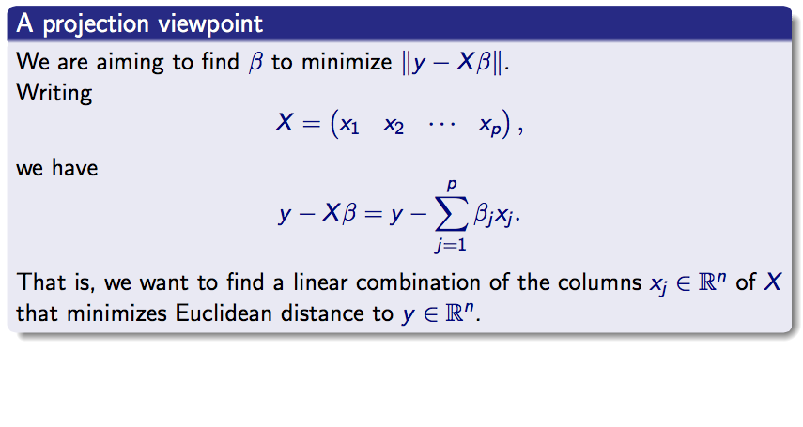
2. Projections

Slide 7
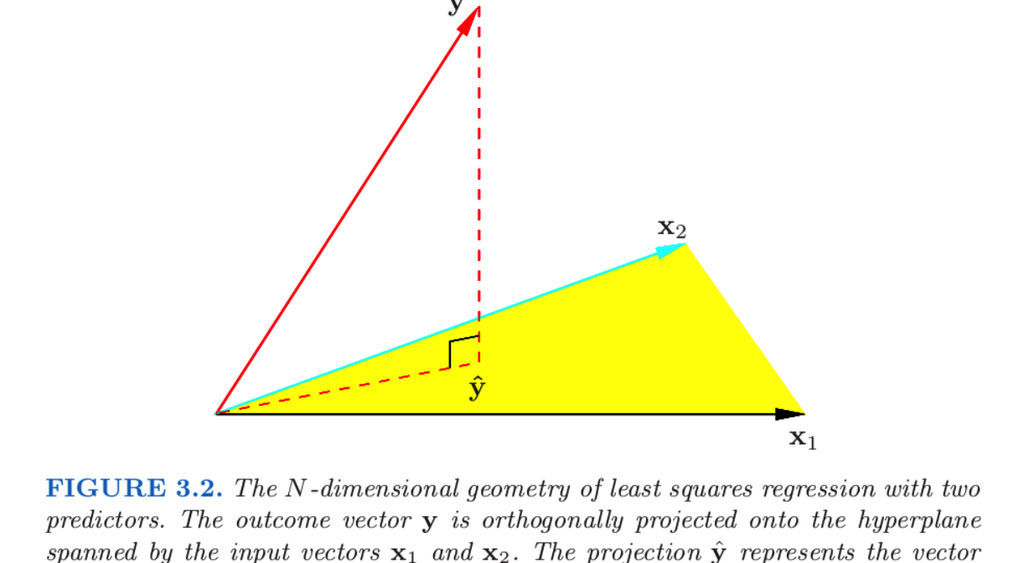
2. Projections

Slide 8
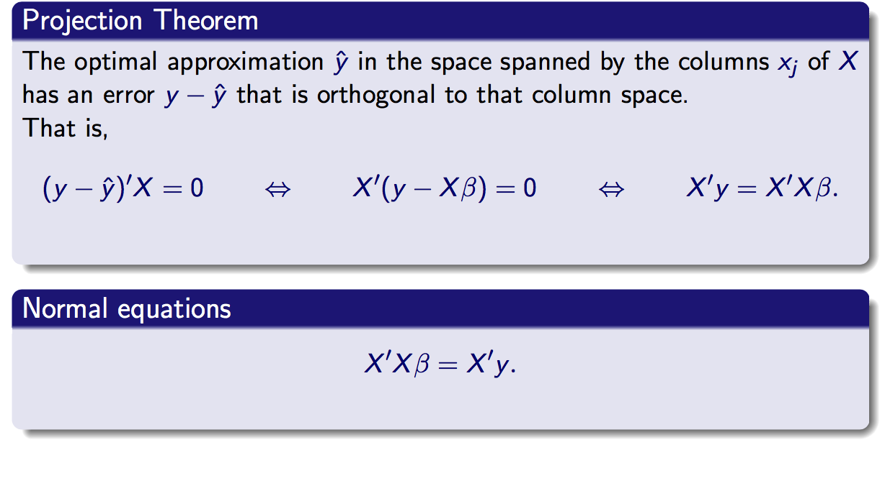
2. Projections

Slide 9
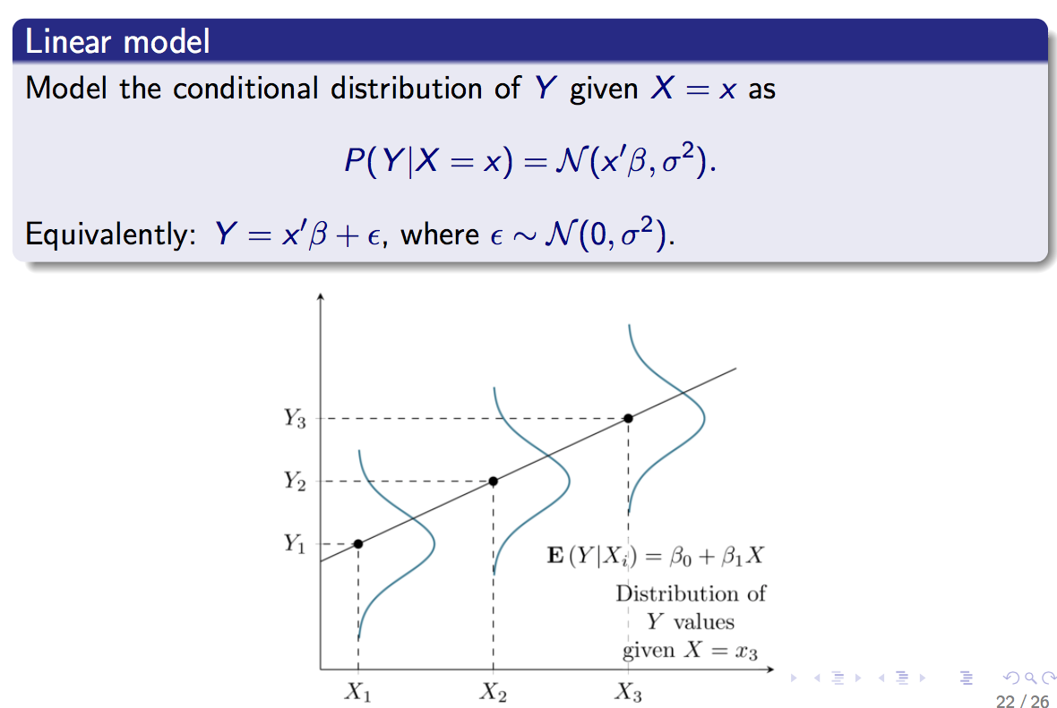
3. Gaussian noise

Slide 10
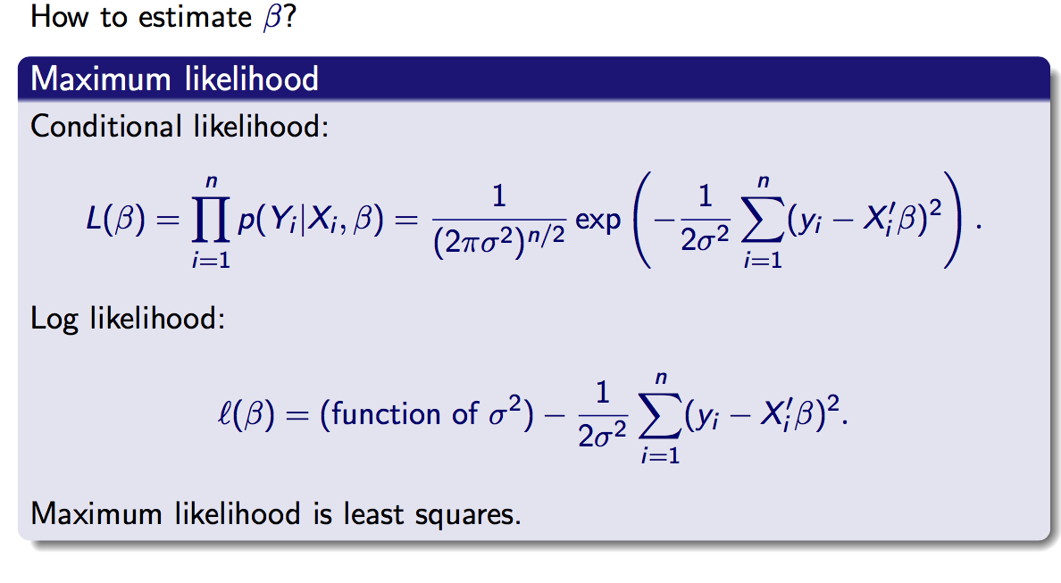
3. Gaussian noise

Slide 11
3. Gaussian noise
HW 3 – first problem has a question on this ☺

Slide 12
Bias & Variance
Bias:
Incorrect assumptions in your model
Your algorithm is only able to capture models of complexity <= C, but the true model complexity is C’ > C
Variance
Sensitivity of your algorithm to noise in the data.
How much your model changes per “unit” change in the data.

Slide 13
Bias & Variance
Bias vs. variance is a tradeoff
Bias
you assume data is linear, when it’s nonlinear.
Variance
you assume data could be polynomial, when it’s always linear.
By assuming data could be polynomial, lots of free parameters that move around if the training data changes.
High variance = “overfitting”

Slide 14
Bias & Variance
If variance if too high, will often add bias in order to reduce variance.
This is the reason regularization exists.
Increase bias, reduce variance.
Usually depends on amount of data
More data → fix down all those free parameters.
Will revisit this with random forests.

Slide 15
Problem 1
a) Do at home
b) Follow the Gaussian noise interpretation of linear regression

Slide 16
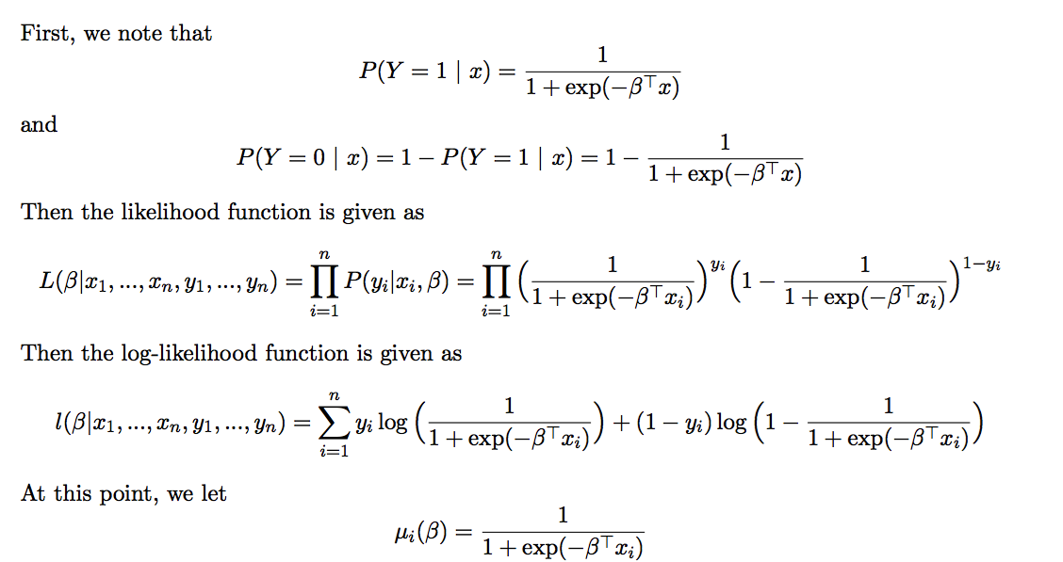
Problem 2
Credit: Yun Park

Slide 17
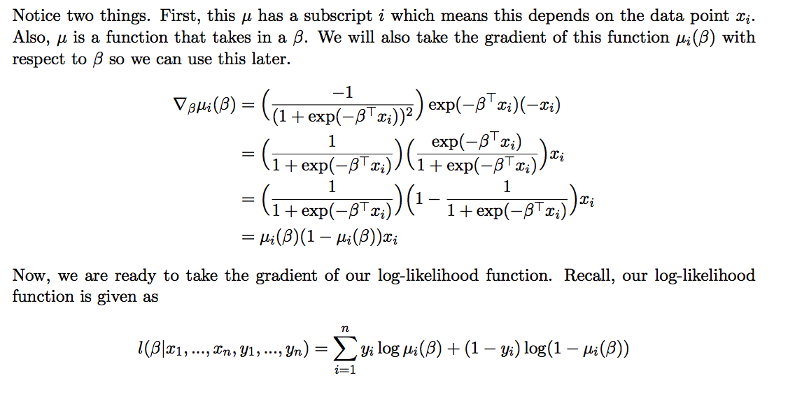
Problem 2
Credit: Yun Park

Slide 18
Problem 3 & 4
3) Write loss function, find derivative.
4) Practice problems
“Extra for experts” is inaccurate – there is a very simple answer.

