Slide 1

CS 189
Brian Chu
brian.c@berkeley.edu
Office Hours:
Cory 246, 6-7p Mon. (hackerspace lounge)
twitter: @brrrianchu
brianchu.com

Slide 2
Agenda
Tips on #winning HW
Lecture clarifications
Worksheet
Email me for slides.

Slide 3
HW 1
Slow code?
Vectorize everything.
In Python, use numpy slicing. MATLAB, use array slicing
Use matrix operations as much as possible.
This will be much more important for neural nets.

Slide 4
Examples
A = np.array([1, 2, 3, 4])
B = np.array([1, 2, 3, 5])
Find # of differences between A and B:
np.count_nonzero(A == B)

Slide 5
How to Win Kaggle
Feature engineering!
Spam: add more word frequencies
Other tricks: bag of words, tf-idf
MNIST: add your own visual features
Histogram of oriented gradients
Another trick that is amazing and will guarantee you win the digits competition every time so I won’t tell you it.

Slide 6
The gradient is a linear operator
R[w] = (1/N) Σ_{k=1:N} L( f(x^{k}, w), y^{k} )
True (total) gradient:
w_{i} ← w_{i} - η ∂R/∂w_{i}
w ← w - η ∇_{w}R ∇_{w}R =[∂R/∂w_{i}]
Stochastic gradient:
w_{i} ← w_{i} - η ∂L/∂w_{i}
w ← w - η ∇_{w}L ∇_{w}L =[∂L/∂w_{i}]
∇_{w} R[w] = (1/N) Σ_{k=1:N} ∇_{w} L( f(x^{k}, w), y^{k} )
The total gradient is the average over the gradients of single samples, but…
Notes:
Any questions about this slide?

Slide 7
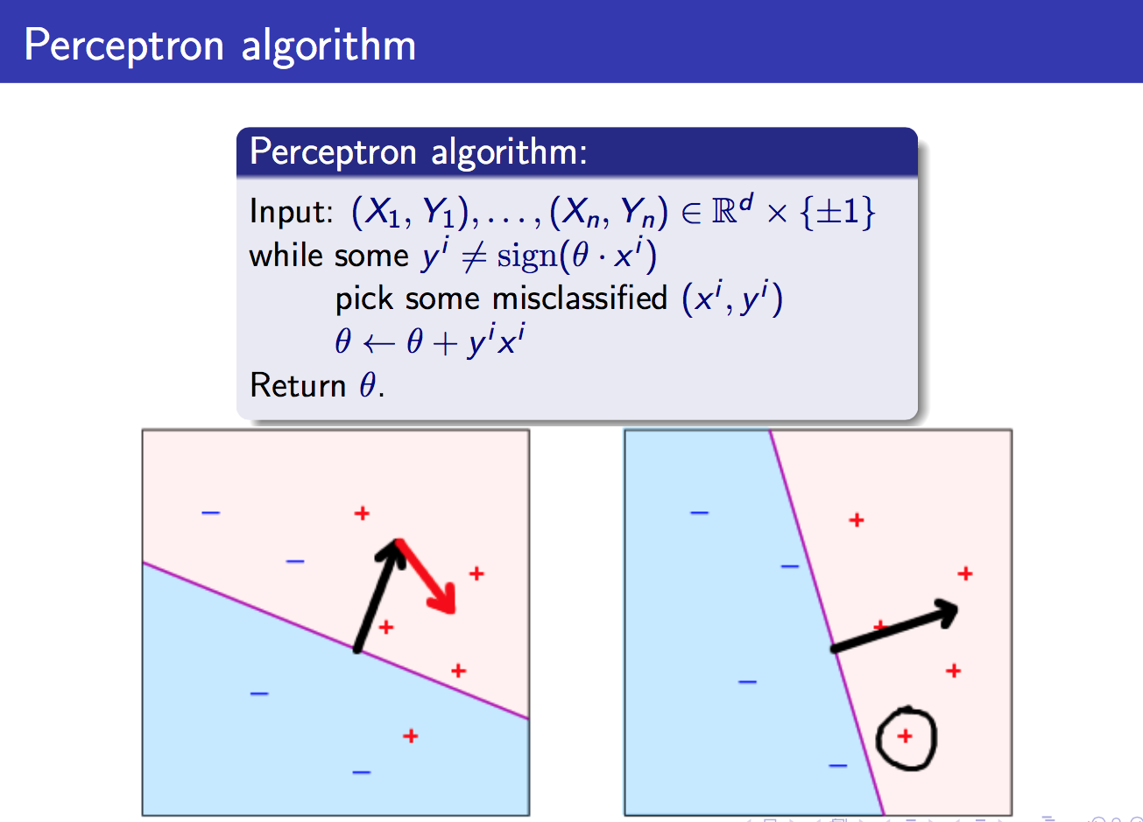

Slide 8
Example: the Perceptron algorithm
Rosenblatt, 1957
f(x) = Σ_{i} w_{i} x_{i}
z = y f(x) = Σ_{i} w_{i} y x_{i}
∂z/∂w_{i} = y x_{i}
L_{perceptron} = max(0, -z)
Δw_{i} = -η ∂L/∂w_{i}
= -η ∂L/∂z . ∂z/∂w_{i}
Δw_{i} =
Like Hebb’s rule but for misclassified examples only.
L(f(x), y)
Decision boundary
Perceptron loss max(0, -z)
z=y f(x)
missclassified
0
well classified
η y x_{i}, if z<0 (misclassified example)
0 otherwise

Slide 9
Concept
Regularization – any method penalizing model complexity, at expense of more training error
Does not have to be (but is often) explicitly part of loss function
Model complexity = how complex of a model your ML algorithm will be able to match
number / magnitude of parameters
how insane of a kernel you use ☺
Etc.

Slide 10
Concept
Assuming x is in R^{d}
L^{p}-norm of x = ||x||_{p} = (|x₁|^{p} + |x₂|^{p} + …)^{1/p}
L⁰-norm of x = ||x||₀ = # of non-zero components (not really a norm)
L¹-norm of x = ||x||₁ = (|x₁| + |x₂| + …) = |x|
^{L2}-norm of x = ||x||₂ = sqrt(x₁² + x₂² + … x_{d}²)

Slide 11
SRM Example (linear model)
S₁⊂ S₂ ⊂ … S_{N}
Rank with ǁwǁ² = Σ_{i} w_{i}²
S_{k} = { w | ǁwǁ² < ω_{k}² }, ω₁<ω₂<…<ω_{n}
Minimization under constraint:
min R_{train}[f] s.t. ǁwǁ² < ω_{k}²
Lagrangian:
R_{reg}[f,γ] = R_{train}[f] + λ ǁwǁ²
R
“L2 – regularization”
capacity
Notes:
Ridge regression : use nested subsets with slowly increasing the parameters norm
To be correct on should use lambda (norm(w) – omega)
But this can be simplified by omitting omega since by derivating w.r.t. w this does not change the result.

Slide 12
Multiple Structures
Shrinkage (weight decay, ridge regression, SVM):
S_{k} = { w | ǁwǁ₂< ω_{k} }, ω₁<ω₂<…<ω_{k}
γ₁ > γ₂ > γ₃ >… > γ_{k} (γ is the ridge)
Feature selection:
S_{k} = { w | ǁwǁ₀< ν_{k} },
ν₁<ν₂<…<ν_{k} (ν is the number of features)
Kernel parameters k(s, t) = (s • t + 1)^{q} :
q₁<q₂<…<q_{k} (q is the polynomial degree)
k(s, t) = exp(-ǁs-tǁ²/σ²)
σ₁ > σ₂ > σ₃ >… > σ_{k} (σ is the kernel width)
Notes:
0-norm : is the nb of parameters (hard clipping of the parameter vector)

Slide 13
Equivalent formulations
ǁwǁ = 1
⇔
M = 1/ ǁwǁ
M_{opt} = max (1/ ǁwǁ)
s.t. min_{k}(y^{k}f(x^{k})) = 1
M_{opt} = argmax_{w} (min_{k}(y^{k}f(x^{k}))
x₂
x₂
f(x) = 0
f(x) = 0
w
w/ǁwǁ
f(x) = M
f(x) = 1
f(x) = -M
f(x) = -1
x₁
x₁
13
Notes:
||w|| = 1 is just fixed that way
Min → closest point k
Find w maximizing that distance (note that f(x) is sum w_i * x_i = w dot x)
Optimization problem (max margin, subject to fact that closest points are on margin) (we define margin to be 1)

Slide 14
Optimum margin
Hard margin
Soft margin
M = 1/ ǁwǁ
M_{opt} = max (1/ ǁwǁ)
s.t. min_{k}(y^{k}f(x^{k})) = 1
min R_{reg}[f] = R_{train}[f] + λ ǁwǁ²
x₂
x₂
Use the hinge loss
f(x) = 0
f(x) = 0
w
w
f(x) = 1
f(x) = 1
f(x) = -1
f(x) = -1
x₁
x₁
Notes:
Hard because constraint MUST be satisfied
Soft because constraint can be violated – just incurs a numeric score penalty
Soft margin – does not have to be linearly separable
Lambda penalizes small margins (low margins) → this is the inverse of C

