Slide 1

CS 189
Brian Chu
brian.c@berkeley.edu
Slides at: brianchu.com/ml/
Office Hours:
Cory 246, 6-7p Mon. (hackerspace lounge)
twitter: @brrrianchu

Slide 2
Agenda
Bias-variance decomposition
Conceptual problem
Worksheet

Slide 3
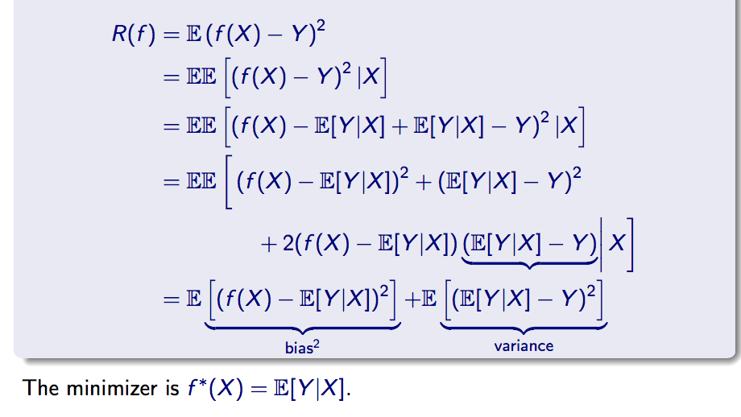
Bias-variance decomposition
Squared loss (linear regression):

Slide 4
Conceptual problem
We have a website where we collect hundreds of thousands of metrics on each registered user. We also track the length of each user’s session.
When a user visits the site, we try to predict the length of a user’s session using linear regression on those metrics.
Our model does really badly.
What can we try?

Slide 5
Conceptual problem
Reduce dimensionality – a hundred thousand features might be too much
PCA or something else.
Try regularization: L1 or L2 (implicitly reduces dimension)
Tangent: we can try both L1 and L2, which is called elastic-net regularization
Manually select features / engineer features
Try something else (kernel, regression trees, etc.)

Slide 6
Midterm
Heavy conceptual emphasis. (half)

Slide 7
1. Check your dimensions!
Gradient
Hessian

Slide 8
2. Review all material
Review homework, discussion worksheets, solutions, old midterms.

Slide 9
Major topics
Risk/loss functions, Matrix calculus, (stochastic) gradient descent
Hebb’s rule, perceptron, SVMs, logistic regression, linear regression
Using kernels in each of these methods
Model selection, Fit vs. robustness, regularization
Performance evaluation (Bonferroni, bootstrap, etc.)
LDA, PCA, Gaussian classifiers
the linear algebra related to dealing with covariance matrices, invertibility, eigenvalues/eigenvectors

