Slide 1

CS 189
Brian Chu
brian.c@berkeley.edu
Slides at: brianchu.com/ml/
Office Hours:
Cory 246, 6-7p Mon. (hackerspace lounge)
twitter: @brrrianchu

Slide 2
Agenda
Questions?
Tuning using test set
Dual
Vocab
HW
Worksheet

Slide 3
Someone didn’t take 189…
ImageNet competition (ILSVRC)
Human error: 5.1%
Jan 13, 2015, Baidu: 5.98% test error
Feb. 6, Microsoft Research: 4.94%
Feb. 11: Google: 4.8%
May 11, new Baidu error: 4.58%

Slide 4
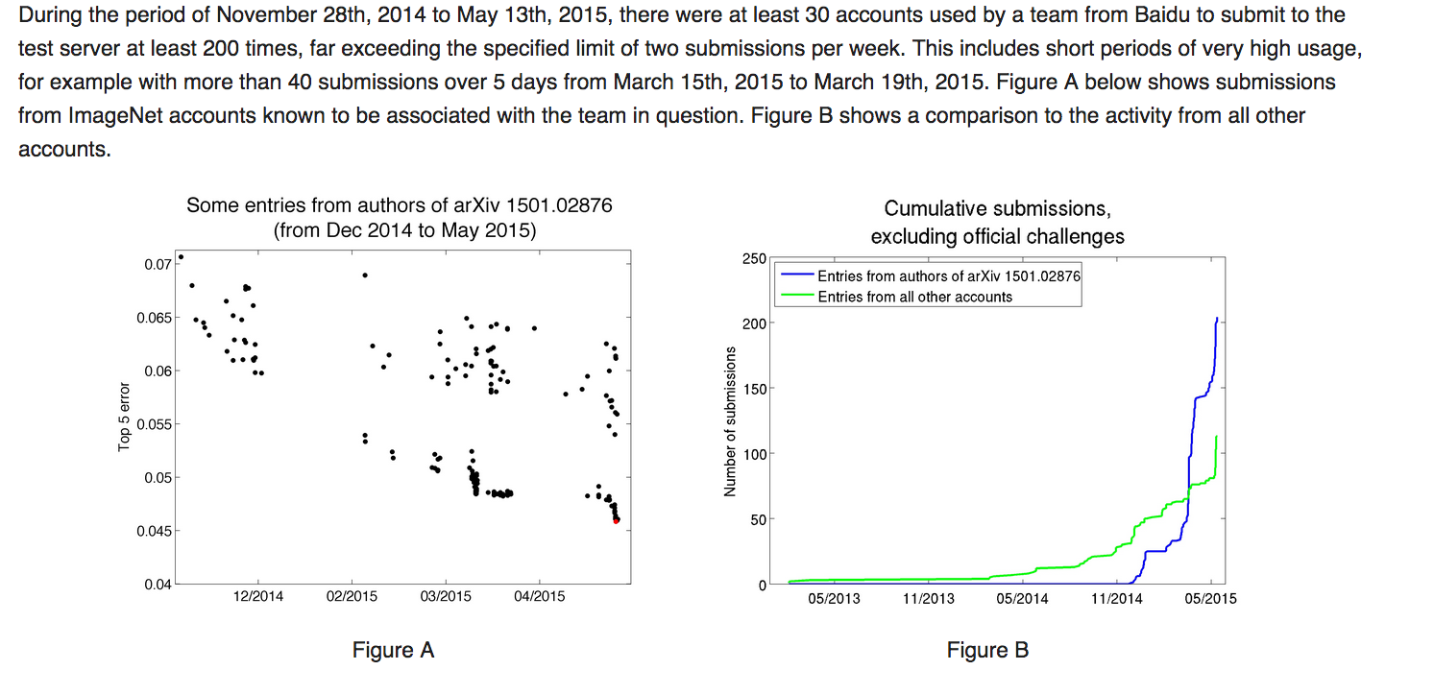
Someone didn’t take 189…

Slide 5
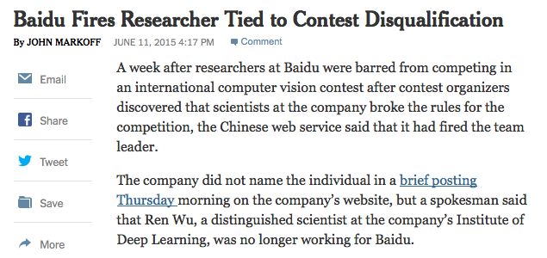

Slide 6
Dual example
Left pseudo-inverse
Right pseudo-inverse
Notes:
Left psuedoinverse

Slide 7
Dual example
For all of the linear classification algorithms in this class, you can derive that w is a linear combination of the training vectors.
Different derivations for each algo.
Different update rules.
But it exists.

Slide 8
Vocab
Leave one out cross-validation – cross validation where k (number of folds) = n (number of training points).

Slide 9
HW – logistic derivation
Take gradient of sum
Make dimensions match up
Pack back into matrix naively
(literally the first thing you think of that matches the dimensions will probably work)
If you want, verify the packing is correct by expanding it

Slide 10
HW – logistic derivation
See the note on Piazza – make sure not to confuse yourself with the elementwise notation

Slide 11
HW – Hessian derivation
Take 2 derivatives of sum.
Make dimensions match up
Pack back into matrix naively
(literally the first thing you think of that matches the dimensions will probably work)
If you want, verify the packing is correct by expanding it

