Slide 1

CS 189
Brian Chu
brian.c@berkeley.edu
Slides at: brianchu.com/ml/
Office Hours:
Cory 246, 6-7p Mon. (hackerspace lounge)
twitter: @brrrianchu

Slide 2
Questions?

Slide 3
Hot stock tips:
You should attend more than one section.
Each of us has a completely different perspective / background / experience

Slide 4
Feedback
http://goo.gl/forms/IGD3KkxbA0

Slide 5
Agenda
Dual clarification
LDA
Generative vs. discriminative models
PCA
Supervised vs. unsupervised
Spectral Theorem / eigendecomposition
Worksheet

Slide 6

Dual form exists for any:
Any weight vector that is a function of a linear combination of the training examples
gradient descent (additive updates)
Other cases

Slide 7
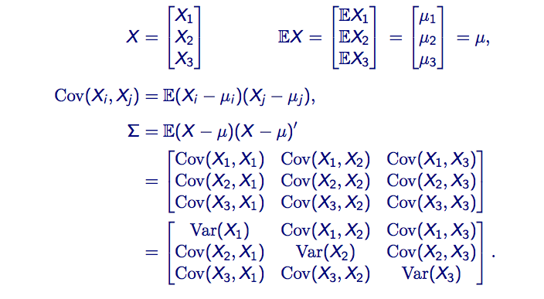
Covariance matrix
= E[X_{i}X_{j}] – E[X_{i}]E[X_{j}]

Slide 8
LDA
Assume data for each class is drawn from Gaussian, with different means but same covariance
Use that assumption to find a separating decision boundary

Slide 9
Generative vs. discriminative
Some key ideas:
Bias vs. variance
Parametric vs. nonparametric
Generative vs. discriminative

Slide 10
Generative vs. discriminative
Generative: use P(X|Y) and P(Y) → P(Y|X)
Discriminative: skip straight to P(Y|X)
just tell me Y!
Q: How are they different?
Are these generative or discriminative:
Gaussian classifier, logistic regression, linear regression.

Slide 11
Spectral Theorem / eigendecomposition
Any symmetric real matrix X can be decomposed as X = UΛU^{T}
where Λ = diag(λ₁,…, λ_{n}) (on the diagonal are n real eigenvalues)
U = [v₁,…, v_{n} ] = n orthonormal eigenvectors
Orthonormal → U^{T}U = UU^{T} = I

Slide 12
PCA
Find the principal components (axes of highest variance)
Use eigenvectors/eigenvalues (highest eigenvalues of covariance matrix)

Slide 13
Supervised vs. unsupervised
LDA = supervised
PCA = unsupervised (analysis, dimensionality reduction)

Slide 14
Worksheet
Bayes Risk = optimal risk (minimal possible risk)
Bayes classifier = what’s our decision boundary?

Slide 15
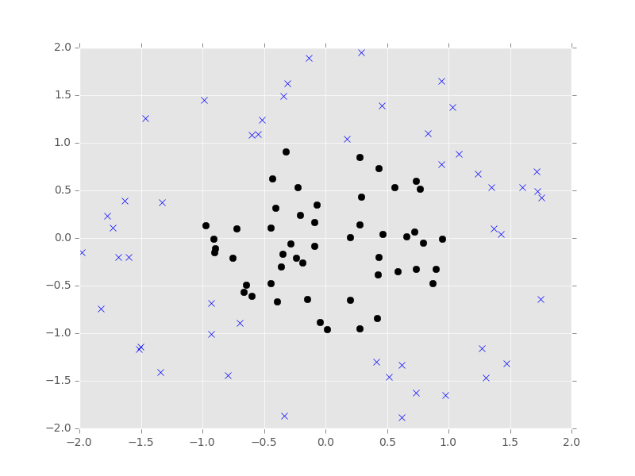
Worksheet

