Slide 1

CS 189
Brian Chu
brian.c@berkeley.edu
Slides at: brianchu.com/ml/
Office Hours:
Cory 246, 6-7p Mon. (hackerspace lounge)
twitter: @brrrianchu

Slide 2
Agenda
Bias-variance decomposition
Gaussian → Logistics
MLDemos
Worksheet

Slide 3
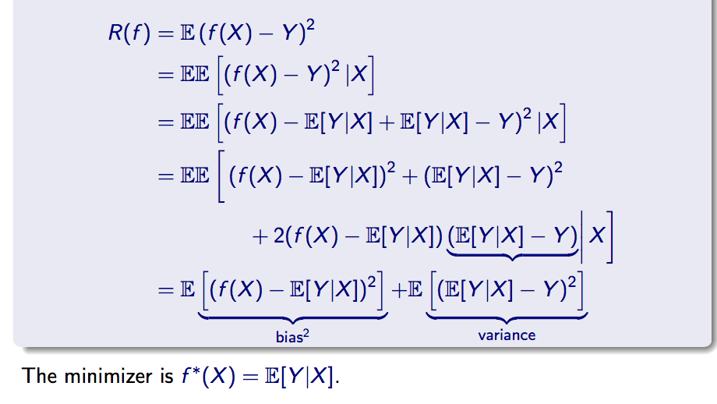
Bias-variance decomposition
Squared loss (linear regression):
Note: E_{X}[(f(X) – E[Y|X])(E[Y|X] – Y) | X] =
(f(X) – E[Y|X])E_{X}[E[Y|X] – Y| X] = (f(X) – E[Y|X]) * 0 = 0,
since for a given value of X, (f(X) – E[Y|X]) is constant

Slide 4
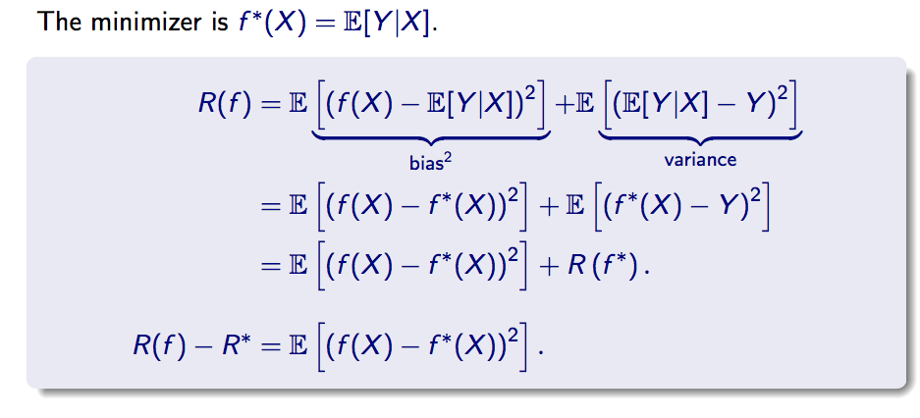
Bias-variance decomposition

Slide 5
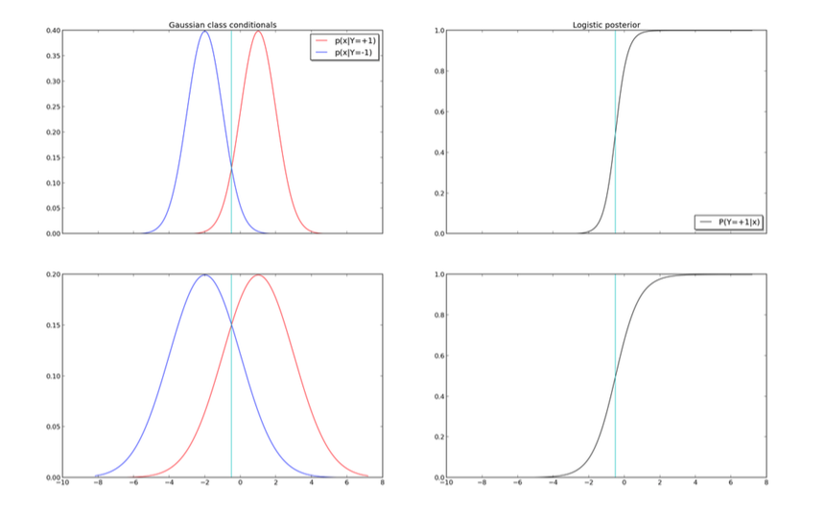
Gaussian → Logistics
Not required for logistic regression
See worksheet for more on this.

Slide 6
Maximum Likelihood Estimation (MLE) Maximum a posteriori (MAP)
MLE = MAP with uniform prior
Various forms of regularization = MAP with certain priors (see worksheet)

Slide 7
MLDemos

