Slide 1
Process Manager Application
Presented by: Brandon Chung
Date: December 9, 2024

Slide 2
TABLE OF CONTENTS
01 Introduction
02 Problem Statement
03 Solution Overview
04 Architecture of the Application
05 Challenges Faced
07 Demo & Conclusion
06 Code Snippets

Slide 3
01 Introduction
Goal: Create a C application that allows users to monitor system processes.
Main Focus: Classify CPU and I/O bound processes.
Importance: Helps system performance monitoring.

Slide 4

02 Problem Statement
Challenges Addressed:
- Identify processes that consume CPU or I/O resources.
- Display real-time information on processes.
- Classify processes as CPU or I/O bound.
Important. Why?:
- A tool that can help monitor system performance.
- Can identify resource-hungry processes.

Slide 5
03 Solution Overview
Solution: A C application utilizing tlhelp32.h and windows.h to classify processes and display them.
Key feature: Displays process details (PID, Name, CPU or I/O Bound).
Key Feature: Classify processes based on resource consumption.

Slide 6
04 Architecture of the Application
Header Files Used:
- “windows.h”: access to windows API for process info
- “tl32help.h”: gives info on processes
Code Pipeline:
1. Gather data from windows API
2. Classify process (CPU vs I/O)
3. Display results in GUI

Slide 7
05 Challenges Faced
Adding a Clean GUI:
Used Windows API to set up a basic GUI.
Real-Time Data:
Added a refresh button to allow users to have real-time data.
Handling Process States:
Added error handling for process states that were unknown.

Slide 8
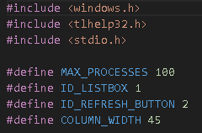
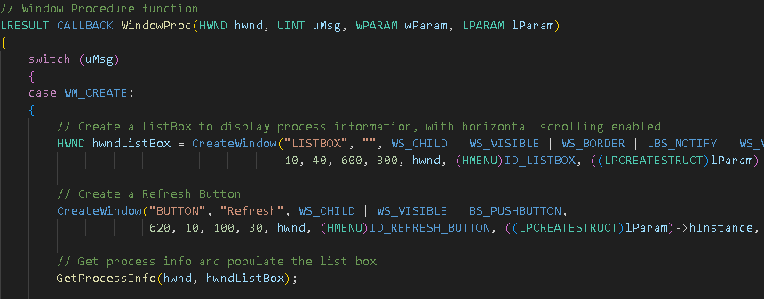
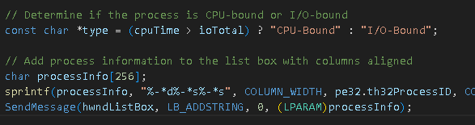
06 Code Snippets

Slide 9
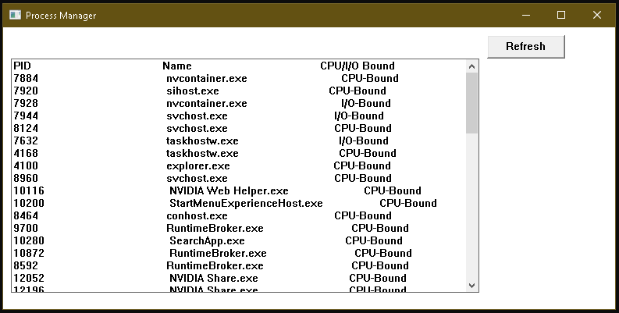
07 Demo & Conclusion

Slide 10

Thank You
Name: Brandon Chung
Panther ID: 002495106
Email: bchung9@student.gsu.edu

