Slide 1
Cancer Methylome Analysis
CLL vs. B-cells
Datascience 2019
Group 4: Leona Brandl, Carlotta Brüggen, Tim Kühn, Violetta Schaaf
Supervisor: Dr. Matthias Schlesner, Christian Heyer
Tutor: Valentina Giunchiglia
1

Slide 2
Are there significant differences in DNA methylation between cancer cells and healthy cells?
2

Slide 3
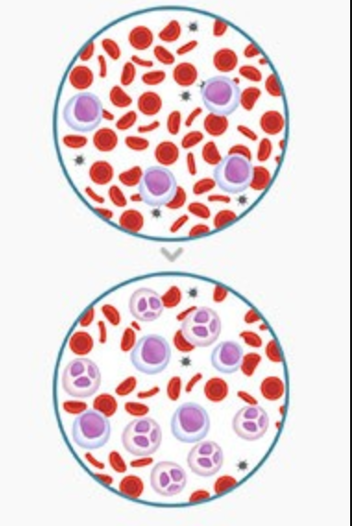
Chronic lymphocytic leukemia (CLL)
Uncontrolled proliferation and inhibition of apoptosis of B-Lymphocytes
functional incompetent
accumulate and displace healthy blood cells
Consequences
vulnerable for infections
less oxygen in the blood
longer bleeding in case of an injury
https://selpers.com/lektion/cll-verstehen-wie-entsteht-cll/
3

Slide 4
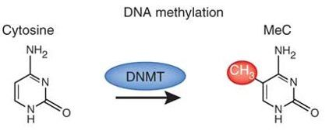
Methylation
Most common form of DNA methylation is 5‐methylcytosine
In CLL
Global hypomethylation compared to healthy cells ➔ activation of gene expression (e.g. ERB-A1) ➔ genomic instability
Hypermethylation of gene promoters ➔ inhibition of promoter activity (e.g. hTERT) ➔ affects tumor suppressor genes
Day, J.J., and Sweatt, J.D. (2010). DNA methylation and memory formation. Nature Neuroscience 13, 1319.
Important in epigenetics
Methylation leads to gene silencing
4

Slide 5
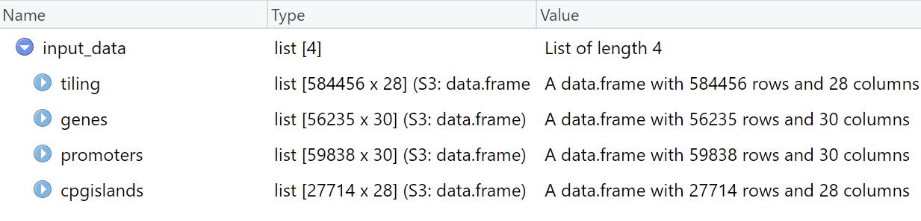
Datasets
Main dataset
CpG – islands
Regions in genome containing a high amount of CpG dinucleotides
~ 40% of mammalian promoters contain CpG islands
Control of transcription in (housekeeping) genes ➝ methylation could silence genes
5

Slide 6
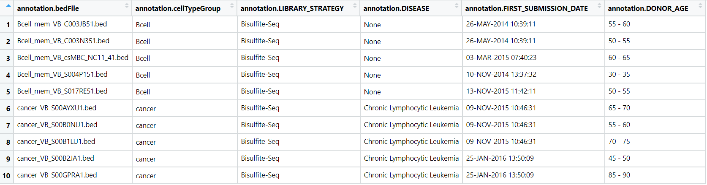
Datasets
Main dataset
Annotation
6

Slide 7
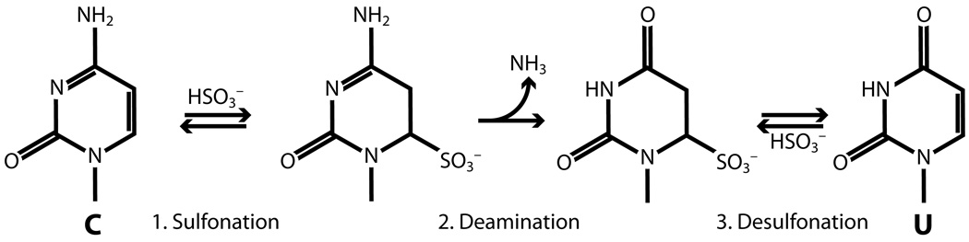
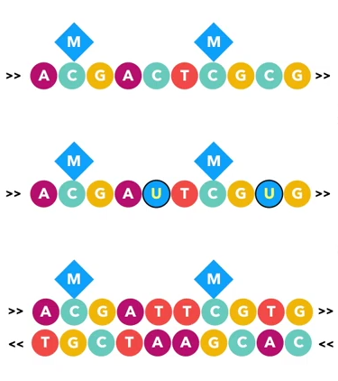

Bisulfite sequencing
5´
3´
Bisulfite conversion
5´
3´
β = $\frac{Cafter}{Cbeginning }$
PCR
5´
3´
3´
5´
7
https://www.youtube.com/watch?v=5NEoqa-k3xM&t=204s
(Teschendorff and Relton, 2017)
Darst RP, Pardo CE, Ai L, Brown KD, Kladde MP. Bisulfite sequencing of DNA. Curr Protoc Mol Biol. 2010;Chapter 7:Unit–7.9.17. doi:10.1002/0471142727.mb0709s91

Slide 8
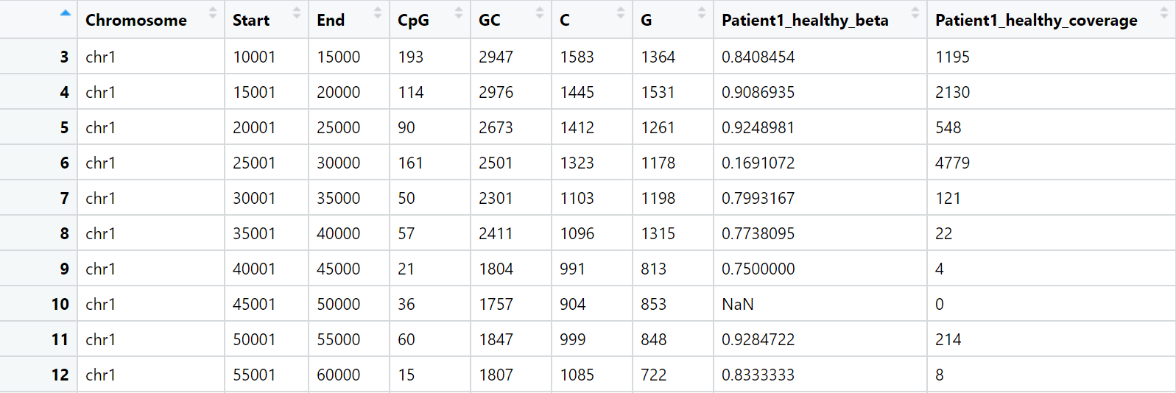
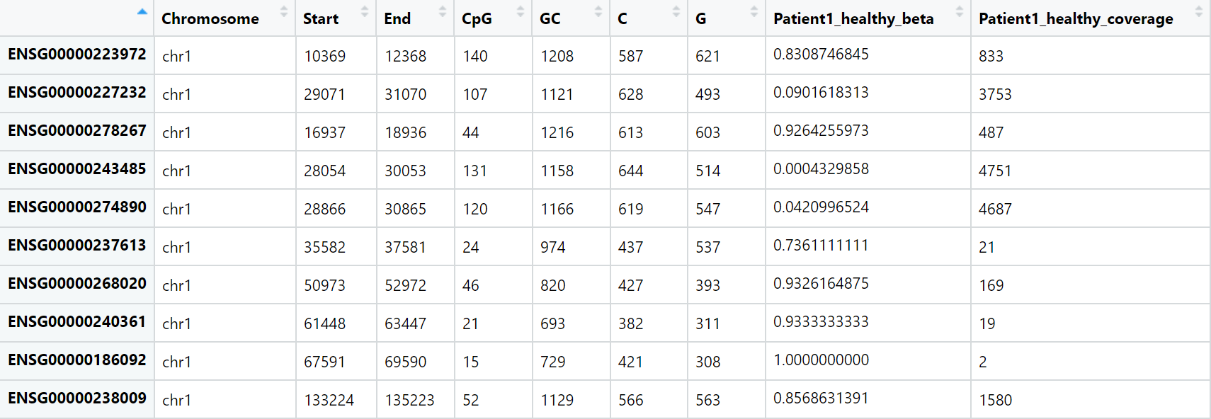
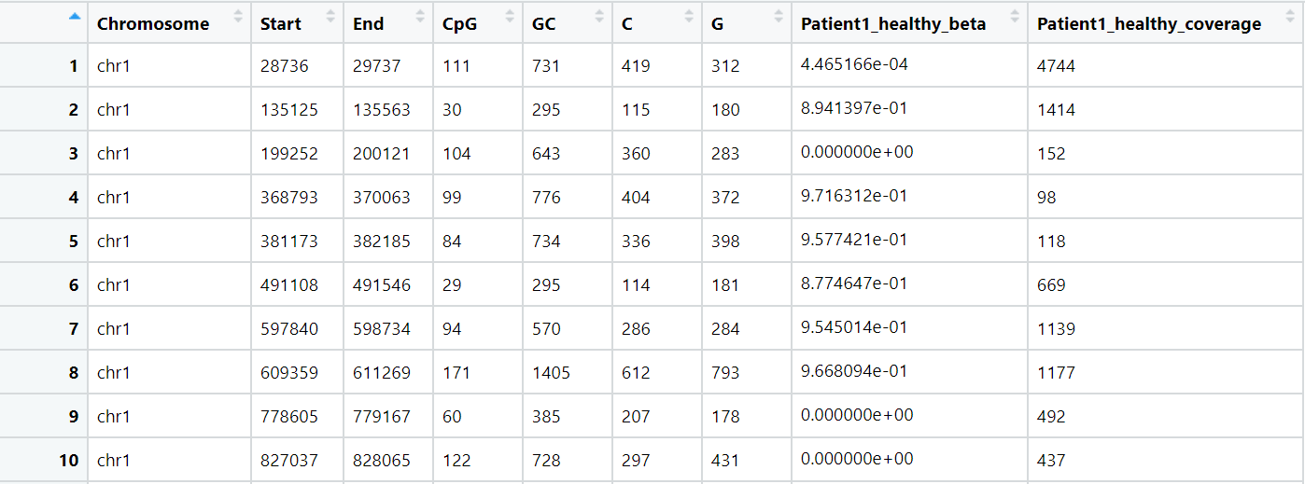
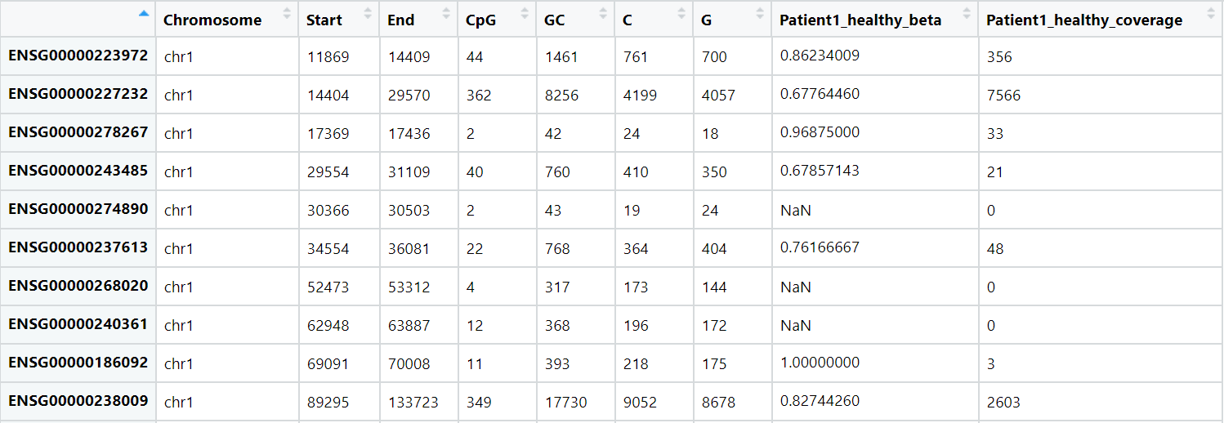
Main Dataset
Tiling
Promoters
CpG Island
Genes
8

Slide 9
Timeline
Visualisation
Data reduction
29.05.
26.06.
24.07.
Logistic regression
Data processing
Normalisation
Clustering
Identification of DMRs
Data interpretation
Create
Markdown document and presentation
12.06.
10.07.
9

Slide 10
Data processing
Reorganize the data
Divide dataset into four tables
Rename columns
Divide table into beta—values and coverage values
Divide table into healthy and sick patients
Quality control
Remove missing values
Remove senseless coverage values
29.05.
Make dataset easy to work with
Normalisation
Transform beta-values into M-values
Prepare data for statistical tests
10

Slide 11
Visualisation
12.06.
View distribution of methylation data
among all genes
at specific genes associated with CLL
By creating
boxplots or density plots of methylation data of sick and healthy B-cells
Get an initial view on distribution and maybe see a tendency
Data reduction
Feature selection
Dimensionality reduction (PCA)
Reduce dimensions to perform calculations easier
11

Slide 12
Clustering
26.06.
Perform k-means clustering
Cluster patients into meaningful groups
Identification of DMRs (Differentially methylated regions)
T-test to get significance of methylation differences
Scatter plot to visually identify different methylation levels of sick and healthy patients
Find systematic differences in methylation level in specific regions between sick and healthy cells
12

Slide 13
Logistic regression
10.07.
Using methylation data of genome regions to make predictions about the phenotype: cancer cells or healthy cells
To conclude from methylation data on cancer or health
13

Slide 14
Data interpretation
24.07.
Sum up results
Interpret results
Make biological conclusions
Create...
… a Markdown document
… a PP presentation
Present our project on 24th of July
14

Slide 15
Sources
Bock, C. (2012). Analysing and interpreting DNA methylation data. Nature Reviews Genetics 13, 705.
Cahill, N., and Rosenquist, R. (2013). Uncovering the DNA methylome in chronic lymphocytic leukemia. Epigenetics 8, 138-148.
Du, P., Zhang, X., Huang, C.-C., Jafari, N., Kibbe, W.A., Hou, L., and Lin, S.M. (2010). Comparison of Beta-value and M-value methods for quantifying methylation levels by microarray analysis. BMC Bioinformatics 11, 587.
Hallek, M. (2017). Chronic lymphocytic leukemia: 2017 update on diagnosis, risk stratification, and treatment. American Journal of Hematology 92, 946-965.
Mansouri, L., Wierzbinska, J.A., Plass, C., and Rosenquist, R. (2018). Epigenetic deregulation in chronic lymphocytic leukemia: Clinical and biological impact. Seminars in Cancer Biology 51, 1-11.
Teschendorff, A.E., and Relton, C.L. (2017). Statistical and integrative system-level analysis of DNA methylation data. Nature Reviews Genetics 19, 129.
16

Slide 16
Timeline
Visualization
Global view on methylation data
(eg. boxplot, density plot,…)
Data reduction
Feature selection
Dimensionality reduction (PCA)
29.05.
26.06.
24.07.
Logistic regression
To find predictions between variables
Data processing
Reorganize the data
Quality control
(coverage, NA)
Normalisation
M-value
Clustering k-means
Identify DMRs
Find systematic differences in methylation level between sick and healthy cells
(scatter plot, t-test)
Data interpretation
Sum up, interpret the results and make bological conclusions
Create
Markdown document Presentation
12.06.
10.07.
17

