Slide 1
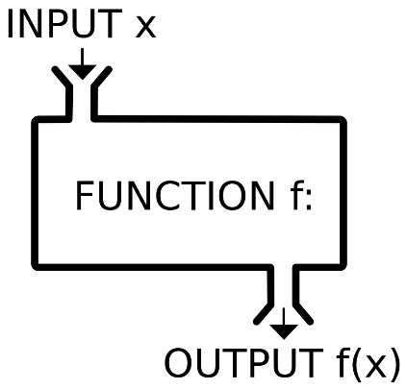
STEP 1: Include INTERMACS patients who were alive and provided follow-up data at time T.
Testing data
(2016 – 2017)
C-statistic, calibration, and Brier score.
STEP 5: Evaluate risk prediction function in the testing data.
INTERMACS data
INTERMACS, baseline + follow-up through time T
STEP 2: Split these data into training and testing sets.
STEP 4: Form risk prediction function using training data and selected modeling algorithm.
Training data
(2012 – 2015)
STEP 3: Select an optimal modeling algorithm using 100-fold cross validation.
(PMP)
Selected modeling
algorithm
Candidate modeling
algorithms
(>600,000)

