Slide 1
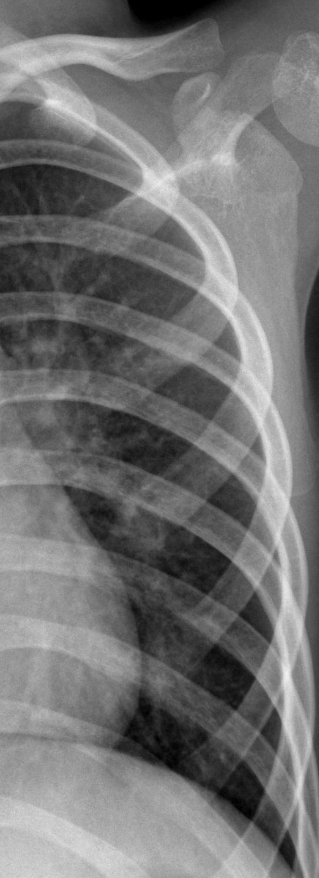


X-Ray pneumonia detection
A Deep Learning Approach
Notes:
Hello, thank you for joining me for today’s presentation. My name is Braydon Janecek and today we will be discussing a an approach to pneumonia detection using x-rays and computer vision.

Slide 2
Problem Statement
Covid-19
Available Testing
Available Data
Over a million confirmed cases and nearly one hundred thousand deaths in United States as of May 2020
Countries with less resources are likely undercounting due to difficulty of testing
US has tested over 10 million individuals for Covid-19
Many hospitals and testing centers are still facing shortages, especially rural areas
Confluence Health in Wenatchee, WA was unable to test patients for over a week in early May 2020
Radiologists may diagnose pneumonia using x-ray images
Public Covid-19 X-Ray data is extremely limited (73 total found)
Effective deep learning requires substantial data
Idea was to train model on more generalize pneumonia x-ray data and apply model to Covid-19 data

Slide 3
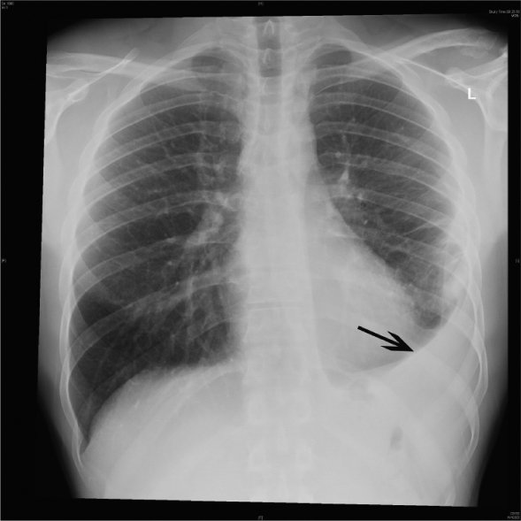
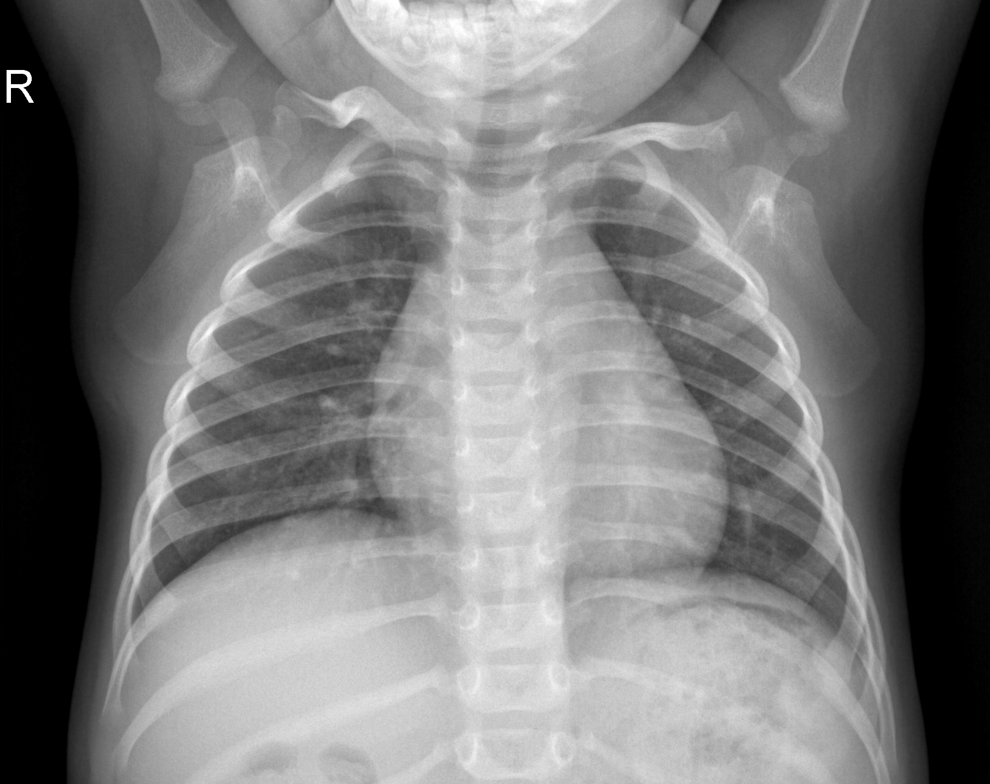
X-ray dataset
3,875 pneumonia
1,349 normal
Notes:
The dataset we trained our algorithm on consisted of 3,875 pneumonia cases and 1,349 normal cases.
Note the pulmonary effusion on the patients left lung in the photograph on the left. This is the type of features we attempted to train our models to pick up on.

Slide 4
Problem approach
Baseline Models – VGG16 Architecture
~73% Accuracy
Generalization Attempts
~75% Accuracy
Transfer Learning Approach – VGG16 and Xception
~83% Accuracy
Notes:
As with most image classification problems, our problem was well suited for deep learning
We elected to utilize a baseline model based on an architecture which had proven well on image classification problems, including the widely know benchmark ImageNet dataset
We proceeded to iterate on this model by making in more generalizable. We had a limited dataset to train on so we created augmented images in order to artificially increase the size of the training data
Finally, we utilized models which had been fully trained models on the large ImageNet themselves which led to our best results

Slide 5
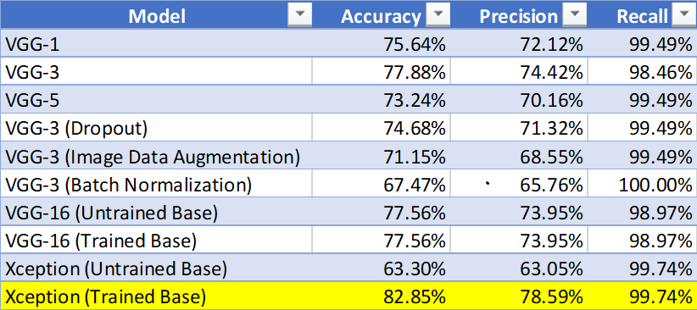
Final Model performance on test set
Notes:
Our best model had an accuracy of 82.85% on the test dataset which contained 390 pneumonia cases and 234 normal cases. Though it generated many false positives, our model could recognize 99.74% of all pneumonia cases. In the medical field it is obviously much more preferred to have a high FPR as opposed to a high FNR.
Disappointingly our model did not generalize well to our small Covid-19 dataset. The same model was capable of detecting 85% of the Covid-19 cases, however, its accuracy was around 60% which is hardly better than flipping a coin. There is certainly room for improvement here, however, more data is needed.

Slide 6


Future work
Train on More Data
Explore More Models
Better Prepare Images
Obtain more data (specifically Covid-19 patients)
Generate more x-ray images data using deep learning
Thousands of CNN models are now open source and available on the web
Train models at scale using cloud-based GPUs
Each x-ray image came in a different size and aspect ratio
Our images were “squashed” to a consistent size for training
This likely distorted the images making training less effective
Mechanical Turk cropping

Slide 7
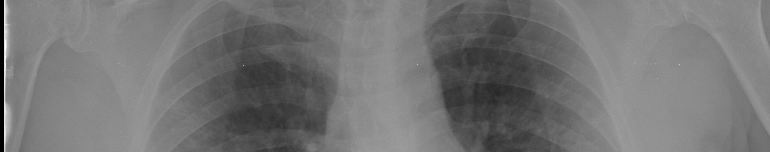


THANK YOU
Braydon Charles Janecek
braydoncharlesjanecek@gmail.com
https://bcjanecek.github.io/

