Slide 1
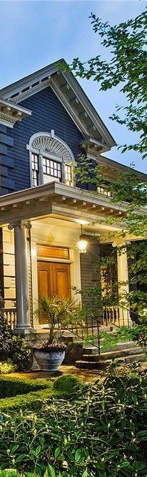

Residential real estate investing
Bargain Hunting in a Hot Market

Slide 2
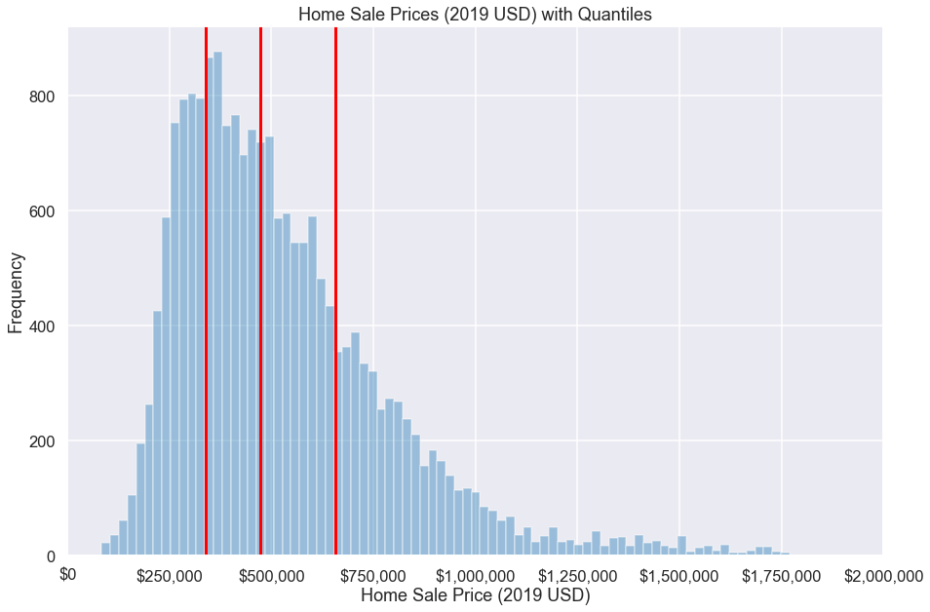

Home sale price distribution (2015-2016)
Notes:
Hot Market – great jobs, high growth, rich culture, outdoor recreation, desirable place to live overall
Median Home Values = $472k adjusted to 2019 USD
What type, where, and when can an investor find a bargain?
Answer with exploratory data analysis
Finally we’ll build a regression model which could serve as giving us an indication whether we’re looking at a good deal.
NOTES:
Eliminated outliers across all features more than 3 std away from mean – left us with about 19k of original 21k datapoints
This is acceptable for our purposes – our target investment properties are more likely in the $250-500k range

Slide 3
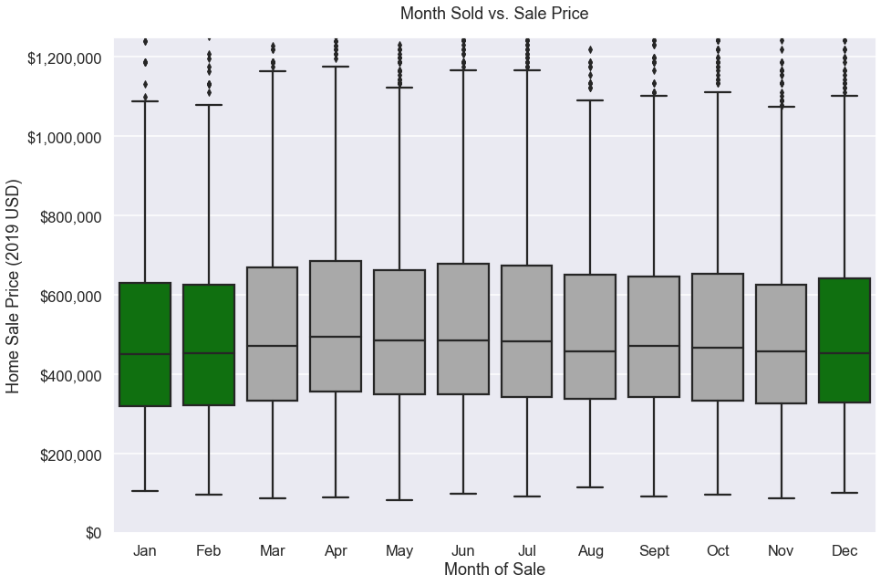
Buy at the right time
Best / Worst Month to Buy
January ($452k median)
April ($496k median)
Notes:
Easiest way to save money is buy during the winter!
Everyone is thinking about moving in over the summer before the kids go back to school.
Home buyers in April paid nearly a 10% premium compared to home buyers in January.

Slide 4
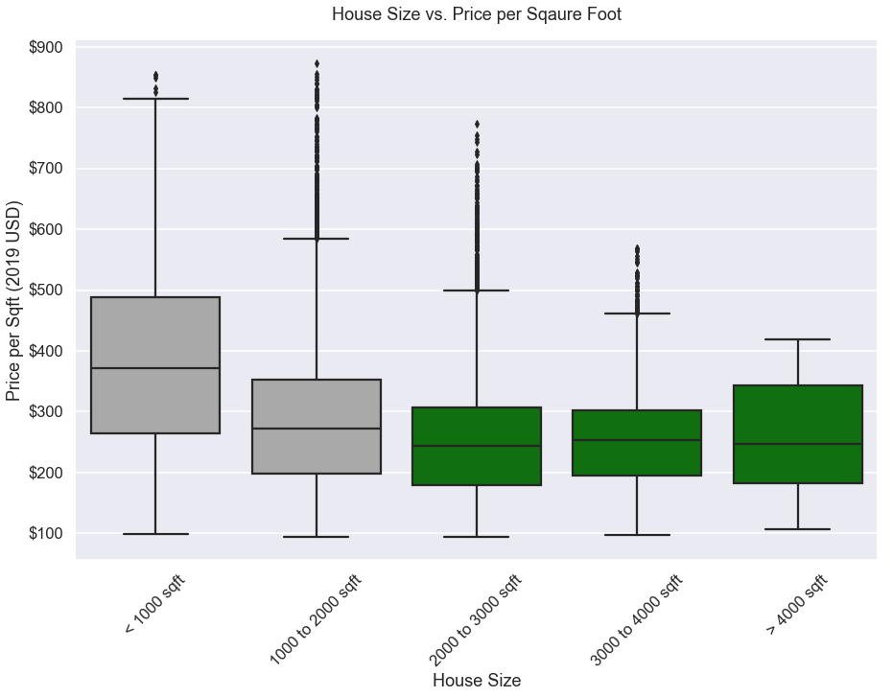

Buy the right size home
Notes:
Home sizes below 2,000 sf most expensive.
Buying home with at least 2,000 sf of living space makes sense for multiple reasons.
1. Homes over this size yield the best deal on a square foot basis.
2. If you wish to make a rental out of the unit having at least 2,000 sf will make your property ideal for young families - typical home renters.
3. If you wish to remodel your cost on a square foot basis will be less than it would be on a smaller home. Contractors typically charge a premium on smaller jobs to make them worth their time. If you plan to buy the materials, you can save money by buying in bulk on a larger job.
4. If you believe home values are to increase (which you wouldn’t be interested in investing if you didn’t) then your ROI will be greater on a larger home.

Slide 5
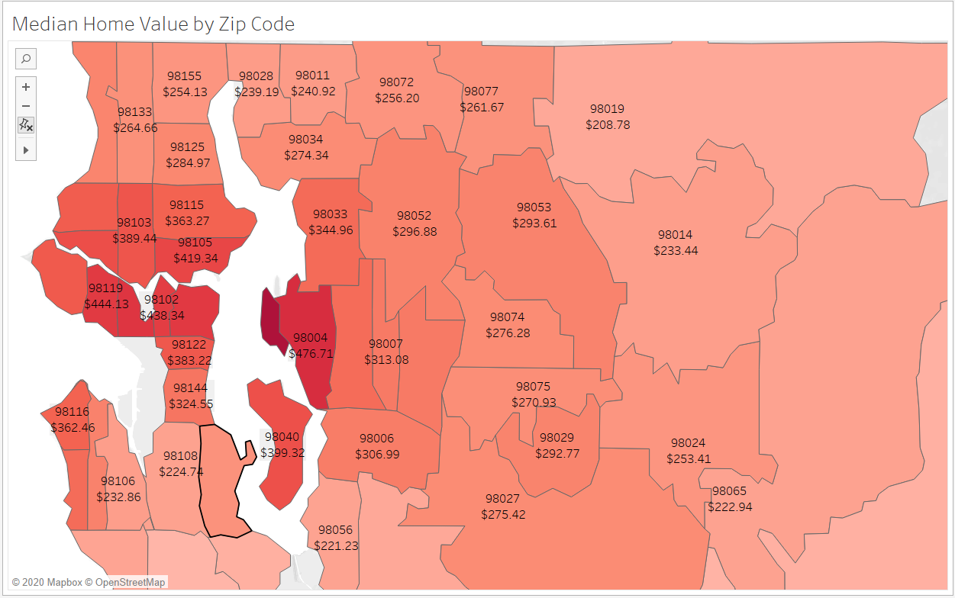
Shop the right neighborhoods
Favorite Neighborhoods
Kenmore, WA
Renton, WA
Snoqualmie, WA
Notes:
Each area is charming in its own way, has average to excellent school systems, and is a reasonable commute to major business hubs
1. Snoqualmie / North Bend area (98065) - growing rapidly as the Seattle metro area expands. Prices are currently reasonable with a median home value of $223/sf. 30 min commute to Redmond or Bellevue, and 35 min commute to downtown Seattle.
2. Renton area (98056) - this is an area with reasonable commute times to multiple business hubs. The area has a 20 min commute to Bellevue, a 30 min commute to Redmond, and a 20 minute commute to downtown Seattle. Median home prices are $221/sf.
3. Kenmore area (98028) - The area is a 25 min commute to Redmond or Bellevue, and a 35 min commute to Seattle. Median home prices are $239/sf.

Slide 6
Simple linear regression model
Top Six Features
Coefficient Interpretation Utility
Model Prediction Accuracy
Waterfront
Viewed
Square foot age of living area
Latitude
Longitude
Average income of zip code
Square footage of living area
Increasing square footage by 10% increases home value by 5.4%
Useful information for flip home financial model
Best model had RMSE of about $127k – not great considering median home value of $472k
Notes:
First look at top six features of model
Viewed is whether the home had been viewed previously by a potential buyer
Average income of zip code was engineered using KC zip codes and IRS data
Just these six features explained 77% of variance in model! Final model utilizing 22 features only had marginal increase in r-squared adjusted of 0.79.
Coefficient interpretation – use sf living as example, “model suggests that 10% increase in living space will lead to 5.4% increase in home sale price”; this could be useful when creating financial model for flip homes
RMSE not great! Prediction accuracy is questionable at best, however, determining relevant features of home price was much for valuable for us.

Slide 7
Future work
Consider School Districts
Future Business Hubs
Analyze Longer Time Frame
Advanced Regression Models
Parents are willing to pay more on housing to send kids to top schools
Engineer features describing public school quality for each zip code
City of Seattle is becoming less business friendly with tax policies
Companies such as Amazon and Microsoft are moving employees
Geographical analyses over time to find low key areas showing early signs of future growth
Ensemble methods such as gradient boosting decision trees
Push boundaries of overfitting data and use regularization
Leave outliers and use robust regression
Notes:
Future hubs – companies are moving employees and office to Redmond and Bellevue.. Are there any other up and coming business hubs?
Adv reg models – we were never close to overfitting, perhaps introduce more features and test again, introduce regularized models if necessary

Slide 8
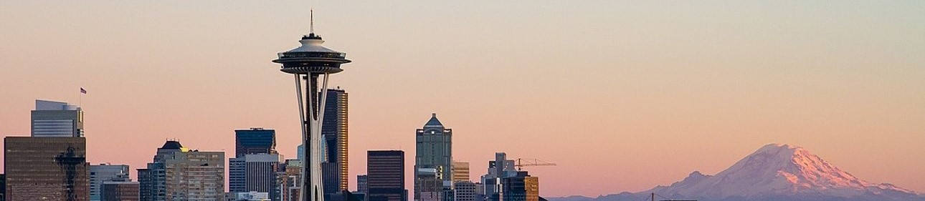


THANK YOU
Braydon Charles Janecek
braydoncharlesjanecek@gmail.com
https://bcjanecek.github.io/

