Slide 1



Machine learning in Cybersecurity
Network Intrusion Detection System
Notes:
Hello, thank you for joining me for today’s presentation. My name is Braydon Janecek and today we will be discussing a machine learning approach to cybersecurity, specifically network intrusion detection.

Slide 2

Problem Statement
Cybersecurity in 2020
The Dataset
Attack Categories
Intrusion Detection System
64% of companies have experienced web-based attacks
Small businesses target 43% of time
Average data breach to cost $150 billion
About six months to notice
DARPA Intrusion Detection Evaluation Program (1998)
MIT Lincoln Labs
Simulated 494k connections (benign and variety of attacks) in military network environment
Denial of Service (DOS)
User-to-Root (U2R)
Probe
Remote-to-Local (R2L)
Train various classifier on 494k connections containing 24 unique attack types
Test classifiers on 311k connections containing 38 unique attack types
Notes:
Go over 2020 Cybersecurity stats
Review dataset – collaboration between DARPA and MIT; simulated variety of attacks and normal connections and gathered network connection data
DOS: denial-of-service, e.g. syn flood;
R2L: unauthorized access from a remote machine, e.g. guessing password;
U2R: unauthorized access to local superuser (root) privileges, e.g., various ``buffer overflow'' attacks;
probing: surveillance and other probing, e.g., port scanning.
"Some intrusion experts believe that most novel attacks are variants of known attacks and the "signature" of known attacks can be sufficient to catch novel variants."
This dataset is obviously largely outdated but is the largest labeled network connection dataset available to the public at this point in time

Slide 3
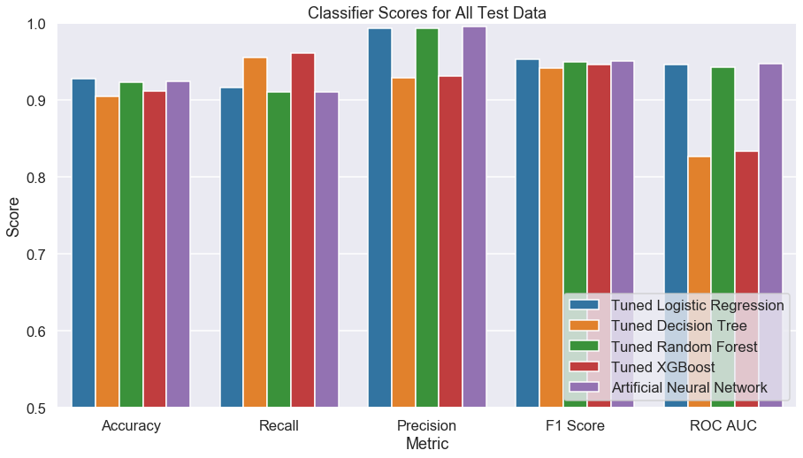
Final Model performance on test set
Notes:
Note precision/recall trade off for both logreg and ANN models; cutoffs could be tuned to lowered to recognize more attacks at expense of classifying more normal connections as attacks

Slide 4
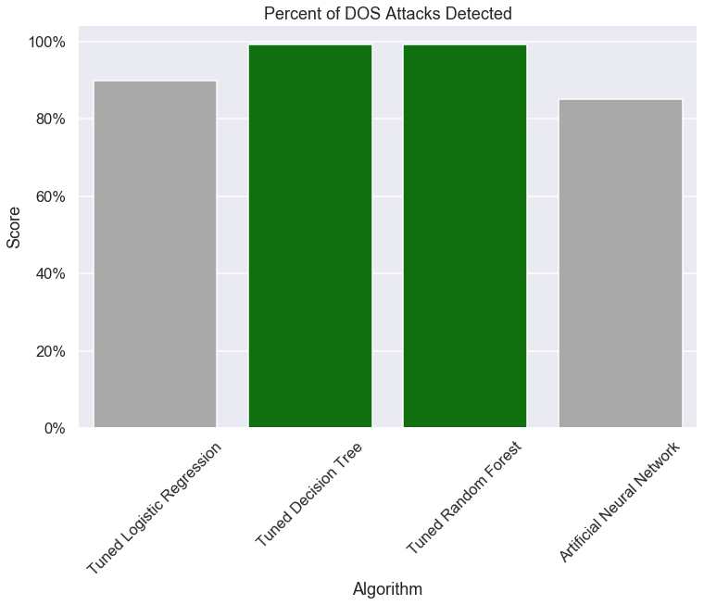
performance detecting dos attacks
Attacks Detected
Decision Tree: 99.2%
Random Forest: 99.2%
Notes:
Note on Performance: Different algorithms did a better job detecting different categories of attack therefore we are recommending a stacked model approach to the ISD which uses multiple models
Note we omitted XGBoost classifier (something is going wrong with our predictions on this dataset)

Slide 5
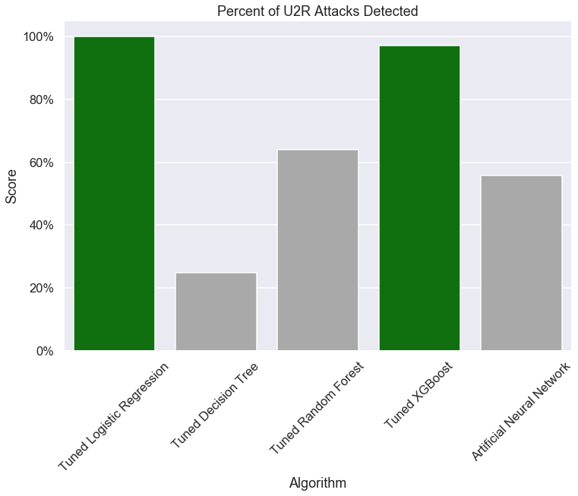
performance detecting U2R attacks
Attacks Detected
Logistic Regression: 100%
XGBoost: 97.1%

Slide 6
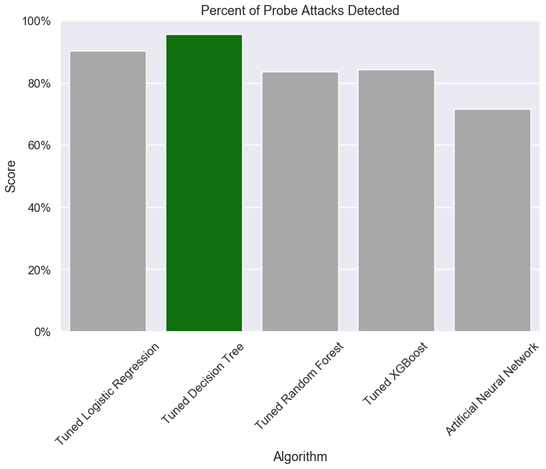
performance detecting Probe attacks
Attacks Detected
Decision Tree : 95.7%
Notes:
Unacceptable detection rate; gather more data to train on

Slide 7
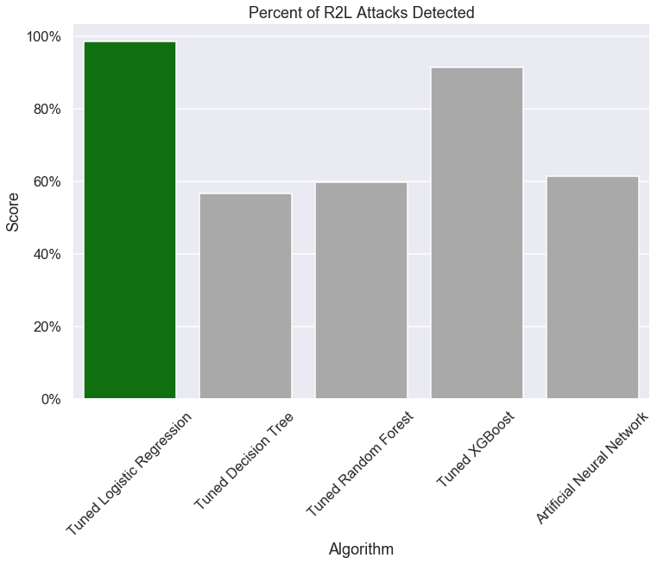
performance detecting r2l attacks
Attacks Detected
Logistic Regression: 99.2%

Slide 8


Future work
Employ Rigorous Feature Selection
Address Attack Category Class Imbalance
Spend More Time on Model Tuning
Test Anomaly Detection Methods
Many unimportant features could be hurting model accuracy
Employ advanced techniques to determine salient features
Most connections in training data were normal or DOS attacks (99%)
Address attack category imbalance or get more data
Specifically XGBoost and artificial neural network classifiers
Train model exclusively on “normal” connections
Test model to see if it can recognize abnormal connections (i.e. attacks)

Slide 9



THANK YOU
Braydon Charles Janecek
braydoncharlesjanecek@gmail.com
https://bcjanecek.github.io/

