Slide 1
Software Architecture
App Name: KidChore
Team Name: DebugZ
Benjamin Wong, Lei Shi, Natasa Trkulja, Kiahna Tucker, Varun Lalwani

Slide 2
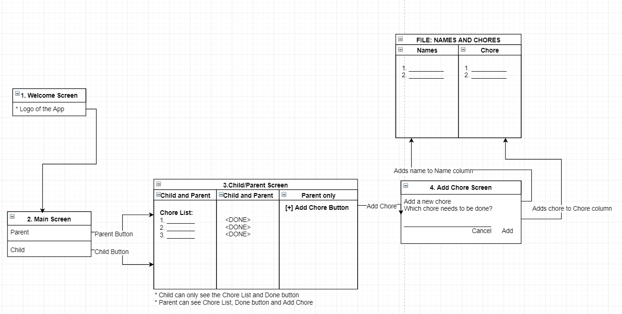
App Design

Slide 3
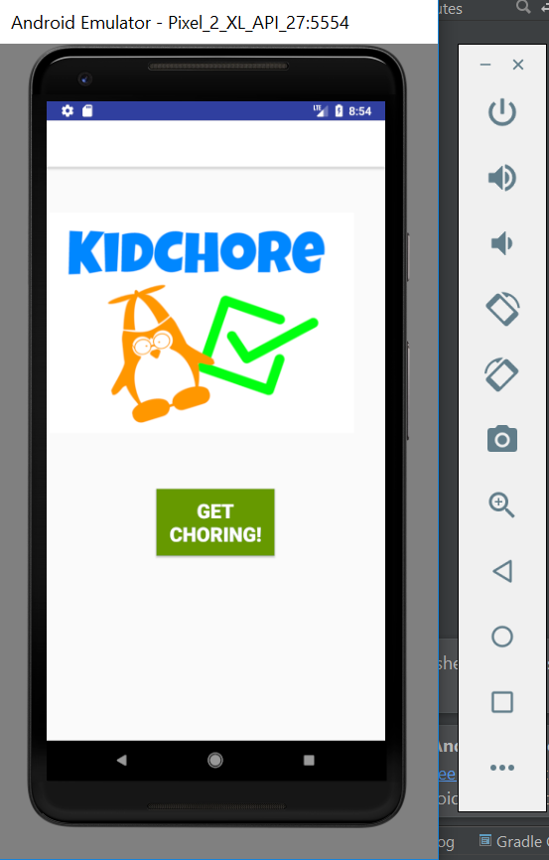
Welcome Screen
This is the welcome screen that appears when the app is opened

Slide 4
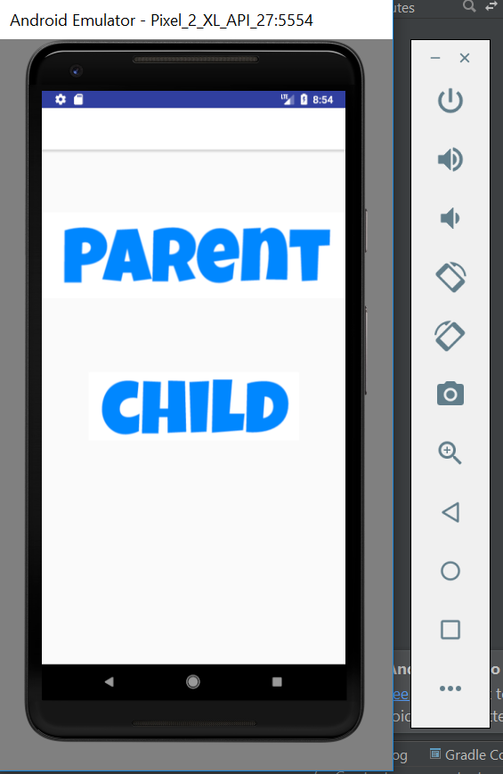
Main Screen
This is the main screen where the user can choose to go to the Parent screen or the Child screen

Slide 5
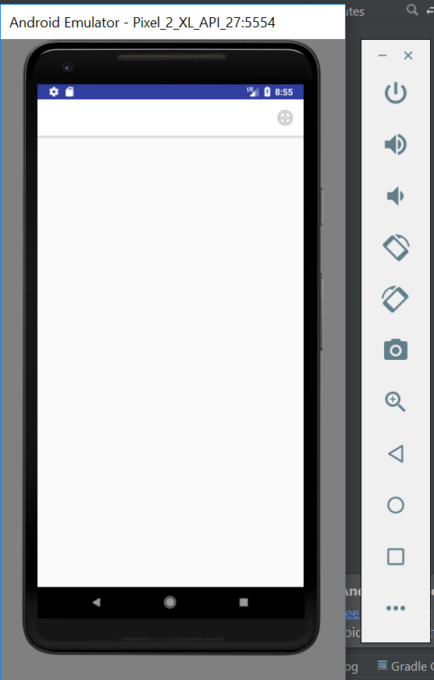
*Parent Screen 1
This is the Parent screen
The parent is able to add a chore
Press the “+” button top right to add a chore

Slide 6
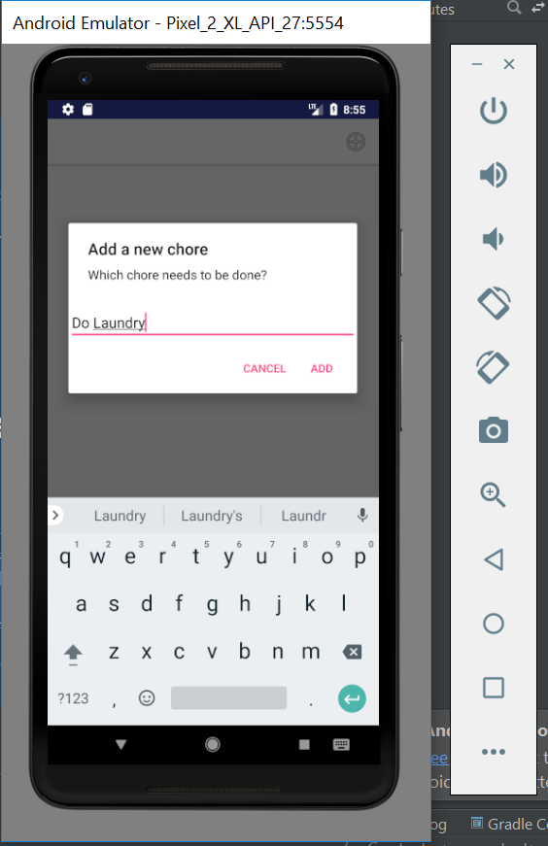
*Parent Screen Add Chore
After the “+” button is pressed, the parent can write in the chore and add it

Slide 7
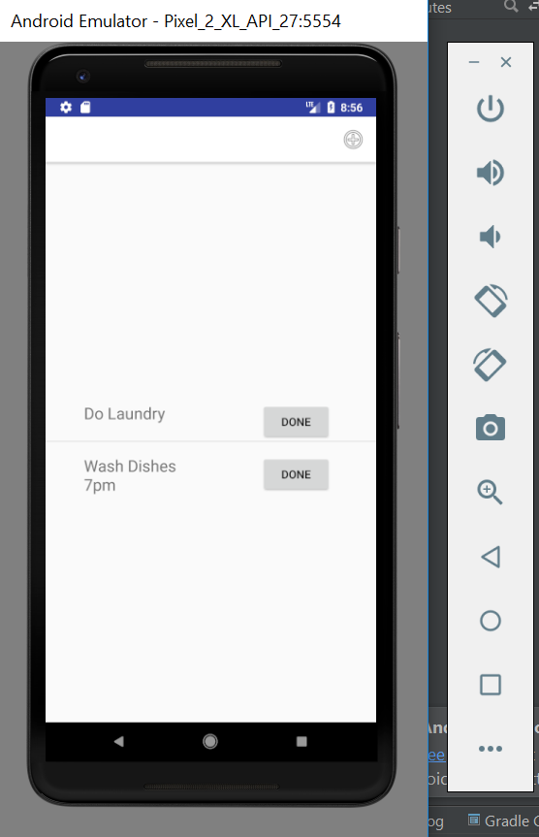
*Parent Screen Chore Added
The parent can see all the listed chores

Slide 8
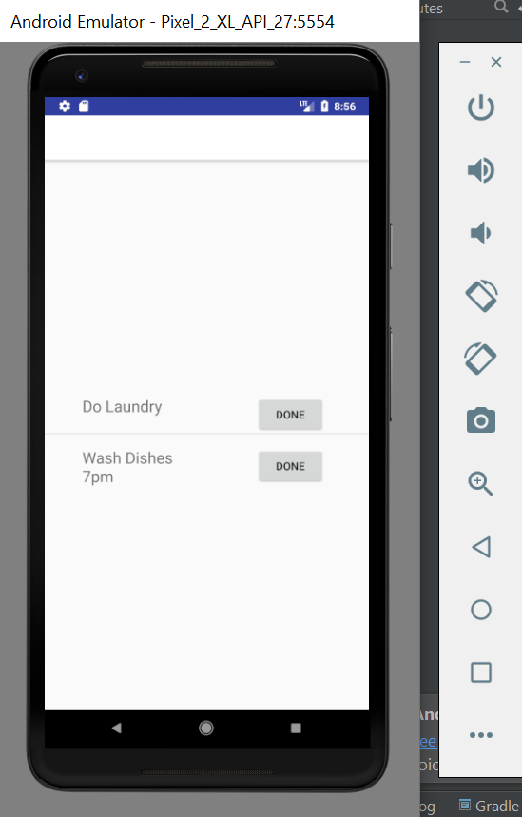
* Child Screen
This is the Child screen
The child is able to see the chores needed to be done
Note that the child cannot see the “+” add button. Only the list of chores is visible
The “DONE” button deletes the chore

