Slide 1
Export of Forwarding Path Delay in IPFIX draft-tgraf-opsawg-ipfix-inband-telemetry-01
Enabling a statistical network delay view, giving insights where delay is being accumulated in the forwarding path
thomas.graf@swisscom.com
benoit.claise@huawei.com
alex.huang-feng@insa-lyon.fr
28. July 2022

Slide 2




IPFIX – State of the Union at Swisscom Proven value and scale since 2015
Increasing coverage from 3000 nodes today to 10'000 by end of 2022. Covering MPLS-SR P, PE to CE.
Collecting and Aggregating 100'000 IPFIX Packets per second.
Producing 700'000 Apache Kafka messages with 20'000'000 metrics per second.
Being used by 300 engineers every day to verify network maintenance windows and troubleshoot customer incidents.
Platform onboarding
IETF vendor, operator and university colaboration
Change verification and troubleshooting
Anomaly detection
SLO Reporting
Network visualization
Early adopters
Early majority
Late majority
Laggards
Capacity management and trend detection

Slide 3
Inband Telemetry with IPFIX Flow-Aggregation Aggregate and sample as early as possible – Chose your Cardinality
IPFIX defines two key data engineering tools to reduce collected and exported amount of data. Sampling and Aggregation. Enabling a statistical view from the network usage. Also called connectivity matrix.
IPFIX measures packets and bytes and give device and control-plane context.
With Inband Telemetry, iOAM, Path Tracing and iFIT, delay can be measured actively (probing) or passively. Metrics are exposed on every node, postcards or only at the last node (passport).
IPFIX lacks the ability to export delay. A key element for monitoring Customer Service Level Agreements.
Inband Telemetry lacks Flow Aggregation support as defined in RFC 7015. Therefore, scalability in terms of data export and collection is drastically limited today.
draft-tgraf-opsawg-ipfix-inband-telemetry enables IPFIX to export delay while preserving the ability to aggregate and also adds the Inband Telemetry path delay metric definition in the performance registry for proper delay definition.

Slide 4
Measure delay and give network context Enabling a statistical network delay view
Packets are captured ingress with an optional sampler, data-plane dimensions extracted, enriched with device and control-plane dimensions and added with a unique flow ID to a flow cache on the node for aggregation.
The data-plane dimensions answers which packet. The control-plane which service. The device dimensions where in the network.
In case of Inband Telemetry, a timestamp and optionally a direct export tag is added to the packet header when entering the Inband Telemetry domain.
Each subsequent packet for the same flow increases byte and packet count. Each new flow creates a new flow ID in the flow cache.
In case of Inband Telemetry, At each node in transit (postcard) or only at the last node (passport), the delay is calculated by comparing the timestamp in the packet and when packet is received on the node. Delay is populated into the flow cache besides packet and byte count.

Slide 5
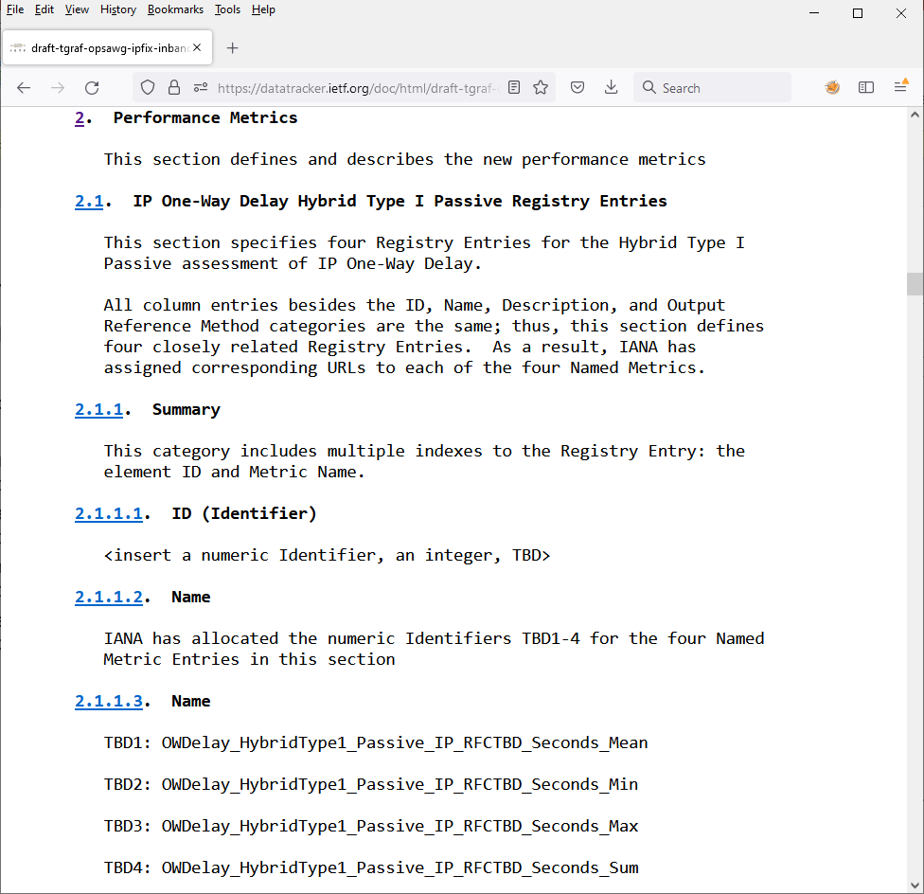
Performance Registry Defining new entries
4 new IP One-Way Delay Hybrid Type I Passive Registry Entries. Path delay between the IOAM encapsulation node and the local node with the IOAM domain (either an IOAM transit node or an IOAM decapsulation node).
Minimum Delay – Describing the lowest delay of all accounted packets for a given flow id.
Maximum Delay – Describing the highest delay of all accounted packets for a given flow id.
Sum of the Delay – Describing the summed delay of all accounted packets for a given flow id.
Mean Delay – Describing the average delay of all accounted packets for a given flow id. Applicable only on data collection.

Slide 6
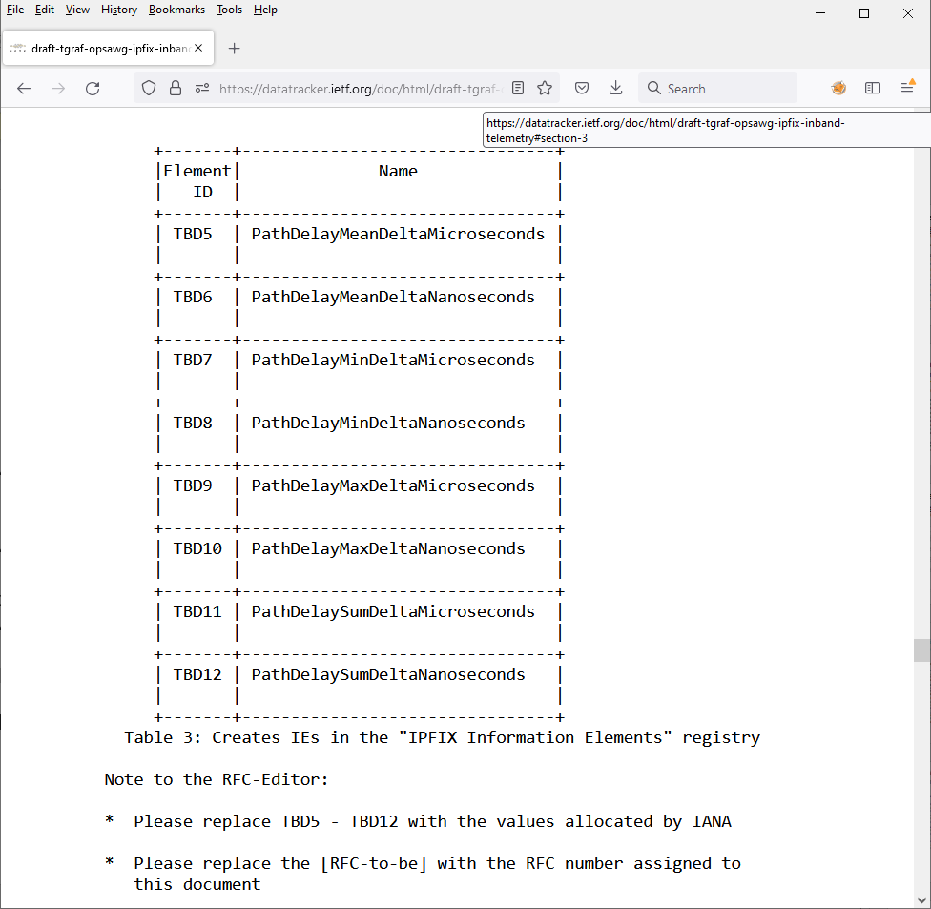
IPFIX Registry Defining new entries
8 new Path Delay Registry Entries. Corresponds to the entries in the performance registry.
Minimum Delay – Describing the lowest delay of all accounted packets for a given flow id in micro or in nanoseconds.
Maximum Delay – Describing the highest delay of all accounted packets for a given flow id in micro or in nanoseconds.
Sum of the Delay – Describing the summed delay of all accounted packets for a given flow id in micro or in nanoseconds.
Mean Delay – Describing the average delay of all accounted packets for a given flow id in micro or in nanoseconds. Applicable only on data collection.

Slide 7
Export of Forwarding Path Delay in IPFIX Draft Status and Next Steps
Do you recognize the problem statement?
Network operators want to understand
where delay with which network and device dimensions is being accumulated
at highest scale for a statistical network delay view.
IEs in document defined are independent from how the delay is being metered.
Two vendors are validating on technical feasibility. Others showing interest.
INSA Lyon working on running open-source code in FD.io VPP. Will be shown at IETF 115 hackathon.
Draft version -01 will contain data record and template examples.
-> Requesting review and collecting comments in OPSAWG and IPPM working groups.
thomas.graf@swisscom.com
benoit.claise@huawei.com
alex.huang-feng@insa-lyon.fr
28. July 2022

