Slide 1

SRv6 On-Path Delay Measurement with Anomaly Detection OPSAWG WG
IETF 116
March 25-26th, 2023
Hackathon

Slide 2
Hackathon - Plan
Establish multivendor SRv6 network topology with network telemetry data collection and data processing pipeline.
Validate and visualize two IPFIX implementations of draft-ietf-opsawg-ipfix-srv6-srh and draft-ietf-opsawg-ipfix-on-path-telemetry in FD.io VPP and on Huawei VRP.
Extend Network Anomaly Detection to recognize on-path delay increase and include delay in Max Concern Score calculation.

Slide 3
Hackathon – Software
Software
Huawei Versatile Routing Platform Software Version 8.220
VPP extended by INSA Lyon
Wireshark IPFIX dissector for packet analysis
pmacct nfacctd for IPFIX and BMP data collection
Confluent Apache Kafka as message broker
Apache Druid as timeseries DB
Imply Pivot as user interface

Slide 4
Hackathon – Network (1/2)
SRv6 network topology with two vendors and IPFIX data processing pipeline.
Huawei with four P and two PE nodes exposing SRH provider data-plane draft-ietf-opsawg-ipfix-srv6-srh and on-path delay as described in draft-ietf-opsawg-ipfix-on-path-telemetry.
Cisco with two PE nodes exposing customer data-plane.

Slide 5
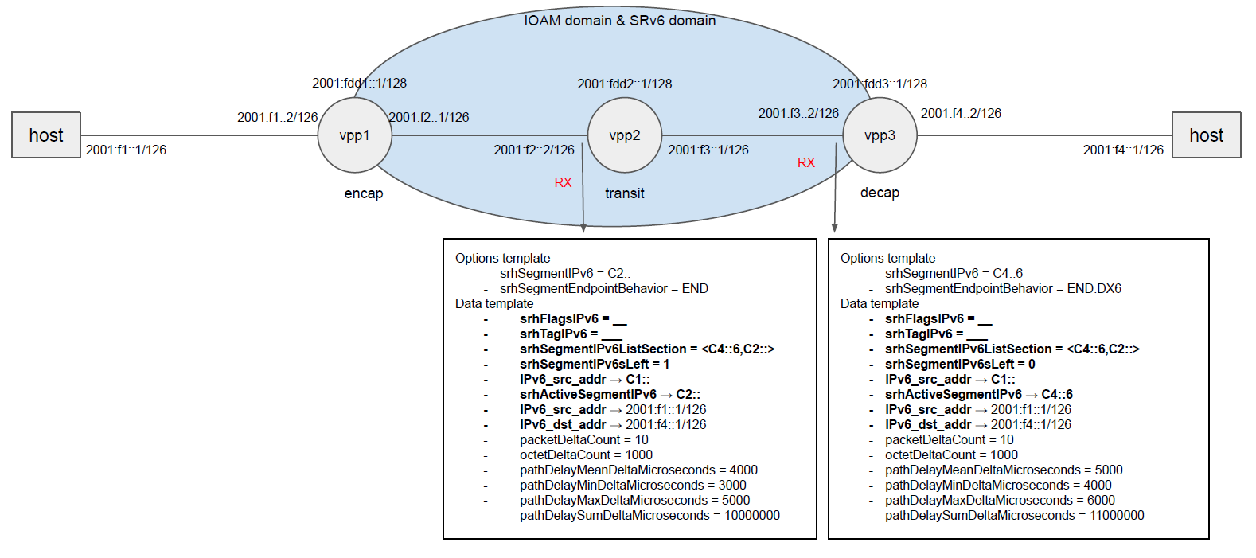
Hackathon – Network (2/2)
FD.io VPP Open Source Code published: https://github.com/network-analytics/vpp-srh-onpath-telemetry

Slide 6

Pmacct Integration
{
"event_type": "purge",
"peer_ip_src": "33.33.33.33",
"ip_src": "2001:f4::1",
"ip_dst": "2001:f4::1",
"srv6_seg_ipv6_list": ["c4::6-0", "c2::-1"],
"packets": 20, "bytes": 10560, "PathDelayMean": 120,
}
IPFIX packet
JSON

Slide 7
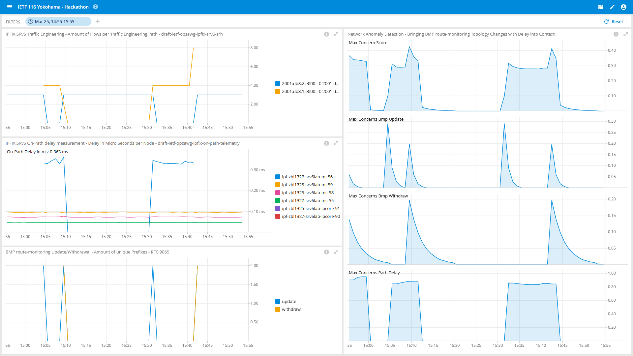
Visualization
Shows SRv6 SID list change of the traffic engineered paths.
Shows on which node how much on-path delay was being measured.
Shows the BGP update/withdrawals from the topology change.
Shows that Network Anomaly Detection detects the topology and delay change and the Max Concern Score calculation.
1
4
2
3

Slide 8

Conclusion
Achievements
Running SRv6 multivendor network topology with traffic engineering and uSID compression.
Validating two interoperable implementations of draft-ietf-opsawg-ipfix-on-path-telemetry
Calculate PathDelayMeanDeltaMicroseconds by dividing PathDelaySumDeltaMicroseconds by packetDeltaCount in pmacct data collection
Network Anomaly Detection recognized BGP topology and on-path delay change

Slide 9

What we learned (again)
Good
Preparation and good team setup is gold.
Yuta Fukagawa and Takeru Hayasaka joining our table and implementing draft-ietf-opsawg-ipfix-srv6-srh in XDP (eXpress Data Path).
As always… the beers were most welcome!
Bad
-

Slide 10
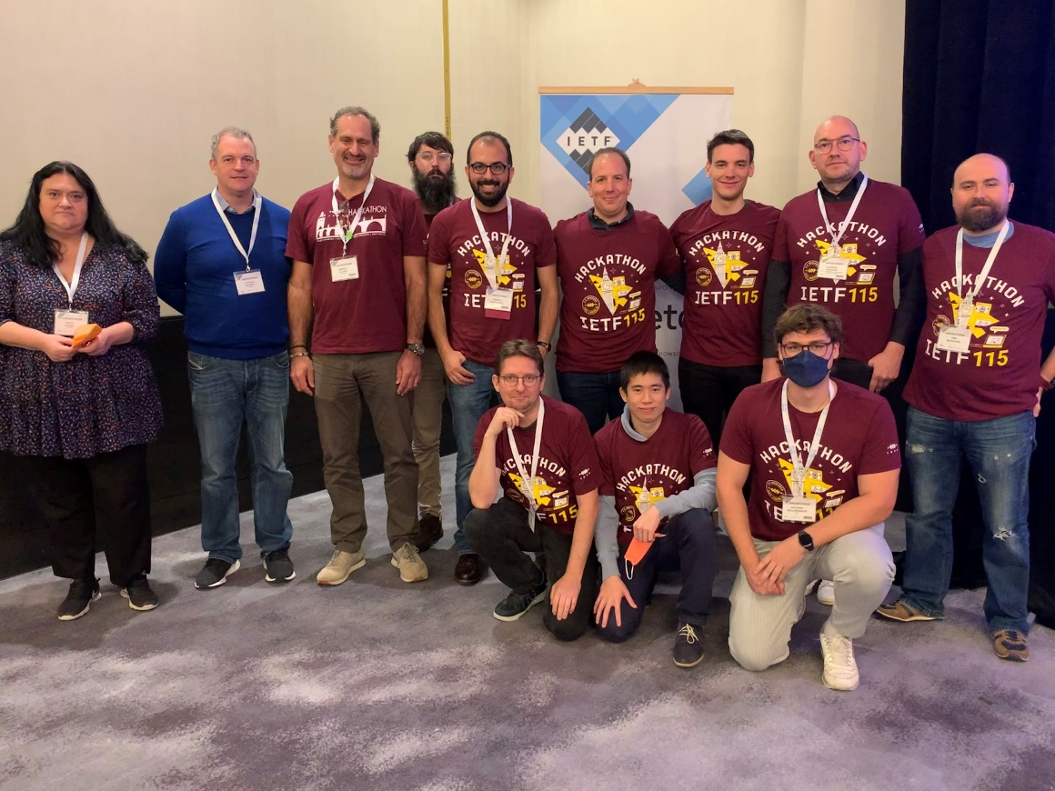
Thanks to…
Alex Huang Feng – INSA
Severin Dellsperger - OST University (remote)
Paolo Lucente – NTT
Benoit Claise – Huawei
Jean Quilbeuf - Huawei
Olga Havel – Huawei
Wanting Du – Swisscom (remote)
Yannick Buchs – Swisscom (remote)
Marco Tollini - Swisscom
Thomas Graf - Swisscom
….and Huawei, INSA Lyon and Pmacct for the network environment, software and test cases.

Slide 11
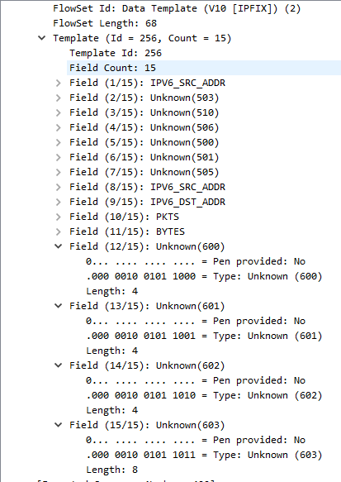
IETF 116 Hackathon - VPP Implementation Status Records exposed
PathDelayMeanDeltaMicroseconds
16-bit unsigned integer that identifies the mean path delay in microseconds, between the IOAM encapsulation node and the local node with the IOAM domain (either an IOAM transit node or an IOAM decapsulation node).
PathDelayMaxDeltaMicroseconds
16-bit unsigned integer that identifies the highest path delay in microseconds, between the IOAM encapsulation node and the local node with the IOAM domain (either an IOAM transit node or an IOAM decapsulation node).
PathDelayMinDeltaMicroseconds
16-bit unsigned integer that identifies the lowest path delay in microseconds, between the IOAM encapsulation node and the local node with the IOAM domain (either an IOAM transit node or an IOAM decapsulation node).
PathDelaySumDeltaMicroseconds
32-bit unsigned integer that identifies the sum of the path delay in microseconds, between the IOAM encapsulation node and the local node with the IOAM domain (either an IOAM transit node or an IOAM decapsulation node).
1
2
3
4

Slide 12
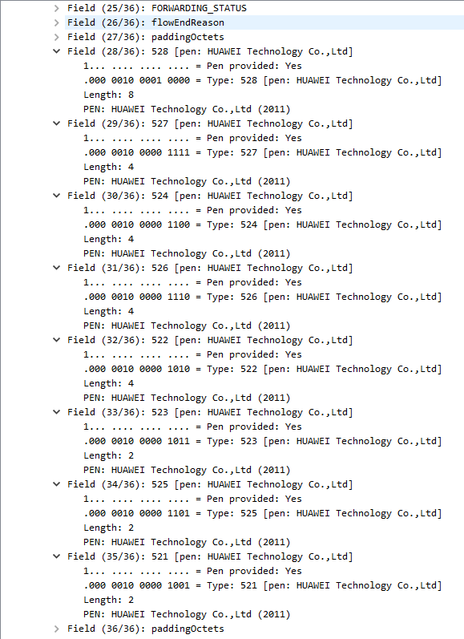
IETF 116 Hackathon - Huawei Implementation Status Records exposed
PathDelayMeanDeltaMicroseconds
16-bit unsigned integer that identifies the mean path delay in microseconds, between the IOAM encapsulation node and the local node with the IOAM domain (either an IOAM transit node or an IOAM decapsulation node).
PathDelayMaxDeltaMicroseconds
16-bit unsigned integer that identifies the highest path delay in microseconds, between the IOAM encapsulation node and the local node with the IOAM domain (either an IOAM transit node or an IOAM decapsulation node).
PathDelayMinDeltaMicroseconds
16-bit unsigned integer that identifies the lowest path delay in microseconds, between the IOAM encapsulation node and the local node with the IOAM domain (either an IOAM transit node or an IOAM decapsulation node).
PathDelaySumDeltaMicroseconds
32-bit unsigned integer that identifies the sum of the path delay in microseconds, between the IOAM encapsulation node and the local node with the IOAM domain (either an IOAM transit node or an IOAM decapsulation node).
4
3
2
1

