Slide 1
Export of Segment Routing IPv6 Information in IPFIX draft-ietf-opsawg-ipfix-srv6-srh-03
Enabling insights in SRv6 forwarding plane
by adding Segment Routing dimensions
thomas.graf@swisscom.com
benoit.claise@huawei.com
pierre.francois@insa-lyon.fr
06. November 2022

Slide 2
SRv6 @ IPFIX Draft Status
Received comments from SPRING, OPSAWG and network vendors working on implementations.
Addressed all open issues. Verified with IANA how to manage the srhFlagsIPv6 and srhSegmentEndpointBehavior registries. Outcome is to have a reference to the "Segment Routing Header" registry instead of listing the entries in the IPFIX registry.
Expanded the terminology section to have a consolidated view on which terms are inherited from which RFC.
Added "Segment Routing Policy" in the srhActiveSegmentIPv6Type registry.
Added "Multiple Segment Routing Headers" in the "Operational Considerations" section.
Corrected "Template Record and Data Set with SRH Section" example.
Added the "Implementation Status" to document the current implementations.

Slide 3
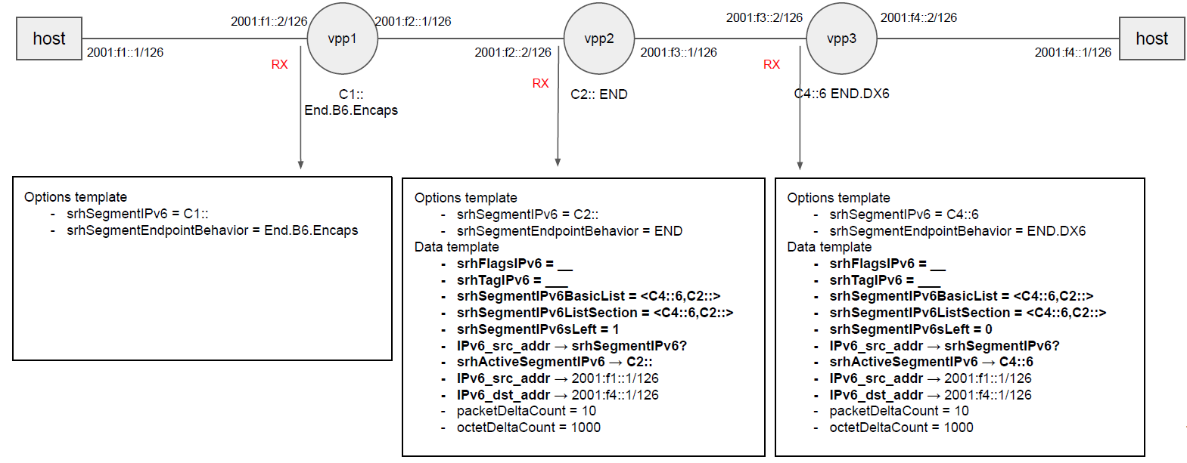
IETF 115 Hackathon – VPP Implementation Status Lab topology
FD.io VPP Open Source Code published: https://github.com/insa-unyte/vpp-srh-onpath-telemetry

Slide 4
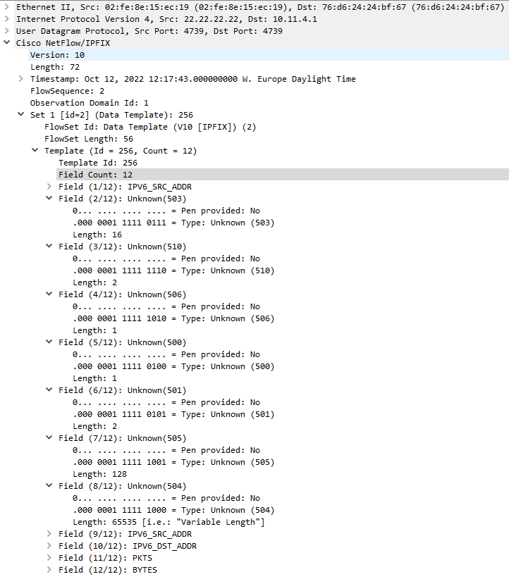
IETF 115 Hackathon - VPP Implementation Status Record order matters
1
Shows an IPFIX data-template example for a IPv6 encapsulated SRv6 Packet. IPFIX entity sourceIPv6Address appears twice.
Order of the data records matter as described in Section 8 of [RFC7011]. Distinguishes between the tunneled Customer Data Plane and the Provider Data Plane.
2
3

Slide 5
IETF 115 Hackathon - VPP Implementation Status Records exposed
srhActiveSegmentIPv6
128-bit IPv6 address that represents the active SRv6 segment.
srhSegmentEndpointBehavior
16-bit unsigned integer that represents a SRv6 Endpoint behavior as per Section 4 of [RFC8986].
srhSegmentIPv6sLeft
8-bit unsigned integer defining the number of route segments remaining to reach the end of the segment list.
srhFlagsIPv6
8-bit flags defined in the SRH.
srhTagIPv6
16-bit tag field defined in the SRH that marks a packet as part of a class or group of packets sharing the same set of properties.
srhSegmentIPv6ListSection
Exposes the SRH Segment List as defined in section 2 of [RFC8754] as series of n octets.
srhSegmentIPv6BasicList
Ordered basicList [RFC6313] of zero or more 128-bit IPv6 addresses in the SRH that represents the SRv6 segment list. The Segment List is encoded starting from the active segment of the SR Policy.
1
2
3
4
5
6
7

Slide 6
IETF 115 Hackathon - Huawei Implementation Status Lab topology
SRv6 network topology with two vendors and IPFIX data processing pipeline.
Huawei with four P and two PE nodes exposing SRH provider data-plane as described in draft-ietf-opsawg-ipfix-srv6-srh.
Cisco with two PE nodes exposing customer data-plane.

Slide 7
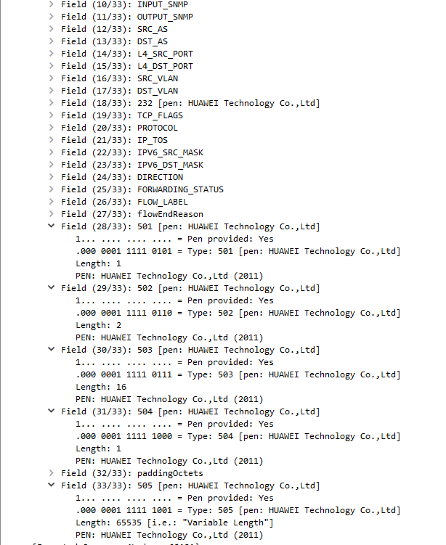
IETF 115 Hackathon - Huawei Implementation Status Records exposed
srhFlagsIPv6
8-bit flags defined in the SRH.
srhTagIPv6
16-bit tag field defined in the SRH that marks a packet as part of a class or group of packets sharing the same set of properties.
srhActiveSegmentIPv6
128-bit IPv6 address that represents the active SRv6 segment.
srhSegmentIPv6ListSection
Exposes the SRH Segment List as defined in section 2 of [RFC8754] as series of n octets.
srhSegmentIPv6sLeft
8-bit unsigned integer defining the number of route segments remaining to reach the end of the segment list.
According to A.1.2. Template Record and Data Set with Segment List Section
1
2
3
4
5

Slide 8
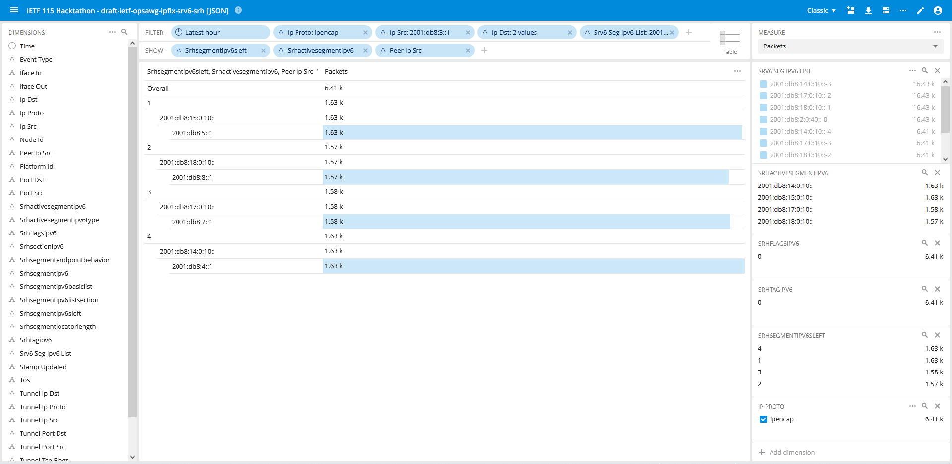
IETF 115 Hackathon – Monitoring your neighbor desk When all puzzle pieces fall together for the very first time
With Segment List Section we can select the traffic engineered path.
Segments Left shows where we are in the forwarding path.
Active Segment where we forward next to.
Peer IP Src from where the metrics were exported.
2
3
4
1

Slide 9
SRv6 @ IPFIX Next Steps
Missing SRv6 data-plane visibility is a recognized problem.
Open-source running code published on https://github.com/insa-unyte/vpp-srh-onpath-telemetry.
First commercial vendor implementations will be public end of Q1 and Q3 2023.
The authors would like to ask the OPSAWG working group wherever they belief that the document is in stable state to request early code point allocation at IANA or not.
thomas.graf@swisscom.com
benoit.claise@huawei.com
pierre.francois@insa-lyon.fr
6. November 2022

