Slide 1
Export of Segment Routing IPv6 Information in IPFIX draft-tgraf-opsawg-ipfix-srv6-srh
Enabling insights in SRv6 forwarding plane
by adding Segment Routing dimensions
thomas.graf@swisscom.com
benoit.claise@huawei.com
16. March 2022

Slide 2
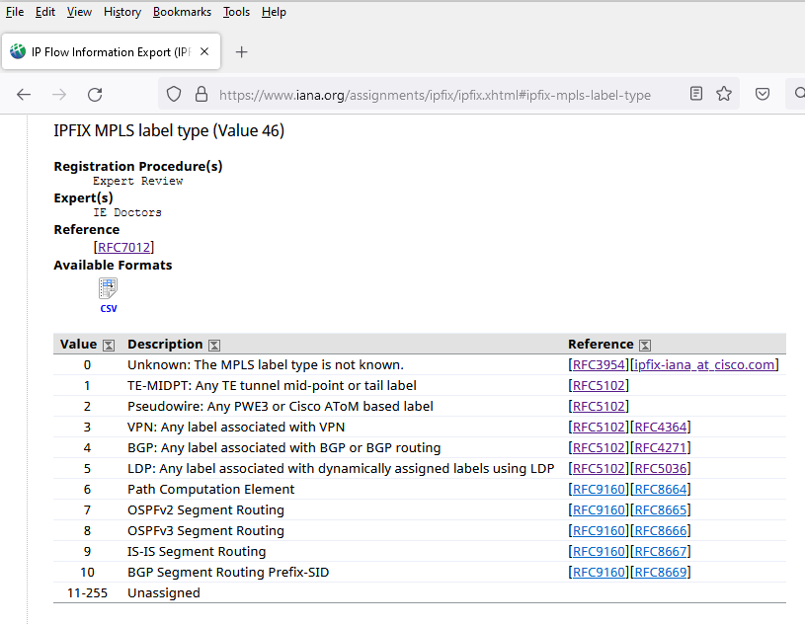
MPLS-SR @ IPFIX Adressed with RFC 9160 @ OPSAWG
In MPLS-SR the data-plane is still the same as in MPLS. Only the routing protocol providing the label changes.
IE70 mplsTopLabelStackSection is the top label FEC used to forward. Each following label in the label stack is decomposed in IE71-79 separately.
0 1 2
0 1 2 3 4 5 6 7 8 9 0 1 2 3 4 5 6 7 8 9 0 1 2 3
+-+-+-+-+-+-+-+-+-+-+-+-+-+-+-+-+-+-+-+-+-+-+-+-+
| Label | Exp |S|
+-+-+-+-+-+-+-+-+-+-+-+-+-+-+-+-+-+-+-+-+-+-+-+-+
Label: Label Value, 20 bits
Exp: Experimental Use, 3 bits
S: Bottom of Stack, 1 bit
IE47 mplsTopLabelIPv4Address is the top label IP address where the traffic is forwarded to.
IE46 mplsTopLabelType describes from which routing protocol the top label IP address and label is coming from. Updated with RFC 9160 to cover MPLS-SR routing protocols.

Slide 3
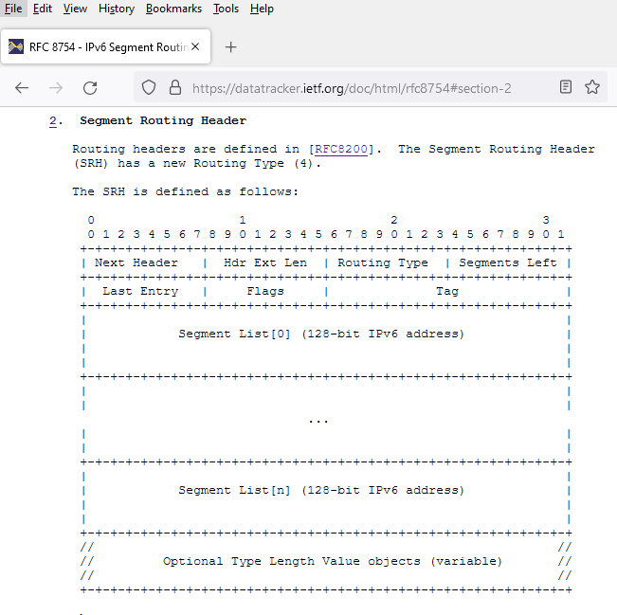
SRv6 @ IPFIX Data-Plane visibility is missing in SRv6
SRv6 is already deployed at network operators (draft-matsushima-spring-srv6-deployment-status). Unaware of any network operator migrated from MPLS to SRv6 yet.
-> Feedback welcome
Data-Plane visibility is missing in SRv6. Unable to see how much traffic is being forwarded or dropped with which SID. Network operators flying blind.
Segment Routing Header is defined in Section 2 of RFC 8754.

Slide 4
SRv6 @ IPFIX IPFIX entities in context of the SRH (1)
ipv6SRHSegmentsLeft
8-bit unsigned integer defining the number of route segments remaining to reach the end of the segment list.
ipv6SRHTag
16-bit tag field defined in the SRH that marks a packet as part of a class or group of packets sharing the same set of properties.
ipv6SRHFlags
8-bit flags defined in the SRH.
ipv6SRHSegmentType
Name of the routing protocol or PCEP extension from where the active SRv6 segment has been learned from.

Slide 5
SRv6 @ IPFIX IPFIX entities in context of the SRH (2)
ipv6SRHSection
Exposes the SRH and its TLV's as defined in section 2 of [RFC8754] as series of n octets.
ipv6SRHSegmentListSection
Exposes the SRH Segment List as defined in section 2 of [RFC8754] as series of n octets.
ipv6SRHSegment
128-bit IPv6 address that represents an SRv6 segment.
ipv6SRHSegmentBasicList
Ordered basicList [RFC6313] of zero or more 128-bit IPv6 addresses in the SRH that represents the SRv6 segment list. The Segment List is encoded starting from the active segment of the SR Policy.

Slide 6
SRv6 @ IPFIX Operational Considerations
ipv6SRHSegmentBasicList Encodes the SID list of IPv6 addresses with a basicList, specified in the IPFIX Structured Data [RFC6313]. This encoding offers the advantage to the data collection that the different IPv6 addresses are already structured as a list, without the need of post processing. However, this method requires some extra processing on the exporter, to realize the BasicList data mapping.
ipv6SRHSegmentListSection On the other hand, encodes the list of IPv6 addresses as an octetArray. This doesn't impose any data flow manipulation on the exporter, facilitating the immediate export. However, the data collection must be able to decode the IPv6 addresses according the SR specifications.

Slide 7
SRv6 @ IPFIX Compressed-SID container
As described in draft-ietf-spring-srv6-srh-compression-00.html#section-2, the compressed-SID container (C-SID container) is 128-bit long and contains a sequence of C-SIDs. Therefore, the ipv6SRHSegmentList contains either a list of IPv6 SID's, a list of C-SID containers or both. They are not mutually exclusive.
It probably makes sense to add an operational consideration section to how an IPFIX data-collection could distinct between a list of IPv6 SID's and a list of C-SID containers.
From what we understood it does not bring much added value to decompose the C-SID container into Compressed-SID (C-SID) in IPFIX.
-> Feedback welcome

Slide 8
SRv6 @ IPFIX Draft Status
Feedback collected from SPRING, OPSAWG and IPFIX doctor.
ipv6SRHSection and ipv6SRHSegmentListSection added to allow export of entire SRH and Segment List in one IPFIX entity.
ipv6SRHSegmentsLeft added to express at which position of the Segment List the forwarding happens. Useful for detecting forwarding loops.
Added operational considerations section to describe when ipv6SRHSection and ipv6SRHSegmentListSection makes sense.
Updated IANA considerations to be in line with RFC 8126.
The document doesn't introduce any new protocols. It is for documentation purposes. However, because new IPFIX registries are introduced, we specified the document as Internet standard, to be aligned with previous similar IPFIX RFCs (7133, 8158)

Slide 9
SRv6 @ IPFIX Next Steps
Data-Plane visibility is missing in SRv6. Do you recognize the problem statement?
Authors believe that document should progress quickly through IETF to avoid private enterprise code points being used in SRv6 deployments.
-> Call for adoption at OPSAWG at IETF 113
thomas.graf@swisscom.com
benoit.claise@huawei.com
16. March 2022

