Slide 1
Export of Segment Routing IPv6 Information in IPFIX draft-tgraf-opsawg-ipfix-srv6-srh
Enabling insights in SRv6 forwarding plane
by adding Segment Routing dimensions
thomas.graf@swisscom.com
benoit.claise@huawei.com
pierre.francois@insa-lyon.fr
21. July 2022

Slide 2
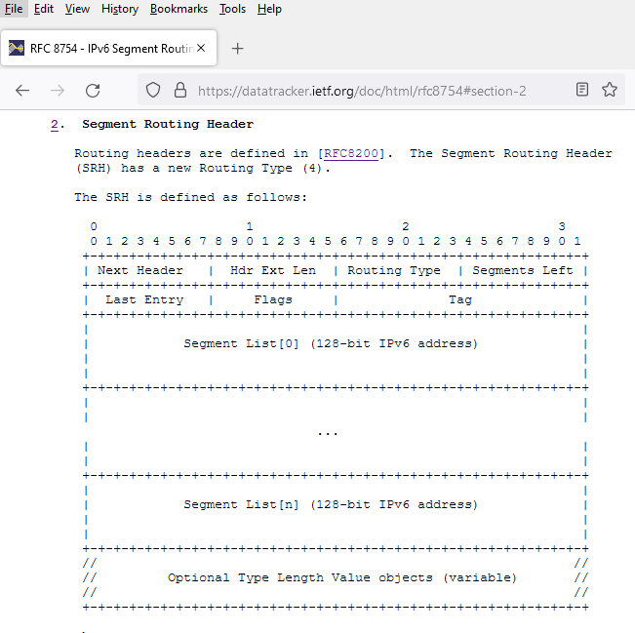
SRv6 @ IPFIX Data-Plane visibility is missing in SRv6
SRv6 is already deployed at network operators (draft-matsushima-spring-srv6-deployment-status). If you know any other network operator which migrated from MPLS to SRv6 yet.
-> Feedback welcome
Data-Plane visibility is missing in SRv6. Unable to see how much traffic is being forwarded or dropped with which SID. Network operators flying blind.
Segment Routing Header is defined in Section 2 of RFC 8754.

Slide 3
SRv6 @ IPFIX IPFIX entities in context of the SRH (1)
srhSegmentIPv6sLeft
8-bit unsigned integer defining the number of route segments remaining to reach the end of the segment list.
srhTagIPv6
16-bit tag field defined in the SRH that marks a packet as part of a class or group of packets sharing the same set of properties.
srhFlagsIPv6
8-bit flags defined in the SRH.
srhActiveSegmentIPv6Type
Name of the routing protocol or PCEP extension from where the active SRv6 segment has been learned from.
srhSegmentLocatorLength
The number of significant bits. Together with srhSegmentIPv6 it enables the calculation of the SRv6 Locator.
srhSegmentEndpointBehavior
16-bit unsigned integer that represents a SRv6 Endpoint behavior.

Slide 4
SRv6 @ IPFIX IPFIX entities in context of the SRH (2)
srhSectionIPv6
Exposes the SRH and its TLV's as defined in section 2 of [RFC8754] as series of n octets.
srhSegmentIPv6ListSection
Exposes the SRH Segment List as defined in section 2 of [RFC8754] as series of n octets.
srhSegmentIPv6
128-bit IPv6 address that represents an SRv6 segment.
srhActiveSegmentIPv6
128-bit IPv6 address that represents the active SRv6 segment.
srhSegmentIPv6BasicList
Ordered basicList [RFC6313] of zero or more 128-bit IPv6 addresses in the SRH that represents the SRv6 segment list. The Segment List is encoded starting from the active segment of the SR Policy.

Slide 5
SRv6 @ IPFIX Draft Status
Received comments from SPRING, OPSAWG and other network operators.
Addressed all open issues and double-checked the IANA consideration section with the IPFIX doctors.
Added "Compressed SRv6 Segment List Decomposition" in operational consideration section
srhSegmentLocatorLength and srhSegmentEndpointBehavior has been added and included in the use case and operational section description
Aligned IE naming according to https://datatracker.ietf.org/doc/html/rfc7012#section-2.3
Updated srhFlagsIPv6 registry
Added data-template and data-record examples for srhSegmentIPv6ListSection and srhSectionIPv6 in example section

Slide 6
SRv6 @ IPFIX Next Steps
Missing SRv6 data-plane visibility is a recognized problem.
2 vendors validated technical feasibility and working on implementations.
INSA Lyon working on running open-source code in FD.io VPP. Will be shown at IETF 115 hackathon.
The authors believe that document should progress quickly through IETF to avoid private enterprise code points being used in SRv6 deployments.
The authors would like to go call for adoption in OPSAWG (was already requested at IETF 113)
thomas.graf@swisscom.com
benoit.claise@huawei.com
pierre.francois@insa-lyon.fr
21. July 2022

