Slide 1

Notes:
Interaction and design and simple focused around prodcutivity apps

Slide 2

AnnoTree is a new way to organize and collaborate on design and testing for mobile applications
Notes:
AnnoTree is the new collaborative way to design and test mobile applications
We will enable users to literally draw directly on mobile application or website to mark a design change or bug and then send this information to a collaborative platform
On this collaborative platform developers, designers, and app owners can track, discuss and organize these design and bug changes to streamline and improve their design and testing process
Our goal for the next 8 months is to launch our open beta and support >100 users.

Slide 3
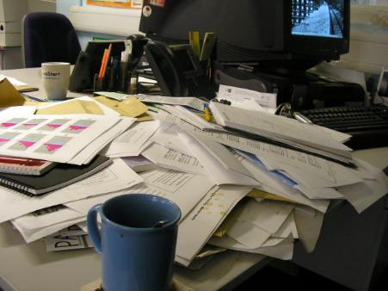
Problem
Building mobile applications can easily be a tedious and unorganized process
Gathering feedback directly from testers or designers is generally not straightforward
Collaborating on these changes is also a crucial part that can be improved on

Slide 4
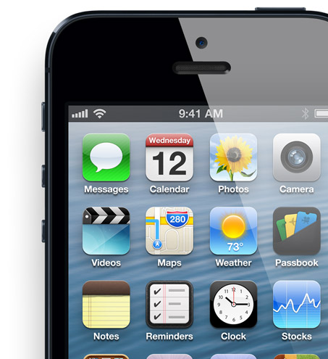
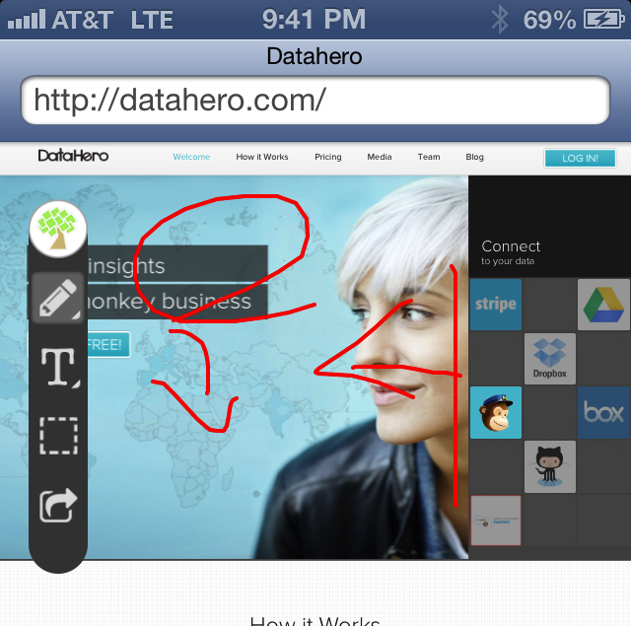
Solution
A simple to use plugin for mobile applications that enables users to draw and place text annotations directly on an application
Central collaboration platform to discuss design changes and bugs socially
Organized as a tree to easily structure , collaborate on, and improve bugs and design changes for an application
Notes:
So we want to make it easy for any application development shop, to create awesome applications with the polish of a large scale budget. Thus we created AnnoTree.

Slide 5
Demo

Slide 6
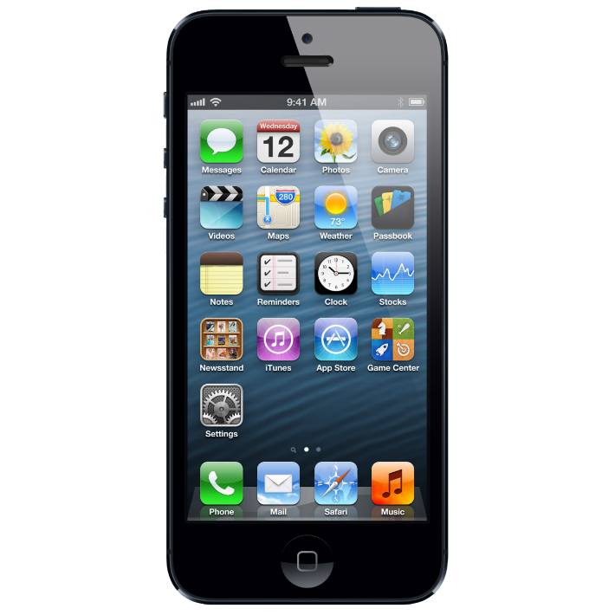
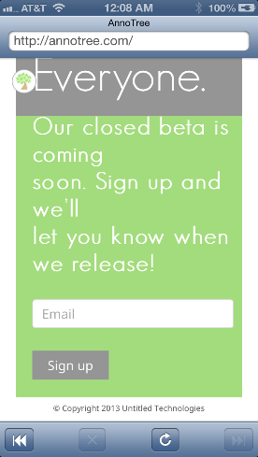

Slide 7
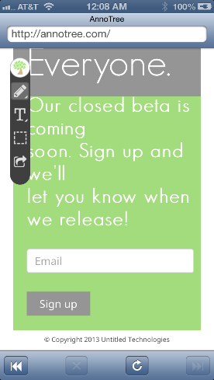

Slide 8
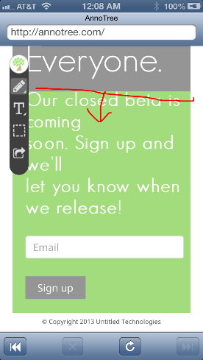

Slide 9
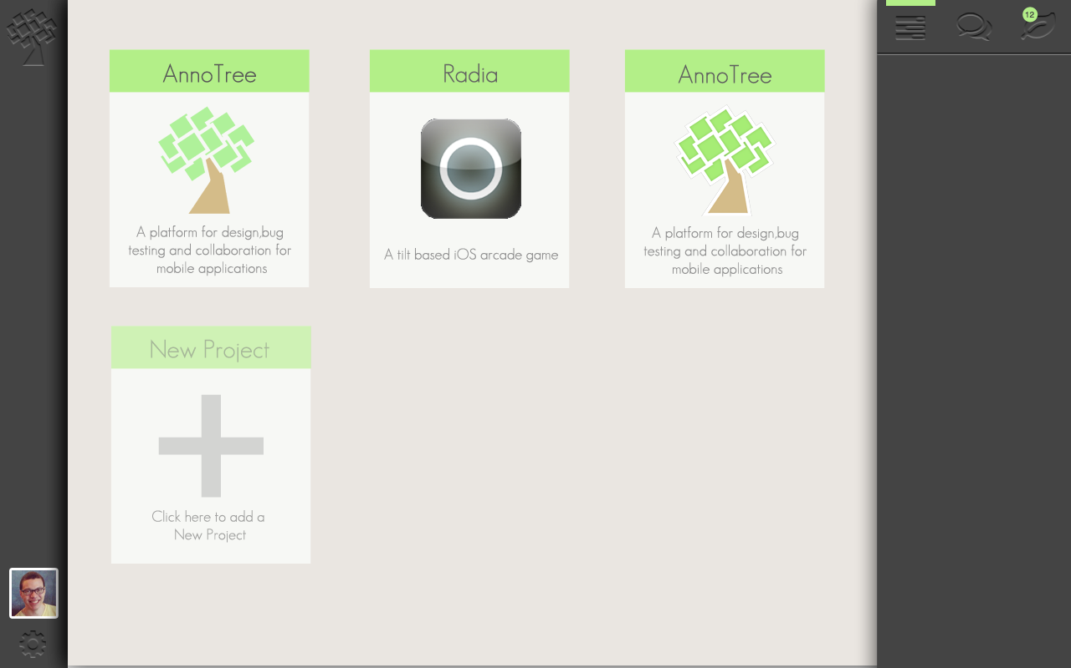
Notes:
Forest CCP with Notifications

Slide 10
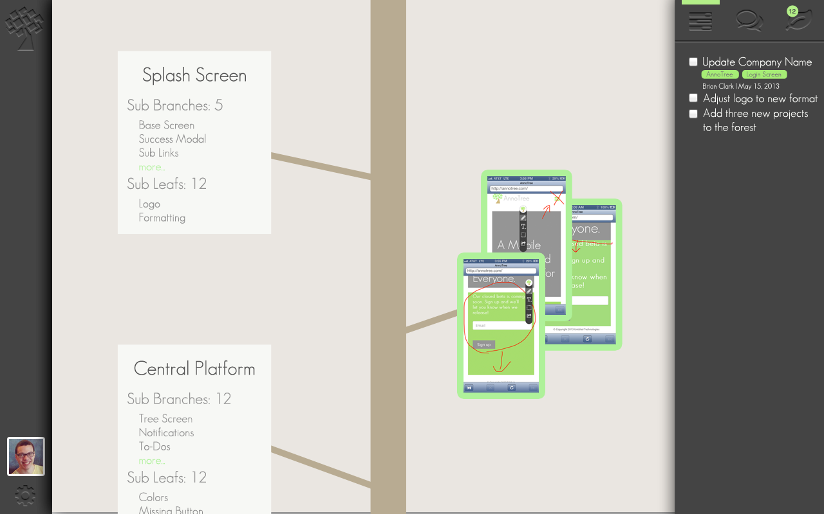
Notes:
Tree and Branches CCP with Specific To-Do’s

Slide 11
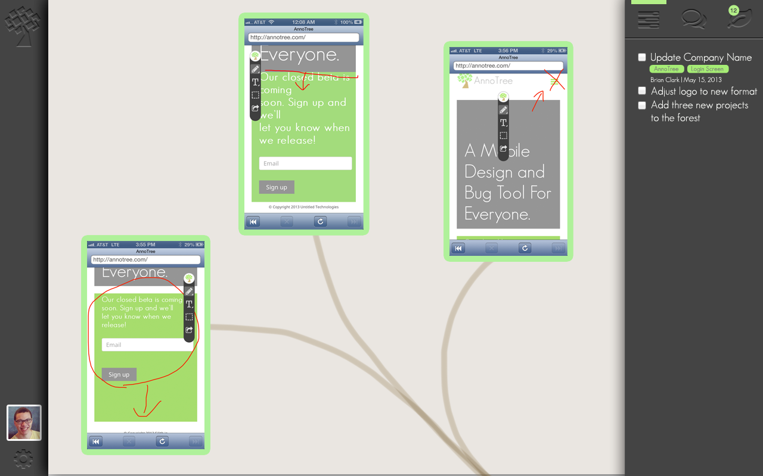
Notes:
Tree and Branches CCP with Specific To-Do’s

Slide 12
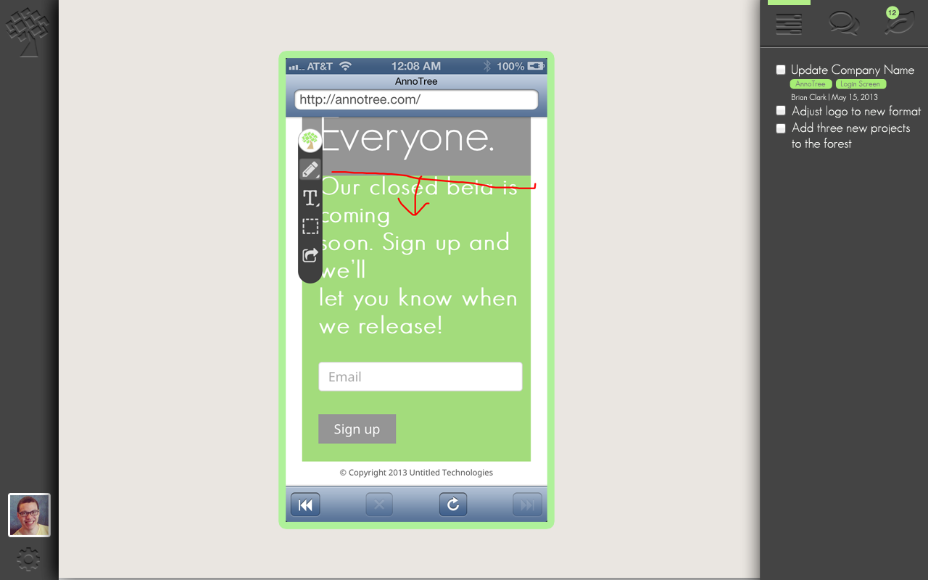
Notes:
Tree and Branches CCP with Specific To-Do’s

Slide 13
Market Size
Worldwide Application Development software market reached more than US$9 billion in 2012.
96-98% of this comes from app creation services like concept creation, design and coding.
Our Bottom Up Analysis indicates a potential market size of over $232M
 | iOS | Android | Total
Number of Applications | 850,000 | 800,000+ | 1,650,000+
Number of Developers | 275,000 | 450,000+ | 725,000+
Number of Testers* | 91,500 | 150,000+ | 241,500+
Total Market Potential Revenue ($)** | $88M | $144M | $232M
*Based on $20/user per month
*Based on a ratio of 3-to-1
**Based on $20/user per month
Notes:
http://www.drdobbs.com/cloud/application-development-now-worth-more-t/240006233
http://readwrite.com/2011/07/05/app-development-services-market-to-reach-100-billion-by-2015
More insightful perhaps are predictions that mobile application development projects targeting smartphones and tablets will outnumber native PC projects by a ratio of 4:1 by 2015.
Need Top Down (reported overall) and bottom up (calculated by people and $)
With this increase in market size, it has become harder and harder to differentiate your application from the competition. In order to have a successful application you must create an application with the fit and finish of large firms with large budgets. (testing mobile app revenue)
825k Apple App Store
850k Google Play Store
Millions of mobile websites/apps

Slide 14


Business Model
Will offer a basic free version
AnnoTree will charge a subscription fee to access the platform
Per Project
Per User
Notes:
$20 / month = 5 projects
$5/user basic - $25/user premium / month

Slide 15
Competitive Analysis
 | uTest | ConceptShare | Jira | AnnoTree
Description | Comprehensive Testing Tool | Web Collaborative Tool | Bug Tracking Tool | Mobile Collaborative Platform
Platform | iOS, Android, Web, Desktop | Web | Web | iOS, Android
Cost Effective ($-$$$$) | $$$$ | $$ | $ | $

Slide 16
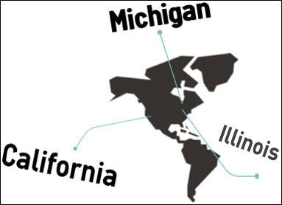
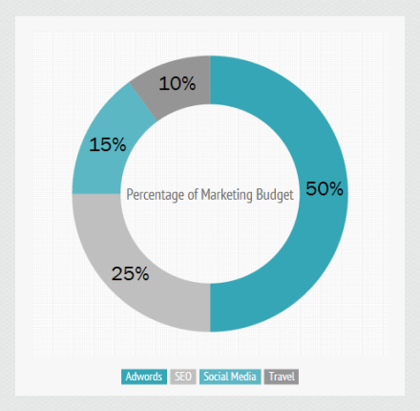
Marketing Strategy
Central Locations of Operation
Michigan
Team based in Michigan
Central location of initial business
California
Home of Silicon Valley
Base of West-Coast Division
Illinois
Easy expansion relative to base operations.
Notes:
Our Marketing Budget is 6% of our Gross Profit. It is given a low percentage of our profits due to where it lies in terms of priority. Generating profit
Google Adwords is 50% of our Marketing Budget. Why? Relatively low CPC with specific, low-competition keywords. Will generate traffic while we build up organic traffic via SEO.
SEO is 35% of our Marketing Budget. Why? Building organic traffic is key to long-term, sustainable marketing success. We will initially spend this money working with SEO companies and purchasing data while we build our website to match modern SEO needs while positioning ourselves in light of market trends and where the industry is heading.
Social Media Advertising is 15% of our budget. Why? The average American spends roughly 7 hours per month on social media websites. With well over a billion eyes, we can capitalize on this by running targeted advertisements on social media websites.
Sponsored hackathon – Free Beer/Pizza – Get hackers there, give away prizes
(rackspace, etc.)
More firm customer acquisition strategy
Gonna have hackathons
Gonna go to developers and get intro

Slide 17

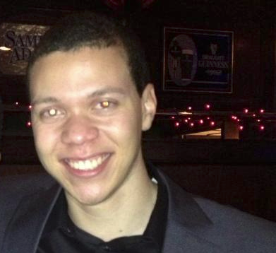


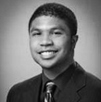

Our Team
Preston Parry
Business Development
Brian Clark
Chief Executive Officer
Brad Clark
Chief Marketing Officer
Shaun Nikore
Chief Financial Officer
Dan Carter
JavaScript Ninja
Matt Price
Lord of the Servers
Notes:
Talk about Radia!

Slide 18
Money
Seeking $250k in investment
Infrastructure costs
Marketing / Customer Support
Basic Living Expenses

Slide 19

Questions

Slide 20
Appendix

Slide 21
Financials
Required Funding
Founders Contribution: $3,500 initially
Revenue
Product Sale Price: $10 per user
First Month Sales: 10 units w/ 30% month-over-month growth
Cost Structure
Infrastructure Cost: $475 <1000 users $900 >= 1000
Marketing: 6% of Gross Profit
Conservative: 2 salaries with a total of 50k, Year 3, 3 salaries with a total of 150k
Medium: 2 salaries with a total of 77k, Year 3, 6 salaries with a total of 300k
Aggressive: Year 2 3 Salaries with a total of 185k and 6 totaling 300k for Year 3
Investor Contribution | Conservative | Medium | Aggressive
Year 1 | $50,000 | $40,000.00 | $50,000.00
Year 2 | $- | $75,000.00 | $180,000.00
Year 3 | $- | $- | $-
Total | $50,000 | $115,000.00 | $230,000.00

Slide 22
Financials (Aggressive)
INCOME STATEMENT
Aggressive
Year | Year 1 | Year 2 | Year 3
Product Sales | $- | $29,786.15 | $966,250.36
COGS | $- | $5,700.00 | $9,950.00
Royalties | $- | $- | $-
Gross Income | $(2,375.00) | $24,086.15 | $956,300.36
Executive Salaries | $- | $185,000.00 | $300,000.00
Employee Salaries | $- | $- | $-
Overhead | $- | $9,250.00 | $45,000.00
Total Salaries and Benefits | $- | $194,250.00 | $345,000.00
Lease | $- | $- | $-
Marketing | $- | $1,382.65 | $94,343.04
Development Tools | $600.00 | $1,200.00 | $3,000.00
Telecom & Internet | $- | $- | $1,200.00
Office Supplies | $200.00 | $- | $-
Utilities | $- | $- | $960.00
Depreciation | $- | $- | $-
General Expenses | $140.00 | $600.00 | $1,800.00
Total Other Expenses | $940.00 | $3,182.65 | $101,303.04
Total Expenses
Operating Income | $(3,315.00) | $(173,346.50) | $509,997.32
Interest Expense | $- | $- | $-
Net Income (Before Taxes) | $(3,315.00) | $(173,346.50) | $509,997.32
Income Tax | $- | $- | $-
Net Income (Loss) | $(3,315.00) | $(173,346.50) | $509,997.32

Slide 23
Financials (Medium)
INCOME STATEMENT
Medium
Year | Year 1 | Year 2 | Year 3
Product Sales | $- | $29,786.15 | $966,250.36
COGS | $- | $5,700.00 | $9,950.00
Royalties | $- | $- | $-
Gross Income | $(2,375.00) | $24,086.15 | $956,300.36
Executive Salaries | $- | $77,000.00 | $300,000.00
Employee Salaries | $- | $- | $-
Overhead | $- | $9,250.00 | $45,000.00
Total Salaries and Benefits | $- | $86,250.00 | $345,000.00
Lease | $- | $- | $-
Marketing | $- | $1,382.65 | $94,343.04
Development Tools | $600.00 | $1,200.00 | $3,000.00
Telecom & Internet | $- | $- | $1,200.00
Office Supplies | $200.00 | $- | $-
Utilities | $- | $- | $960.00
Depreciation | $- | $- | $-
General Expenses | $140.00 | $600.00 | $1,800.00
Total Other Expenses | $940.00 | $3,182.65 | $101,303.04
Total Expenses
Operating Income | $(3,315.00) | $(65,346.50) | $509,997.32
Interest Expense | $- | $- | $-
Net Income (Before Taxes) | $(3,315.00) | $(65,346.50) | $509,997.32
Income Tax | $- | $- | $-
Net Income (Loss) | $(3,315.00) | $(65,346.50) | $509,997.32

Slide 24
Financials (Conservative)
INCOME STATEMENT
Conservative
Year | Year 1 | Year 2 | Year 3
Product Sales | $- | $29,786.15 | $966,250.36
COGS | $- | $5,700.00 | $9,950.00
Royalties | $- | $- | $-
Gross Income | $(2,375.00) | $24,086.15 | $956,300.36
Executive Salaries | $- | $50,000.00 | $150,000.00
Employee Salaries | $- | $- | $-
Overhead | $- | $9,250.00 | $45,000.00
Total Salaries and Benefits | $- | $59,250.00 | $195,000.00
Lease | $- | $- | $-
Marketing | $- | $1,382.65 | $94,343.04
Development Tools | $600.00 | $1,200.00 | $3,000.00
Telecom & Internet | $- | $- | $1,200.00
Office Supplies | $200.00 | $- | $-
Utilities | $- | $- | $960.00
Depreciation | $- | $- | $-
General Expenses | $140.00 | $600.00 | $1,800.00
Total Other Expenses | $940.00 | $3,182.65 | $101,303.04
Total Expenses
Operating Income | $(3,315.00) | $(38,346.50) | $659,997.32
Interest Expense | $- | $- | $-
Net Income (Before Taxes) | $(3,315.00) | $(38,346.50) | $659,997.32
Income Tax | $- | $- | $-
Net Income (Loss) | $(3,315.00) | $(38,346.50) | $659,997.32

