Slide 1

Notes:
Mention company big picture
A Mobile First company building Beautiful, Intuitive platforms for application and business development

Slide 2



AnnoTree
AnnoTree is a new way to organize and collaborate on design and testing for mobile applications
Notes:
Sends to cloud
Organized in CCP

Slide 3
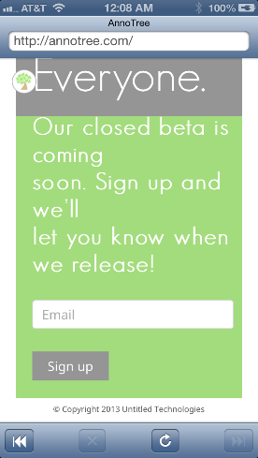
Notes:
Widget on app implemented with one line of code as an SDK

Slide 4
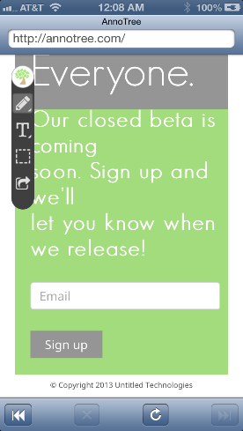

Slide 5
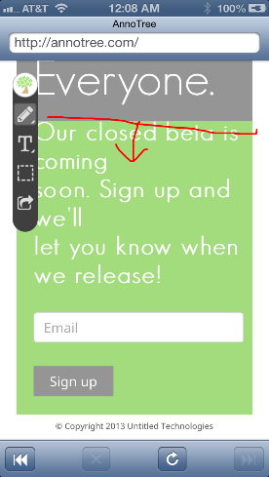

Slide 6
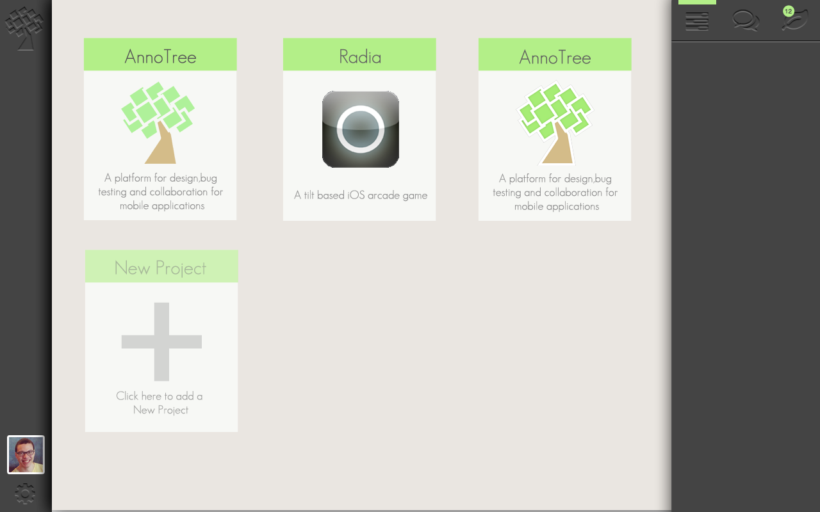
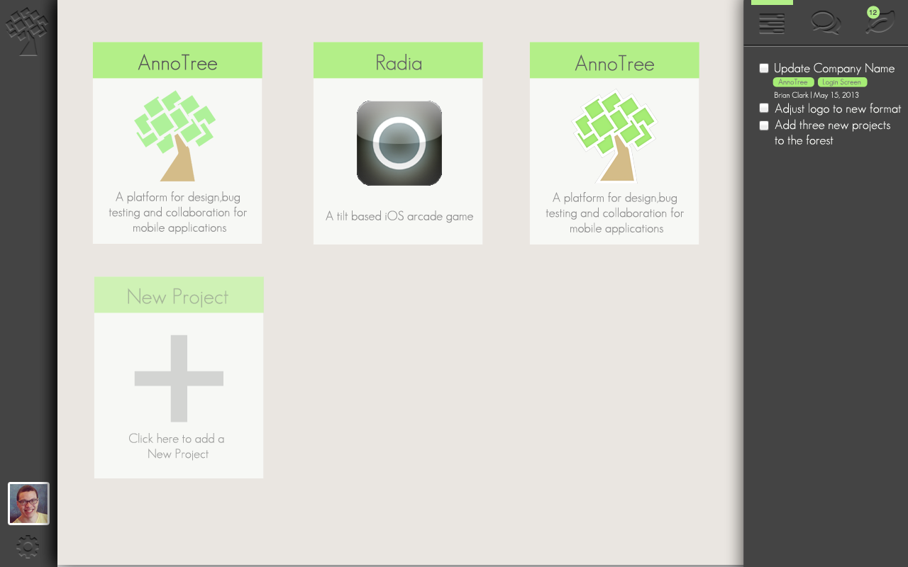
Notes:
Forest CCP with Notifications

Slide 7
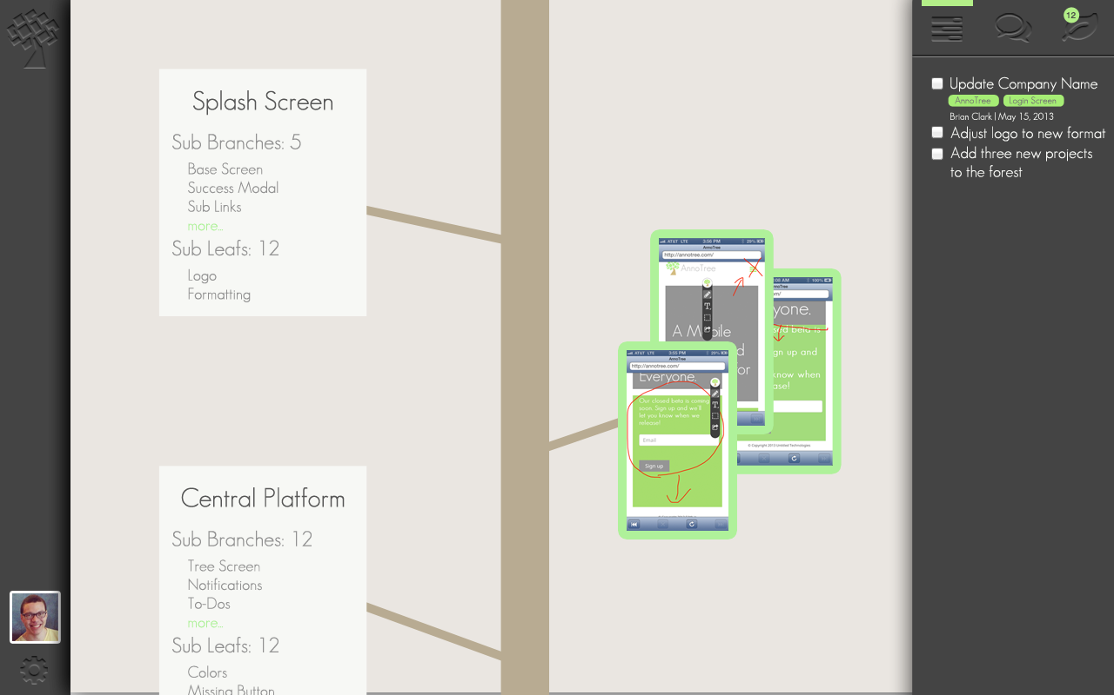
Notes:
Tree and Branches CCP with Specific To-Do’s

Slide 8
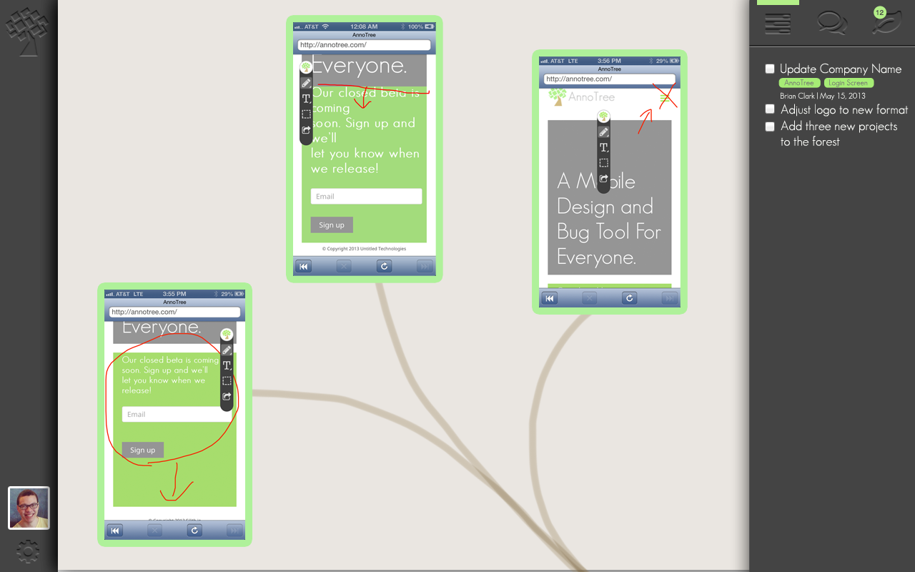
Notes:
Tree and Branches CCP with Specific To-Do’s

Slide 9
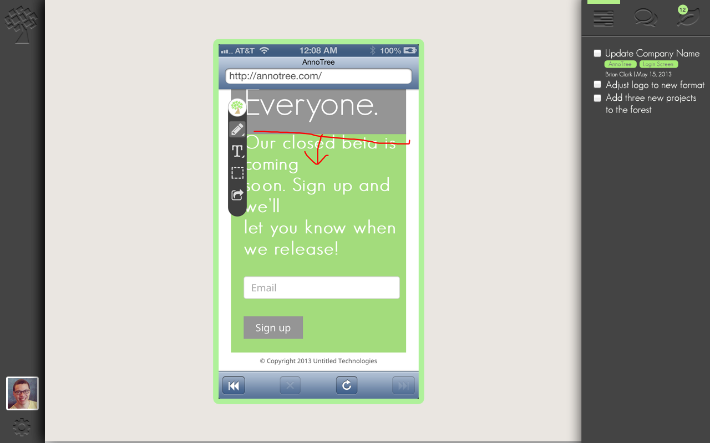
Notes:
Tree and Branches CCP with Specific To-Do’s

Slide 10
What Next?
Milestones
MVP Key Customers – July 2013
Public Alpha – Sep 2013
Public Beta – Jan 2014
brian@silith.io

