Slide 1

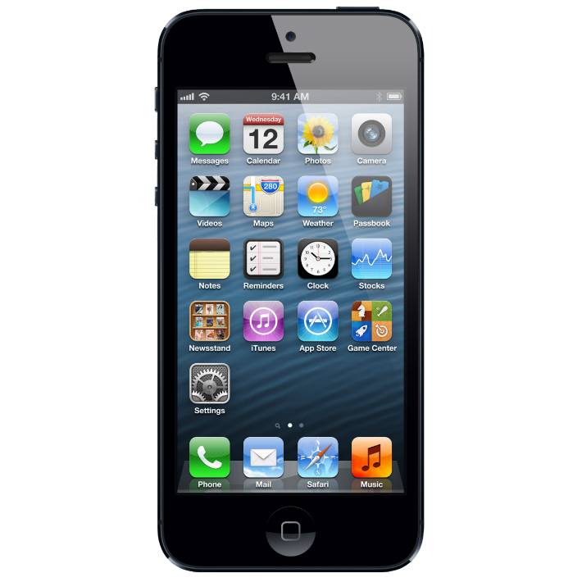

AnnoTree
AnnoTree is a new way to organize and collaborate on design and testing for mobile applications
Notes:
Sends to cloud
Organized in CCP

Slide 2
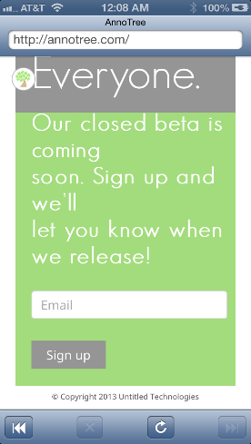
Install the AnnoTree SDK with one line
Notes:
Widget on app implemented with one line of code as an SDK

Slide 3
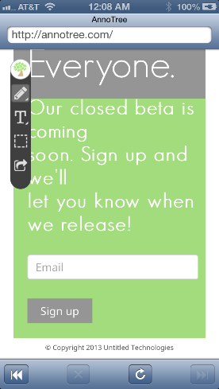
Tap it to open up the Toolbar
Notes:
Widget on app implemented with one line of code as an SDK

Slide 4
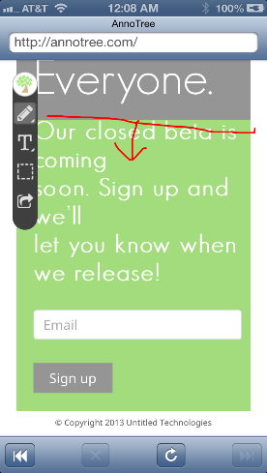
Can Annotate and send back these “leafs” to our collaboration platform
Notes:
Widget on app implemented with one line of code as an SDK

Slide 5
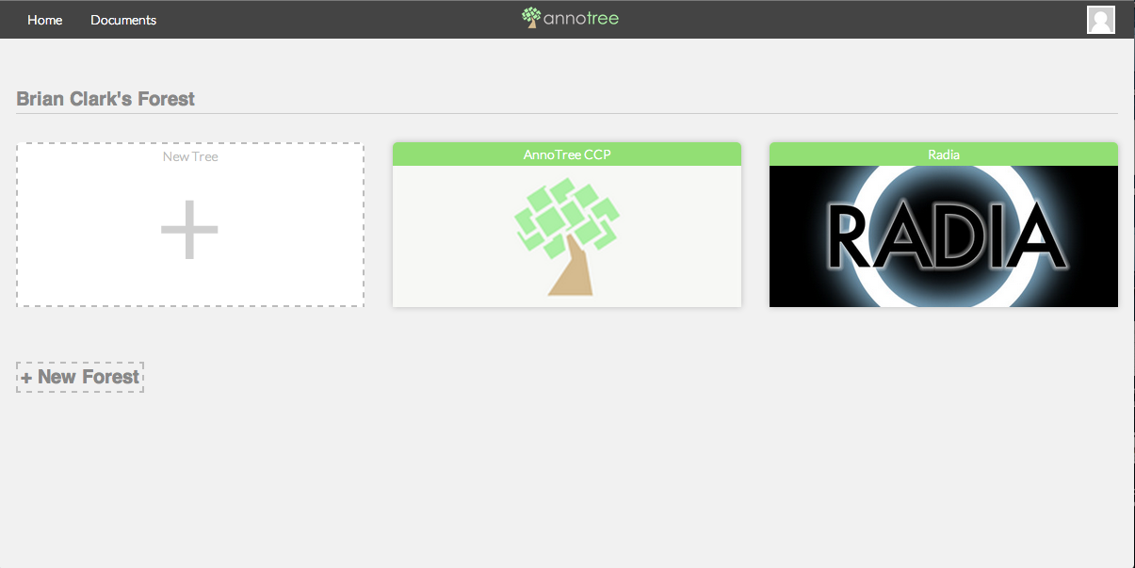
The forest screen has a collection of your Trees (applications)
Notes:
Forest CCP with Notifications

Slide 6
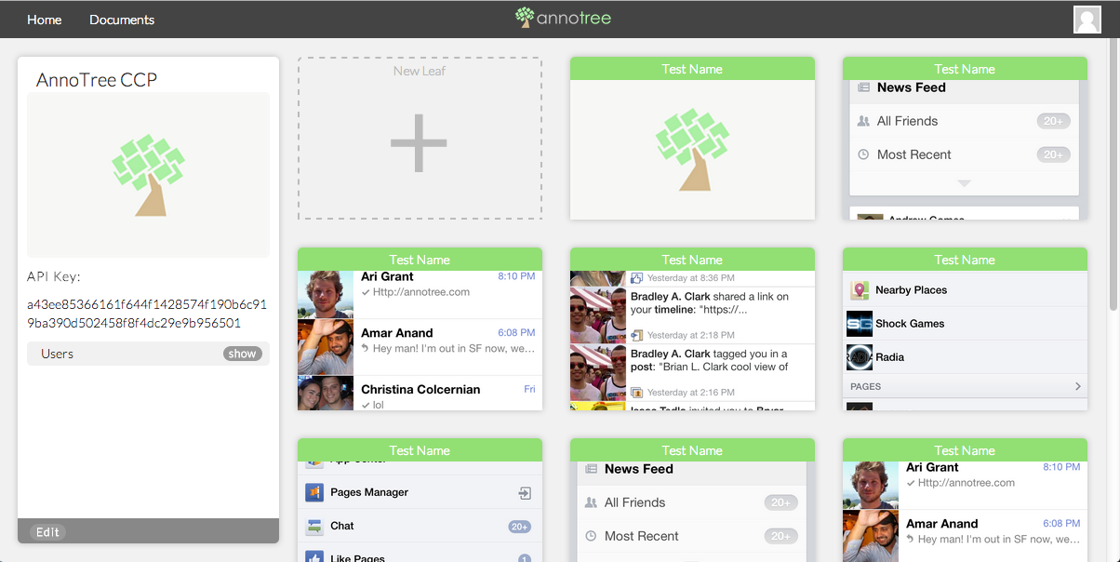
On the tree screen you can organize all your leafs
Notes:
Forest CCP with Notifications

Slide 7
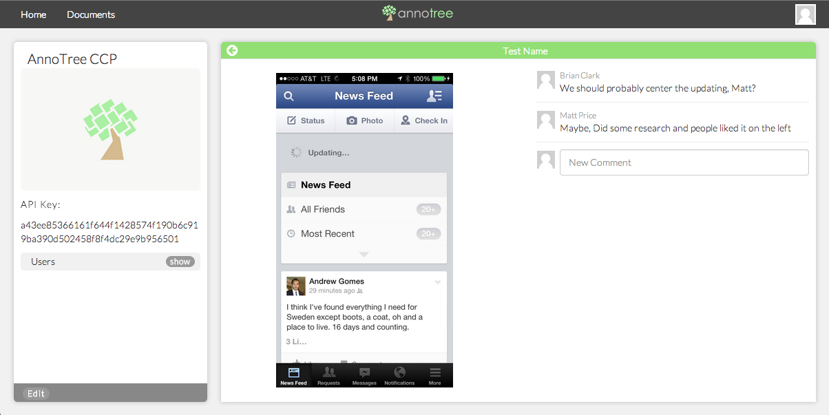
And collaborate on them with your entire team
Notes:
Forest CCP with Notifications

