Slide 1


Notes:
Mention company big picture
A Mobile First company building Beautiful, Intuitive platforms for application and business development

Slide 2

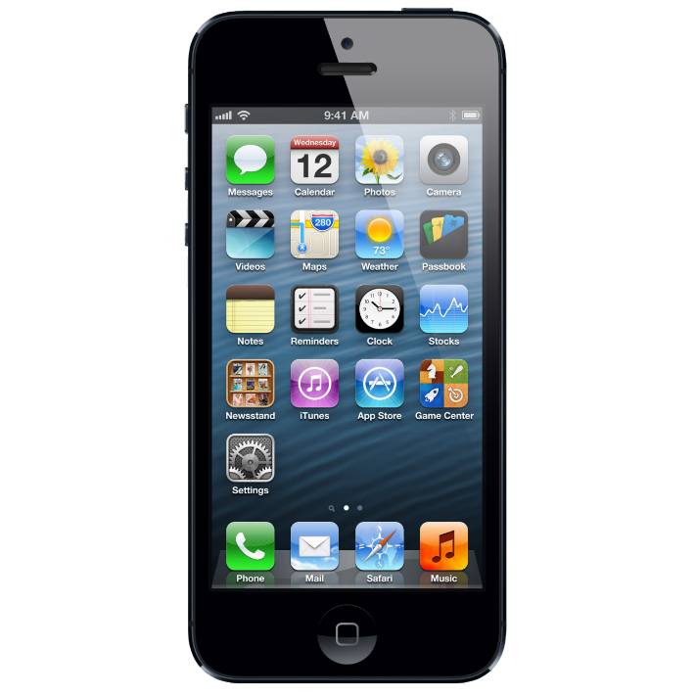

AnnoTree
AnnoTree is a new way to organize and collaborate on design and testing for mobile applications
Notes:
Sends to cloud
Organized in CCP

Slide 3
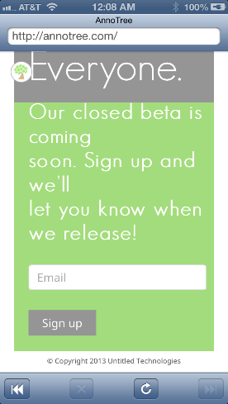
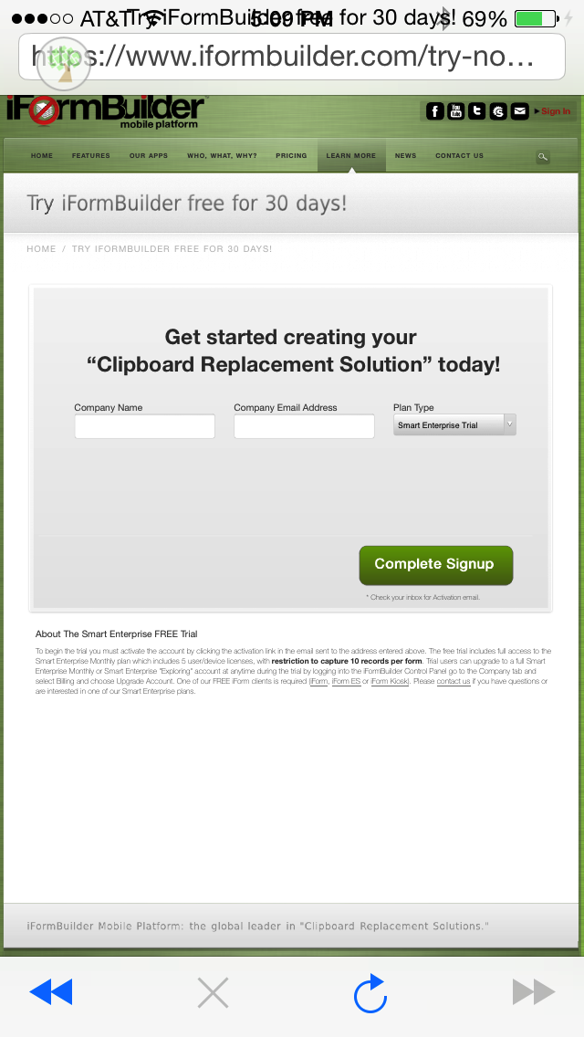
Notes:
Widget on app implemented with one line of code as an SDK

Slide 4
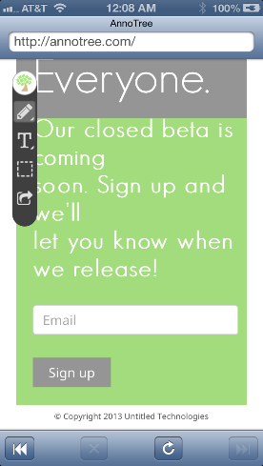
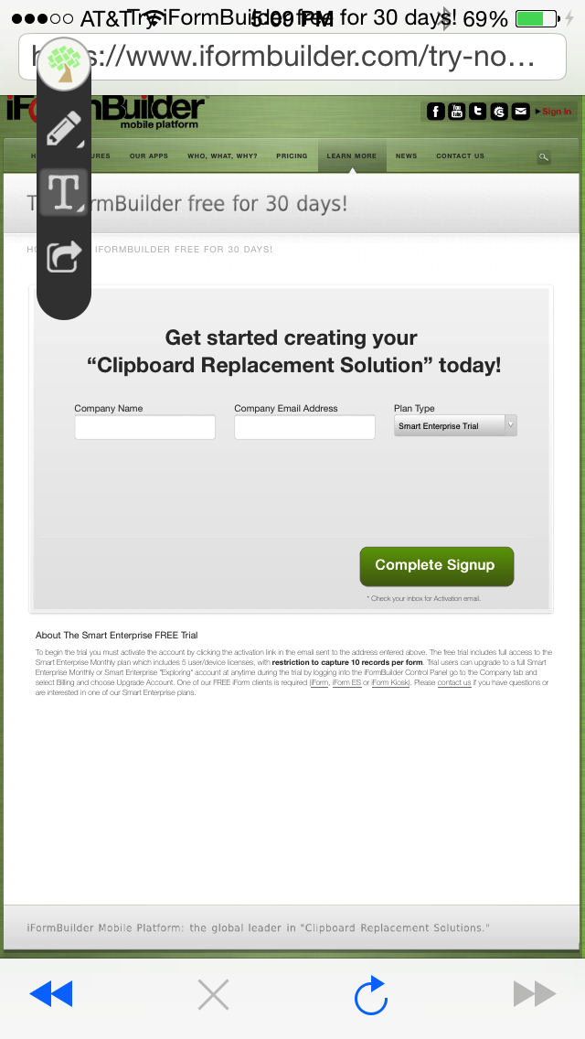

Slide 5
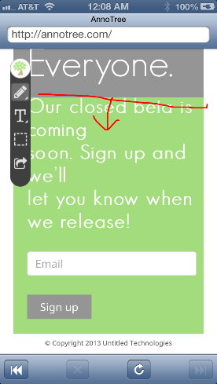
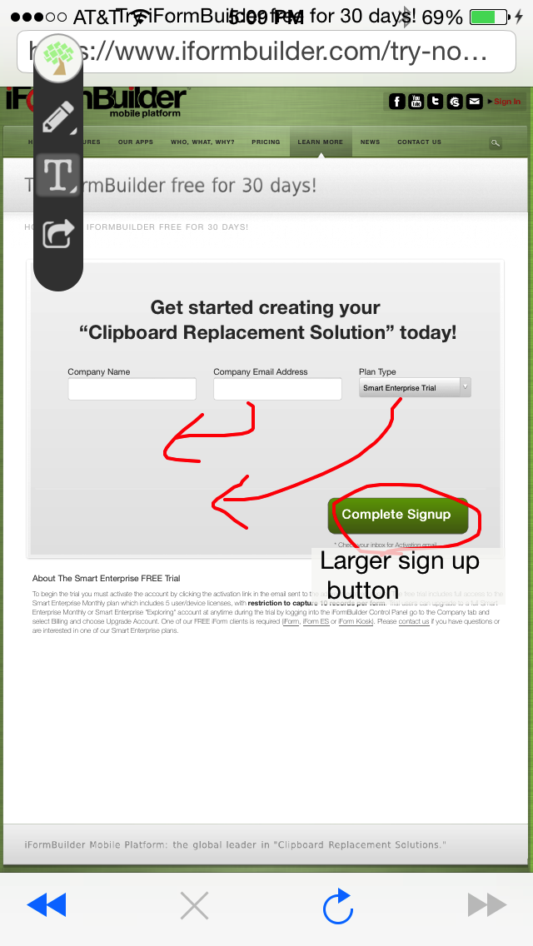

Slide 6
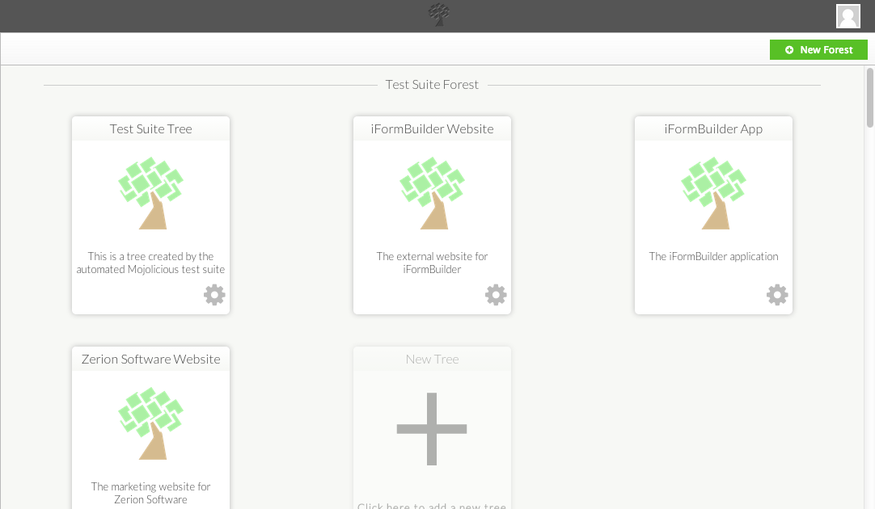
Notes:
Forest CCP with Notifications

Slide 7
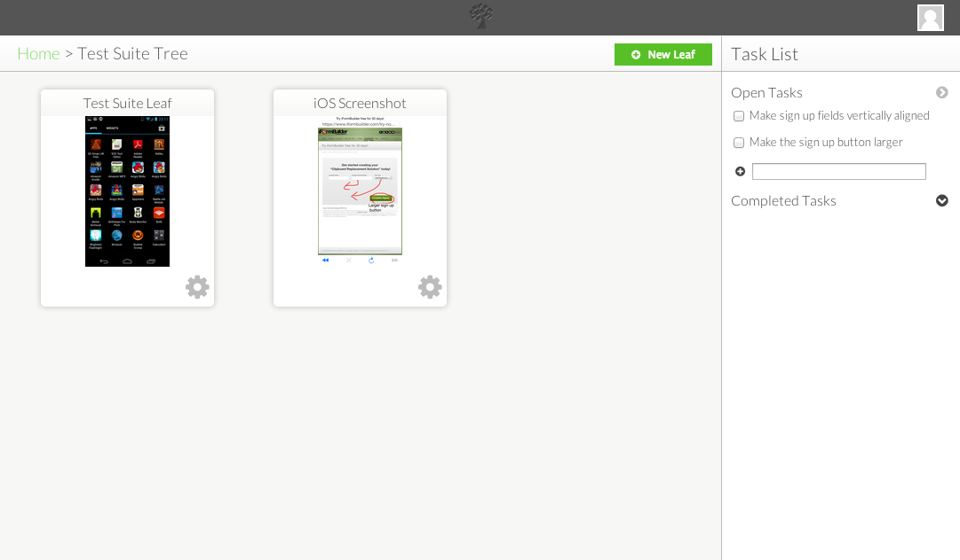
Notes:
Forest CCP with Notifications

Slide 8
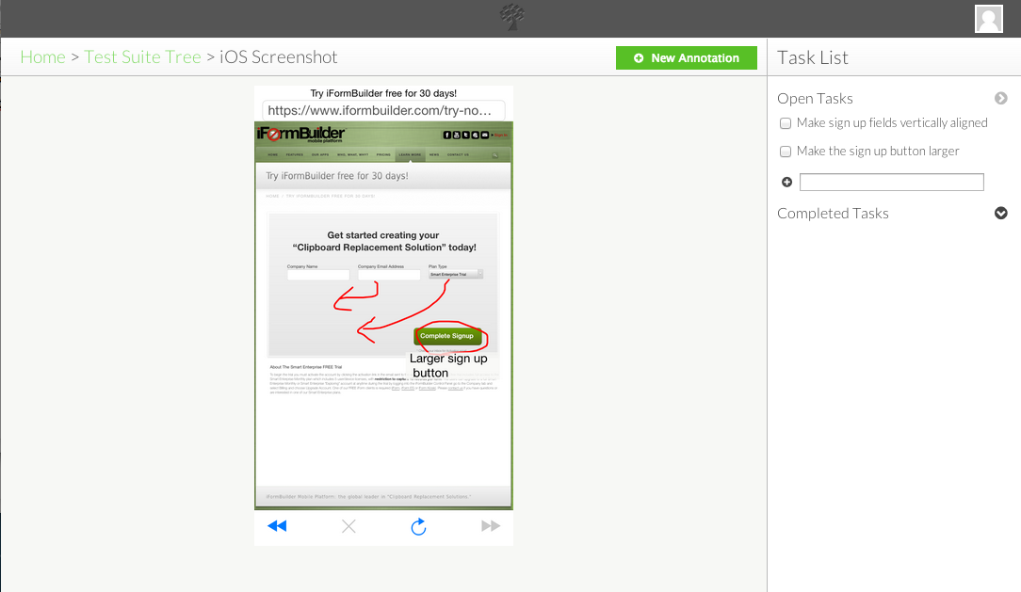
Notes:
Forest CCP with Notifications

