Slide 1
Astrophysics Stuff: k and v

Slide 2
Getting the data
Courtney supplied a list of identifiers for the starts in the northern hemisphere (over 250,000).

Slide 3
Getting the data
Courtney supplied a list of identifiers for the starts in the northern hemisphere (over 250,000).
She believes their K and V values might help her predict which are useful for her research.

Slide 4
Getting the data
Courtney supplied a list of identifiers for the starts in the northern hemisphere (over 250,000).
She believes their K and V values might help her predict which are useful for her research.
Data is available through SIMBAD astronomical database

Slide 5
Getting the data
Courtney supplied a list of identifiers for the starts in the northern hemisphere (over 250,000).
She believes their K and V values might help her predict which are useful for her research.
Data is available through SIMBAD astronomical database
CHALLENGE: query one object at a time

Slide 6
Getting the data
Courtney supplied a list of identifiers for the starts in the northern hemisphere (over 250,000).
She believes their K and V values might help her predict which are useful for her research.
Data is available through SIMBAD astronomical database
CHALLENGE: query one object at a time
SOLUTION: from astroquery.simbad import Simbad

Slide 7
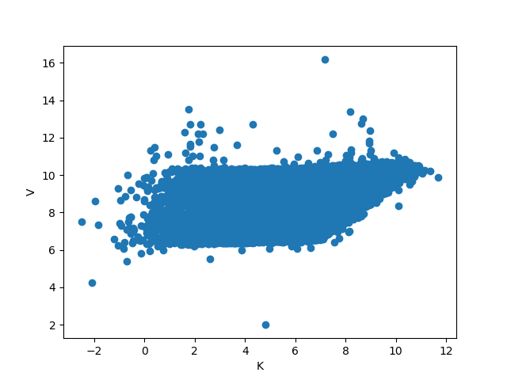
The Data

Slide 8
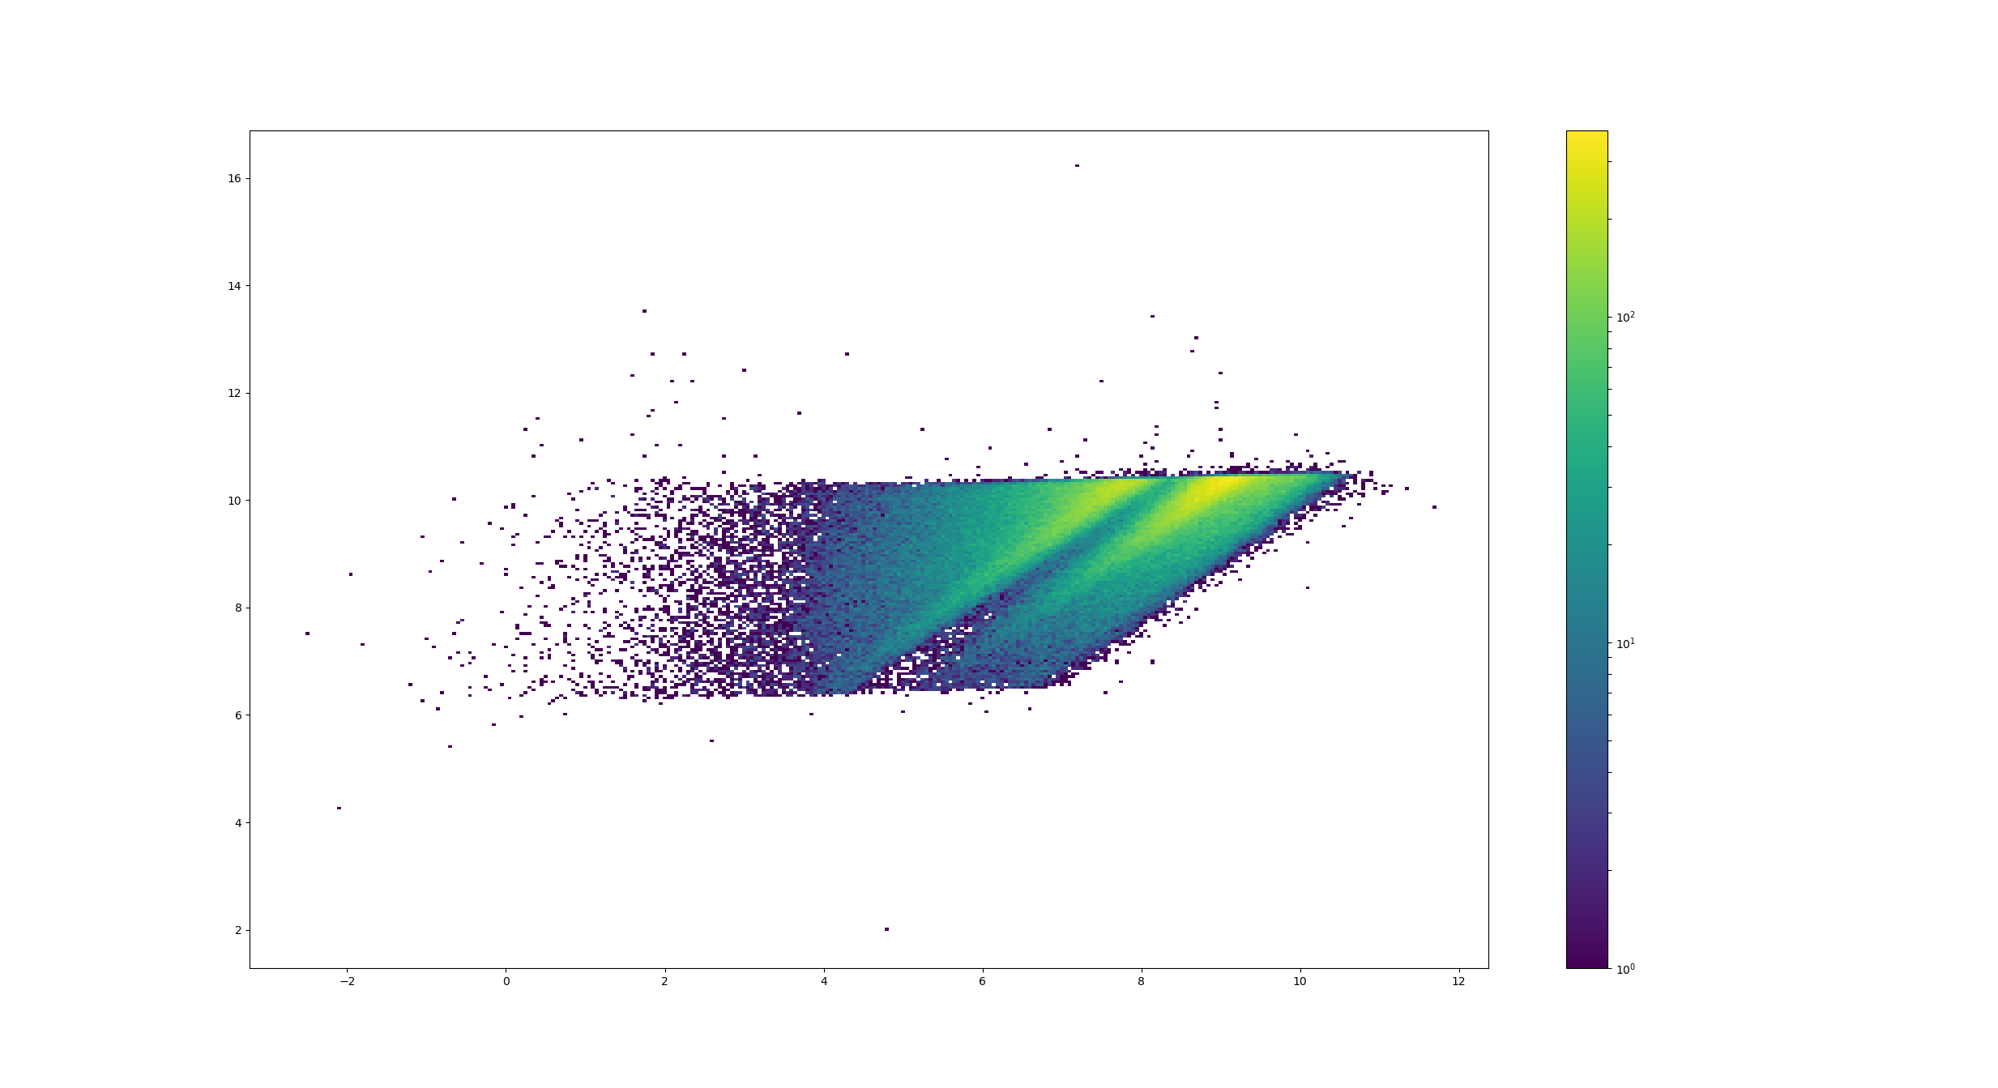
The Data

Slide 9
Interactive Visualizations
Bokeh
  Select only points that fall along a slanted line
  Learn more about the shape of the data

Slide 10
Courtney Achievements
Comfort with python
Visualizations with matplotlib.
Experience with pandas data frames.
Experience finding and using astronomical python packages

Slide 11
Clint Achievements
Experience with bokeh
Experience with affine image/data transformations using skimage
Experience making 2d histograms

Slide 12
Further Work
Select by width, angle, and diagonal crossing instead of width, slope, and y intercept
Integrate with Courtney‘s research to select where the relevant starts have been found.

