Slide 1
Compiling C code 101

Slide 2
Executables

Slide 3
Creating an executable
Header files
(.h)
Preprocessor
(cpp)
Source code with macros expanded
(.i)
Compiler (cc1)
Human readable assembly file(s) (.s)
Assembler (as)
Source code
(.c)
Object file(s) (.o)
ELF binary
(or Mach-O binary or PE binary)
Dynamic linker (/lib64/ld-linux-x86-64.so.2)
Running process
Header files
(.h)
linker (ld, gold, lld)
Shared libraries (.so or .dylib or .dll)
Shared libraries (.so or .dylib or .dll)
Static libraries (.a)
<- Compile time
Runtime ->

Slide 4
 | gcc | llvm
Compiler driver | gcc | clang
Preprocessor | cpp | clang-cpp
Compiler | cc1 | clang -cc1
Assembler | as (binutils) | llvm-as
Linker | ld (binutils) gold (binutils)* | lld
Dynamic linker / loader | linux: /lib64/ld-linux-x86-64.so.2 macos: /usr/lib/dyld (I think?)
Debugger | gdb | lldb
Archiver | ar | llvm-ar

Slide 5
LLVM frontends
.c and .h files
Clang
Machine code
(x64_64)
.rs files
Rustc
Machine code
(aarch64)
LLVM Intermediate Representation (LLVM IR)
LLVM backend
.zig files
Zig compiler
…
.swift files
Swift compiler
…

Slide 6
Libraries

Slide 7
Shared libraries: What and why?
It’s a library
That contains code and data
That can be loaded dynamically at runtime
That can be shared or reused by multiple processes
Pros:
Disk space usage
Memory usage
Localization
Bug fixes, security patches, etc.
Development time (only have to keep recompiling shared lib, not entire project)
Cons:
Sometime a pain to get all the shared libs where they need to be
Lots of “assumptions” about what is on your system and where it is
Can’t optimize across shared library boundary (every call across a shared library boundary is essentially an indirect call)

Slide 8
Static library: What
It’s a library
That contains code and data
That can be compiled in at compile time

Slide 9
Creating a shared library
Creating a static library
Object file(s) (.o)
Object file(s) (.o)
Object file(s) (.o)
linker (ld, gold, lld)
Shared library (.so or .dylib or .dll)
Object file(s) (.o)
ar
Static library (.a)
Object file(s) (.o)
Object file(s) (.o)

Slide 10
Demo: Making an executable

Slide 11
Code
Just run
Just build-simple

Slide 12
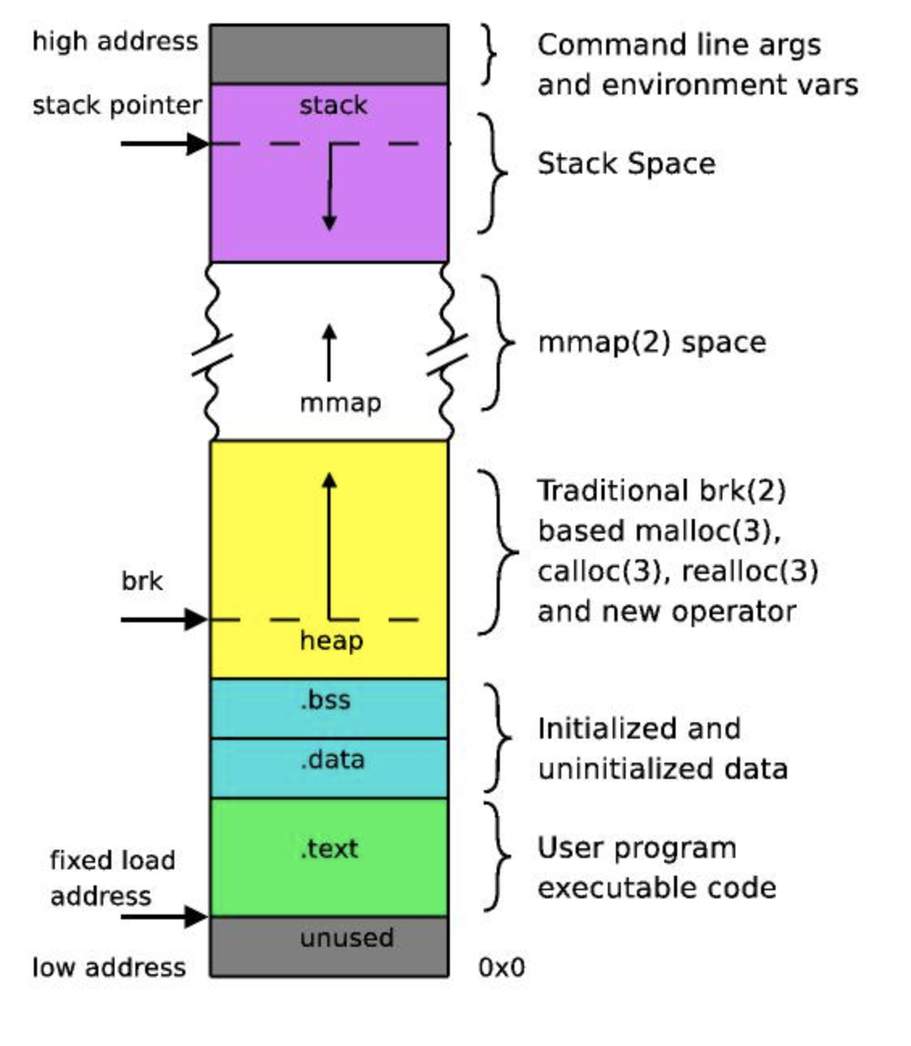
Process memory (basic)

Slide 13
Aside: main is not the start of your program
Just build-simple
nvim build/main/main-no-pie-dynamic.dump
nvim /usr/src/glibc/glibc-2.35/csu/libc-start.c

Slide 14
Position Independence
Position Independent Executable (PIE)
The default
Dynamic loader can place your executable at any place in virtual memory
Position Independent Code (PIC and pic)
Used for building shared libraries

Slide 15
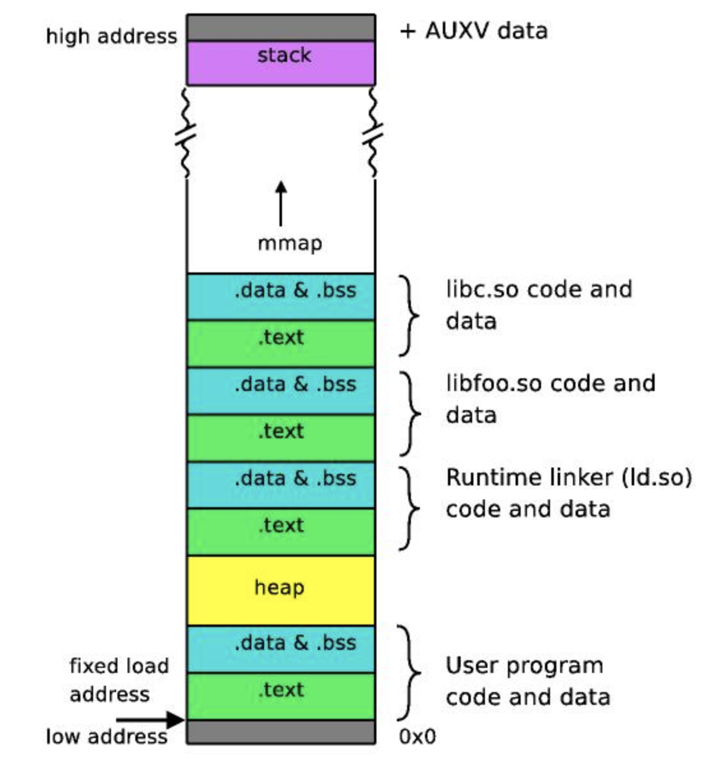
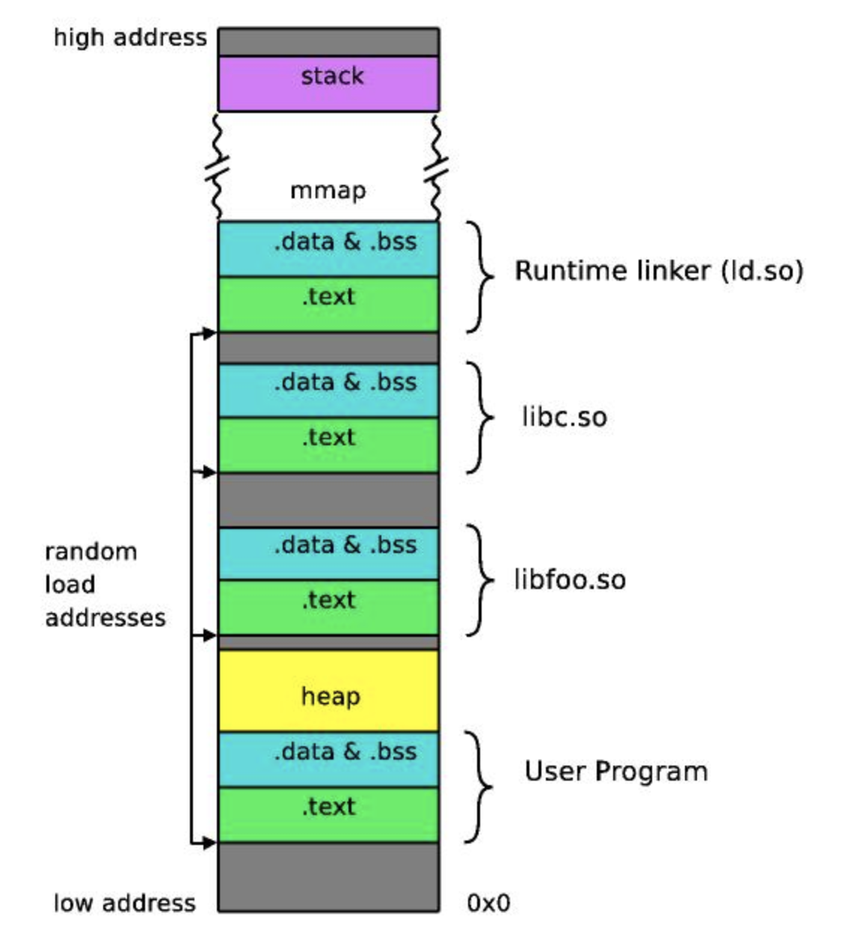
Address Space Layout Randomization
No ASRL / No shared libs
No ASRL / Shared libs
ASRL / Shared libs

Slide 16
Global Offset Table (GOT) and Proceedure Linkage Table (PLT)
Used to access external variables or call external functions whose address is not known at the time of linking, but is left to be resolved by the dynamic linker at run time
GOT table (r/w): Use for variables
All global variables are pointers to the GOT
Dynamic linker fixes up the GOT at runtime
Not lazy; does the all
PLT table (read-only): Use for functions
Unlike variables, lazy binding
You never resolve addresses of functions you never call (but performance hit at runtime)
Each PLT entry has a corresponding GOT entry (GOT is used for indirection)
PLT[0] always a pointer to the dynamic linker

Slide 17
Just file

Slide 18
File formats
linux and BSDs: Executable and Linkable Format (ELF)
macos: Mach Object File Format (Mach-O)
windows: Portable Executable Format (PE)

Slide 19
Little endian
Representation in memory:
0x00_00_00_01
Logical representation (i.e. what the number actually is):
0x01_00_00_00
= 16777216
!= 1

Slide 20
Calling convention
Example:
System V x86-64
This is a 64-bit platform. The stack grows downwards. Parameters to functions are passed in the registers rdi, rsi, rdx, rcx, r8, r9, and further values are passed on the stack in reverse order. Parameters passed on the stack may be modified by the called function. Functions are called using the call instruction that pushes the address of the next instruction to the stack and jumps to the operand. Functions return to the caller using the ret instruction that pops a value from the stack and jump to it. The stack is 16-byte aligned just before the call instruction is called.
Functions preserve the registers rbx, rsp, rbp, r12, r13, r14, and r15; while rax, rdi, rsi, rdx, rcx, r8, r9, r10, r11 are scratch registers. The return value is stored in the rax register, or if it is a 128-bit value, then the higher 64-bits go in rdx. Optionally, functions push rbp such that the caller-return-rip is 8 bytes above it, and set rbp to the address of the saved rbp. This allows iterating through the existing stack frames. This can be eliminated by specifying the -fomit-frame-pointer GCC option.
Signal handlers are executed on the same stack, but 128 bytes known as the red zone is subtracted from the stack before anything is pushed to the stack. This allows small leaf functions to use 128 bytes of stack space without reserving stack space by subtracting from the stack pointer. The red zone is well-known to cause problems for x86-64 kernel developers, as the CPU itself doesn't respect the red zone when calling interrupt handlers. This leads to a subtle kernel breakage as the ABI contradicts the CPU behavior. The solution is to build all kernel code with -mno-red-zone or by handling interrupts in kernel mode on another stack than the current (and thus implementing the ABI).

Slide 21
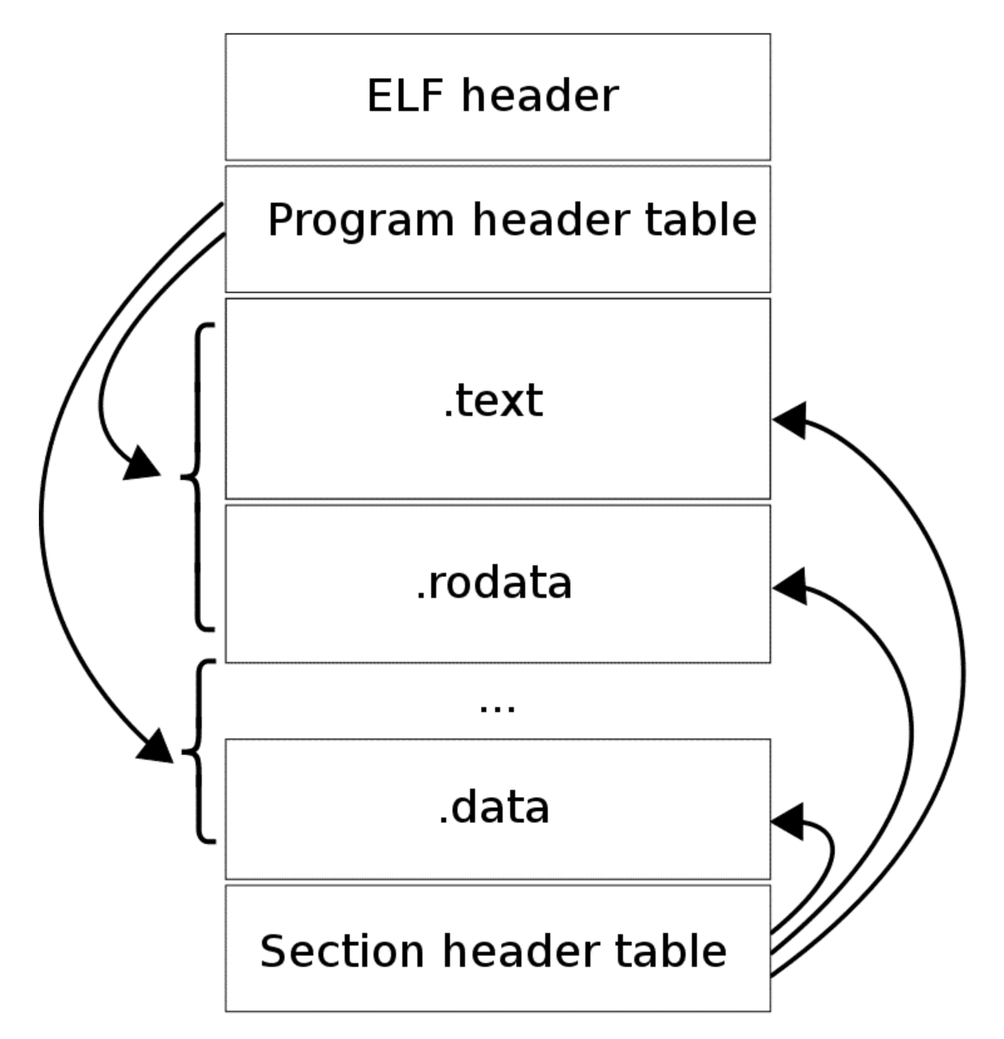
ELF
Program headers (used at runtime by dynamic linker)
Section headers (used at compile time by linker)

Slide 22
Just needed
Just program-headers
Just run-gdb

Slide 23
Your process’s virtual address space
Libc (shared memory)
printf code
Dynamic linker
GOT
Printf entry
Your code’s .text section
Call to printf

Slide 24
Demo: Making libraries

Slide 25
Compiler flags
-I<path>
Extra “include” path
Non-standard directory to search for .h files in
-L<path>
Extra “lib” path
Non-standard directories to search for .a and .so files in
-l<libname>
Specifically link against <libname> library

Slide 26
Just run2
Just run3

