Slide 1
Question and Answering System And Computer Science Education
Belinda Copus
CS 5560
Summer 2017

Slide 2
Motivation
Introductory computer programming courses have high rates of failure.
Intelligent Tutoring Systems exist but are lacking. The system is often reactive and limited in scope.
Could Knowledge Discovery be applied to this issue?

Slide 3
Data Source/ Corpus
Freely available textbooks on programming languages.
Data available in PDF format, opened in Word, saved as .txt.
Data was very dirty and required some preprocessing to remove unregonizable characters and other items that would be gargage to the pipeline.
Corpus included a single textbook on Python, with each chapter dividend into a separate document, for a total of 23 documents.

Slide 4
Raw Corpus
QA Dataflow
RDD [Document]
RDD [Concepts]
RDD [Sentence]
Score doc. full text TF-IDF
score doc concepts TF-IDF
Answer Processing
Composite doc score
Select best 5 docs
Score sentences
Select best 5 sentences
Extract answer
Question expansion
Question
Lemmatize
Noun/Verb extraction
select best answer
Question Processing

Slide 5
QA System Class Diagram
Abstract Document
<<Interface>>
AnswerProvider
TF-IDF Document Processor Document (Scala)
Document
Sentence
Core NLP Pipeline
QA System
(Scala)
<<enum>>
PartOfSpeech
Token
Core NLP Wrapper
Question
<<enum>>
Named Entity Class
<<enum>>
InterogativeType
Word Expansion

Slide 6
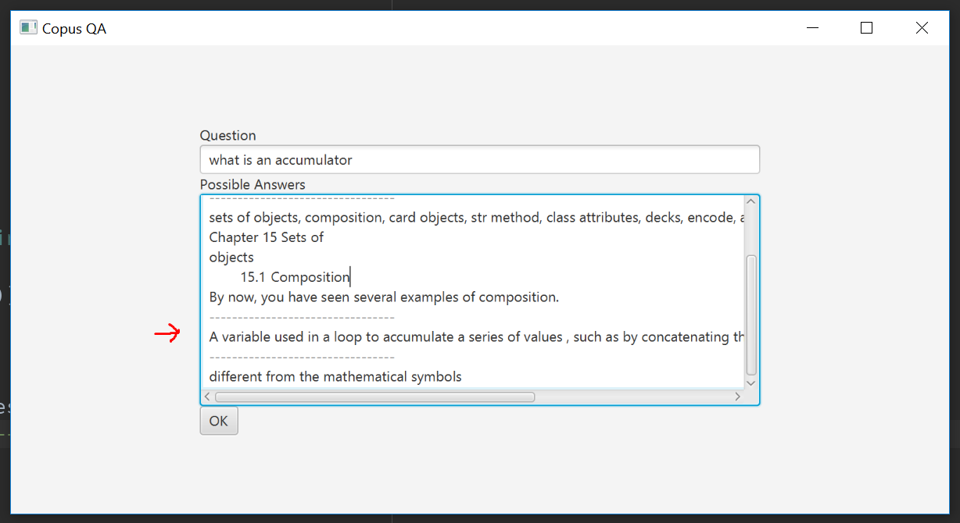
Screenshots

Slide 7
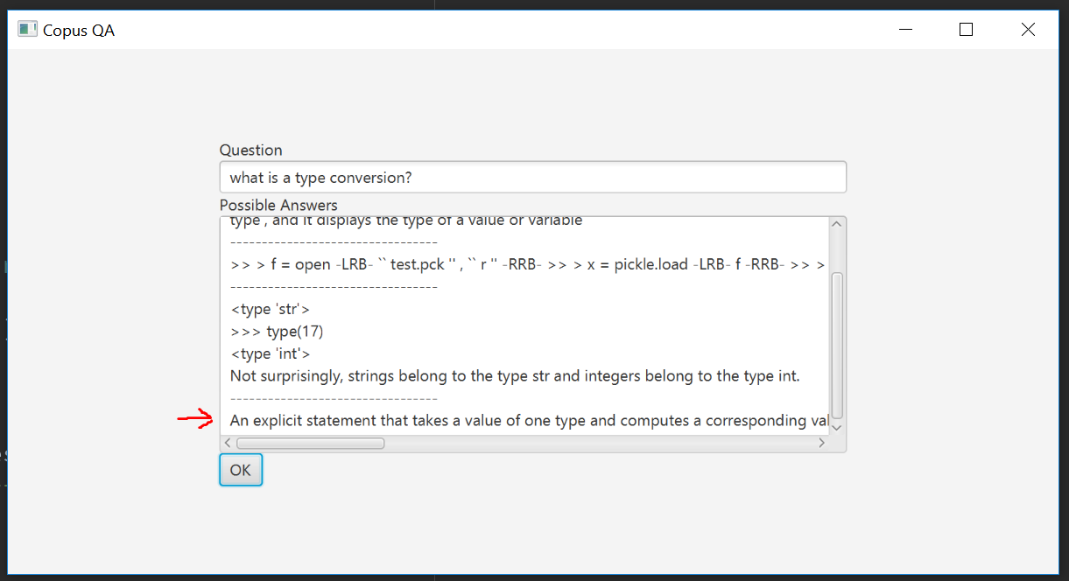
Screenshots

Slide 8
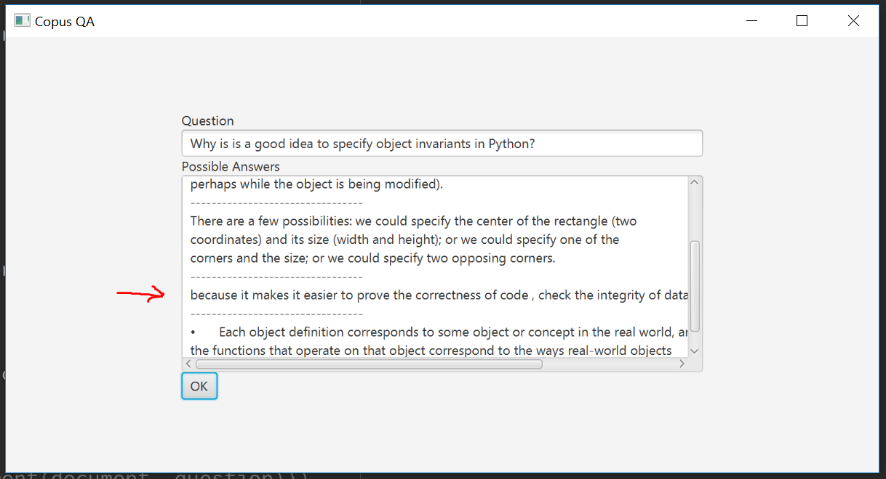
Screenshots

Slide 9
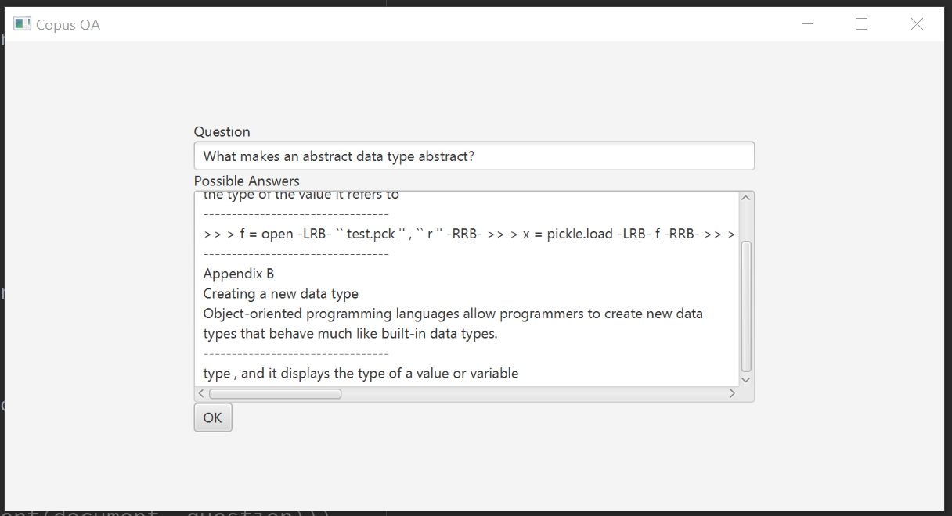
Screenshots
This next one, no answer. The question is too abstract

Slide 10
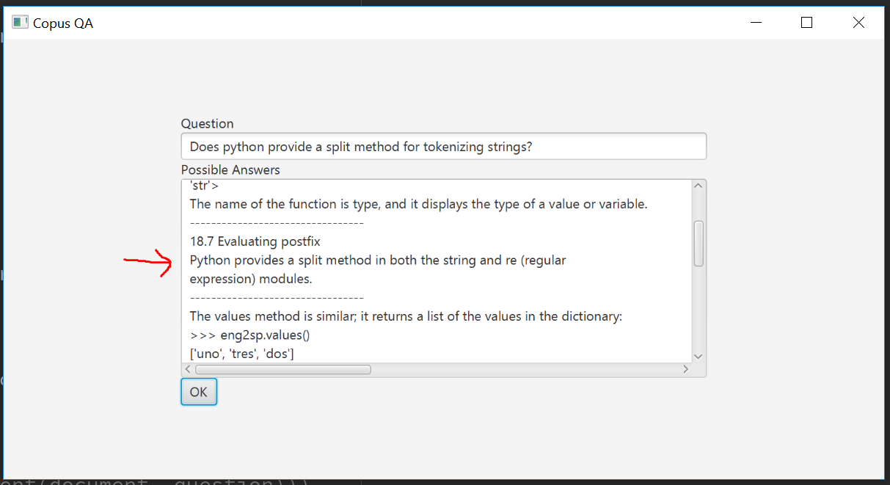
Screenshots

Slide 11
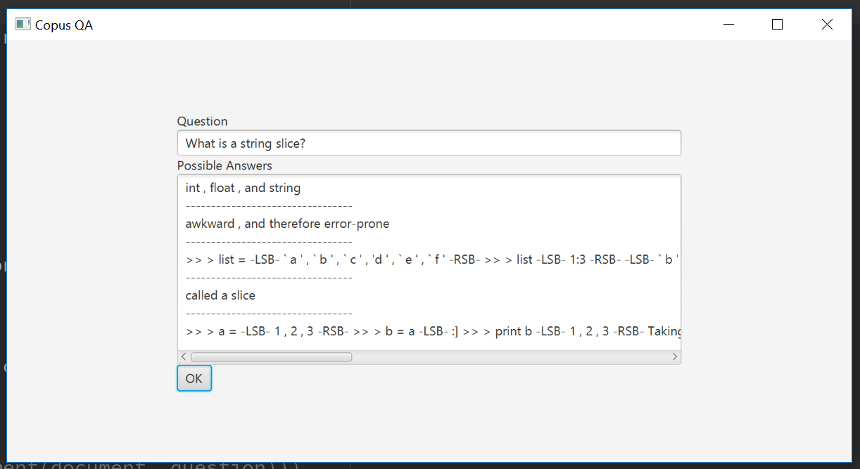
Screenshots
Next one shows a weakness in that we are processing code as if it were natural language, we need to parse the code in another way, or else recognize and ignore, when we preprocess the corpus

Slide 12
What works, what doesn’t
Gets pretty close, but does not have the ability to pick a best answer to a question.

Slide 13
Discoveries
Synonyms for technical content was inadequate in WordNet.
Manually created synonyms
topic discovery was weak. Leveraged glossary and index to develop topics.

Slide 14
Improvements for future development
Ontology for programming languages would be useful. This is already being done in the world of medicine.
Include much more data for improvement in determining correct answer to a question.

