Slide 1
Quantum Selective Encryption for Medical Images
Heidari, S., Naseri, M. & Nagata, K. International Journal of Theoretical Physics 58, 3908–3926 (2019). https://doi.org/10.1007/s10773-019-04258-6
Brian Cornet
ECE 621 – Multimedia Communications
Dr. Honggang Wang
November 24, 2020

Slide 2
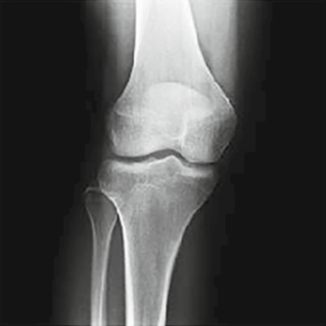
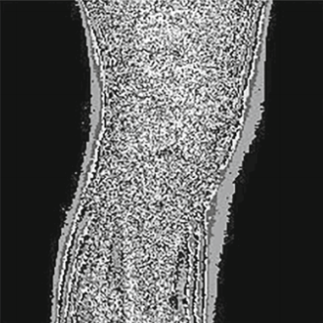
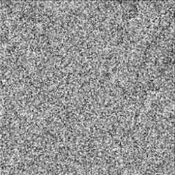
Selective Encryption for Medical Images
Image encryption for only the relevant parts of an image, aka region of interest (ROI)
Improves encryption/decryption time over full encryption by skipping irrelevant parts
Less secure than full encryption of the entire image
Medical grayscale images from ultrasounds, x-rays, etc. have large black (0x00) space
Ideal for entropy encoding to reduce file size and improve transmission time
Selective encryption retains black space; full encryption makes it noisy
Original Image
Selectively Encrypted
Fully Encrypted

Slide 3
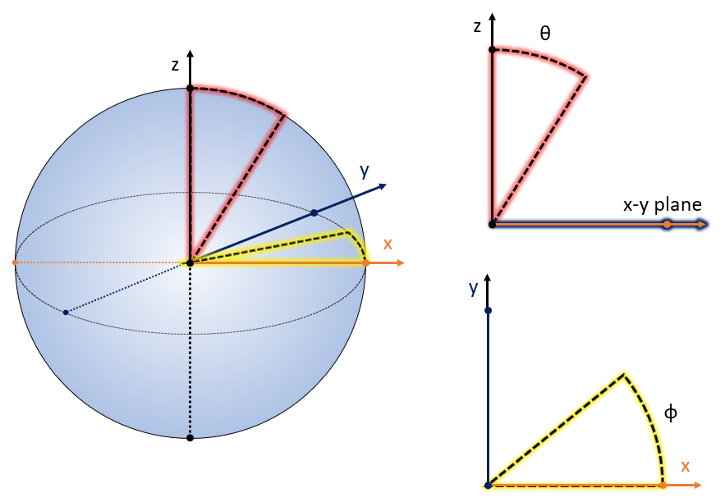
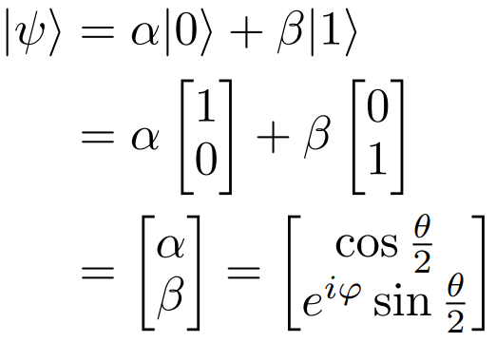


Classical vs. Quantum: Bit Representation
Classical bits are discrete values of 0 or 1 exclusively
Quantum bits (qubits) are continuous probability vectors of 0 or 1 inclusively
0
0
1
1

Slide 4
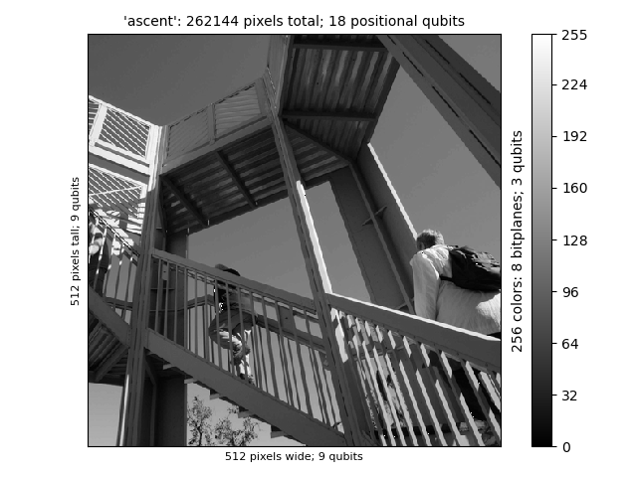
Classical vs. Quantum: Bit String Lengths
In a classical bitmap, an MˣN image with C colors needs MˣNˣlog₂(C) bits
The Bitplane Representation of Quantum Images (BRQI) method needs log₂(MˣNˣlog₂(C)) + 1 qubits
Bit Type | Classical | Quantum
Position | 262144 | 18
Color | 8 | 3
Value | 1 | 1
Total Bits | 2097152 | 22

Slide 5
Classical vs. Quantum: Algorithms
Classical algorithms must operate over sets of bits iteratively
Very easy to manipulate, less prone to error
Improved with more efficient algorithms, better processors, and multiple threads
Quantum algorithms can operate over sets of entangled qubits simultaneously
Significantly improved time complexity for large sets, completely secure while in quantum state
Improved with better particles/environments for manipulation, better error correction

Slide 6
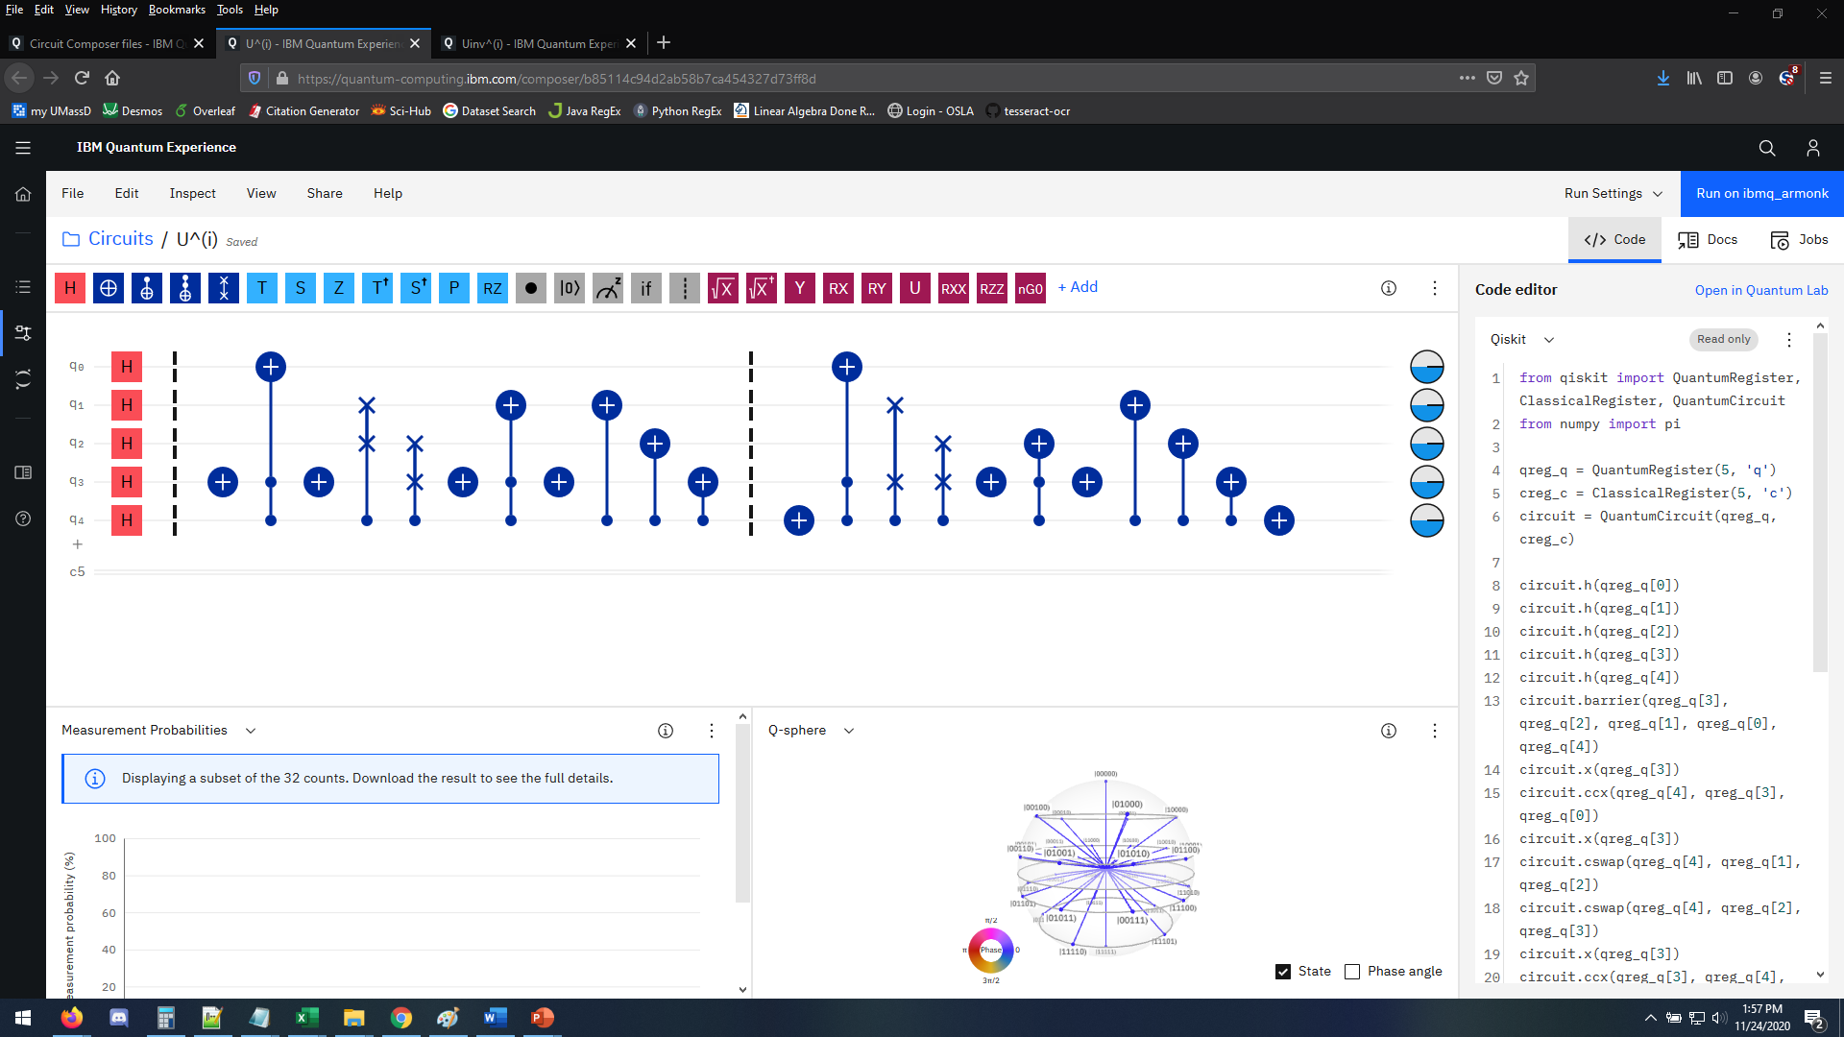
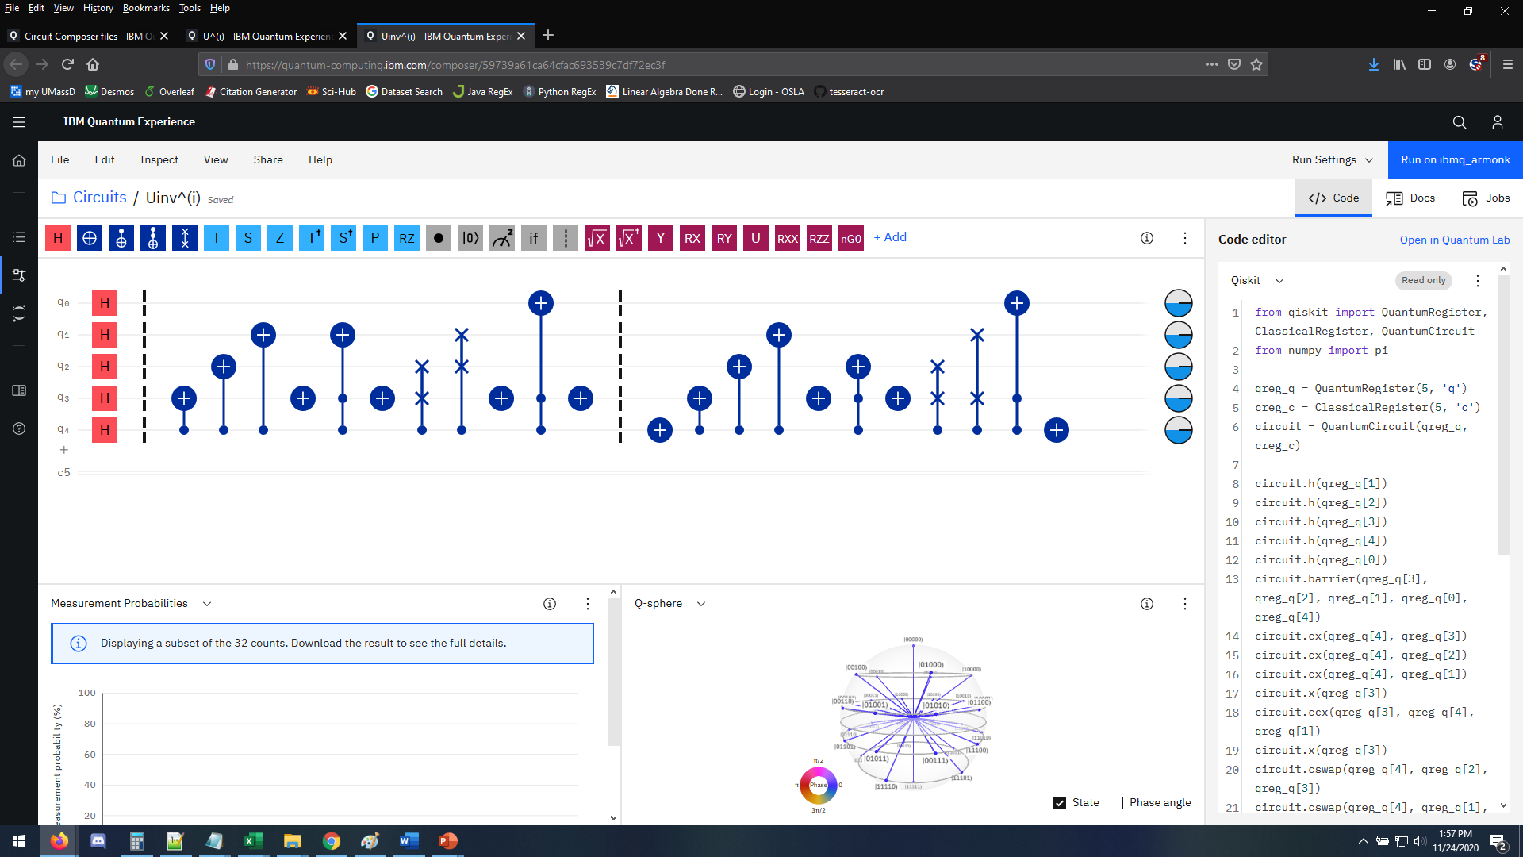
Recreating the Encryption Method
The base paper from Heidari et al.¹ describes the encryption and decryption methods for an image already represented in quantum data. Recreating these methods was done in IBM’s Quantum Computing Circuit Composer. This provided initial code for Qiskit (Python).
Encryption Method
Decryption Method

Slide 7
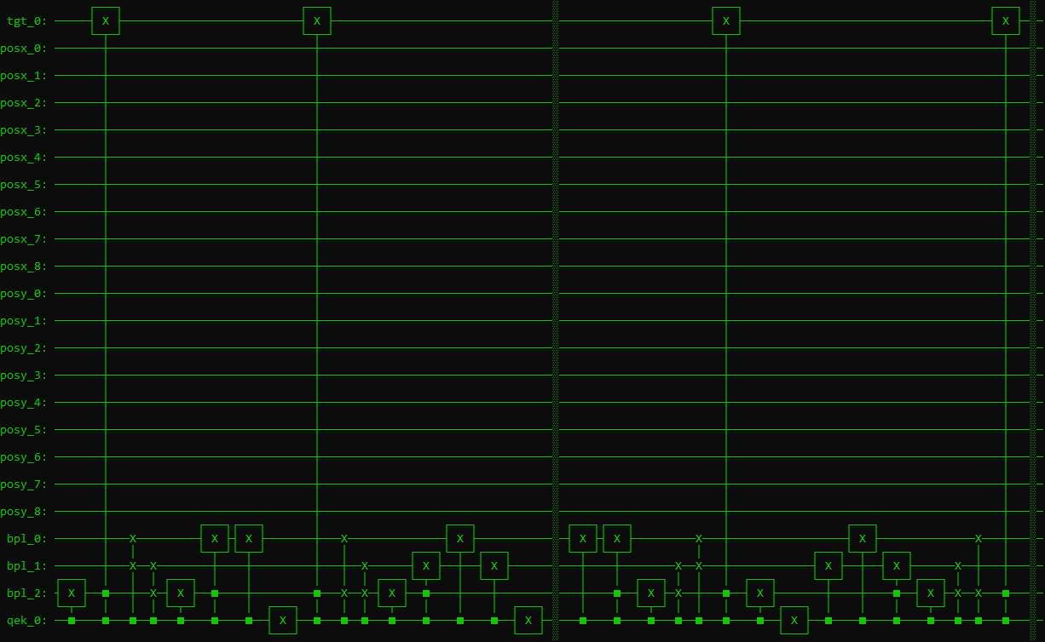
Converting Classical Data to Quantum
Problem: need to recreate images in qubits
No-cloning theorem:
An arbitrary unknown qubit cannot be copied or amplified without disturbing its original state.
?

Slide 8
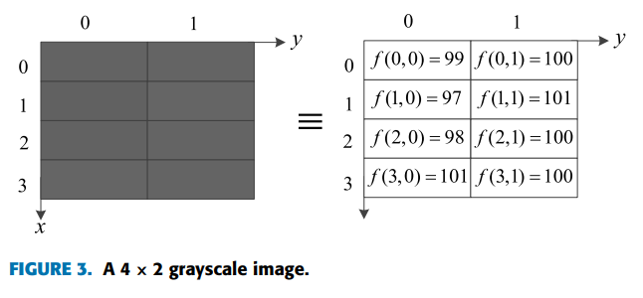
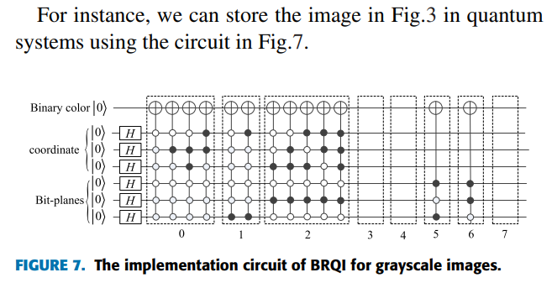
Using Quantum Circuits to Initialize Data
Solution in “A Quantum Image Representation Based on Bitplanes” by Li et al³.
Initial states are created through a quantum circuit specific to that image
CNOT (conditional-NOT) gates are used to create dependencies between specific outcomes

Slide 9
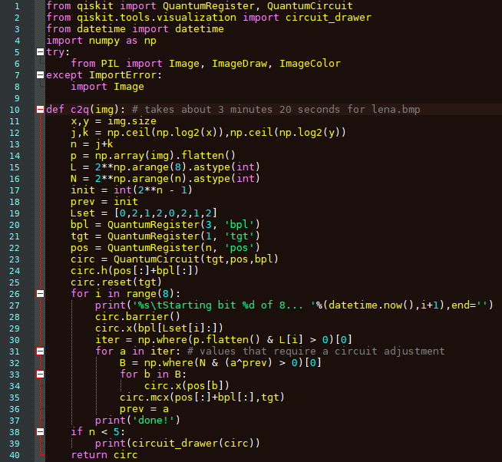
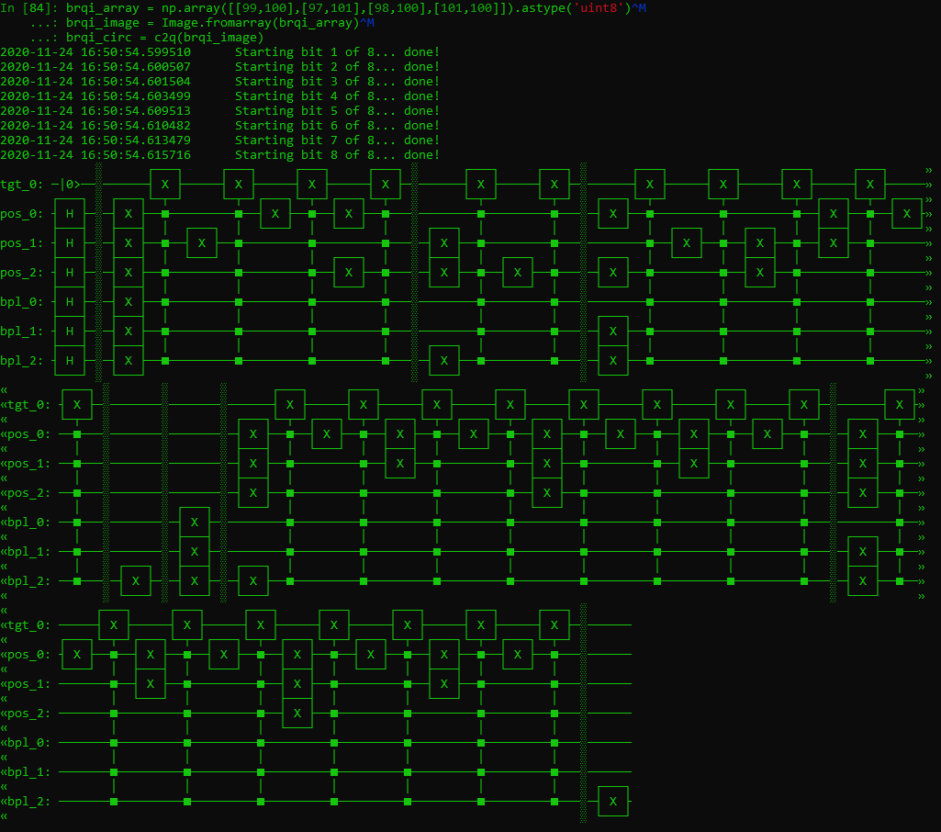
Qiskit Circuit Generation
This code demonstrates a basic implementation of the method for creating a circuit that generates a specific image as quantum data.
The example here is the same as the image from the previous slide.

Slide 10
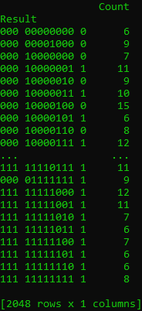
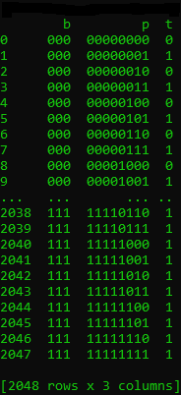
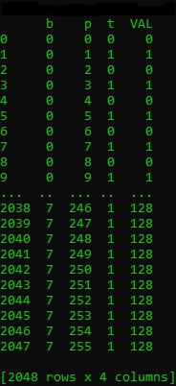
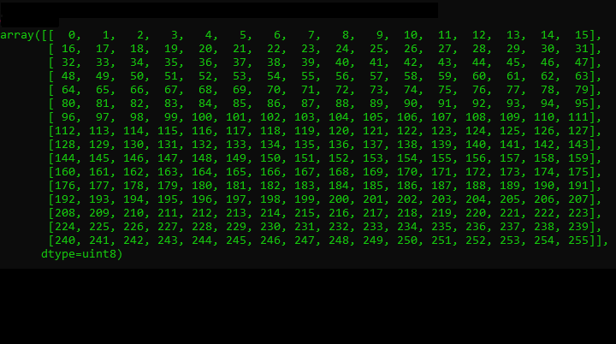
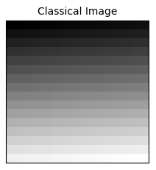
Image Retrieval through Measurements
Quantum states need to be measured to “collapse” onto a classical 0 or 1
One measurement only gives one out of 2^{n+3} results at random, so we need lots of measurements
With all 2^{n+3} results returned as bit strings, the image can eventually be reconstructed
Selectively Encrypted

Slide 11
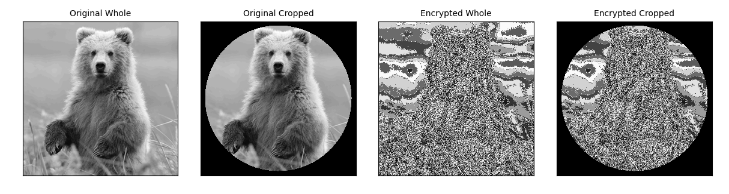
Encrypting Large Images
Quantum simulations on a common classical device can still take a while
Images over 16x16 (6 positional qubits) exceed memory limits
Solution is to break images into 16x16 blocks, encrypt, then reassemble

Slide 12
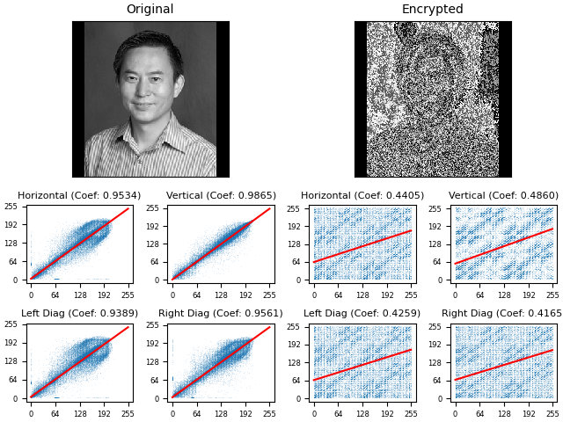
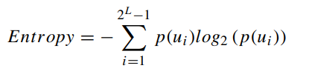
Correlation and Entropy Testing
Normally, adjacent pixels have a high correlation
Encrypted images should have lower correlation and a Shannon entropy near 8
Heidari et al. reported correlation coefficients < 2% and entropy > 7.95 for fully encrypted 256 x 256 images
Entropy: 6.4456
(both images)

Slide 13
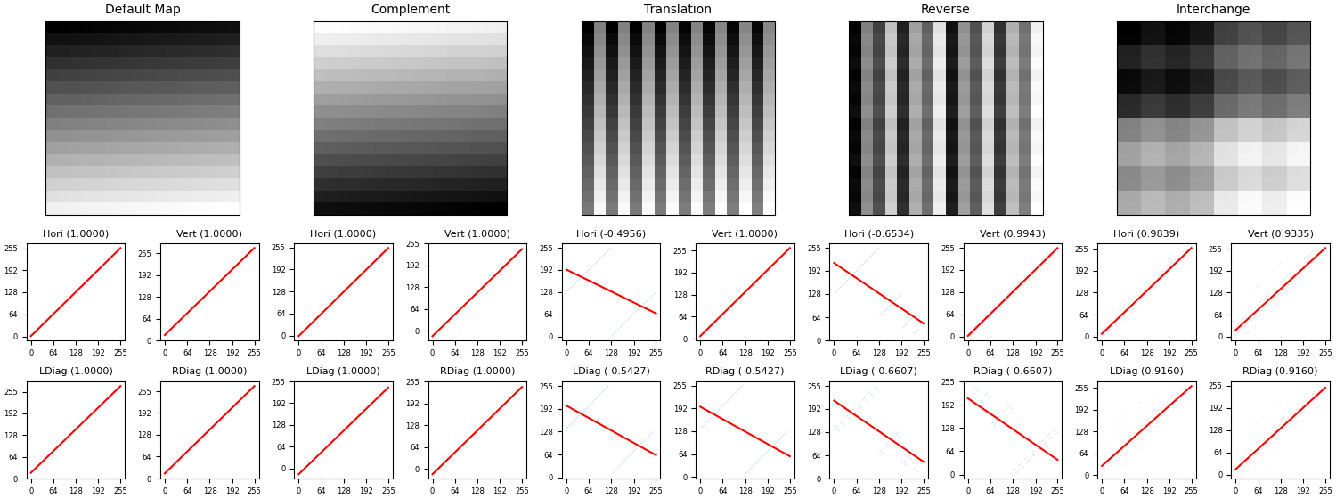
Encryption Transformations

Slide 14
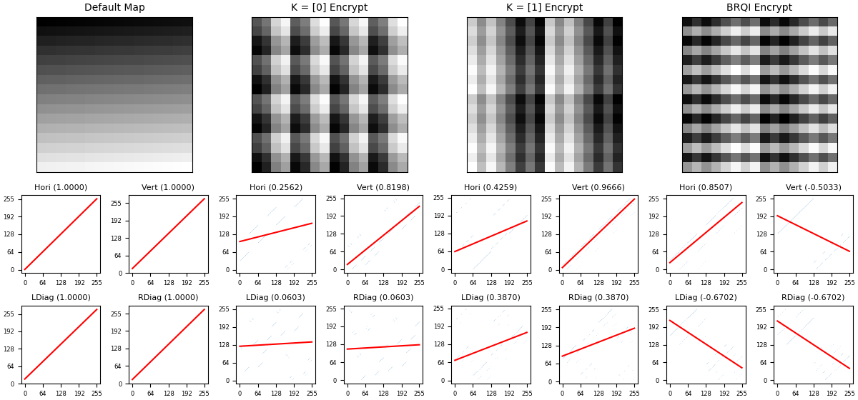
Encryption Methods on Sample Palette
Ignoring complement methods which are incompatible with selective encryption, the BRQI transform has a better immediate result than either encryption operation.
Note that entropy is still fixed and minimum correlations will be limited when some areas have solid colors.

Slide 15
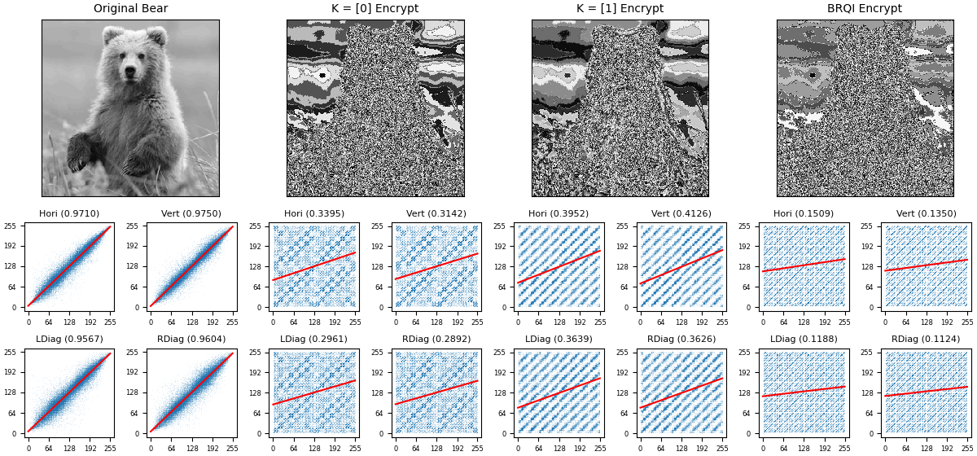
Encryption Methods on Bear Image
Ignoring complement methods which are incompatible with selective encryption, the BRQI transform has a better immediate result than either encryption operation.
Note that entropy is still fixed and minimum correlations will be limited when some areas have solid colors.

Slide 16
Simulation Results
Correctly created quantum circuits and generated quantum images
Successfully implemented encryption/decryption process with measurements
Simulation did not see similar results in correlation and entropy analysis
First attempt at quantum computing!
The original algorithm uses complements to flip the value bits from 0 to 1 or 1 to 0
This causes black pixels (0x00) to become another color unless specific keys are used
Security is better improved through other methods (reverse, interchange, translation)
Solution: develop a new algorithm that avoids complement operations
Black or white pixels will be left alone, all others change conditionally

Slide 17
References in Draft Report
S. Heidari, M. Naseri, and K. Nagata, “Quantum Selective Encryption for Medical Images,” International Journal of Theoretical Physics, vol. 58, no. 11, pp. 3908–3926, Nov. 2019, ISSN:1572-9575, doi: 10.1007/s10773-019-04258-6.
W. K. Wootters and W. H. Zurek, “A Single Quantum Cannot Be Cloned,” Nature, vol. 299, no. 5886, pp. 802-803, 1982.
H. Li, X. Chen, H. Xia, Y. Liang, and Z. Zhou, "A Quantum Image Representation Based on Bitplanes," in IEEE Access, vol. 6, pp. 62396-62404, 2018, doi: 10.1109/ACCESS.2018.2871691.

Slide 18
Additional References for Final Draft
C. H. Bennett and G. Brassard. “Quantum Cryptography: Public Key Distribution and Coin Tossing,” Proceedings of IEEE International Conference on Computers, Systems and Signal Processing, vol. 1, pp. 175-179, 1984.
N. Hosseinidehaj, et al, “Satellite-Based Continuous-Variable Quantum Communications: State-of-the-Art and a Predictive Outlook,” in IEEE Communications Surveys Tutorials, vol. 21, no. 1, pp. 881-919, 2019.
J.-W. Pan, et al, “Satellite-to-Ground Quantum Key Distribution,” Nature, vol. 549, no. 7670, pp. 43-47, 2017.
A. R. Calderbank, E. M. Rains, P. W. Shor, and N. J. A. Sloane, "Quantum Error Correction Via Codes Over GF(4)," Proceedings of IEEE International Symposium on Information Theory, Ulm, Germany, 1997, pp. 292-337.
Z. Zhang et al., "6G Wireless Networks: Vision, Requirements, Architecture, and Key Technologies," in IEEE Vehicular Technology Magazine, vol. 14, no. 3, pp. 28-41, Sept. 2019.

