Slide 1
Brian Cornet DSC 498 Dr. Donghui Yan Data Science Capstone Proposals
September 23rd, 2020

Slide 2
Data Science Capstone Proposals
Quantum Tech. Survey
Raw Image Scanner
MIPS Decompiler
Rules Analyst
Socialization Helper
Help-A-Professor
Resources and Challenges

Slide 3
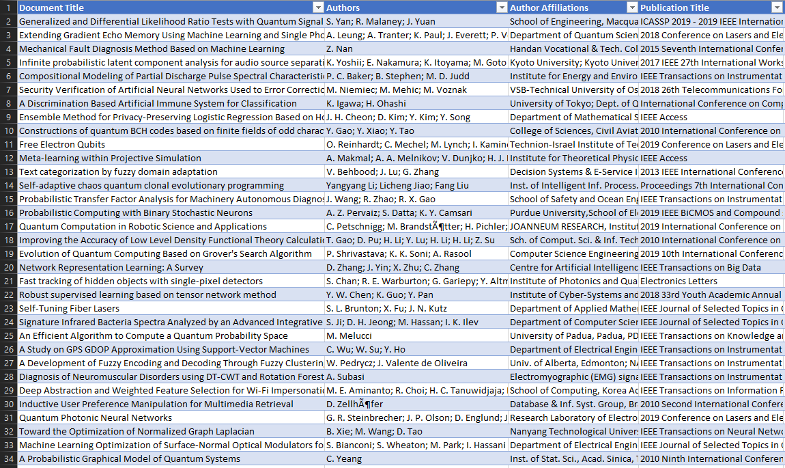
Quantum Tech. Survey
Collect details on published research on quantum technologies (IEEE, commercial, etc.)
Harmonize data set for analysis: contributors, dates, tags, etc.
Determine high-focus areas based on time, region, methods, impact factor, industry

Slide 4
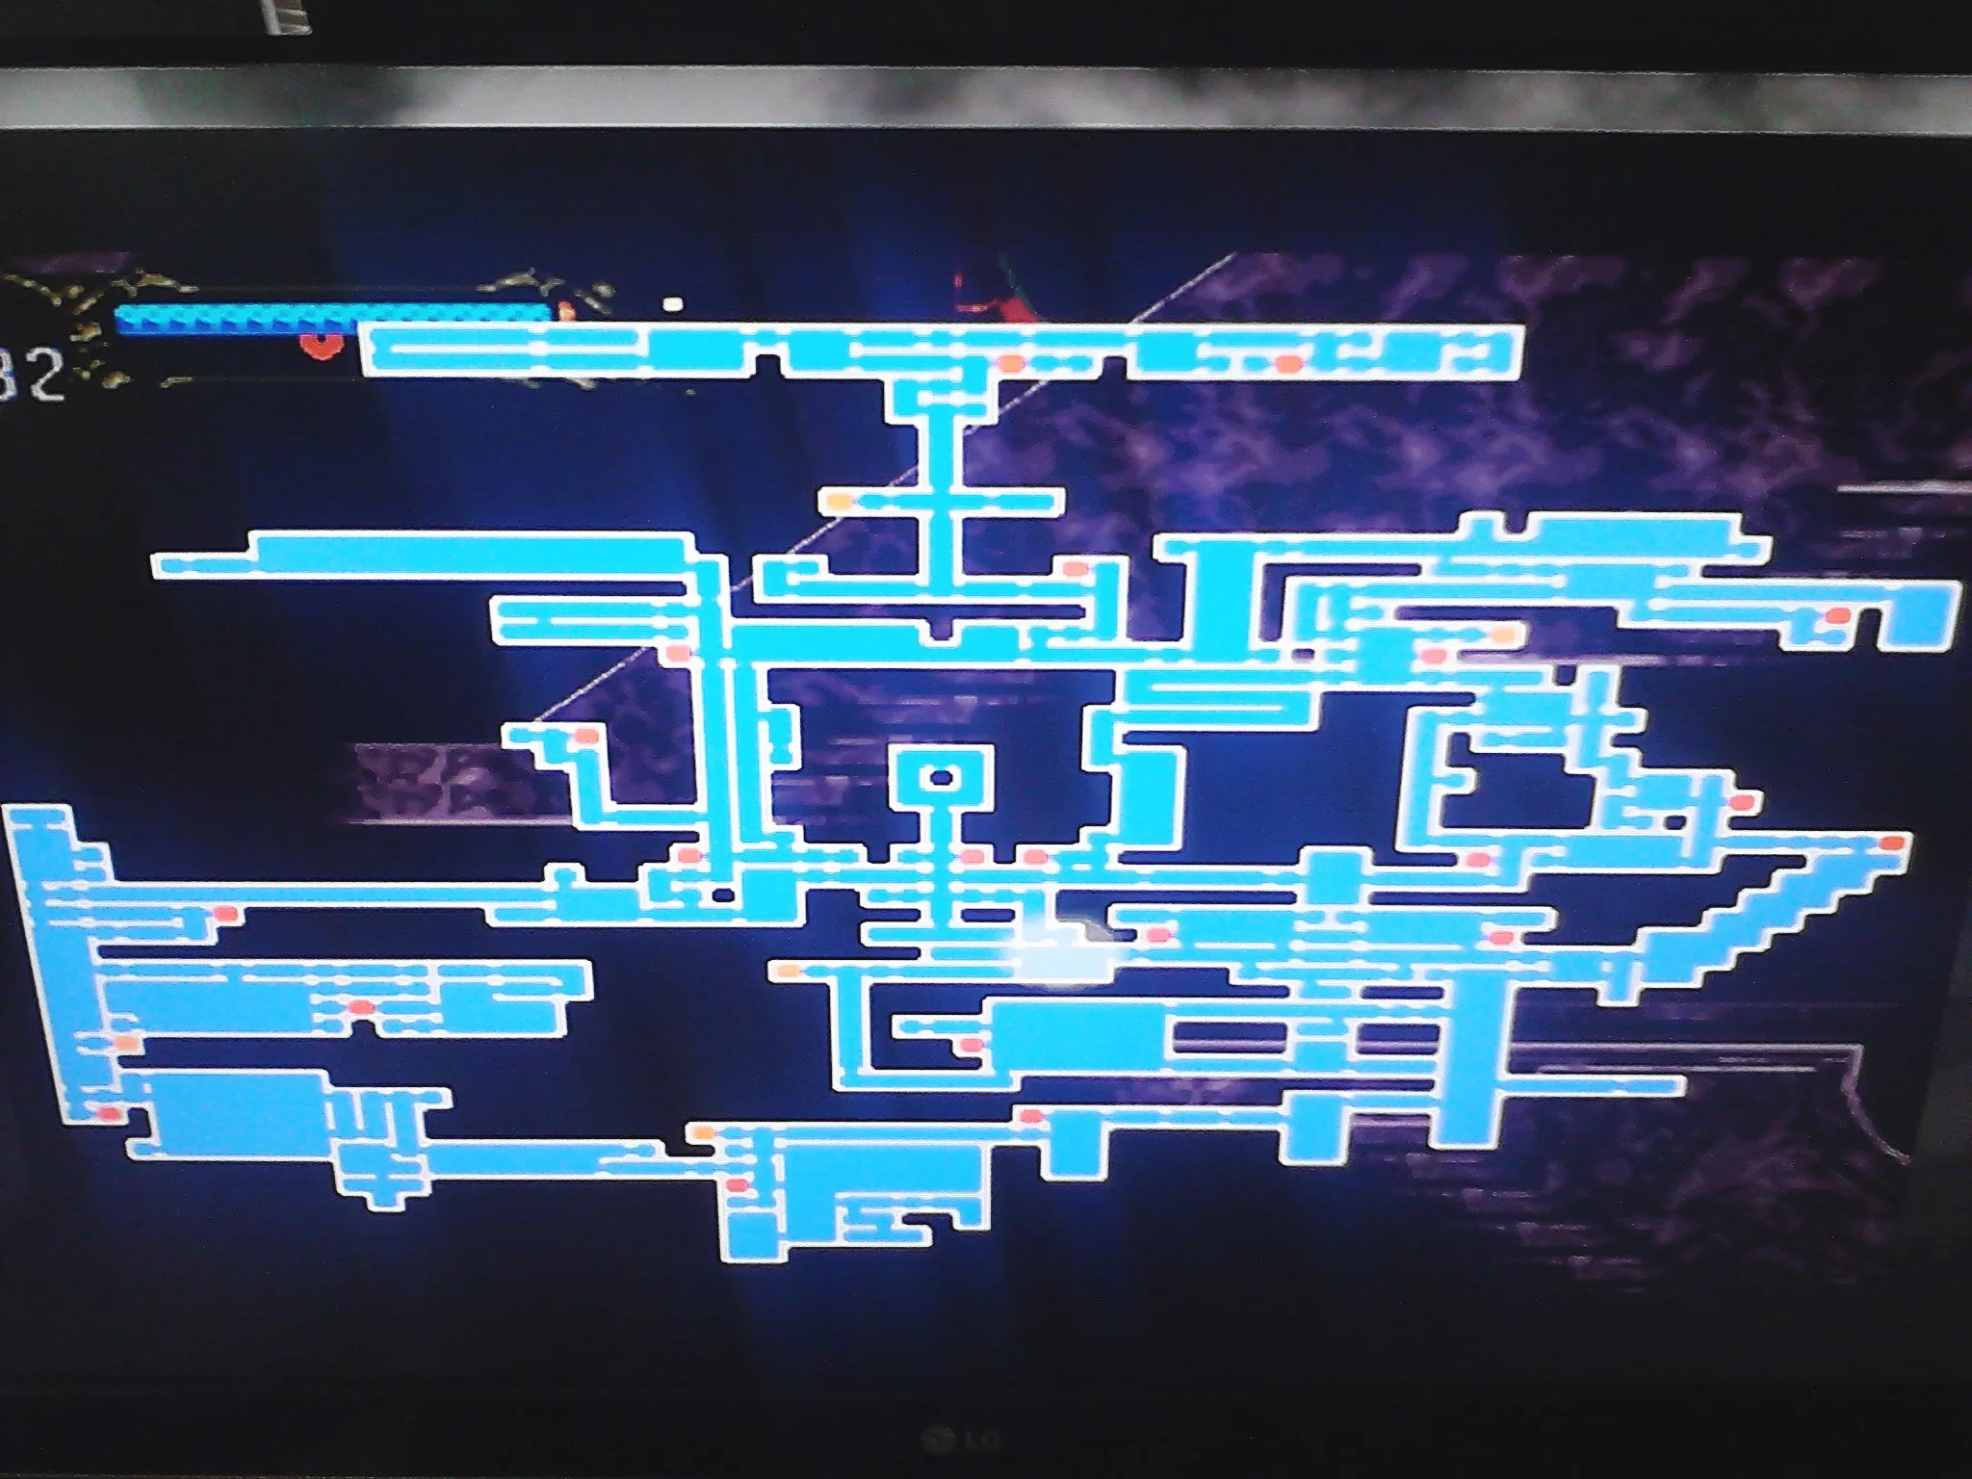
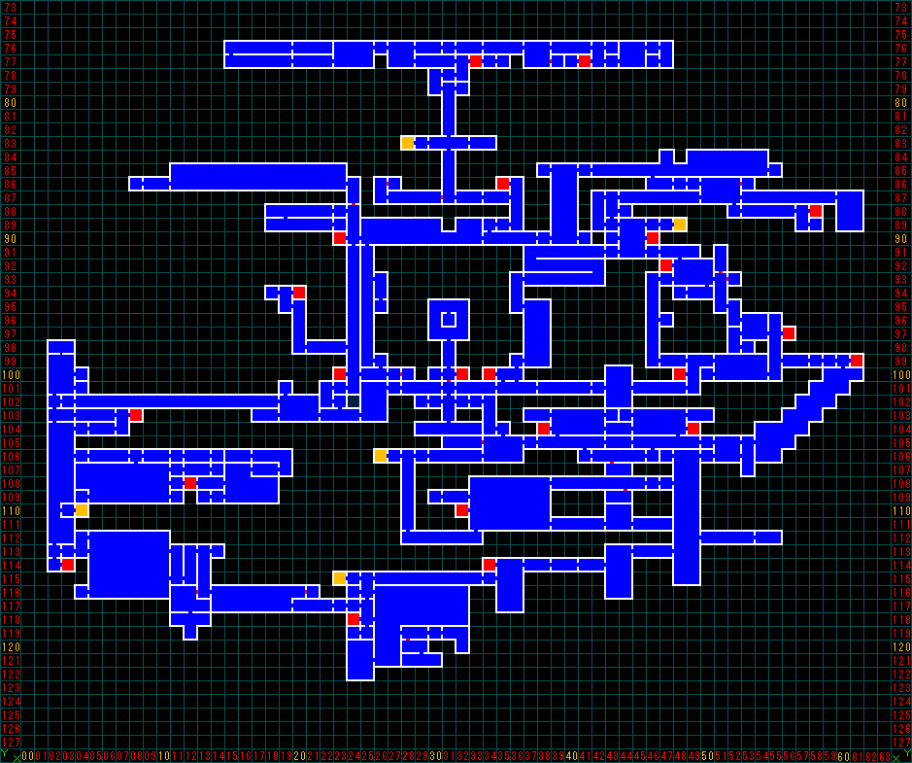
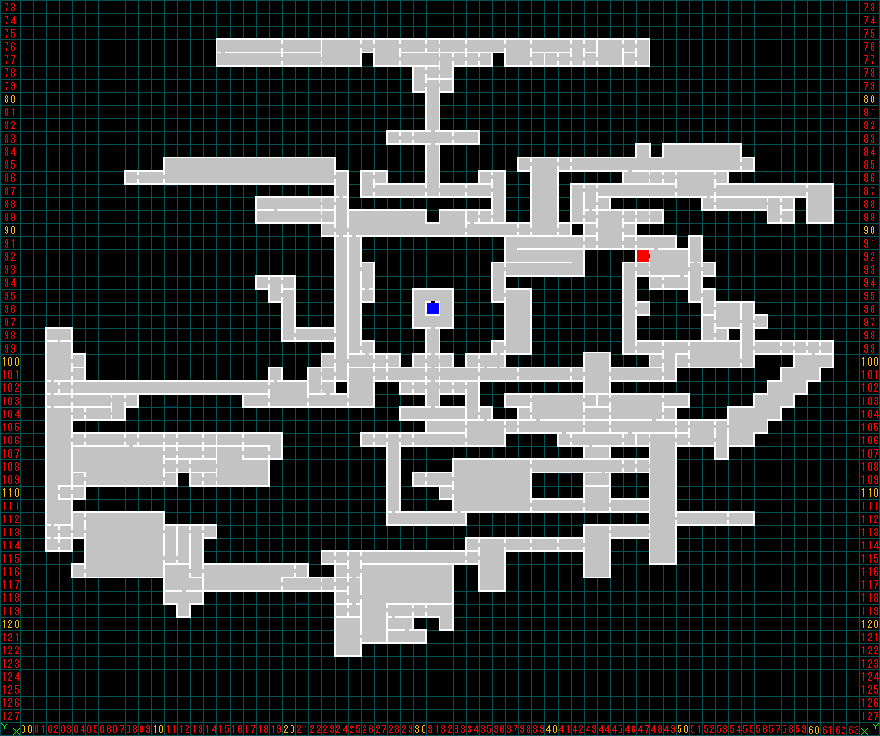
Raw Image Scanner
Create system that accepts an image as a template and compares it to a camera image
Include generating text lists or tables, filling templates, or highlighting differences
Provide image correction for flawed camera images

Slide 5
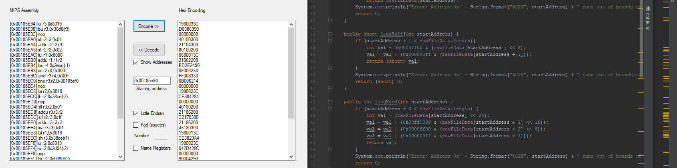
MIPS Decompiler
Convert MIPS Assembly language code into popular modern languages
Revert decompiled or modified code back into MIPS Assembly
Examine compatibility with use on modern hardware

Slide 6
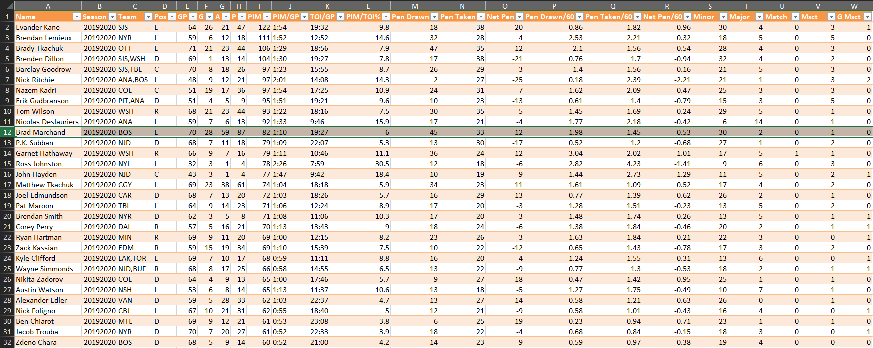
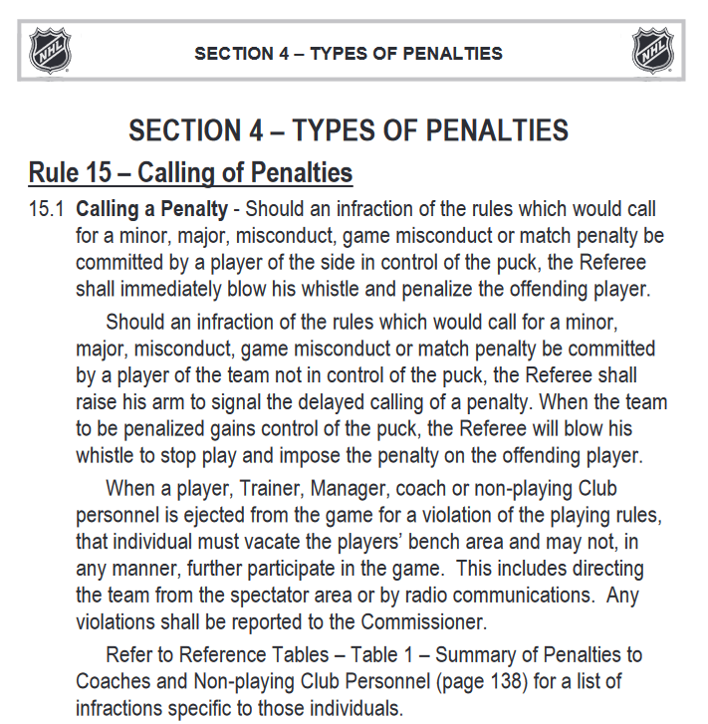
Rules Analyst
Interpret rulesets of various sports or games from source rulebooks through text parsing
Create model for ML using supervised/unsupervised learning
Determine impact of rule changes in style of professional-level play

Slide 7

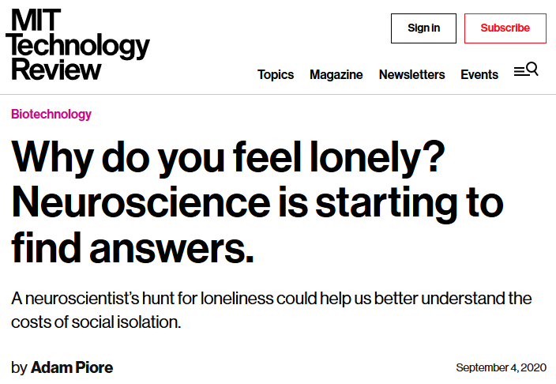
Socialization Helper
Create platform to encourage online interaction among friends/family
Analyze usage habits to help users deal with loneliness and depression
Devise security and privacy methods to deter improper use

Slide 8
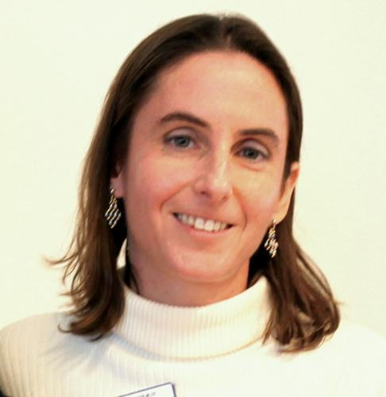
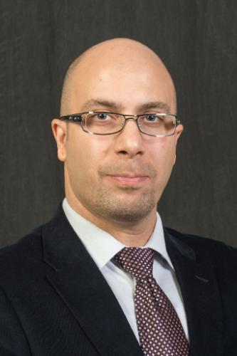
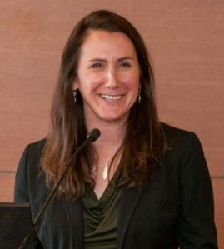
Help-A-Professor
Dean of CAS Prof. Pauline Entin and Prof. Shannon Jenkins:
Comparing online vs. in-person learning methods
Prof. Keivan Sadeghzadeh:
Predictive Models for Preventable Readmission for Mental Patients Using Socioeconomic Disadvantages [Ongoing Project]
Detecting and Predicting Medical Errors in Cancer Screening Process [New Project]
Mental Health Service Supply and Demand in the Post-Pandemic Healthcare [New Project]
Entin (top-left);
Jenkins (bottom-left);
Sadeghzadeh (right).

Slide 9
Resources and Challenges
Resources:
HTML parsing for web data, Optical Character Recognition (OCR)
R, MATLAB, Python, Java, C++, SQL, Assembly language tools as needed
Viewers like you!
Challenges:
Machine learning methods in Spring 2021
Artificial intelligence methods TBA
Physical limitations during pandemic

