Slide 1
Image Scanner
Brian Cornet DSC 498
Week 3 – 10/14/2020
Basic Tesseract Tests

Slide 2
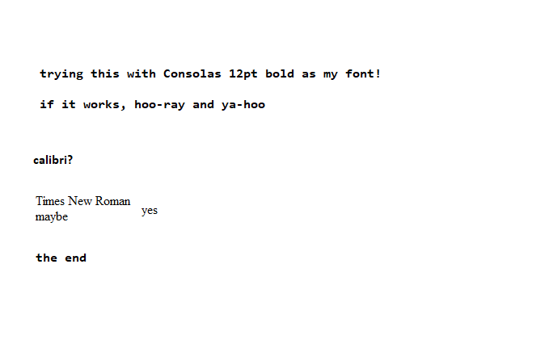
Simple Test with MSPaint Fonts
trying this with Consolas 12pt bold as my font!
if it works, hoo-ray and ya-hoo
calibri?
Times New Roman
maybe yes.
the end
♀
Raw string text: 'trying this with Consolas 12pt bold as my font!\nif it works, hoo-ray and ya-hoo\ncalibri?\n\nTimes New Roman\n\nmaybe yes.\n\nthe end\n\x0c'

Slide 3
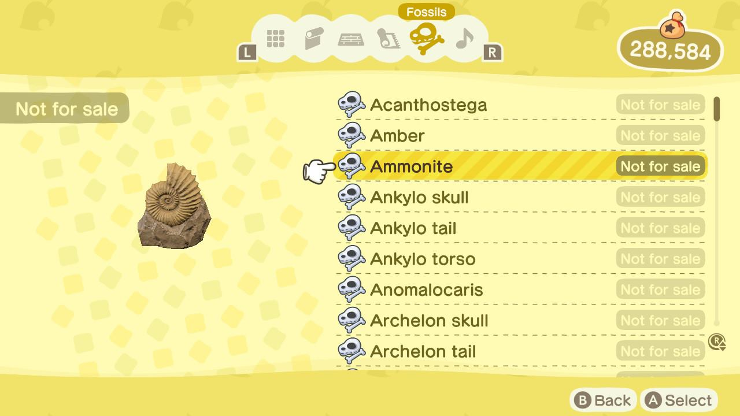
Whole Clean Image Test 1 (Animal Crossing)
ers @YPacanthostesa |
@Back @Select
♀
Raw string text: 'ers @YPacanthostesa |\n\n@Back @Select\n\x0c'

Slide 4
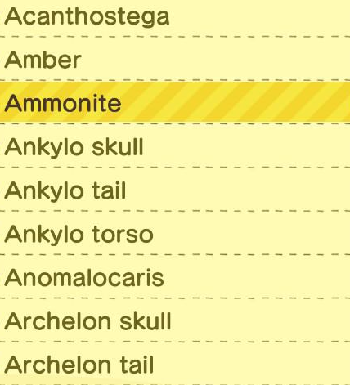
Partial Clean Image Test 1 (Animal Crossing)
Acanthostega
Archelon tail
♀
Raw string text: 'Acanthostega\n\nArchelon tail\n\x0c'

Slide 5

Single Clean Line Test 1 (Animal Crossing)
Anomalocaris
♀
Raw string text: 'Anomalocaris\n\x0c'

Slide 6
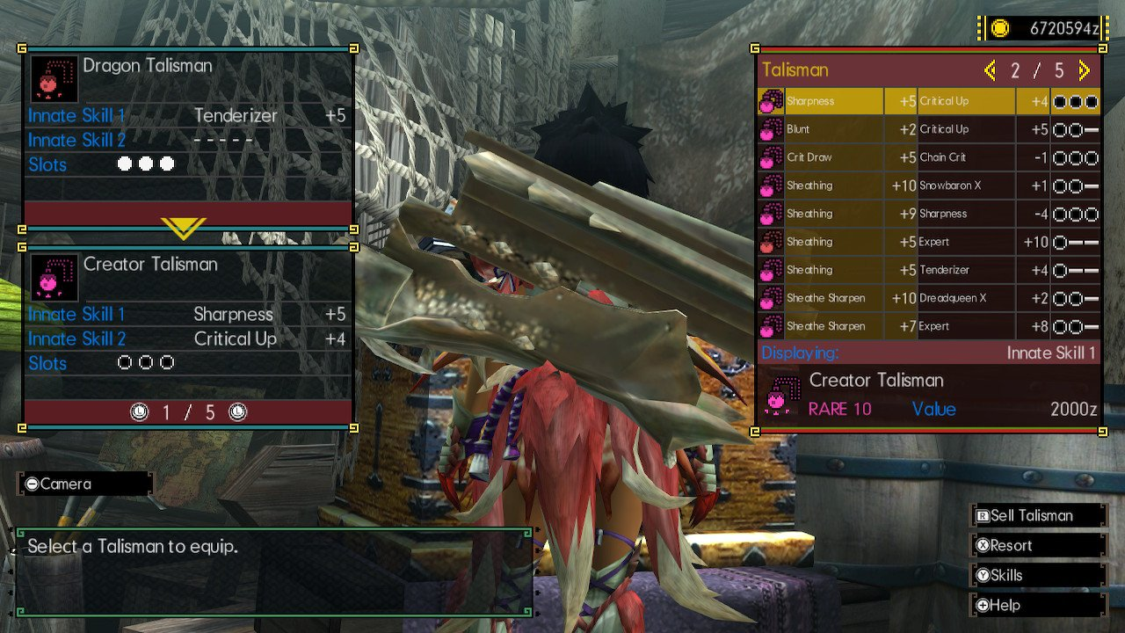
Whole Clean Image Test 2 (Monster Hunter)
cr Pr xerelts
GROW +5 Choin Crit
csr )
Seo Cr! ¥|
Pr) Calin cibd
f : ; : _— a eo
BN
es ig m Pr ue) Bacio
] Creator Talisman Peer Ped
i Ss a eee
—o Skill 1 ii. i +5 a i | oa
ee Skill 2 (et eel he cane 4 Di ra eon p
Slots) ieee aoe
| Creator Talisman
10 Vale 40] 0a
‘&)
@1i1/5@
Eas
‘psel Mere
| oe
ea
[@Help
oa wore TV
♀
Raw string text: ' \n\ncr Pr xerelts\nGROW +5 Choin Crit\n\n \n \n \n \n \n \n \n \n \n \n\ncsr )\nSeo Cr! ¥|\n\n \n\nPr) Calin cibd'+
'\n\n \n \n\n \n\nf : ; : _— a eo\nBN\nes ig m Pr ue) Bacio\n] Creator Talisman Peer Ped\ni Ss a eee\n—o Skill 1 ii. i +5 a i | oa'+
'\nee Skill 2 (et eel he cane 4 Di ra eon p\nSlots) ieee aoe\n| Creator Talisman\n\n \n \n\n10 Vale 40] 0a\n\n‘&)\n\n@1i1/5@\n'+
'Eas\n\n \n \n \n \n\n‘psel Mere\n| oe\nea\n[@Help\n\n \n\noa wore TV\n\x0c'

Slide 7
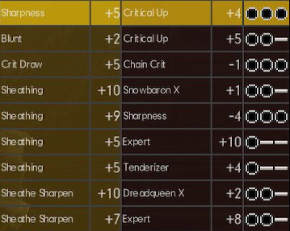
Partial Clean Image Test 2 (Monster Hunter)
Tg
ert
Sheathing
SE)
Sheathing
Sheathing
Sheathe Sharpen
Sheathe Sharpen
+2 Critical Up
+5 Chain Crit
Baio cig
SSL tak
Sen
Secrets
BUCS
Baie os
be)
a a
Saal
a
al
Br Ot
cele
Ss) ad
♀
Raw string text: 'Tg\n\nert\nSheathing\nSE)\nSheathing\nSheathing\nSheathe Sharpen\nSheathe Sharpen\n\n+2 Critical Up\n+5 Chain Crit\nBaio cig\n'+
'SSL tak\nSen\nSecrets\nBUCS\n\nBaie os\n\nbe)\na a\nSaal\na\nal\nBr Ot\ncele\nSs) ad\n\x0c'

Slide 8
Single Clean Line Test 2 (Monster Hunter)
Sheathing +10 Srowboron X Saad
♀
Raw string text: 'Sheathing +10 Srowboron X Saad\n\x0c'

