Slide 1
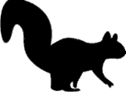
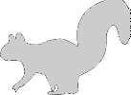
SquirrelMapper
Measuring evolution in action

Slide 2


Slide 3


