Slide 1
Optimal Residential Battery Scheduling with Asset Lifespan Consideration
ISGT Europe 2020
B. Couraud, S. Norbu, M. Andoni, V. Robu, H. Gharavi, D. Flynn

Slide 2
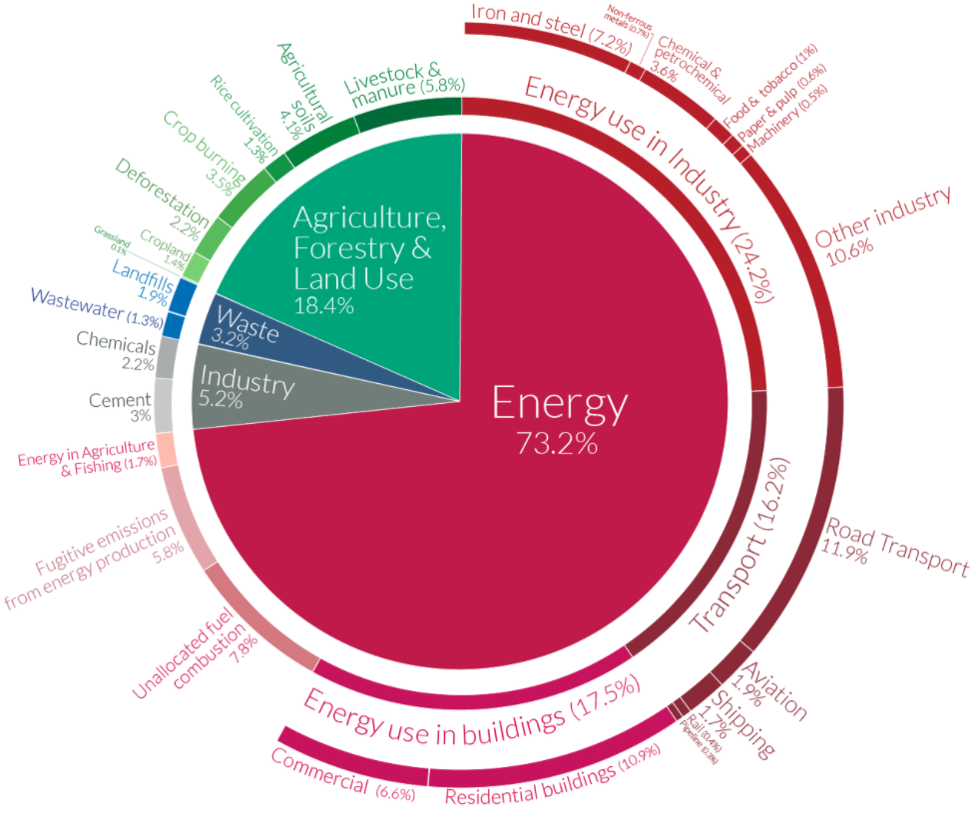
Context
Paris Agreement: 32 kg → 5.5 kg CO2 eq/day
Need to increase resident Renewable energy consumption
Reduction of Feed in Tariffs
→ Incentive for self consumption
Development of Residential batteries: Tesla, LG, …
How to optimally control batteries to reduce their simple payback period ?
Source: https://ourworldindata.org/emissions-by-sector

Slide 3


Battery Control Algorithms
Production forecast
E_{pv t}
Optimal scheduling forecast algorithm
Demand forecast
E_{bat t}
Prices forecast
Real Time production
Battery control algorithm
Real Time demand
Real Time price
E_{D t}
Possible power flow
Optimization can be done using Linear Programming methods or evolutionary based algorithms
→ this work focuses on Linear Programming approaches

Slide 4
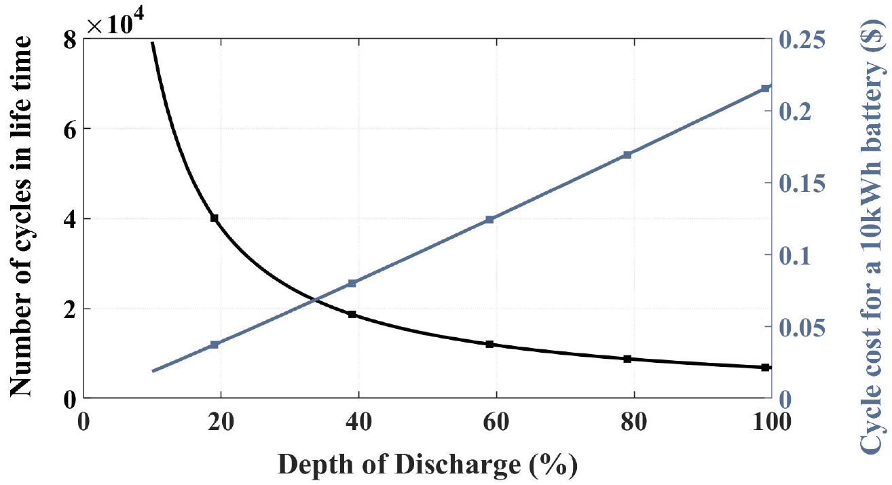
Literature Review
Battery control is a well studied field: charge/discharge schedule
Cycles of battery operation affect its life time
Optimization based schedules must include cycles into consideration
Previous work only consider batteries with cycles starting from 100% State of Charge ➔ need a new formulation

Slide 5

Conventional Battery Control Optimization
MILP Optimization problem:
$$\min_{P_{bat}^{t}, t∈[0,24]}{E_{i}π_{i}−E_{e}π_{e}}$$
Battery Schedule
Energy import cost
Energy export revenue
Optimization variables:
Battery power for every time step (24 elements vector for e.g)
Other continuous/binary variables to ensure:
SoC limits are met
Household import and export are computed
Battery operation is physically possible (no simultaneous charge and discharge)

Slide 6
Optimisation Based Control
Example of implementation for day-ahead operations
100
Energy (kWh per 30 min)
SoC
0
Export Market price
Export Forecast
Production Forecast
Battery State of Charge
Demand Forecast

Slide 7
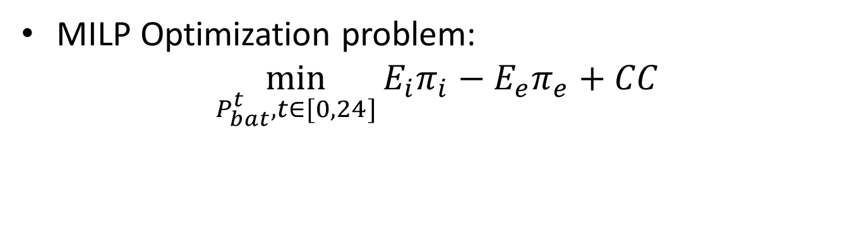
Proposed Battery Control Optimization
MILP Optimization problem:
$$\min_{P_{bat}^{t}, t∈[0,24]}{E_{i}π_{i}−E_{e}π_{e}}+CC$$
Battery Schedule
Energy import cost
Energy export revenue
Cycles Cost
Additional variables:
Cycles depth
The Cycle depth variable is a 24 elements (e.g) vector where elements = 0 if the current cycle is not finished, and = cycle depth at the end of each cycle.
Other continuous/binary variables to compute the cycles depth.

Slide 8
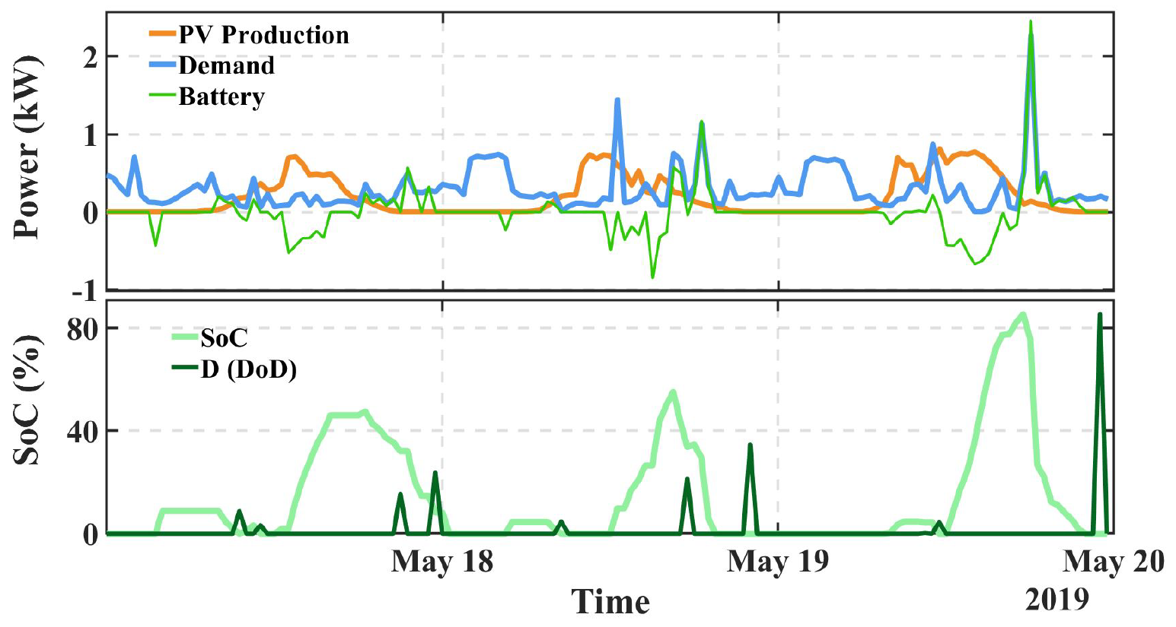
Results
The implementation captures accurately charging and discharging cycles

Slide 9
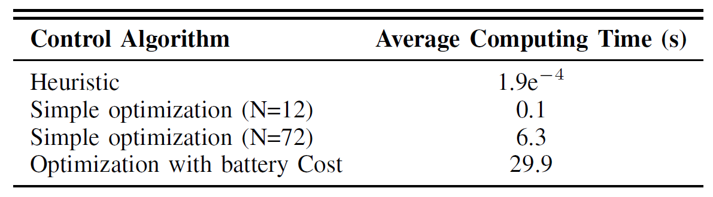
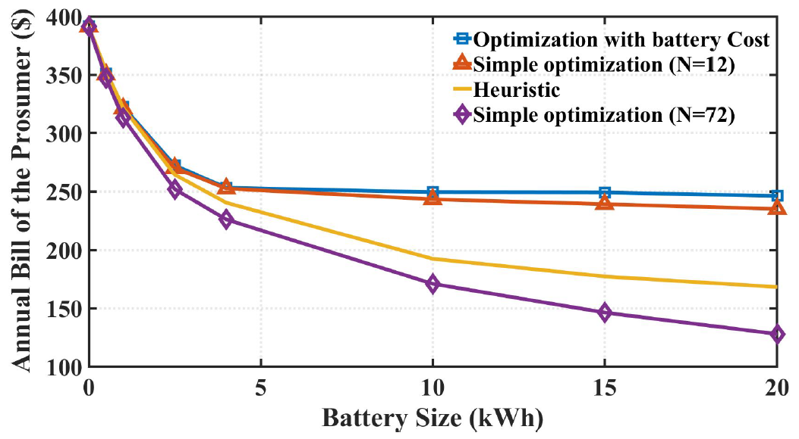
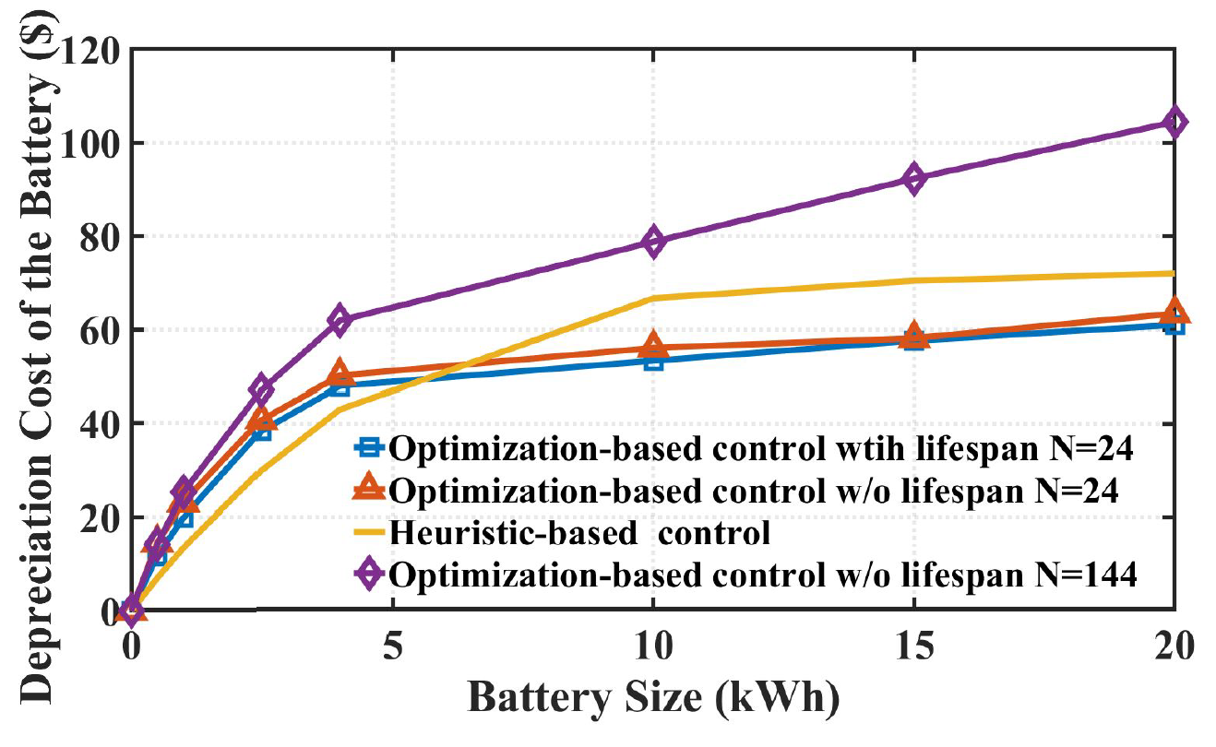
Discussion
Computing time compared to conventional approaches
Comparison of expected electricity bills for different battery control algorithms:

Slide 10
Conclusion
We proposed a new MILP optimization formulation for battery operation optimization that includes battery cycles impact
Computation time is considerable
For normal use, there is no tangible financial benefits compared to other existing methods

Slide 11


Optimal Residential Battery Scheduling with Asset Lifespan Consideration
Production forecast
E_{pv t}
Demand forecast
Optimal scheduling forecast algorithm
Prices forecast
E_{bat t}
Real Time production
Real Time demand
Battery control algorithm
Real Time price
E_{D t}
Possible power flow
Optimization of Batteries’ schedule considering batteries cycling
MILP Optimization problem:
$$\min_{P_{bat}^{t}, t∈[0,24]}{E_{i}π_{i}−E_{e}π_{e}+CC}$$
Cycles Cost
Battery Schedule
Energy import cost
Energy export revenue
Results
Accurately capture Cycles Depth of Discharge
However, it is computationally intensive, so requires a reduction of time horizon

