Slide 1




Production forecast
E_{pv t}
Optimal scheduling forecast algorithm
Demand forecast
E_{bat t}
Prices forecast
Real Time production
Real Time demand
Battery control algorithm
Real Time price
E_{D t}
Possible power flow

Slide 2
Time step t
Yes
Is P_{PV}(t) > Demand (t) ?
No
Yes
Is Battery full?
No
Yes
Is Battery empty?
No
Export P_{PV}(t) -Demand (t) to grid
Charge with P_{bat} = min (P_{bat} _{max}, P_{PV}(t) -Demand (t))
Import P_{PV}(t) -Demand (t) to grid
Discharge with P_{bat} = min (P_{bat} _{max}, Demand (t) - P_{PV}(t))

Slide 4

Forecasting Algorithms
Production forecast
Demand forecast
Prices forecast
Production forecast
E_{pv,t}
Demand forecast
Forecasting Algorithms
Prices forecast
E_{bat,t}
Battery Control Algorithms
Real Time production
Heuristic-based
Real Time demand
Optimization-based w/o lifespan consideration
Real Time price
Optimization-based with lifespan consideration
E_{D,t}
Possible power flow

Slide 5
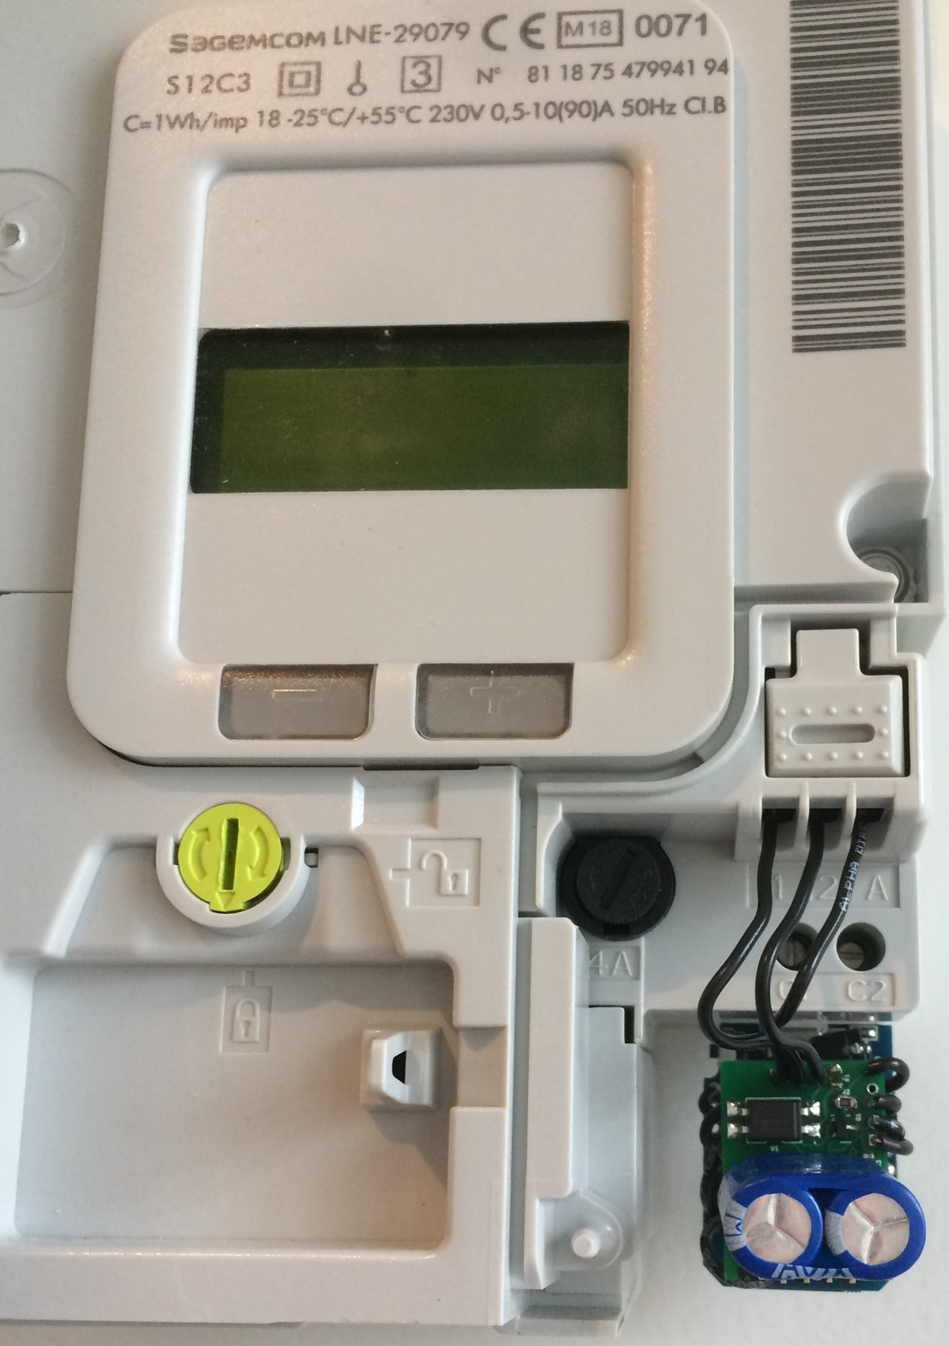
LTR

Slide 6


V₁
VS-10BQ015
U₁ :
PIC
12F1840
U₁ :
PIC
12F1840
9.1k
1.5F
5.5V
MCP
1825s33
270
C₁
Power Supply
Q₁ : 2N7002
1k
D₁
I₂
I₁
A
BZT52H-B3V3
U₂:
LoRa or ESP
Node
10k
A₀
Set
Double coils Latching Relay module
3.3k
R_{x}
Unset
SFH6206
BS170
12k - 22k
Demodulation
Communication
& Control
Actuator

Slide 7
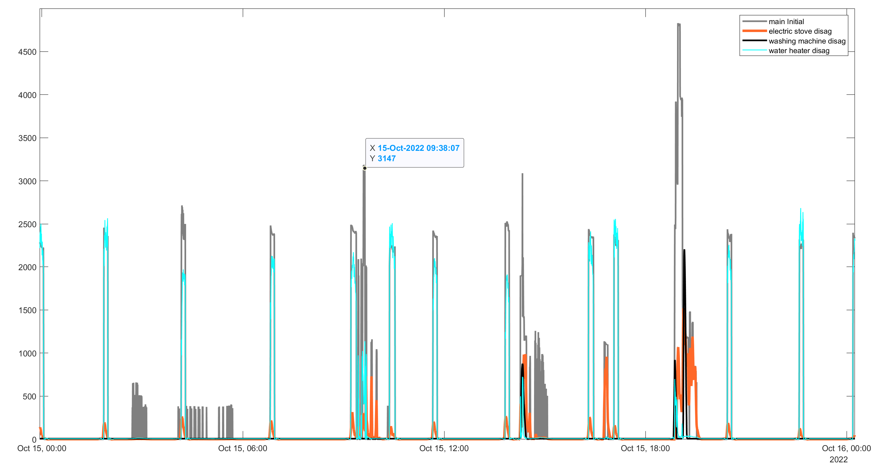
4.5
Main power (LTR data)
Electric Stove disaggregation
Water heater disaggregation
3
Power (kW)
1.5
0
Oct. 15 00:00
Oct. 15 06:00
Oct. 15 12:00
Oct. 15 18:00
Oct. 16 00:00

Slide 8
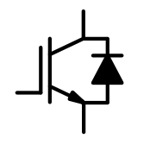
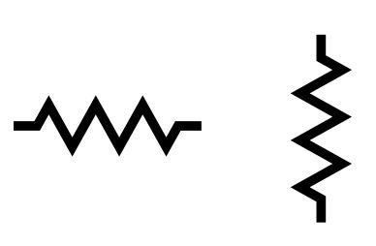
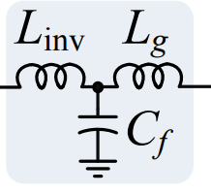

Slide 9
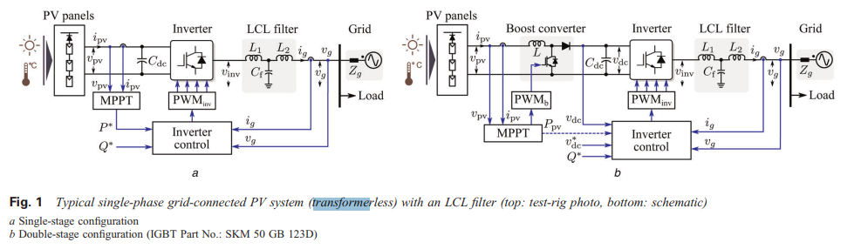



PV Panels
Optional DC Converter
Inverter
Filter + Coupling
Grid
X_{f}
r
1-3
V_{PV}
V_{L}
V_{g}
PWM_{inv}
4-6
i_{PV}
V_{PV}
PWM_{pv}
PWM_{inv}
PLL
$$i_{g_{abc}}$$
$$V_{g_{abc}}$$
m_{PWM} _{abc}
$$α$$
MPPT
abc
dq
abc
abc
dq
dq
i_{d} i_{q}
V_{gd} V_{gq}
m_{PWM} _{dq}
Control Loop in dq frame
Reference Current Generator
Q_{target}
P_{target}
I_{d target} i_{q target}

Slide 10







Single Phase Inverter
Filter + Coupling
(+ Transformer)
PV Panels
DC Converter
Grid
X_{f}
r
V_{L}
V_{g}
V_{PV}
i_{PV}
V_{PV}
PWM_{pv}
PWM_{inv}
V_{L}
V_{g}
MPPT
Q_{ref}
Inverter & Reactive Power Control
i_{g}
(a)
$\underline{V_{g}}$
$$δ$$
$jX_{f}\underline{ i_{g}}$
$$\underline{ i_{g}}$$
$$φ$$
$\underline{V_{L}}$
$$r\underline{ i_{g}}$$
(b)

