Slide 1
β-Variational Autoencoder
Berk Can Özmen
July 2021

Slide 2


z
X
A dataset X,
A model
A latent variable representation
s.t

Slide 3
Idea: Construct a tractable to approximate
W.r.t

Slide 4
μ
X
x_{i}
Encoder
q_{Φ}(z|x)
z
Decoder
p_{θ}(x|z)
X̂_{i}
σ
Latent Vector
Reconstructed Image
Input Image
x_{i}

Slide 5
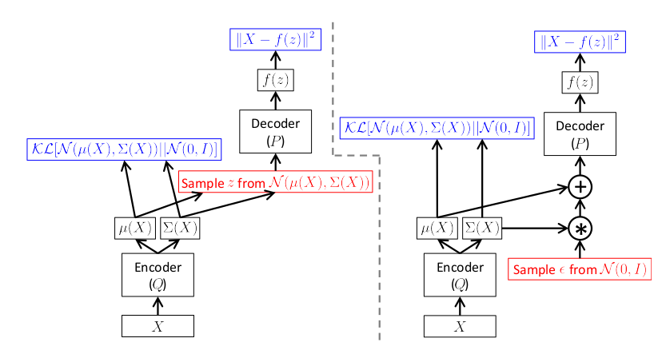
The Reparameterization Trick
(Doersch,2016)

Slide 6
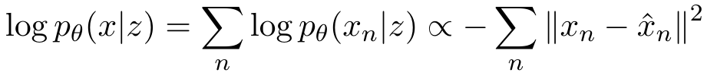
Implementation - Loss function
Assumption: pixels are independent given z and distributed normally
Reconstruction - MSE

Slide 7
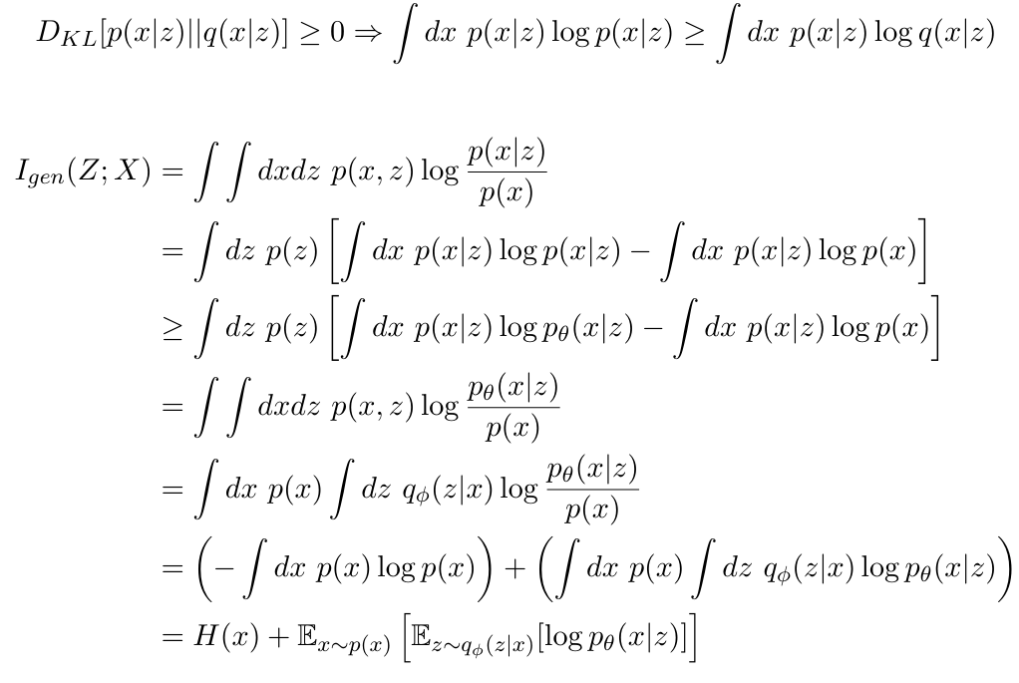
Information Theoretic Perspective

Slide 8
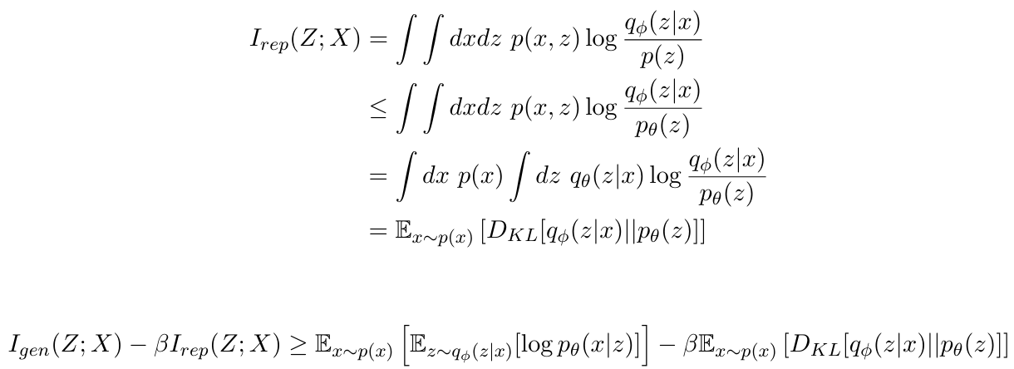
Information Theoretic Perspective
Information to reconstruct
Extra Information

Slide 9
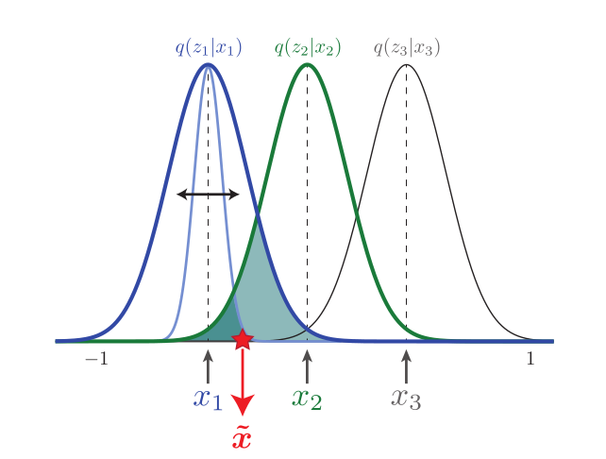
(Burges, et al. 2018)

Slide 10
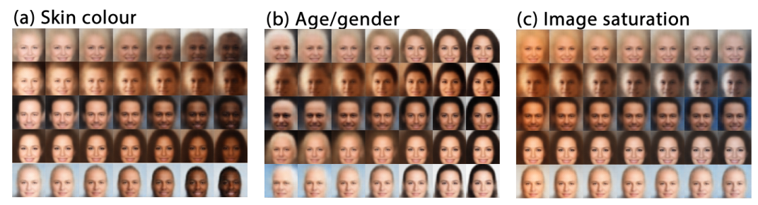
Results (Paper)
(Botvinick, et al. 2017)

Slide 11
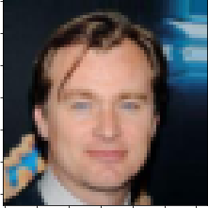
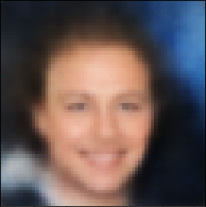


Results (Implementation)

Slide 12
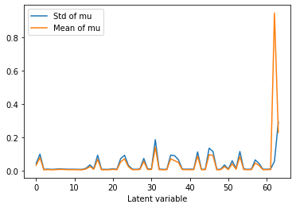
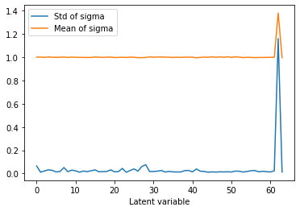
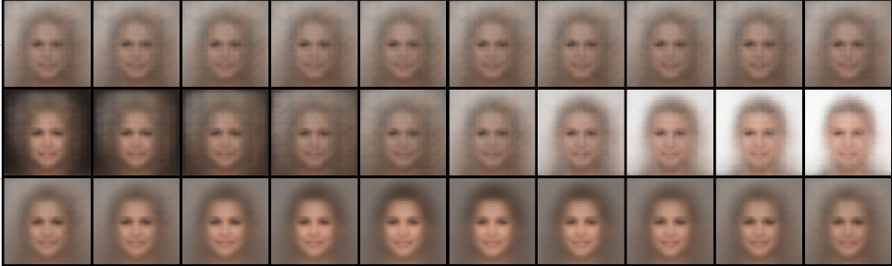

Slide 13
References
Alemi, A. A., Poole, B., Fischer, I., Dillon, J. V., Saurous, R. A., & Murphy, K. (2018). Fixing a Broken ELBO. https://doi.org/https://arxiv.org/abs/1711.00464
Botvinick, M., Burgess, C., Glorot, X., Higgins, I., Lerchner, A., Matthey, L., Mohamed, S., & Pal, A. (2017). beta-VAE: Learning Basic Visual Concepts with a Constrained Variational Framework.
Burgess, C., Desjardins, G., Higgins, I., Lerchner, A., Matthey, L., Pal, A., & Watters, N. (2018). Understanding disentangling in beta-VAE. https://doi.org/https://arxiv.org/abs/1804.03599
Doersch, C. (2016). Tutorial on Variational Autoencoders. https://doi.org/https://arxiv.org/abs/1606.05908

