Slide 1
ENGI 301 Automatic Bottle Opener/Counter Proposal
9/25/22
Brandon Peoples

Slide 2
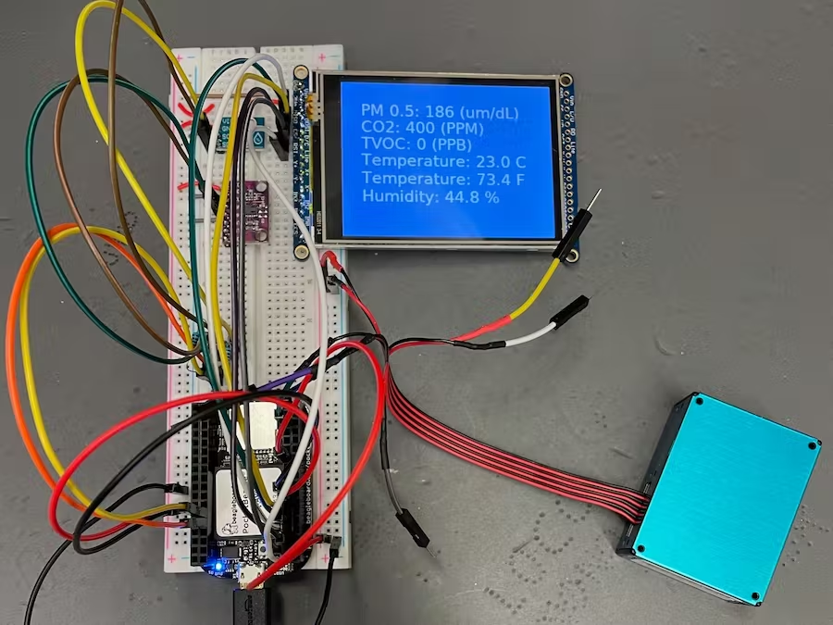
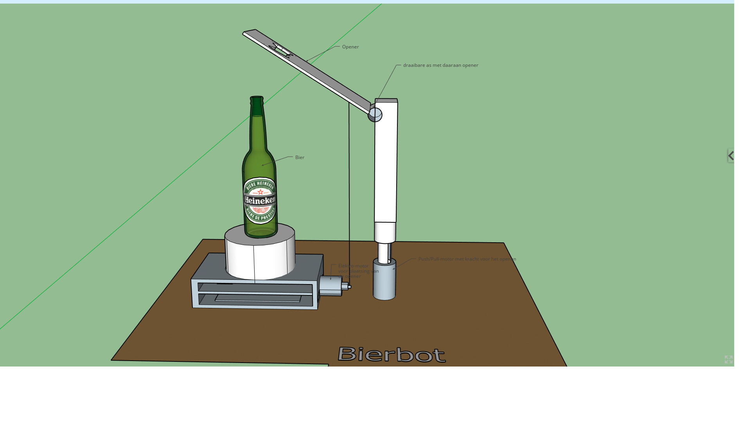
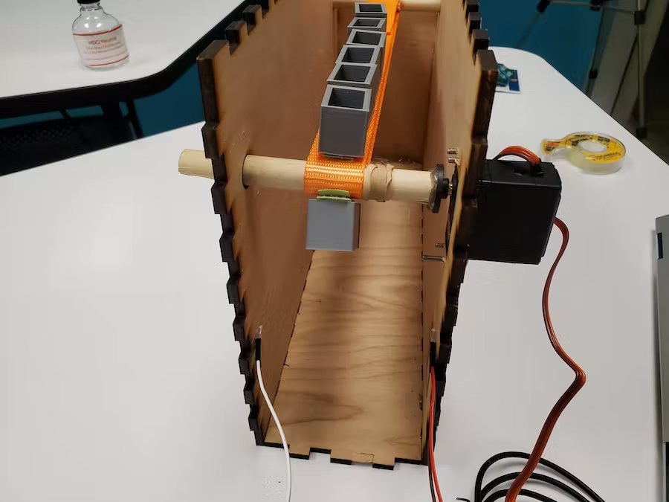
Background Information
What is being proposed?
A device that will open bottles as well as count how many bottles it has opened. This will be done by using multiple motors (stepper), a sensor (ultrasound), and a display that will count the number of bottles that it has opened.
Links to existing projects / libraries
Bottle Counter- Mechanical Counter
Medication Dispenser – Conveyor Belt
Arduino- Stepper Motor Bottle
What improvements / additions over existing project
Instead of a mechanical counter used in a previous project, I would like to utilize a digital one. I will achieve this by using an ultrasound sensor that will register whenever a bottle is detected and log this as “one bottle opened”. The number of bottles opened will then be displayed on a 7 segmented display. Additionally, I would like to utilize a similar conveyer system as was done in the medication dispenser from a previous semester. This will allow the user to place a bottle on the conveyor, press the “on” button and have the bottle move into place to be opened. In addition to “counting” the number of bottles opened, the sensor will also communicate with the conveyer belt, and have it turn off when the bottle is in the correct position. For the bottle opening movement itself, I would like to utilize a previous project that was done with an Arduino (second image) where a stepper motor is connected to a string and will provide a torque on the bottle opener to remove the top off the bottle.
What is your story?

Slide 3
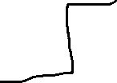
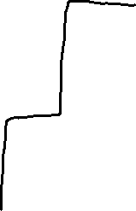
System Block Diagram
Level Convertor 12v to 5v
Stepper Motor for Conveyer Belt
On/Off Button
Create a System Block Diagram
Label interfaces / pins
Components (part numbers if possible)
Level Translator
GPIO
Level Convertor 12v to 5v
Stepper Motor for Bottle Opener Component
Pocket
Beagle
Ultrasound Sensor
Need Moderate Level of Detail
7-Segmented Display

Slide 4




Power Block Diagram
Create a Power Block Diagram
Label voltages / currents of components
Level Convertor 12v to 5v
Stepper Motor for Conveyer Belt
12 V Power Adapter
42 mm high torque stepping motor
Model #XY42STH34-0354A
12 V, 350 mA, 34 ohms
1000 mA capacity
Pocket Beagle
Stepper Motor for Bottle Opener Component
Level Convertor 12v to 5v
42 mm high torque stepping motor
Model #XY42STH34-0354A
12 V, 350 mA, 34 ohms
3.3/5V
Digital Display
0.56" Quadruple Digit Numeric Displays
Model #KW4-56NXLB-P (7 pins)
5 V, 100 mA (max),
Ultrasound Sensor
Ultrasonic Distance Sensor - 3V or 5V - HC-SR04 compatible - RCWL-1601
2.2 mA (4 pins)
Need All Power Inputs and Outputs

Slide 5
Components / Budget
Component | Need to Buy | Cost
Stepper Motor x2 (Stepper motor - NEMA-17 size - 200 steps/rev, 12V 350mA) | 2 | $14.00
Ultrasound Sensor https://www.adafruit.com/product/4007 | 2 | $3.95
Bottle Opener amazon | 1 | $6.99
Button https://www.adafruit.com/product/1683 | No | $1.95
12 V Power Adapter 12V DC 1000mA (1A) regulated switching power adapter - UL listed | 1 | $8.95
Standard LCD https://www.adafruit.com/product/181 | 1 | $9.95
Tie Down Straps (for conveyor) link | 1 | $15.49
Need all components to be purchased by instructor listed; additional components may be purchased by student

Slide 6
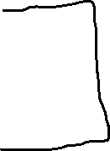
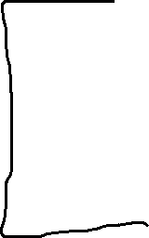

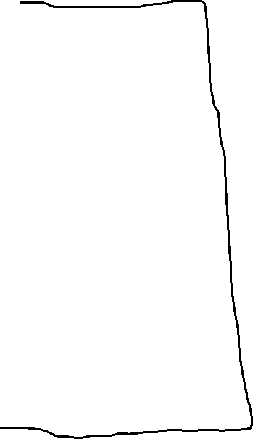
Wait For Start
Start
Check distance
If Distance is Not Sufficient
If Distance is Sufficient
Go Right(steps)
Increase counter
Open bottle
Go Left (starting point)
Update Display

