Slide 1
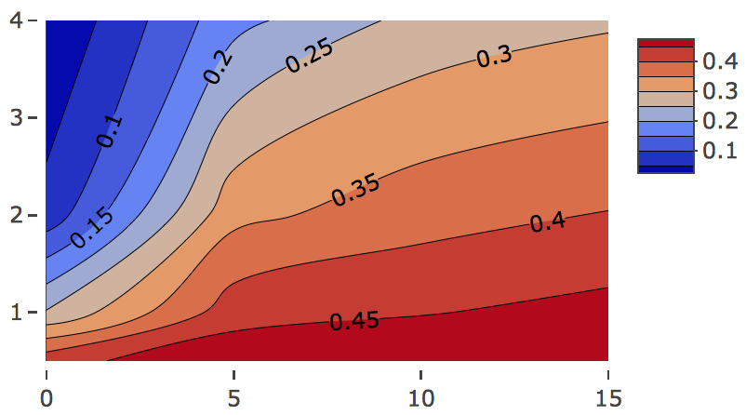
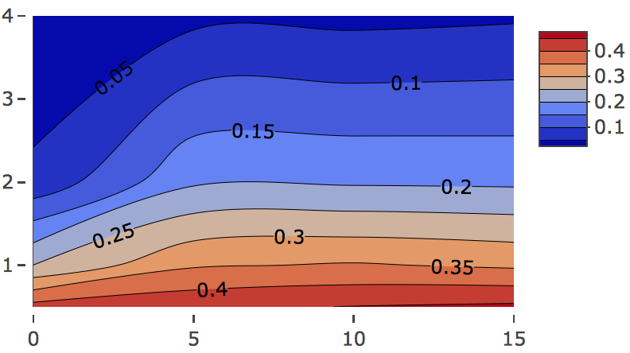
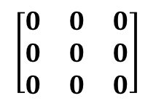
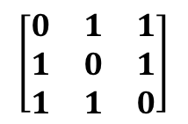
A.
p=260
C.
30 corDis
100 corNonDis
30 unCorDis
100 unCorNonDis
Group 1 (n/2)
n=100
Group 2 (n/2)
Color did not match D
$$\left[\begin{matrix}0 & 0 & 0 \\ 0 & 0 & 0 \\ 0 & 0 & 0\end{matrix}\right]$$
$$\left[\begin{matrix}0 & 1 & 1 \\ 1 & 0 & 1 \\ 1 & 1 & 0\end{matrix}\right]$$
Null design
Dataset 1
Full design
Dataset 2
Y
Dataset 1
Dataset 3
Dataset 2
Y
B.
Dataset 3
D.
Effect size
Effect size
Covariance
Covariance
Notes:
Just a proposition for the main figure. Deifnitely move 2 comps in the supp and remove some of the text / title also on the figure itself. The caption should explain. Perhaps only show FC = 1 and FC = 2 for the main figure, rest in supp? Crop legends and move around for space

Slide 2
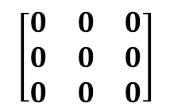
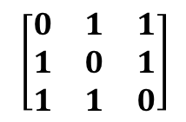
A.
p=260
30 corDis
100 corNonDis
30 unCorDis
100 unCorNonDis
Group 1 (n/2)
n=100
Group 2 (n/2)
Dataset j, j=1,2,3
$$\left[\begin{matrix}0 & 0 & 0 \\ 0 & 0 & 0 \\ 0 & 0 & 0\end{matrix}\right]$$
Null design
$$\left[\begin{matrix}0 & 1 & 1 \\ 1 & 0 & 1 \\ 1 & 1 & 0\end{matrix}\right]$$
Full design
Dataset 1
Dataset 1
Dataset 2
Y
Dataset 2
Y
Dataset 3
Dataset 3
B.
Mean error rate
Mean error rate
Effect size
Effect size
Covariance
Covariance
C.
D.
Notes:
Other option

Slide 3
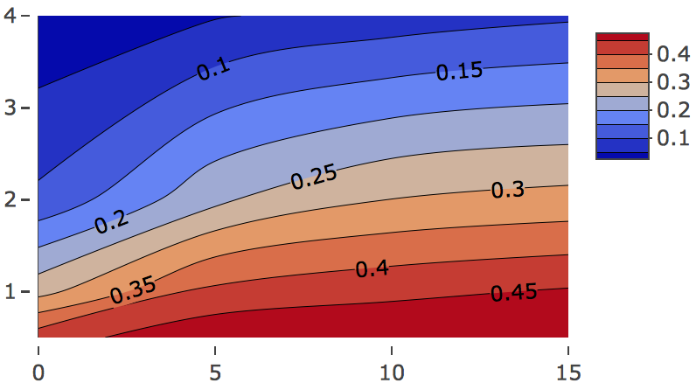
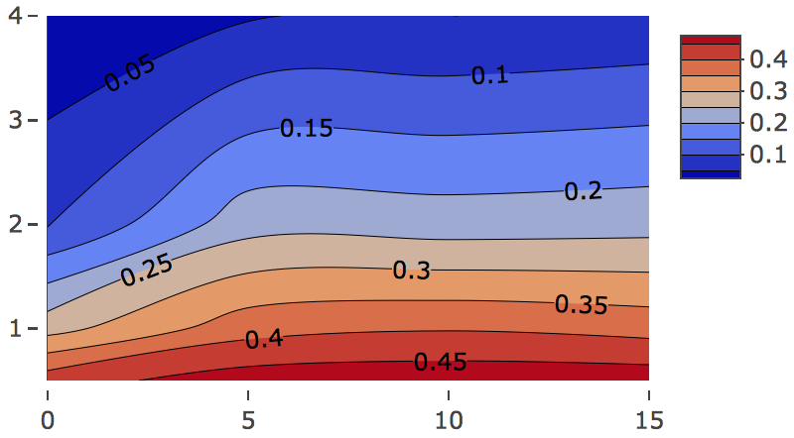
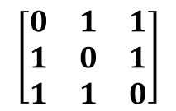
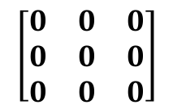
A.
p=260
B1.
30 corDis
100 corNonDis
Mean error rate (Full design, 1 comp)
Mean error rate (Null design, 1 comp)
30 unCorDis
100 unCorNonDis
Group 1 (n/2)
n=100
Group 2 (n/2)
Effect size
Effect size
Dataset j, j=1,2,3
$$\left[\begin{matrix}0 & 0 & 0 \\ 0 & 0 & 0 \\ 0 & 0 & 0\end{matrix}\right]$$
Null design
Full design
$$\left[\begin{matrix}0 & 1 & 1 \\ 1 & 0 & 1 \\ 1 & 1 & 0\end{matrix}\right]$$
Covariance
Covariance
B2.
Mean error rate (Full design, 2 comps)
Mean error rate (Null design, 2 comps)
Dataset 1
Dataset 1
Dataset 2
Y
Dataset 2
Y
Effect size
Effect size
Dataset 3
Dataset 3
Repeat 20 times using different values of covariance (between datasets) and effect size (between groups).
Covariance
Covariance
C.

