Slide 1
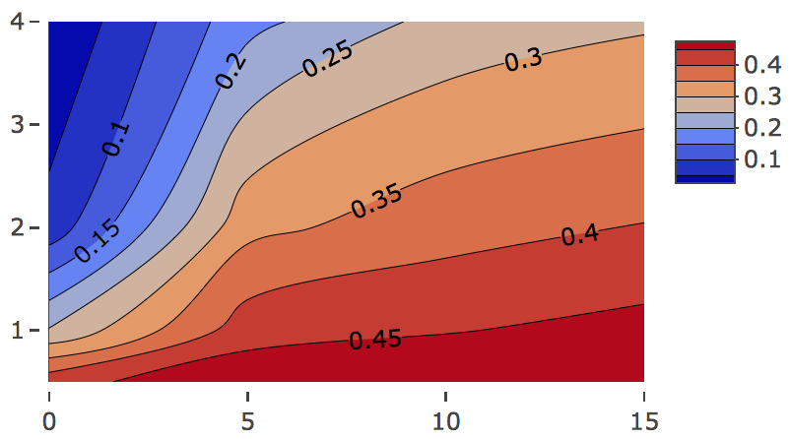
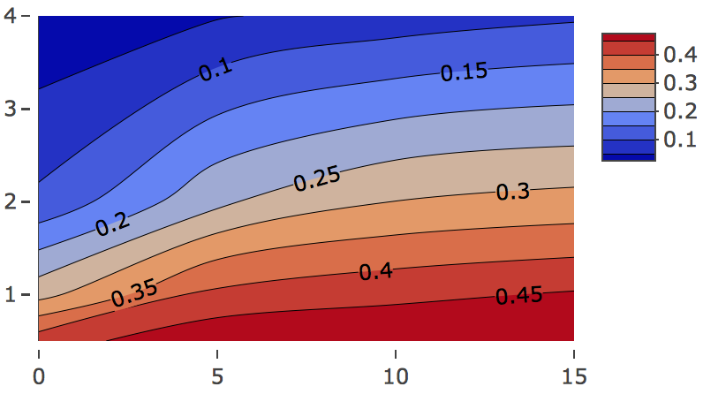
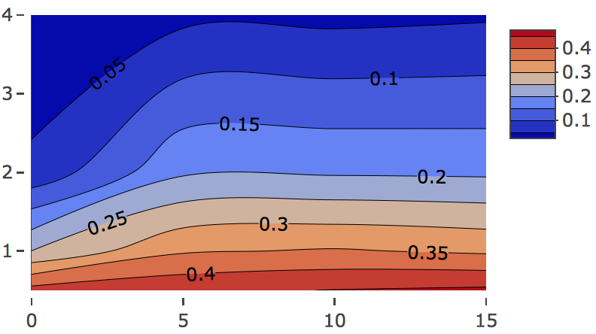
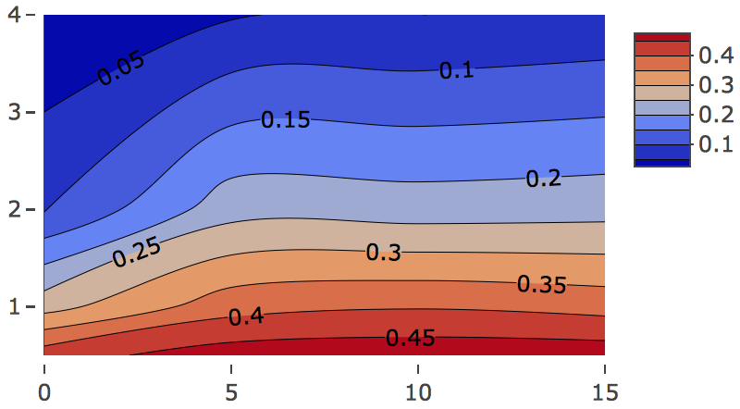
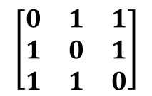
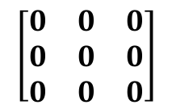
A.
p=260
B.
 | 1 component | 2 components
Full design
Null design
30 corDis
100 corNonDis
Mean error rate
Mean error rate
30 unCorDis
100 unCorNonDis
Group 1 (n/2)
n=100
Group 2 (n/2)
Effect size
Effect size
Dataset j, j=1,2,3
$$\left[\begin{matrix}0 & 0 & 0 \\ 0 & 0 & 0 \\ 0 & 0 & 0\end{matrix}\right]$$
Null design
Full design
$$\left[\begin{matrix}0 & 1 & 1 \\ 1 & 0 & 1 \\ 1 & 1 & 0\end{matrix}\right]$$
Covariance
Covariance
Mean error rate
Mean error rate
Dataset 1
Dataset 1
Dataset 2
Y
Dataset 2
Y
Effect size
Effect size
Dataset 3
Dataset 3
Repeat 20 times using different values of covariance (between datasets) and effect size (between groups).
Covariance
Covariance
C.

