Slide 1
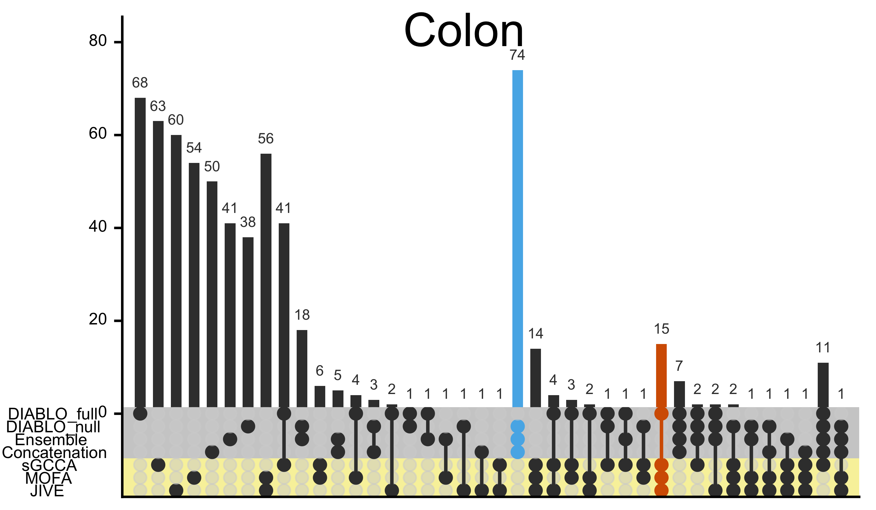
A.
Number of features
B.
C.

