Slide 1
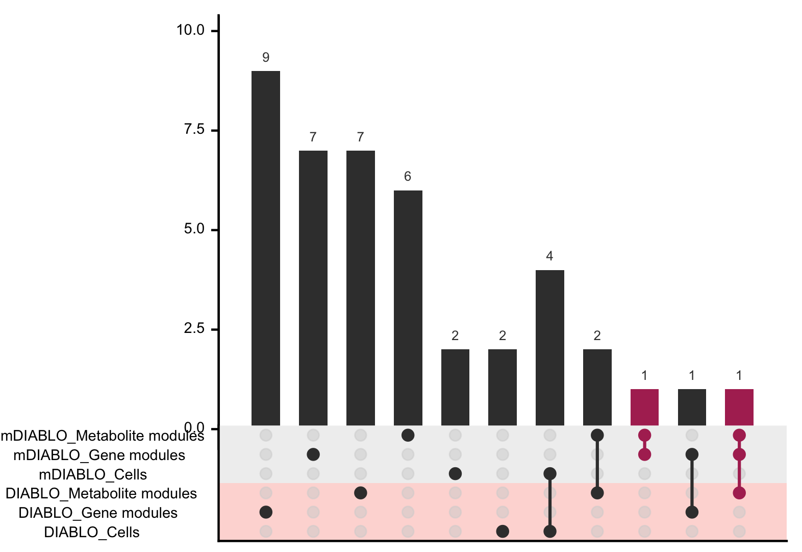
a
Variance decomposition
b
c
mRNA
Gene modules
Pre
vs
Post
Cells
Metabolites
Metabolite modules
d
e
f
remove d and e
put in supp
vertical text as an angle?
vertical figure

