Slide 1
UNSUPERVISED
SUPERVISED
VARIABLE SELECTION
YES
JIVE: r.jive
sMBPLS*
iClusterPlus: iClusterPlus
SNMNMF*
COMPONENT-BASED
Glmnet: glmnet
NETWORK-BASED
sPCA
stSVM: netClass
GELnet: gelnet
sPLSDA
MOFA: MOFAtools
BAYESIAN
CONEXIC*
sGCCA
DIABLO
ATHENA*
MULTI-STEP
(ensemble, concatenation)
mixOmics
NO
WGCNA: WGCNA
SNF: SNFtools
PANDA: pandaR
rGCCA
PLSDA
SVM: e1071
RF: randomForest
NMF: NMF
tSNE: tsne
BCC: bayesCC
GRridge: GRridge
iBAG*
RIMBANET*
MCIA: Omicade4
Joint NMF*
MFA: FactoMineR

Slide 2

 | Method | Type |  | Ref/ R package
Unsupervised | JIVE
 | sMBPLS
 | iClusterPlus
 | sNMNMF
 | MOFA
 | CONEXIC
 | sPCA |  |  | mixOmics
 | DIABLO unsupervised |  |  | mixOmics
 | sGCCA |  |  | mixOmics
Supervised | DIABLO |  |  | mixOmics
 | sPLSDA |  |  | mixOmics
 | glmnet |  |  | glmnet
 | random forest |  |  | randomForest
 | ATHENA
 | stSVM
 | GELNet
Filtered and normalized datasets
mRNA
Input
data
miRNA
CpGs
Proteins
…
Data transformation
Processing
Repeated measures design
Pathway modules
Classification performance
Sample plots
Variable plots
Heatmaps
Integration
Any sample plot here?
component-based
network-based
Proteins
CpGs
Results
Any network plot here?
bayesian
multi-step
miRNA
Multi-omic biomarker panel
mRNA
Notes:
Amrit, a suggestion of Figure that we would put either in supp or in Fig 1 to set the scene and show some of the key features of DIABLO (the DIABLO framework is in the next slide with place holders for different types of figures. Q: is sGCCA the same as DIABLO unsupervised?

Slide 3
Filtered and normalized datasets
Input
data
miRNA
Proteins
CpGs
mRNA
…
Processing
Data transformation
Repeated measures design
Pathway modules
Integration
Proteins
CpGs
Classification performance
Sample plots
Variable plots
Heatmaps
miRNA
mRNA
Results
Multi-omic biomarker panel

Slide 4
Input datasets
Preprocessing
Data Exploration
Discriminant analysis
Outputs
DIABLO
Filtered and normalized datasets
miRNA
Proteins
CpGs
mRNA
Data transformation
Repeated measures
Pathway modules
PCA
Sparse PCA
DIABLO
Multi-omic biomarker panel
Proteins
CpGs
Classification performance
Sample plots
Variable plots
Heatmaps
mRNA
miRNA

Slide 5
UNSUPERVISED
SUPERVISED
JIVE
sMBPLS
iClusterPlus
SNMNMF
COMPONENT-BASED
glmnet
randomForest
NETWORK-BASED
sPCA
stSVM
GELnet
sPLSDA
MOFA
BAYESIAN
DIABLO
^{unsupervised}
DIABLO
ATHENA
CONEXIC
MULTI-STEP
(ensemble, concatenation)
sGCCA
mixOmics
How about we only focus on variable selection?

Slide 6
component based
Supervised
Unsupervised
JIVE
sMBPLS
iClusterPlus
SNMNMF
sGCCA
DIABLO
^{unsupervised}
DIABLO
Bayesian
sPCA
MOFA
ATHENA
CONEXIC
sPLSDA
mixOmics
glmnet
randomForest
stSVM
GELnet
Multi-step

Slide 7
mixOmics
sPLSDA
JIVE
sMBPLS
iClusterPlus
SNMNMF
DIABLO
sGCCA
sPCA
WGCNA
SNF
PANDA
DIABLO
^{unsupervised}
PLSDA
MOFA
CONEXIC
BCC
GRridge
iBAG
SVM
randomForest
RIMBANET
MCIA
Joint NMF
MFA
NMF
tSNE
rGCCA

Slide 8
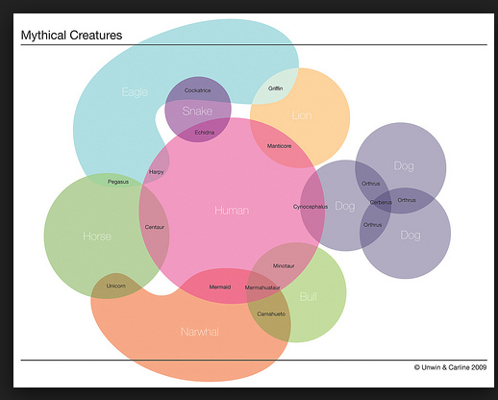
https://laughingsquid.com/mythical-creatures-venn-diagram/

Slide 9
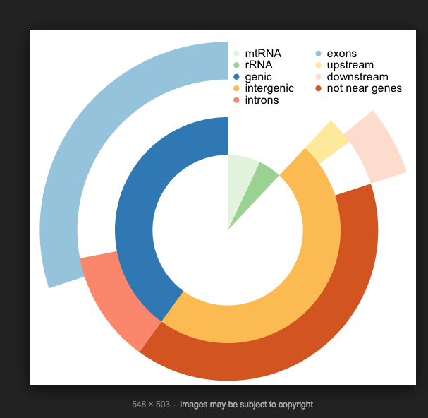
https://www.r-bloggers.com/vennpier-combination-of-venn-diagram-and-pie-chart-in-r/

Slide 10
UNSUPERVISED
SUPERVISED
VARIABLE SELECTION
JIVE, sMBPLS
iClusterPlus, SNMNMF
COMPONENT-BASED
MULTI-STEP
sPCA: mixOmics
NETWORK-BASED
YES
ATHENA
MOFA
BAYESIAN
stSVM, GELnet
CONEXIC
mixOmics
sGCCA (wrapper.sgcca)
DIABLO (block.splsda)
rGCCA (wrapper.rgcca)
DIABLO (block.plsda)
sPLSDA: mixOmics
glmnet
NMF, tSNE
MCIA
Joint NMF
MFA
PLSDA: mixOmics
SVM
randomForest
rGCCA
NO
BCC
WGCNA
SNF
PANDA
GRridge
iBAG
RIMBANET

