Slide 1
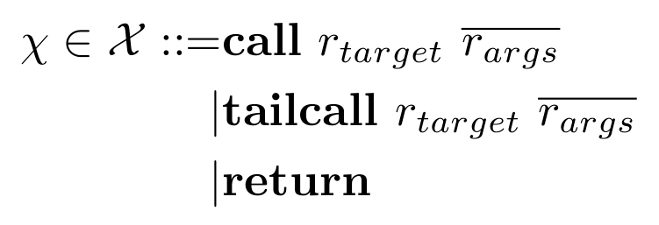
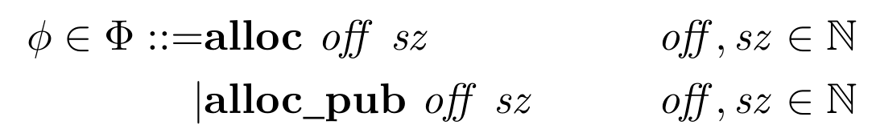
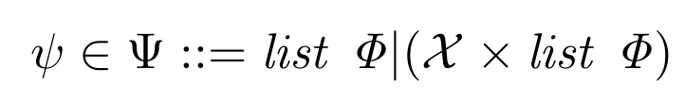

Control Operations:
Call
Tailcall
Return
Privilege Operations:
Allocate private memory
Allocate public memory
Security Operations:
At most one control operation,
any number of privilege operations
Base Machine:
steps labeled with security operations

Slide 2
Why build operation labels into machine?
Property Presentation – jump straight into what operations mean
Supports sophisticated means of determining operations
  Unlabeled returns
  Code generation
Example can differ from testing but still have formalism apply:
  Example system: concrete RISCV, ad-hoc labels
  Concrete RISC-V system with one-instruction labels
  -- or --
  With labeled pseudoinstructions
  -- or --
  With labeled blessed sequences

Slide 3
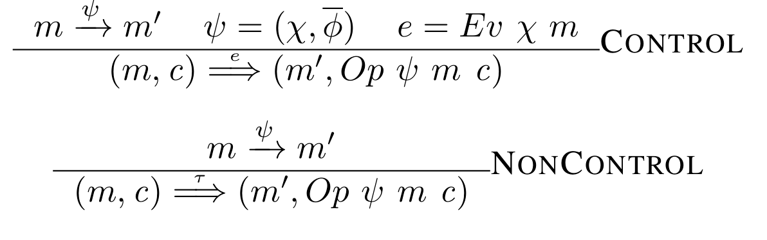
Machine with Property State:
uses step labels to update call stack,
generate events
c – call stack, below
Op – processes all priv. ops,
then control op, if any
Ev – converts control op into event
Call stack:
(V,aPC,aSP)
Active View
V
Pending activations, with views,
return addresses and SPs
(V,aPC,aSP)
View: K → {sealed, unsealed, public, object}

Slide 4
PC
addi sp,sp,-8 (alloc 0 8)
sd zero addi 8
jal 100 ra (call f)
addi sp,sp,-4 (alloc 0 4)
SP
alloc (0,3)
call f
sealed
( , aPC, aSP)
SP
SP

Slide 5
Integrity without (Machine) Traces
call f
…
(m,(V,s))
For proposition P on combined states, d↑P = P holds on return from depth d
(coinductive; holds if we never return)
Let Int (m’,c’) hold if m[k] = m’[k] for all k sealed in V
(Eager) Return-time integrity: |s|↑Int
For confidentiality: relational equivalent
For laziness: event traces

Slide 6
Public Allocations
addi sp,sp,-12 (alloc 0 4;alloc_pub 5 4;alloc 9 4)
sealed
sealed
object
call f
?
sealed
sealed
( , aPC, aSP)
SP
SP
? - depends on what we want to model
Always public = always stays object
Stack argument = object if passed, otherwise sealed
Address-taken = object if reachable (requires provenance machinery!)

