Slide 1
Stack Safety Properties
Notes:
Author stuff here

Slide 2
So many examples
SP
g() {
int s;
*(&s-2) = 1;
}
s
PC
f() {
int x = 0;
g();
assert(x==0);
}
ret
x
0
mov $1,-3(%sp)
Notes:
A lot has been said about stack safety, mostly through the use of examples, like this one. We can clearly see that f’s private data being overwritten is a violation, but what does that mean formally?

Slide 3
But stack safety is...
Confidentiality
Integrity
Well-bracketedness
???
A Security Property
Notes:
We offer a definition in terms of the well-known security concepts of confidentiality and integrity, as well as a simple well-bracketedness condition on control flow

Slide 4


Every Caller Deserves Stack Safety
h
…
f
g
Notes:
A typical security model may partition functions into safe ones that are trusted to obey certain restrictions, and adversaries that try to attack them. Such static divisions do not capture the dynamic, nested nature of the stack: any caller might be attacked by a callee trying to access its data.
Because our properties don’t rely on discrete attacking and defending functions, they apply in low-level environments where functions may not be cleanly separated.

Slide 5
Confidentiality is non-interference
SP: 2
0
SP: 3
0
0
0
ret: 42
0
mov SP ret
42
SP: 2
100
100
PC: 43
50
50
Scramble
Original and variant
step together to return
SP: 2
?
SP: 3
?
ret: 42
?
?
?
42
SP: 2
?
?
PC: 43
?
?
Notes:
Confidentiality is defined in terms of non-interference. Any entry can have its stack scrambled and the scrambled variant will step in unison with the original until both reach the return target – when the stack pointer is restored, and the PC is at the return address.

Slide 6
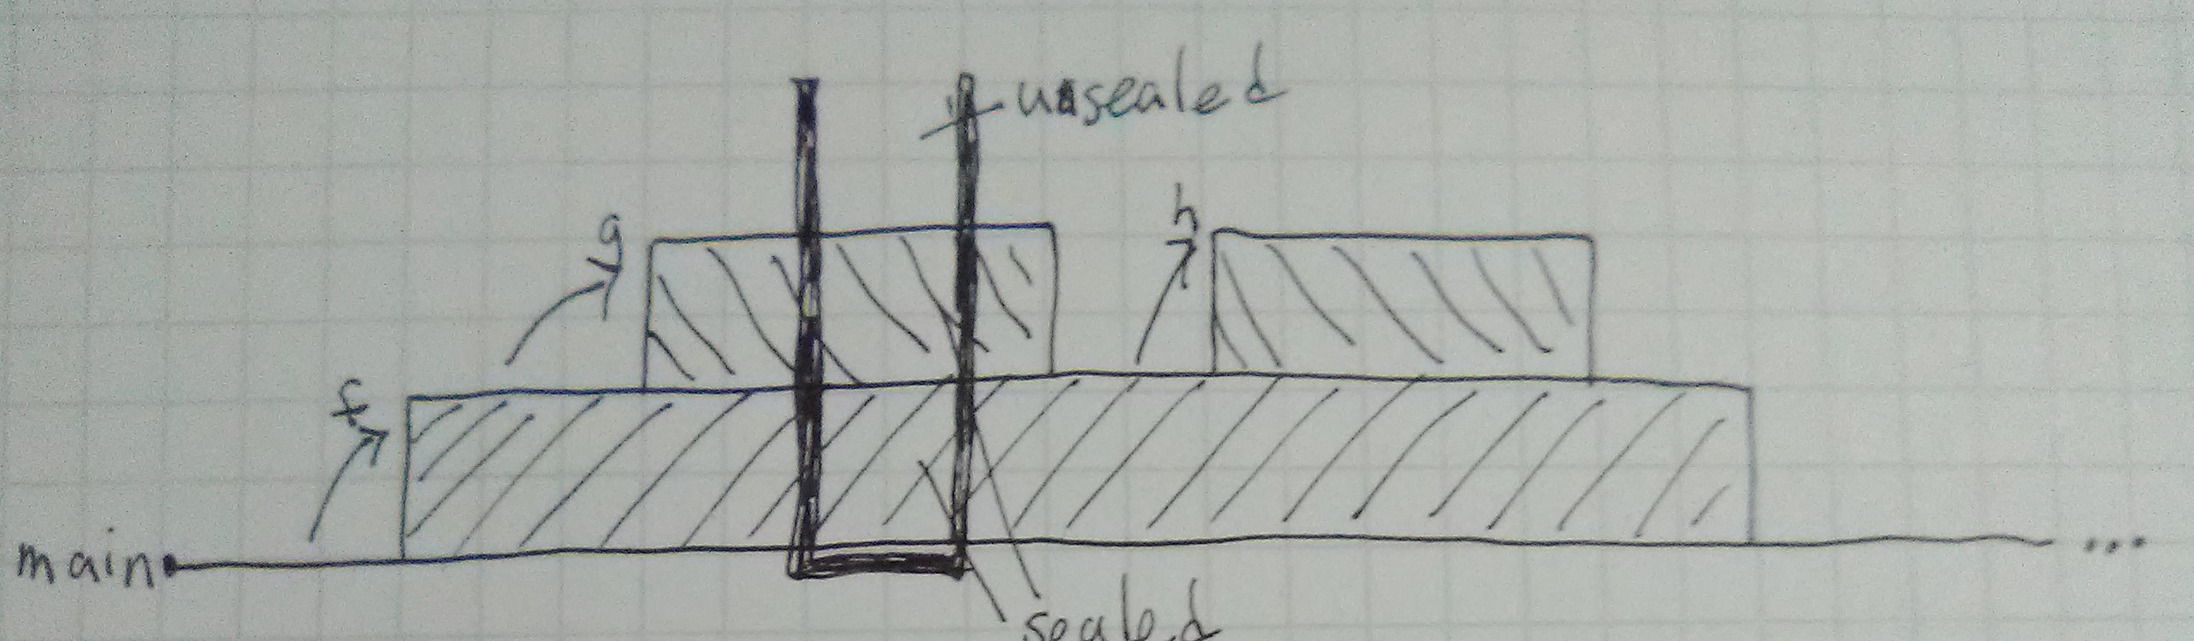
Integrity
Notes:
Integrity is based on “sealing” any part of the stack below the stack pointer at entry. Nested calls may seal more of the stack. When a return point is reached, its associated seals are cleared, and until then sealed memory is invariant.

Slide 7
Well-bracketedness
Notes:
Each nested call has its own return target. Well-bracketedness means that we never reach a return target that isn’t that of the active call. So, no caller is “skipped” in the return sequence.
A callee might diverge or return to its caller.
But in an unstructured, low-level setting, function footprints might overlap. This is outside the scope of this work.

Slide 8
Testing
Randomized property based testing with Quickchick
Tested Roessler and DeHon’s “depth isolation” micro-policy successfully
Roessler and Dehon’s “lazy tagging” fails tests as expected

Slide 9
Lazy Tagging Leaks
f() {
int x = 0;
g();
h();
}
g
h
g: ...
mov $1,-2(%sp)
sp
h: ...
mov -2(%sp),r1
1
Notes:
Roessler and DeHon also introduce a “lazy” variant of depth isolation, in which a callee can overwrite the caller but the caller can’t read the tainted value.
We describe a variant property capturing “no reads after dangerous writes,” but lazy tagging also fails to implement that – sequential calls at the same depth can write data to the caller’s frame and then access it, violating the weakened integrity property and confidentiality at once.
To fix this, we need per-activation tags instead of depth tags.

Slide 10
Additional Features
Call-by-reference and stack-allocated call-by-value
Simple coroutine model
Observational property variants

Slide 11
Ongoing and Future Work
Testing Cheri-esque capability models
Expanding tests to handle arguments, observational properties
Low-level separation logic
See our preprint – link

